Slide 1

Зачем нам нужен иностранный язык
German, chineese, Spanish, french, italIAN

Slide 2
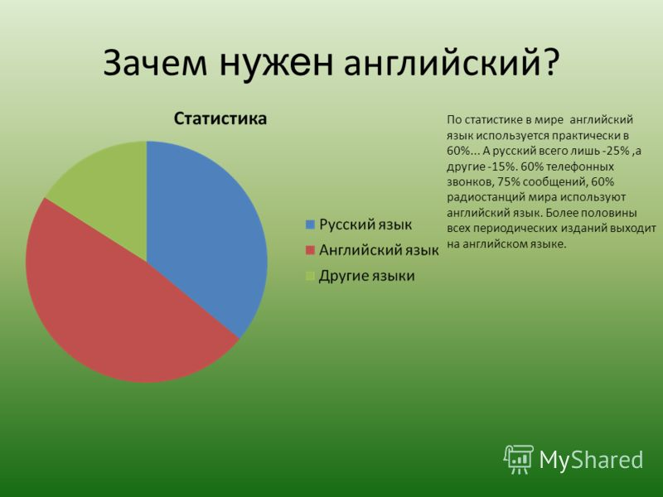

Slide 3
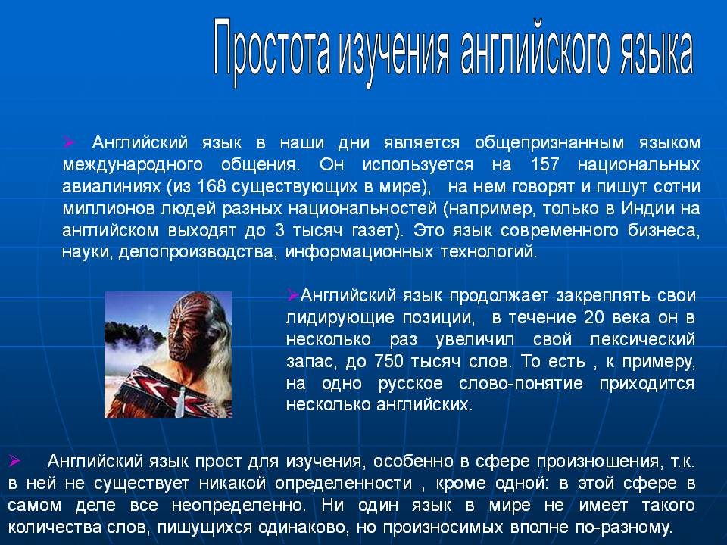

Slide 4

ИНОСТРАНЫЙ ЯЗЫК ПОЗВОЛЯЕТ ЧИТАТЬ ЛИТЕРАТУРУ ЗАРУБЕЖНЫХ АВТОРОВ В ОРИГИНАЛЕ

Slide 5
It was Mr. Bean's birthday, and he wanted to enjoy it! What could he do?
'How can I make this important day a happy day?' he thought. 'I know. I'll go out to a restaurant for dinner this evening! I'll enjoy that. '
Mr. Bean didn't often eat in restaurants. They were sometimes very expensive. And he sometimes did things wrong when he was in a new or strange place.
Oh dear! Life wasn't easy for Mr. Bean!
***
That evening, Mr. Bean put on a clean shirt. He put on his best coat and trousers. He put on his best shoes. Then he drove to a restaurant in the centre of town.
He arrived at eight o'clock and went inside. It was a very nice restaurant. Everybody was wearing their best clothes, and there were flowers on every table.
'I'm going to like it here, ' thought Mr. Bean. 'This is a good restaurant for my birthday dinner. '
The manager met him at the door.
'Good evening, sir, ' he said. 'How are you? Would you like a table for one?'
'Yes, please, ' said Mr. Bean.
'Follow me, sir, ' said the manager.
He walked across the room to a table, and Mr. Bean went after him.
'Here you are, sir, ' said the manager. 'This is a nice table. '
He pulled the chair away from the table. Then he waited for Mr. Bean to sit down. Mr. Bean looked at him.
'Why is he taking my chair away?' thought Mr. Bean. 'What's he doing?'
And he pulled the chair away from the manager and sat down quickly.

Slide 6
round the restaurant. There were a lot of people in the room. There was a man and a woman at the next table. They ate and talked.
Suddenly, a waiter arrived at Mr. Bean's table with a bottle of wine.
'Would you like to try the wine, sir?' he said.
'Oh, yes please, ' said Mr. Bean.
The waiter put some wine in Mr. Bean's glass and Mr. Bean had a drink. It was very nice! He smiled, and the waiter tried to put more wine into the glass.
Of course, the waiter was right. First, the customer tries his wine. When he is happy with it, the waiter gives him more wine. But Mr. Bean didn't know this, and he quickly put his hand across the glass.
'No, thank you, ' he said. 'I don't drink wine when I'm driving.' The waiter looked at him strangely - and walked away. He didn't say, 'Why did you try the wine when you didn't want it.
Mr. Bean took the knife from the table and started to play with it. He pretended to be a bad man. He pretended to push the knife into somebody. But he didn't really want to kill anybody, of course. It was a game.
The woman at the next table looked at him angrily, and Mr. Bean quickly moved the knife. Next, he hit the glasses and plate on his table with it. Ping, ping, ping they went! And after a minute, he played the song 'Happy Birthday' on the glasses. He smiled and thought, 'I'm very clever!'
But the woman at the next table didn't think, 'That's clever!' or 'Oh yes, that's funny!' She thought, 'That man's really stupid!' And she looked hard at Mr. Bean.

Slide 7
English language plays an important role in communication between people from difenfert countries. for its development is very useful to PAY ATTENTION TO progenetica in dialogues

Slide 8
Diana: Hi, Julia. How are you?
Julia: Hi, Diana. I’m fine, thank you. And you?
Diana: I’m also well, thanks. How is your foreign languages’ learning going?
Julia: Great. I really like the classes. Our teachers tell us lots of interesting things every day.
Diana: What languages do you study?
Julia: I study English and French. English is for my career development and French is for pleasure.
Diana: I remember that you had certain difficulties with English grammar and French pronunciation. How is your progress?
Julia: Well, my teacher of English explains grammar rather well. Each time I don’t understand something, I ask her to explain it again. She finds many different ways to explain each topic. So, now I don’t have any problems with grammar.
Diana: How about French?
Julia: The teacher of French is also rather experienced. I understand everything he explains. However, the problem with my pronunciation still exists. He says I will do much better if I visit France and chat with native speakers.
Diana: That’s a good idea. Why don’t you try it?
Julia: I will. In spring my teacher is planning to arrange an educational tour to Paris. He is looking for students who want to join. The more students we attract, the funnier and more interesting the tour will be.
Diana: Are you going to attend the lessons of French there?
Julia: Yes, we are. We are going to live in our penfriends’ houses. The good thing is that we get to have lots of speakig practice while we stay in French families. Apart from that, we will go to the French school everyday. I hope such training will help me to improve my poor pronunciation.
Diana: Sounds interesting. I’d like to join you. I need to ask my parents’ permission though.
Julia: Do you know any French?
Diana: Just a little bit. I used to attend supplementary classes of French last year. Then, I gave up as I didn’t have much free time. My sports training takes lots of time and effort, as you know.
Julia: I see. Well, it’s a good chance for you to learn some basics.
Diana: Yes, that’s why I find this educational tour rather interesting. What else are you going to do during your stay in France?
Julia: We are going to see the sights of Paris, but the main goal is to improve our language skills. It includes reading, speaking, listening, writing and most importantly comprehension skills.
Diana: What do you mean by comprehension skills?
Julia: My teacher says that these skills are the most important ones. They involve everything at once. As soon as you start understanding what you read or hear, you can try to respond according to the situation. It’s the first step to learning foreign languages.
Diana: I see what you mean, but I’ve never spoken to anyone in French or English. I should be extra attentive if I want to understand their speech.
Julia: That’s the main clue. As soon as you understand separate words and put them together into phrases, other language skills start to develop without any difficulties.
Diana: Thanks for telling me this. I have always wanted to learn at least one or two foreign languages.
Julia: You can join me at my foreign languages’ classes anytime.

Slide 9

Many of us love to play computer games, but not everyone knows how to create them, but this will help us c++
=

Slide 10
The semantics of the type system With++ are not polymorphic, however, there are several ways to provide polymorphic behavior. First of all this overloading of class methods inheritance — the traditional OOP method of providing data abstraction. Then there are two ways of implementing parametric polymorphism (in C++community, usually called "generalized programming"). The first method is inherited from C using estipulado pointer and the type cast, depending on other data — even though in C++ this method is traditionally considered aidemitlum and dangerous. The second is to use templates — but, unlike conventional implementations of parametric polymorphism in C++ is automatically generated monomorphic family of overloaded functions based on the polymorphic definition (template) in accordance with contexts of use — that is, parametric polymorphism at the source code level is a situational (ad hoc) at the level of machine, for which C++ has been criticized (see section Computational performance). In C++ there is also a third type of overloading — operator overloading — which in combination with class inheritance provides a greater possibility of improving readability of code by entering a so-called "syntactic sugar".To ensure the data abstraction necessary to combine several classes in the inheritance hierarchy and assign the functions to the same specifications. For example:

Slide 11
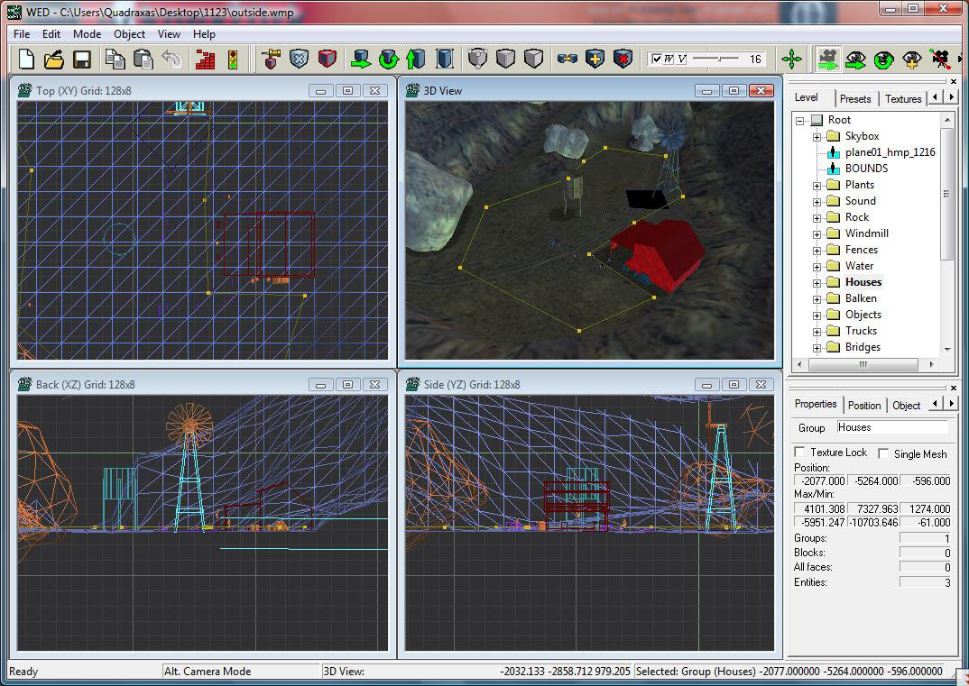
creating games in c++

Slide 12
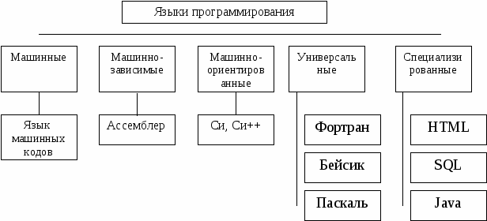
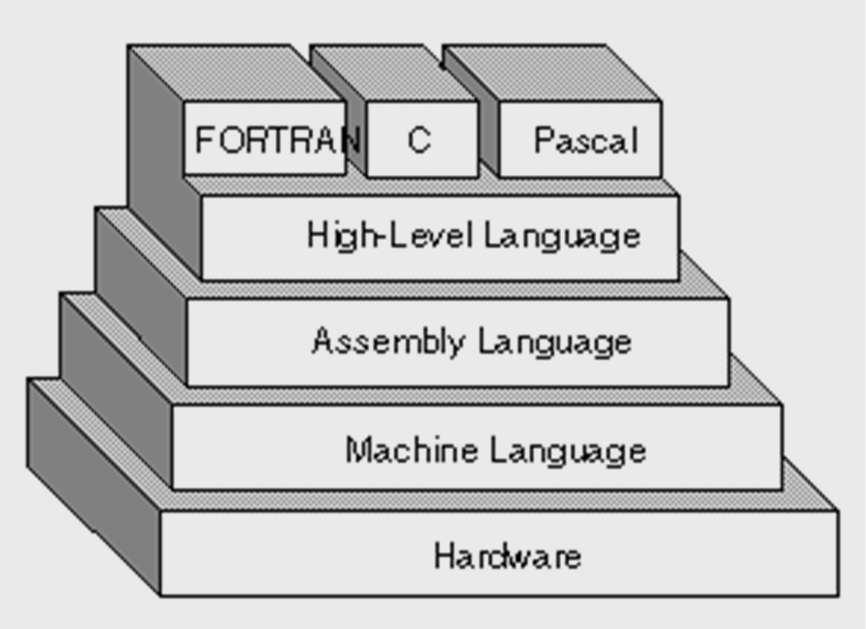
Why programming language is so important in the world

Slide 13

Foreign languages are used everywhere . Let's go on a journey through various cities of America.

Slide 14

Нью-Йорк

Slide 15

Лас-Вегас

Slide 16
On the territory where now is located New York, long before the arrival of the Europeans had lived the Indian tribes Menegatto and Canarsie. This is confirmed by finds of arrowheads and other artifacts in areas of the city, not built up with houses, for example, Inwood hill Park and riverside Park. European settlements appeared here in 1624. In 1625 at the southern tip of Manhattan was founded the Dutch settlement of New Amsterdam (niderl. Nieuw Amsterdam). In 1664 the city was captured by the British, which did not meet with resistance on the part of Governor Stuyvesant, after which the city was renamed to new York (eng. New York), in honor of the initiator of the capture of the Duke of York. The results of the Second Anglo-Dutch war in 1667, the Dutch formally ceded New York to the British in exchange for the colony of Surinam.
During the XIX century the city's populati on grew rapidly due to the influx of a large number of immigrants. In 1811 was developed by a visionary master plan of city development according to which the network of streets was extended to cover the entire Manhattan. By 1835, New York surpassed in population Philadelphia, becoming the largest city in the United States.
In 1829 a trade caravan bound for Los Angeles from Texas at the Spanish trail. Under the scorching unforgiving sun exhausted men made camp, while several volunteers ventured to find water. Among them was Mexican and Rafael Rivera., who was lucky enough to find the in the desert an oasis of artesian water. Accordingly, it was the name of the district, and subsequently the city — "Las Vegas", which translated from Spanish means "fertile valley".Further development of the territory began after a visit of John Fremont in may 1844 to the area . In the future he became a Senator from California, and in 1856 was a candidate for U.S. President from the Republican party. Fremont led expedition, acting in the interests of the Corps of engineers of the U.S. Army. It was a time of the emergence of an independent Republic of Texas, 1836-1845 existed in the years subsequent Mexican-American war in 1846-1848., and then the occurrence of a number of new southern and Western States in the United States.

Slide 17
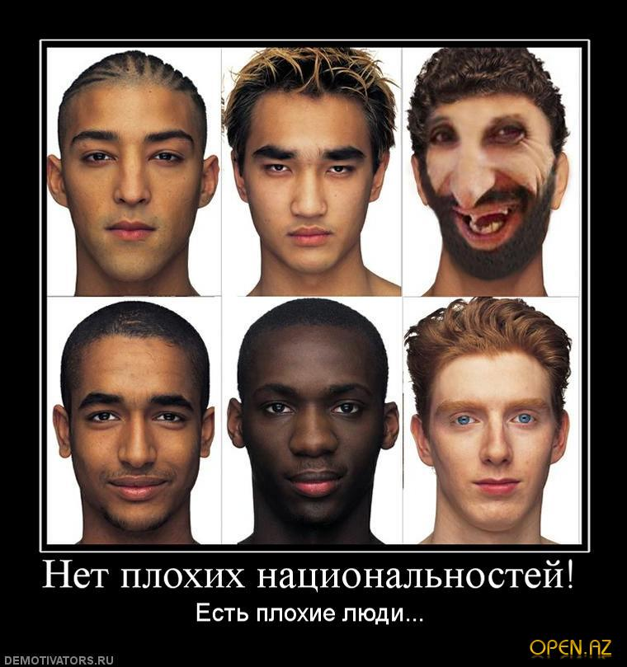
Thus we see what opportunities gives us the knowledge of foreign languages

