Slide 1
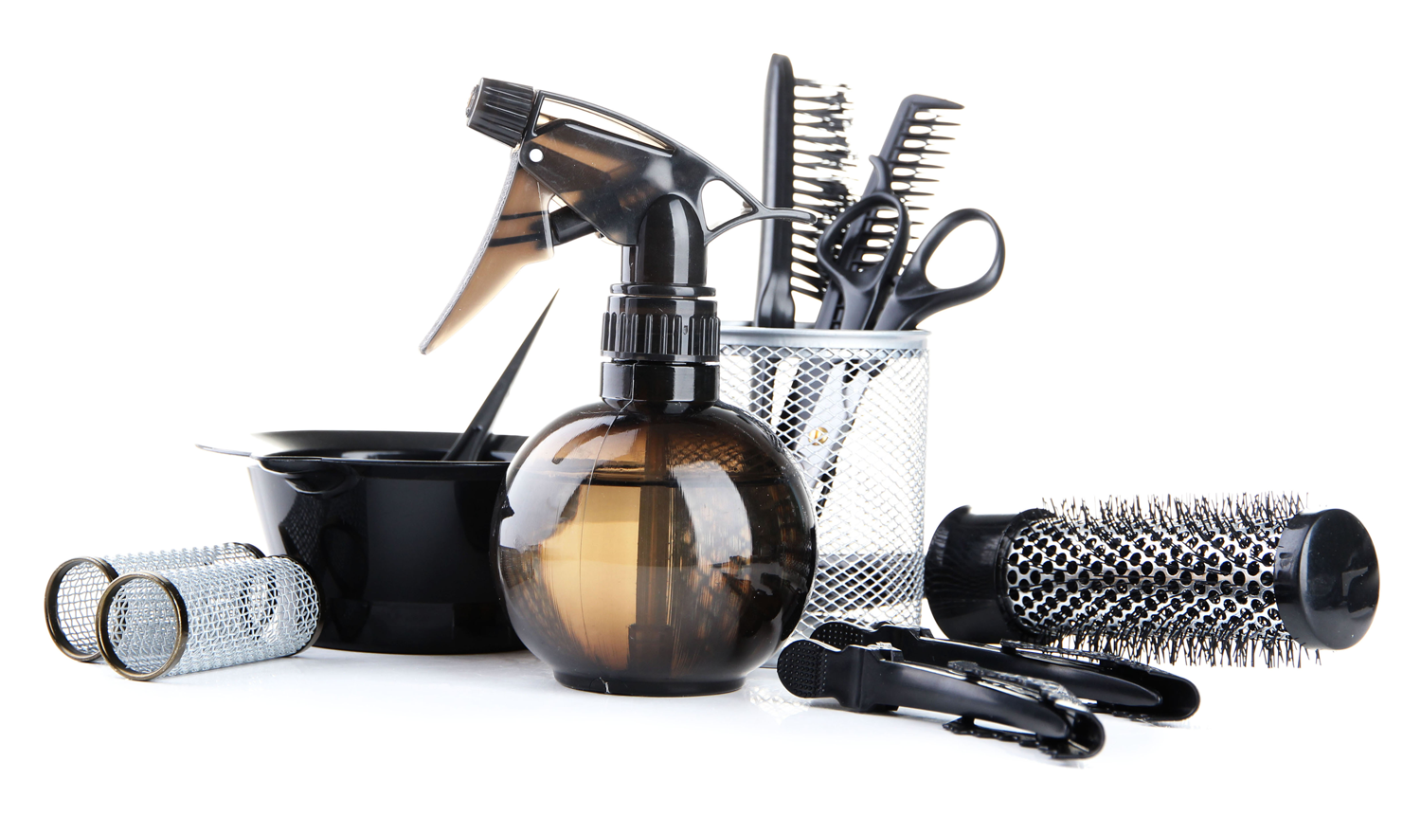
Tools for a hairdresser

Slide 2
The tools of a hairdresser are many and very interesting, the following list shows the tools used by any hairdresser. Each one of them is essential for the job and for perfect results.

Slide 3
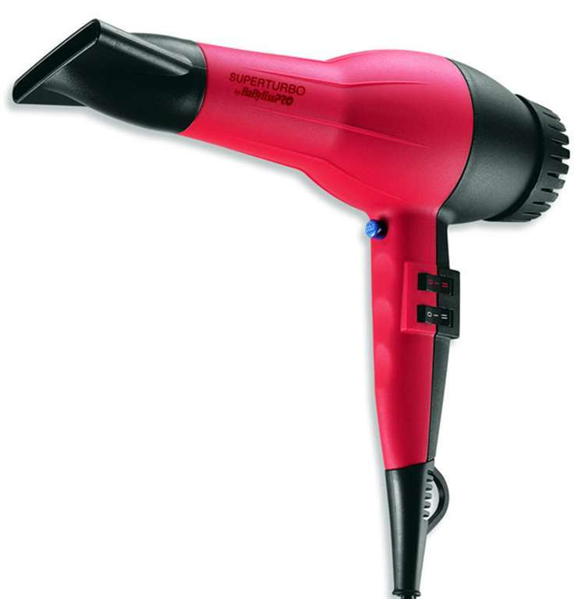
Blow dryer
A blow dryer is an electromechanical device designed to
blow normal or hot air over damp hair to accelerate the
evaporation of water particles and dry the hair.

Slide 4
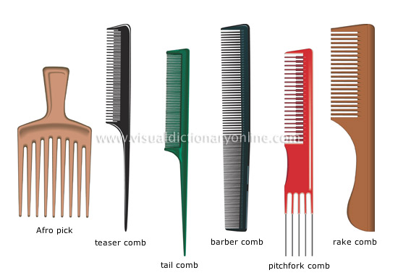
Comb

Slide 5
pitchfork comb
Comb combining a teaser comb and an Afro pick.
rake comb
Comb with broad, widely spaced teeth for detangling hair without
damaging it.
Afro pick
Comb with long, widely spaced teeth used for detangling and tidying
tightly curled hair without undoing the curls.
barber comb
Comb with large, widely spaced teeth for detangling the hair on one
side and small, closely spaced teeth used to arrange the hair on the other
side.
tail comb
Comb with small, closely spaced teeth that is used to arrange the hair.
teaser comb
Comb whose head has teeth of three different lengths; it is used to brush
up the hair to give it more body.

Slide 6
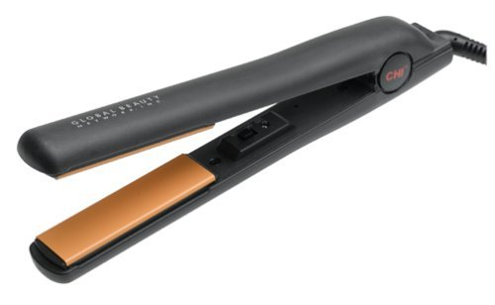
Hair iron
This is used to straighten the hair.

Slide 7
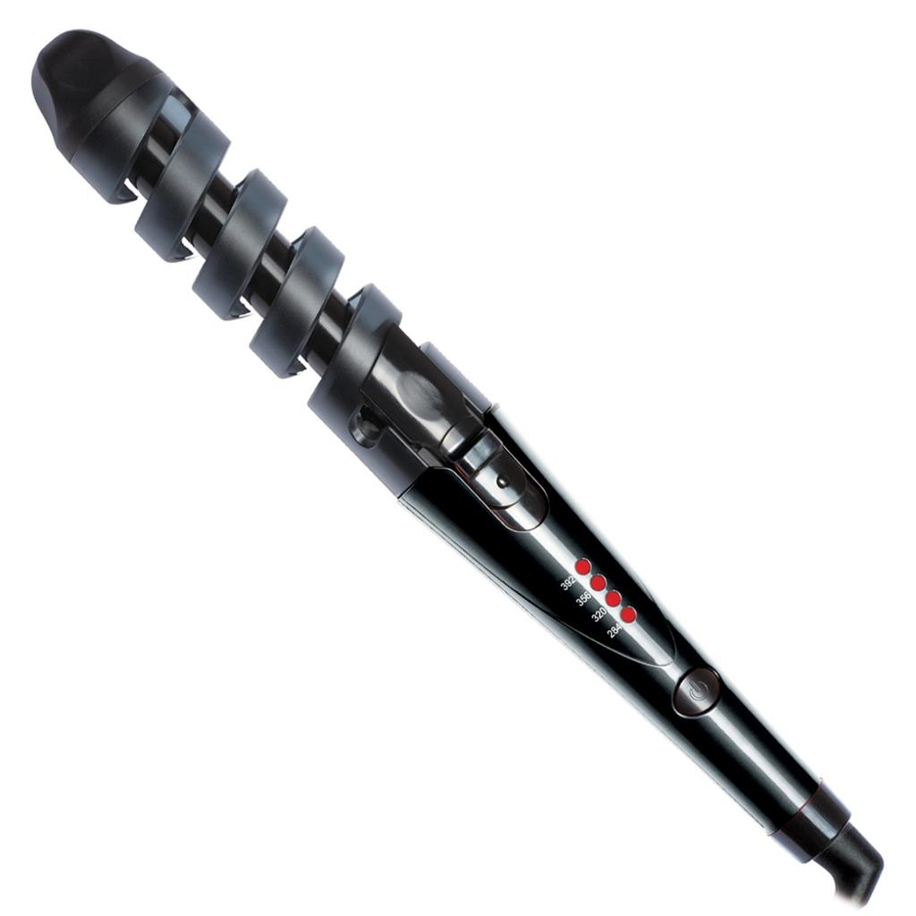
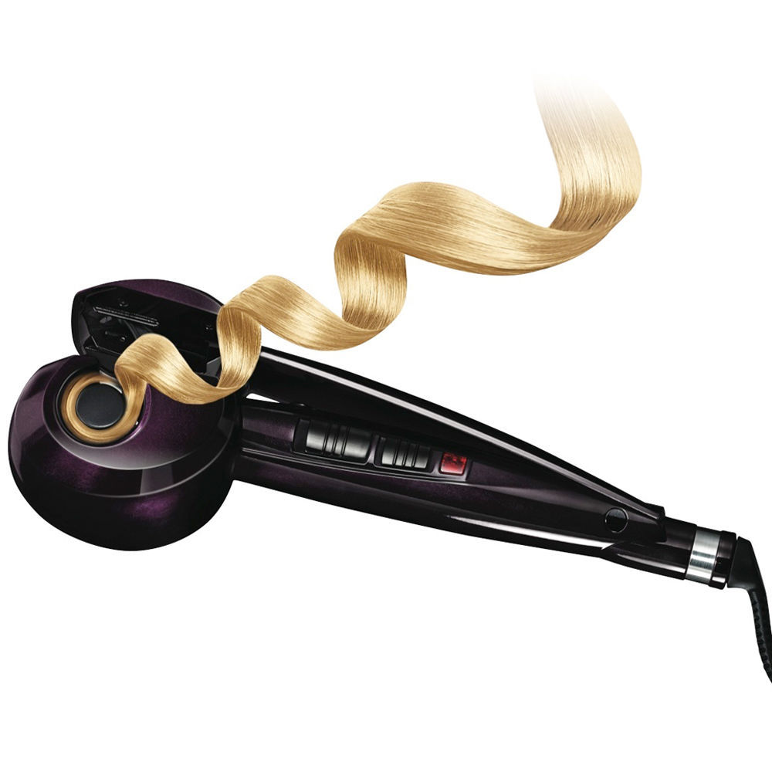
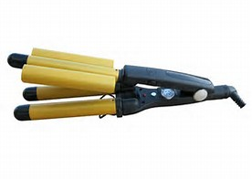
Curler
The hair curler is everything you need to create a mass
of perfect ringlet curls .Curls, waves, volume, it has never
been easier, with no heat damage. No need for chemicals
with this natural hair styling tool set.

Slide 8
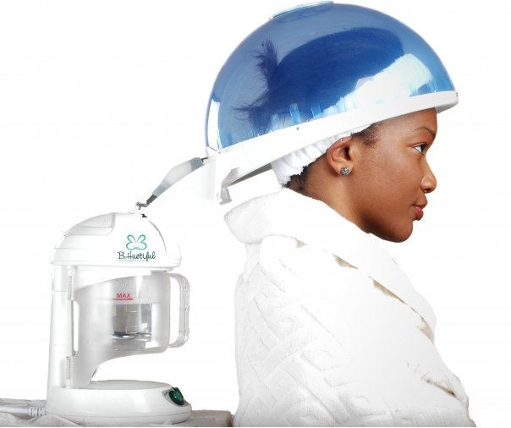
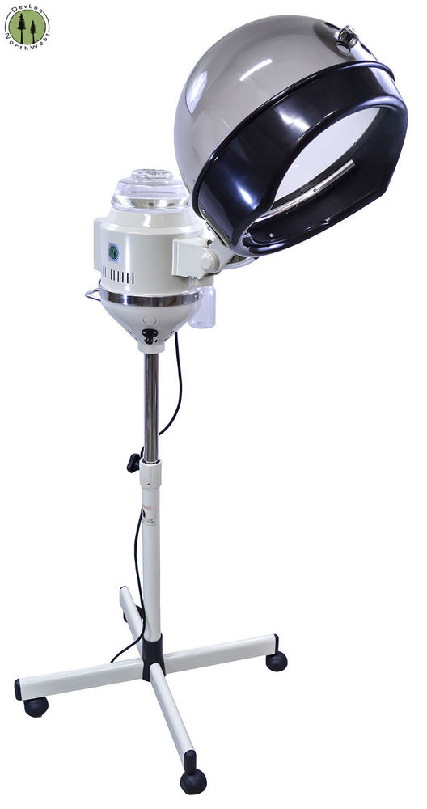
Hair steamer
This is used to give a steam after a head massage
or then also to provide heat to the head while
perming and hair coloring.

Slide 9
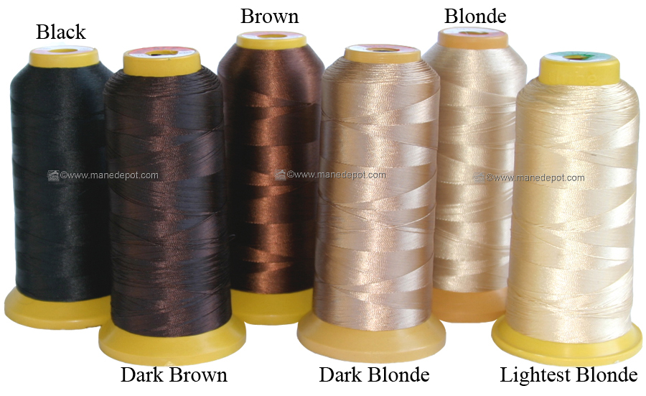
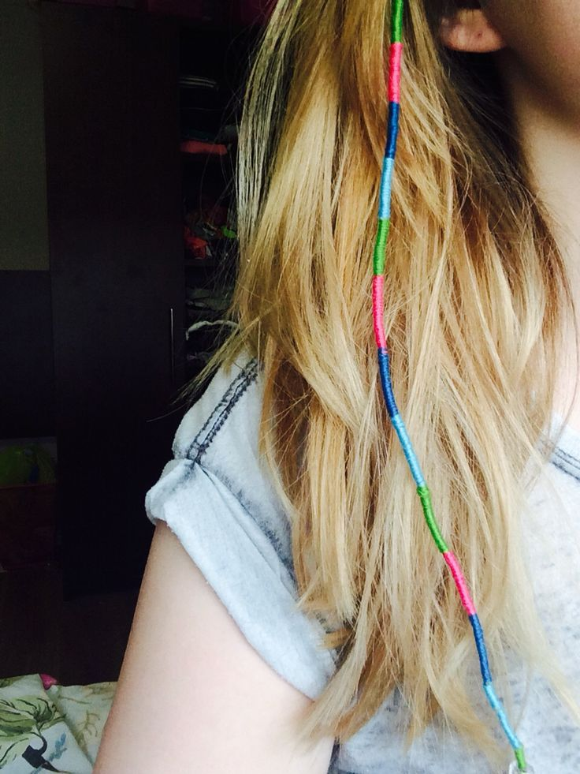
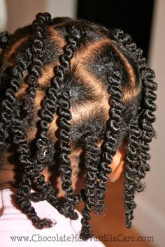
Threads
This is for threading. The Weaving Thread and Needle are
used to sew on wefts of human hair to scalp plaits made by
the natural hair.The thread is made specifically for
weaving hair extensions to your hair. It is strong enough to
handle the weight of extensions of any length for months.

Slide 10
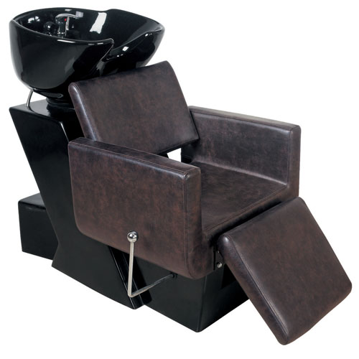
Hair dressing chair
This chair provides all of the essentials that are
needed in the salon business. It is an ideal chair for
washing hair with a perfectly sized matching
ceramic basin.

Slide 11
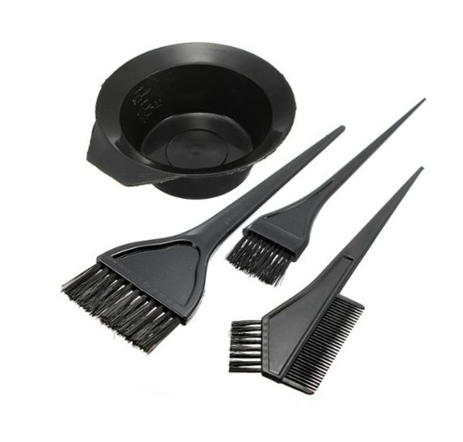
Hair color applying brushes

Slide 12
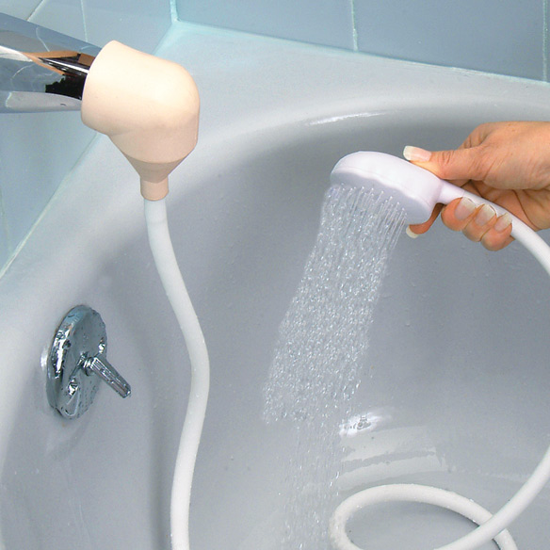
Hair washing sink with
handheld shower

Slide 13
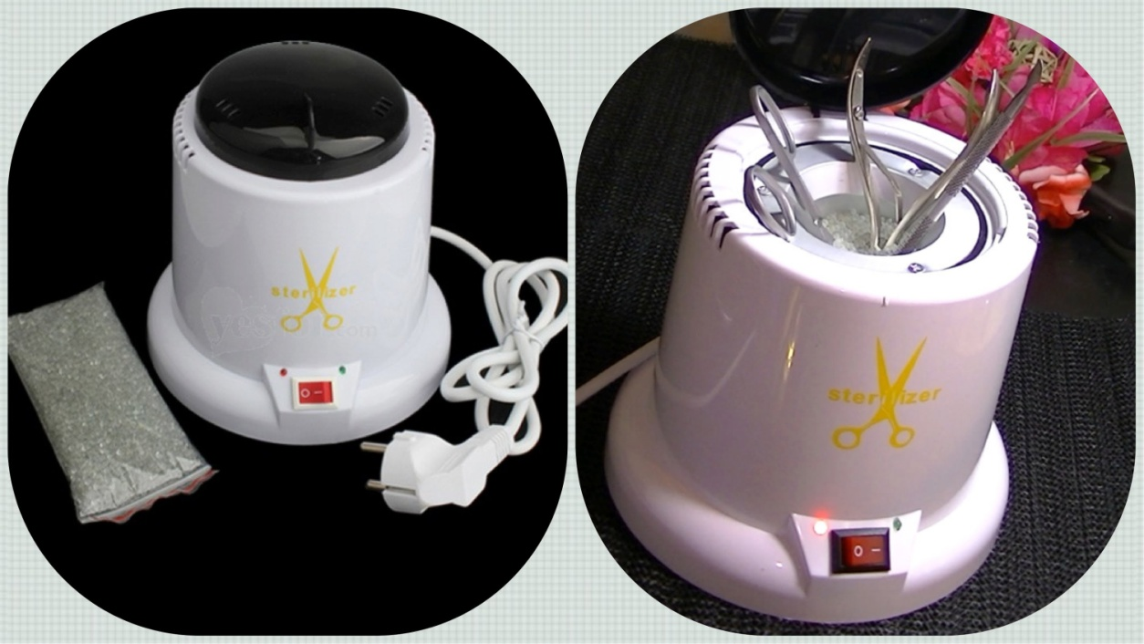
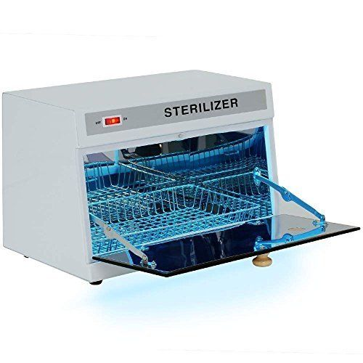
Sterilizer for Hair Salon Tools

Slide 14
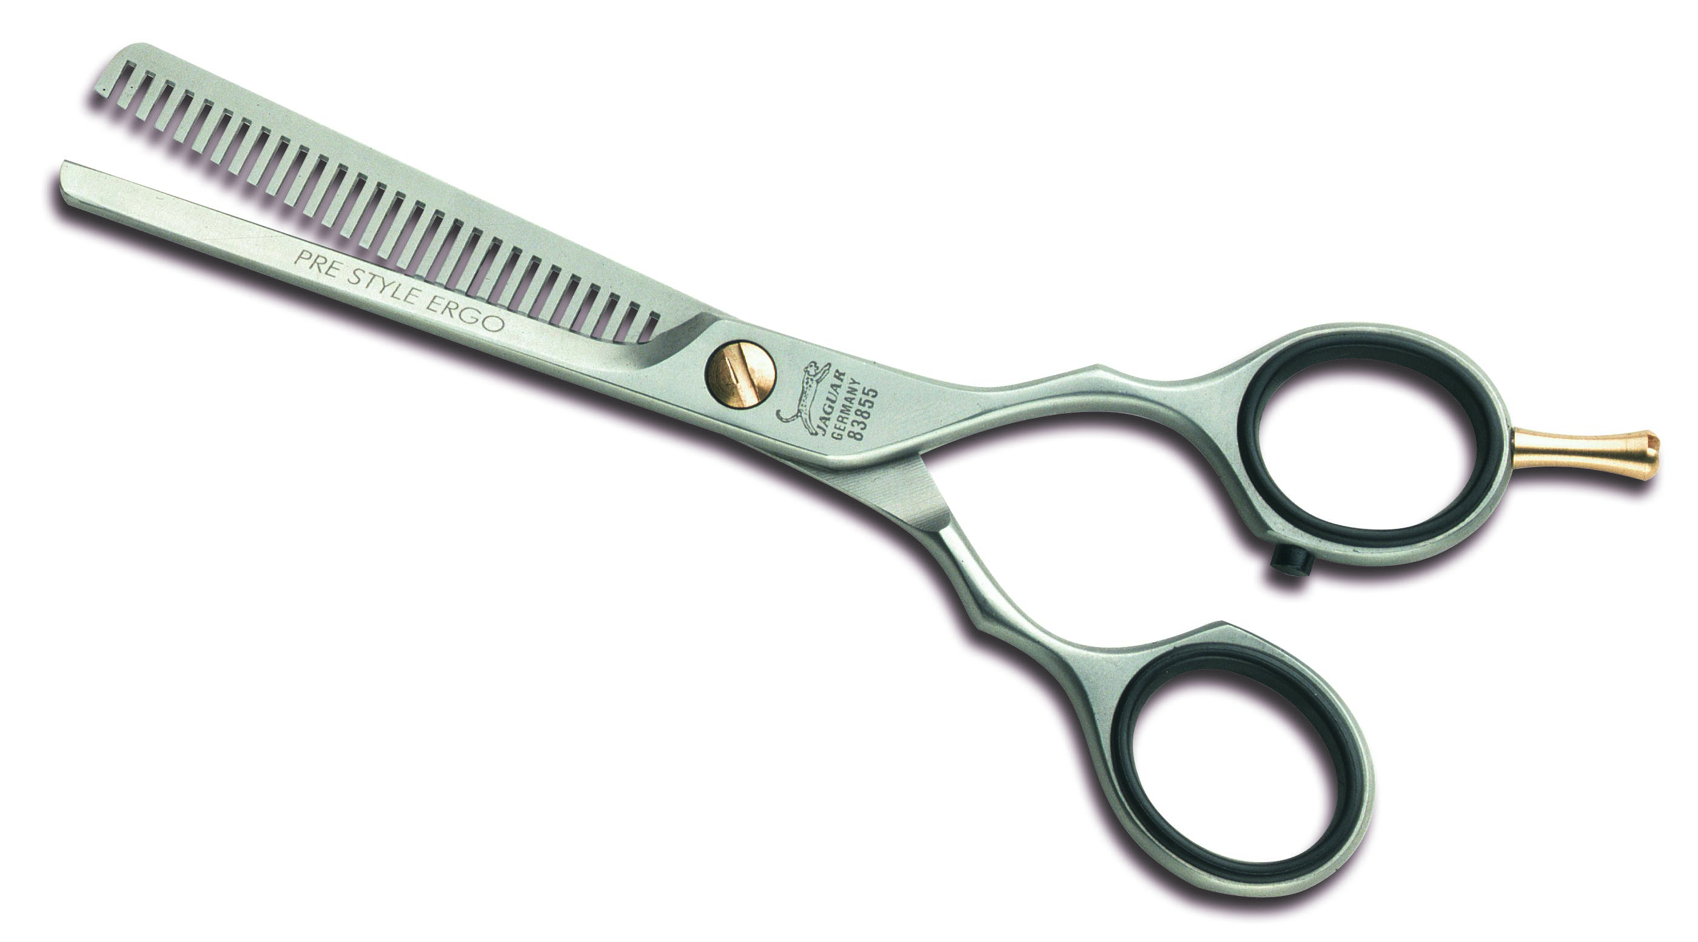
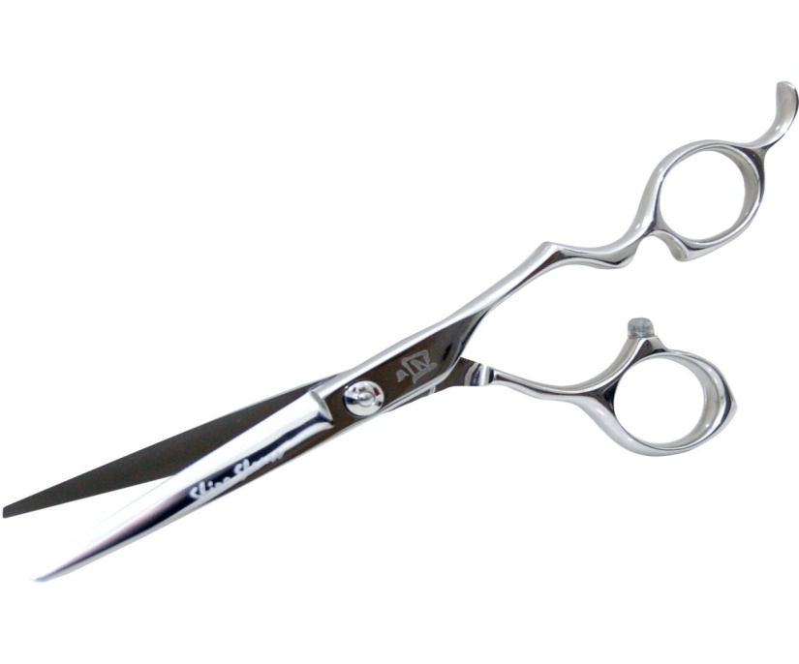
Hairdressing scissors
Every hairdresser prefers to maintain their
own personal kit of hair-cutting and
hair-trimming scissors, also which most
consider their lucky scissors.

Slide 15
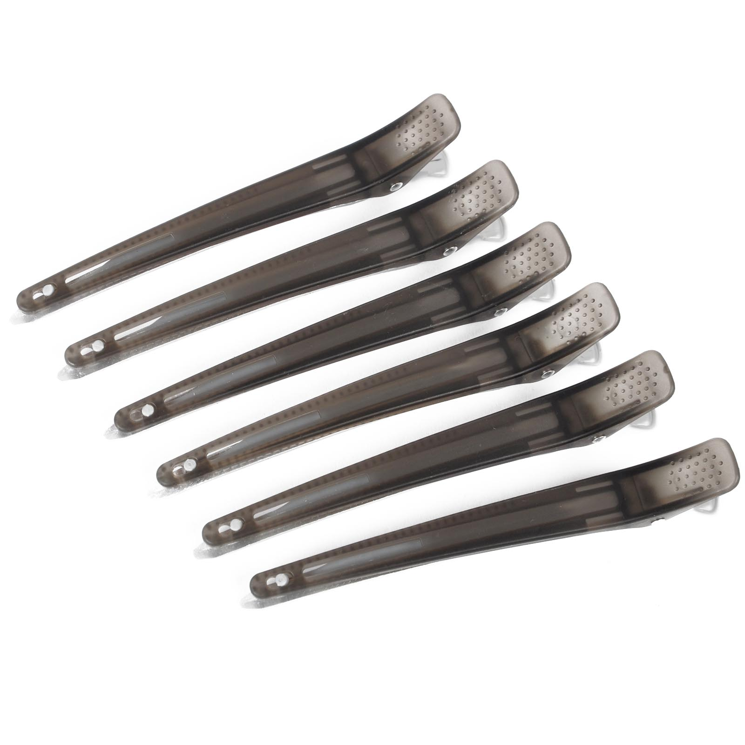
Hair clamps

Slide 16
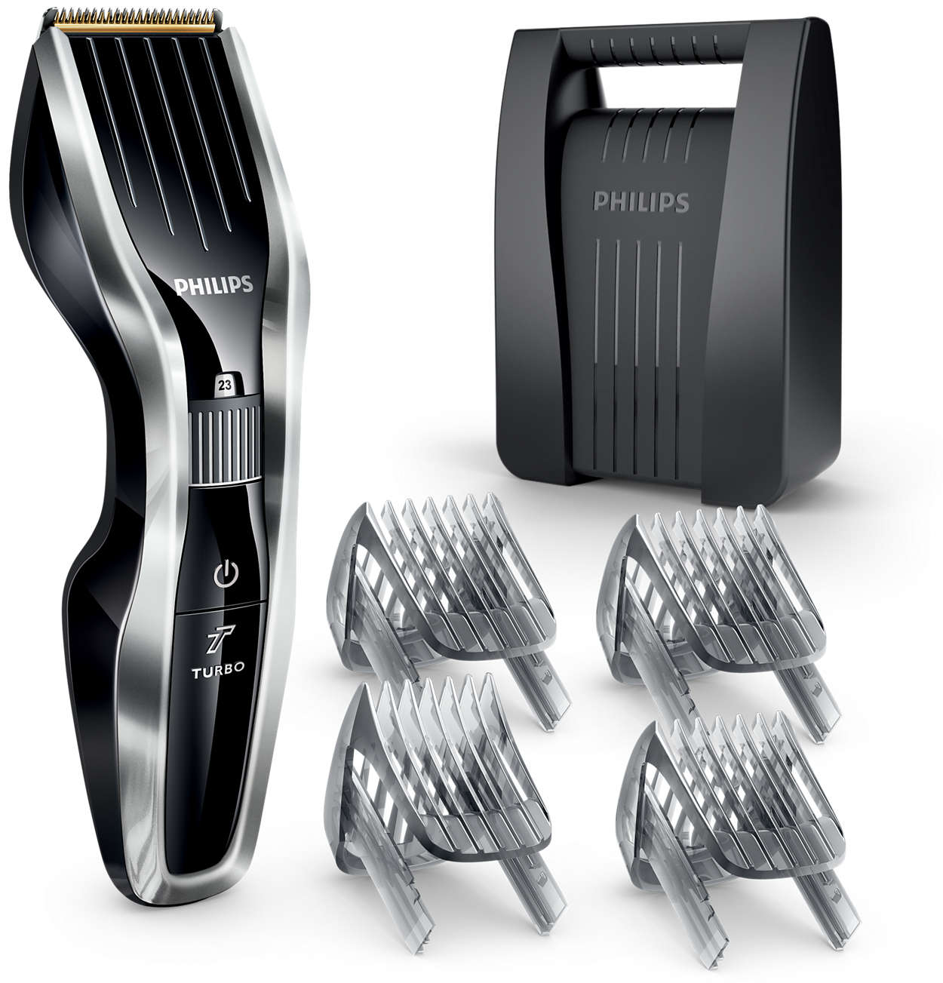
Clipper

Slide 17
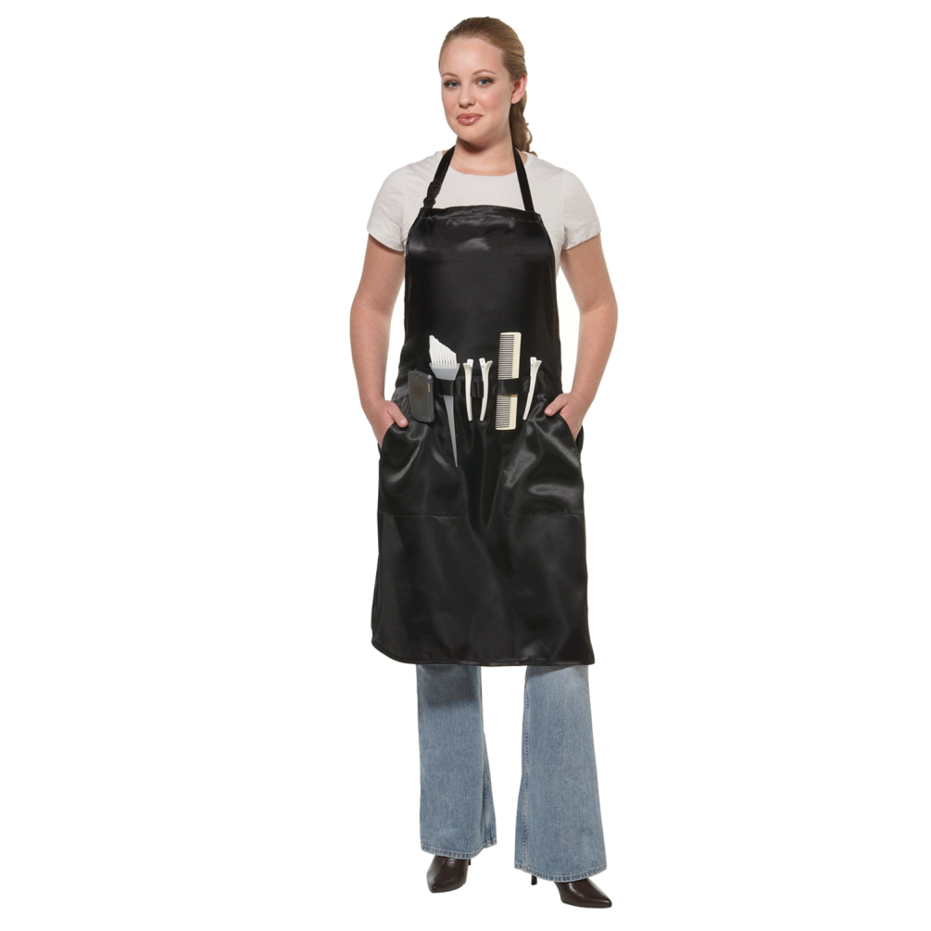
A special apron with pockets

