Slide 1
About modern gadgets

Slide 2
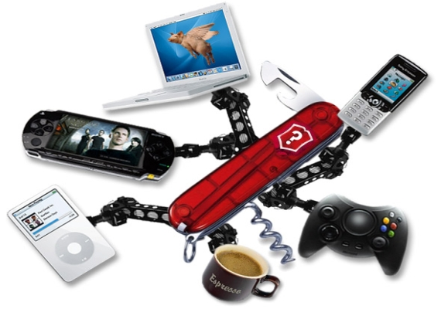
We live in the 21st century. It is the age of technologies and information. Nowadays the majority of people use modern gadgets.
A "gadget" is a modern word, which usually describes a small electronic device. This device helps people to solve some of their problems and contemporary tasks. Everybody uses different gadgets, according to their own needs.

Slide 3
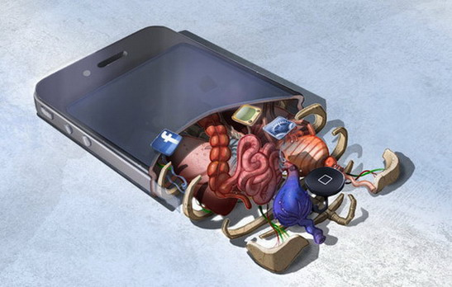
But nowadays one kind of gadgets is the most popular – it is smartphone. The smartphone is a contemporary version of a usual mobile phone. Smartphones get very big evolution nowadays. They are very powerful and useful. And they are really convenient and comfortable to use. Smartphones help people to communicate with each other in spite of the territorial disposition. Smartphones are usually connected to the Internet using a wireless type of connection. This helps people to be always online.

Slide 4

There are three primary kinds of smartphones nowadays: iPhone, Android-platform devices, and Windows Phone-devices. I think the most popular model of smartphones in Russia is iPhone. The second place belongs to Android-platform devices, and after them there are Window-Phone devices. Every kind of smartphones works under the control of its own operation system: iPhones run under iOS, Android-devices run under Android OS, and Windows Phone-devices run under Window Phone OS. Every operation system has its own pros and cons. As for me, I prefer Android OS. But I also like iOS, and I also have an iPod touch. It is a mp4 player, and it is like the iPhone but without making calls. The Windows Phone is the youngest system among them, and it is not so enhanced. But it is becoming better and better. And I think it will become a very good system very soon.

Slide 5
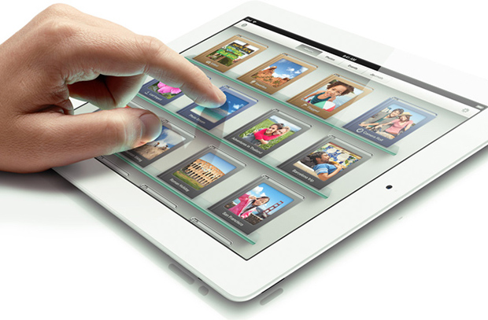
I’d also like to tell you about Pad-computers. They are like big smartphones. Many people have Pads nowadays. Pads work on the same operation systems as smartphones. But I think that among Pads the Pads with iOS are the best. They are called iPads. IOS is optimized for pads better than other systems. So, for sure, smartphones and Pads are the most popular gadgets nowadays.

