Slide 1
ТЕМА УРОКА:
«Российская Федерация»
ЦЕЛИ УРОКА:
Совершенствование умений и навыков практического владения английским языком
Расширение знаний студентов по теме « Российская Федерация»

Slide 2
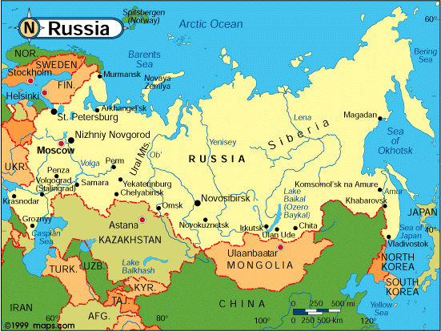
RUSSIAN FEDERATION

Slide 3
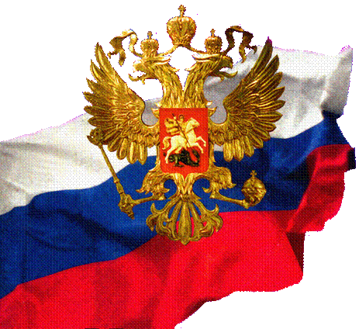
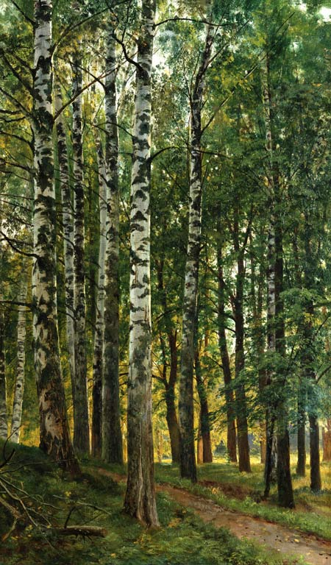
SYMBOLS of RUSSIA
One symbol is the Russian national flag.
It has three stripes: white, blue and red.
Another symbol of Russia
is the birch tree

Slide 4
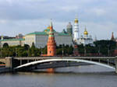
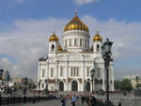
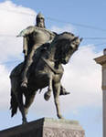
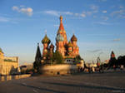
MOSCOW is the capital.
Chronicles first mentioned Moscow in 1147. It was a little settlement at the top of a hill looking over the Moskva river, a settlement founded by Prince Yuri Dolgoruky. It grew and very soon it became “a city, superior to all other cities of Russia”.
Today its population is about 9000000 people.

Slide 5
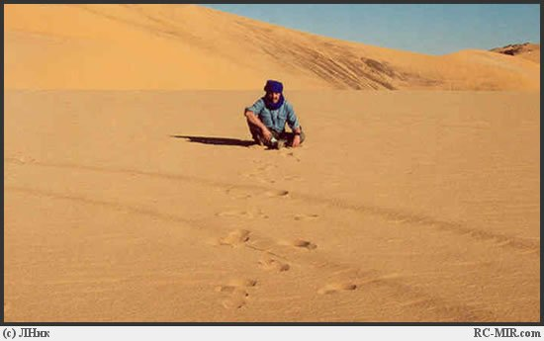
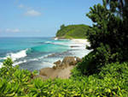
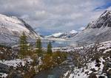
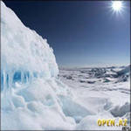
Russia is the largest country of the world. It lies on a huge territory from the coast of the Pacific Ocean to the centre of Europe. Its climate is different.

Slide 6
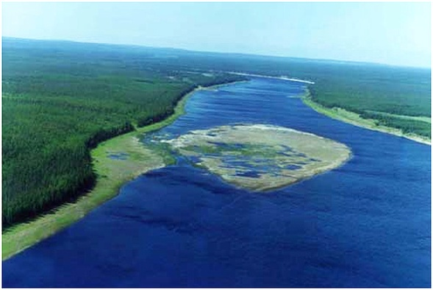
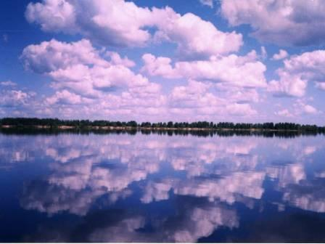
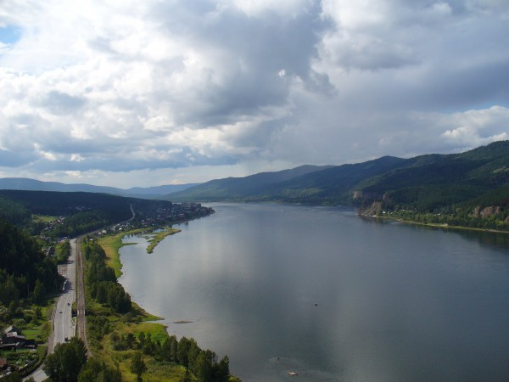
Russia is a very rich country. There are many rivers, lakes, mountains, forests and fields.
The Volga is the longest river in Europe.
The Lena and
the Yenisey

Slide 7
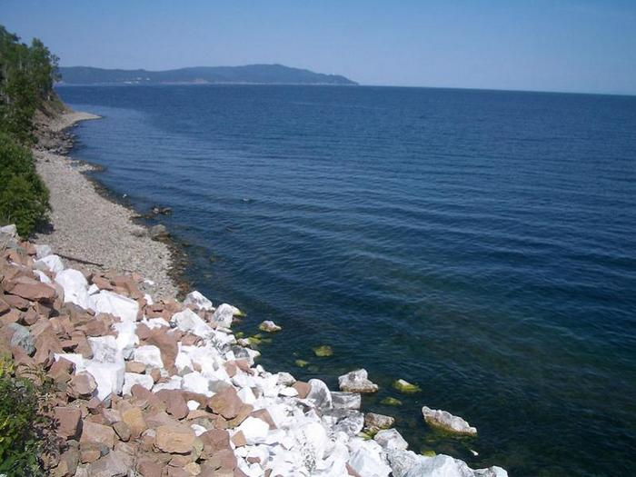
Lake Baikal is the deepest freshwater lake on the Earth. It is 1741 meters deep.

Slide 8
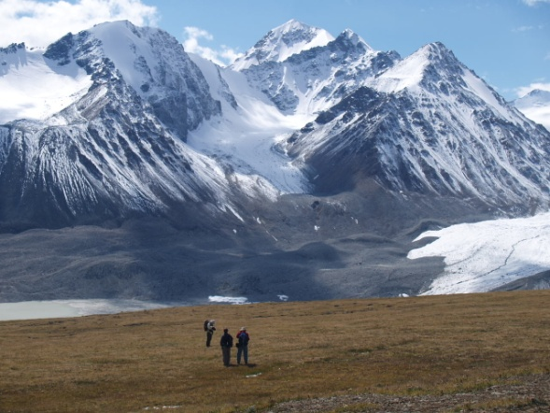
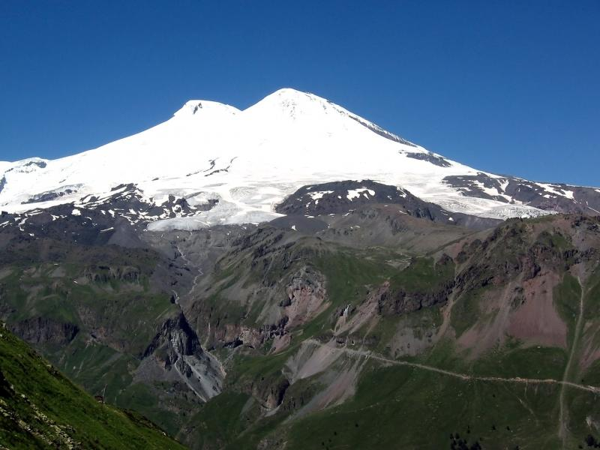
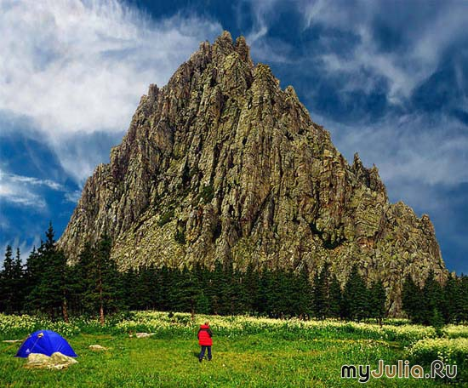
The Altai Mountains lie south of Lake Baikal.
The Caucasus Mountains are between the Black and Caspian se
The Ural Mountains form a natural border between Europe and Asia.

Slide 9
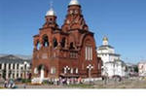
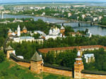
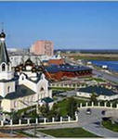
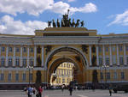
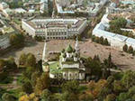
Look at the major cities of Russia.
Vladimir, Perm, St.Petersburg, Yaroslavl,
Novgorod the Great …

Slide 10
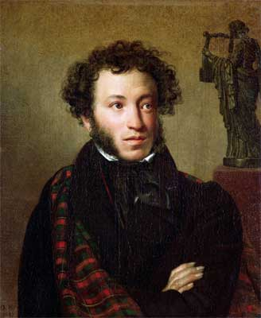
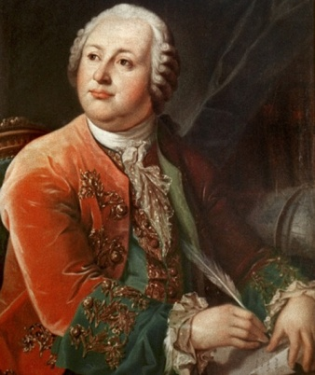
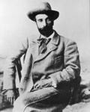
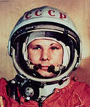
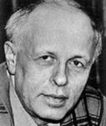
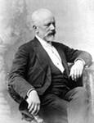
Russia is famous for its people.
Alexander Pushkin
Michael Lomonosov
Isaak Levitan
Peter Tchaikovsky
Yuri Gagarin
Andrei Sakharov

Slide 11
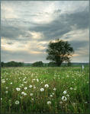
Russia is my country and
I love it very much!

