Slide 1

The history of advertising

Slide 2
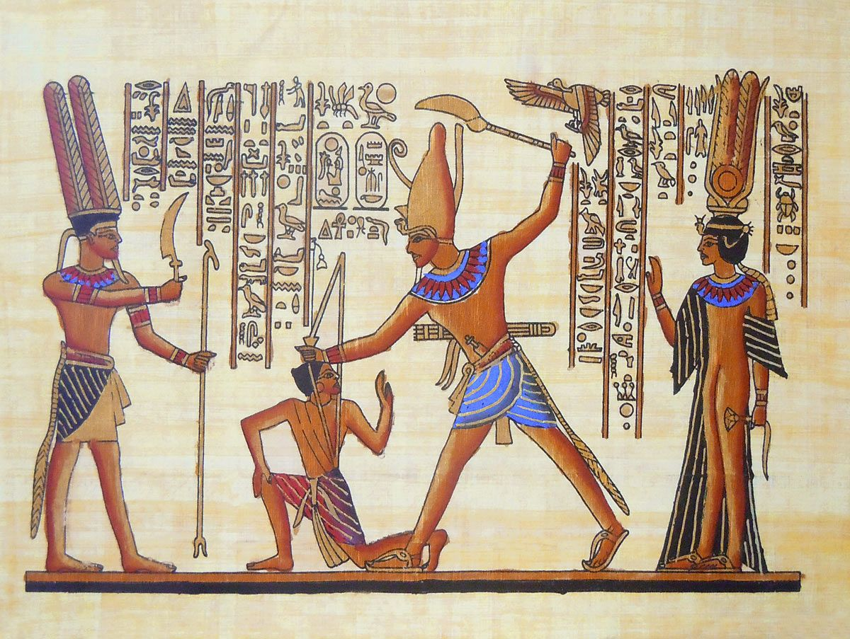
The simplest forms of advertising existed before our era. Тhe first ads under the wanted category were found on Egyptian papyrus, promising a reward for the return of escaped slaves.

Slide 3

The birth of the press came much later, only in the fifteenth century. It was when fast development of trade in European countries started to form a demand for information. It`s satisfaction became possible by a technological breakthrough – the invention of the printing press by Johann Guttenberg.

Slide 4
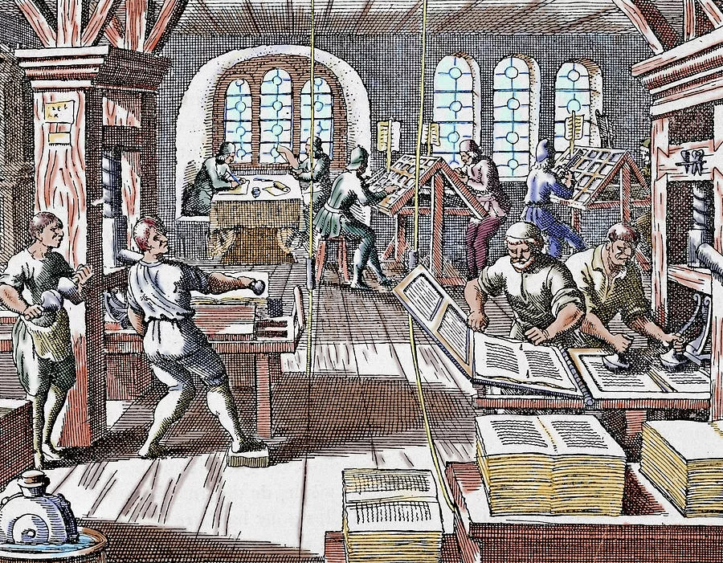
The first printed flyer was published irregularly, in small editions, with unsystematic content. Only in the seventeenth century all over the civilized world began to publish real periodicals.

Slide 5
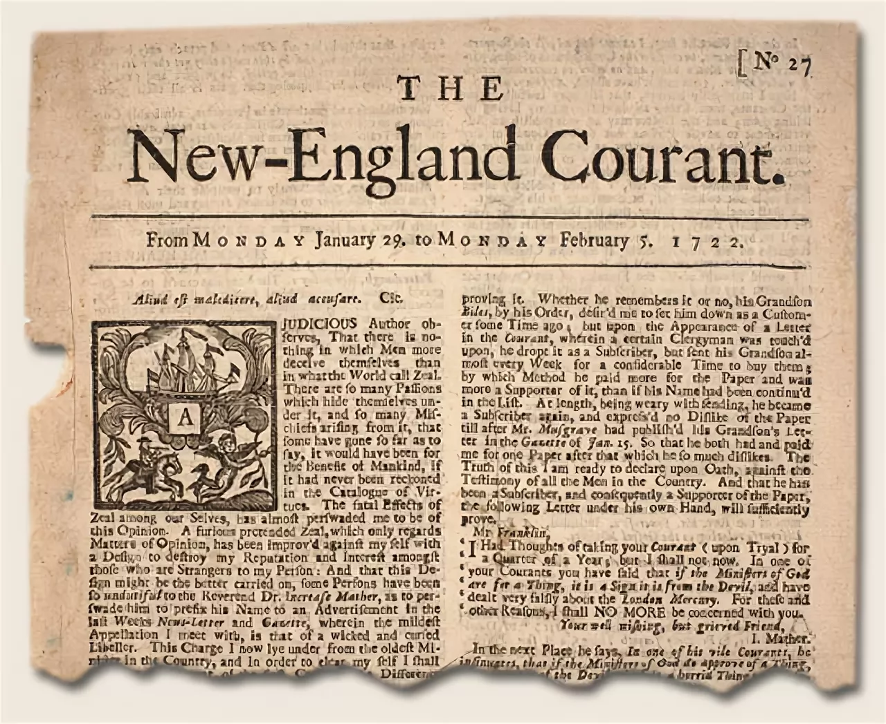
So, in 1631, the first daily newspaper was published in France with a circulation of 1200 copies. Along with the news, it also published ads.

