Slide 1
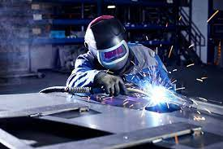
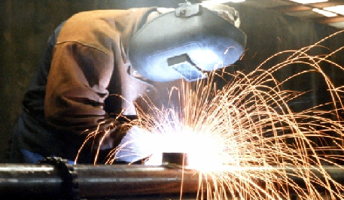
Welding

Slide 2
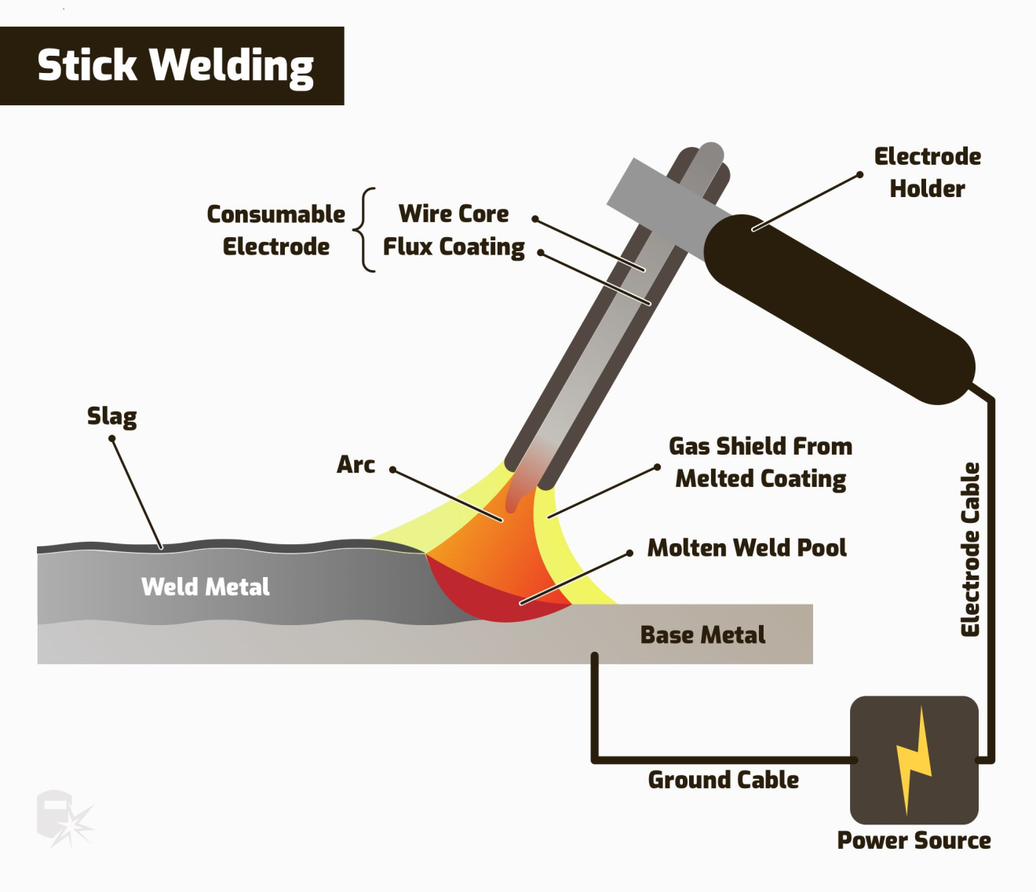
How Does Welding Work?
Welding is a high heat process which melts the base material. Typically with the addition of a filler material. Heat at a high temperature causes a weld pool of molten material which cools to form the join, which can be stronger than the parent metal. Pressure can also be used to produce a weld, either alongside the heat or by itself.

Slide 3
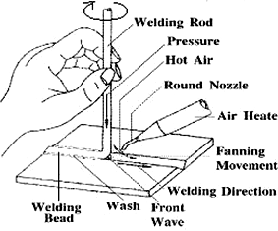
Joining Plastics
Plastics welding also uses heat to join the materials (although not in the case of solvent welding) and is achieved in three stages.
Firstly, the surfaces are prepared before heat and pressure is applied and, finally, the materials are allowed to cool to create fusion. Joining methods for plastics can be separated into external or internal heating methods, depending on the exact process used.

Slide 4
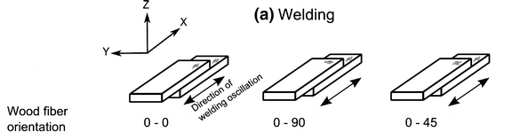
Joining Wood
Wood welding uses heat generated from friction to join the materials. The materials to be joined are subjected to a great deal of pressure before a linear friction movement creates heat to bond the workpieces together.
This is a fast process which allows wood to be joined without adhesives or nails in a matter of seconds.

Slide 5
Joining Wood
Wood welding uses heat generated from friction to join the materials. The materials to be joined are subjected to a great deal of pressure before a linear friction movement creates heat to bond the workpieces together.
This is a fast process which allows wood to be joined without adhesives or nails in a matter of seconds.

Slide 6

Common Joint Configurations
1. Butt Joint
A connection between the ends or edges of two parts making an angle to one another of 135-180° inclusive in the region of the joint.

Slide 7
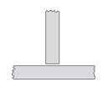
2. T Joint
A connection between the end or edge of one part and the face of the other part, the parts making an angle to one another of more than 5 up to and including 90° in the region of the joint.

Slide 8

3. Corner Joint
A connection between the ends or edges of two parts making an angle to one another of more than 30 but less than 135° in the region of the joint.

Slide 9
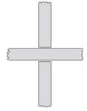
4. Cruciform Joint
A connection in which two flat plates or two bars are welded to another flat plate at right angles and on the same axis.

Slide 10

5. Edge Joint
A connection between the edges of two parts making an angle to one another of 0 to 30° inclusive in the region of the joint.

Slide 11

6. Lap Joint
A connection between two overlapping parts making an angle to one another of 0-5° inclusive in the region of the weld or welds.

Slide 12
Thank you for
your attention

