Slide 1
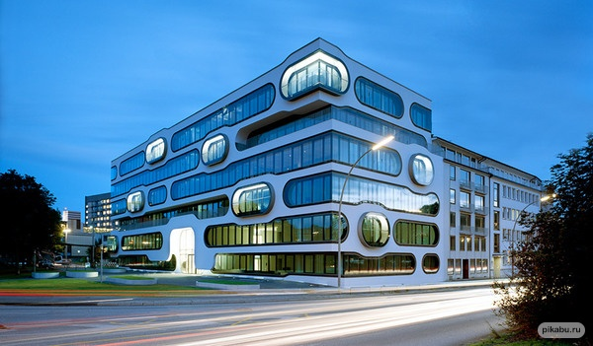
DESCRIBE A BUILDING
There are different possible ways that you may be asked to describe a building. You could be asked some of the following.
Describe a building…
- in your hometown
- in your country
- that you really like
- that you visited when you -were a child
- that has historical significance

Slide 2
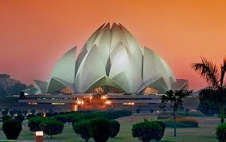
Plan of Description
BUILDING
You should say:
1. where it is
2. what it looks like
3. what it is used for
4. explain why you like/dislike it.

Slide 3
So let’s think for a moment what we need to do to fully answer this task. Remember that you are being assessed partly on task response, so you cannot stray too far off-topic.
1. Can you talk about any building? No – it must be modern.
2. Should you describe its appearance? Yes.
3.Can you pick a building you dislike? Yes – but you must explain why you dislike it

Slide 4
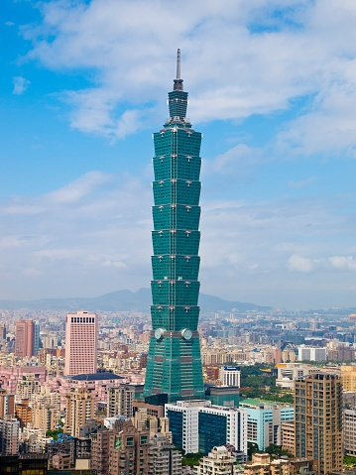
Sample
About ten years ago I visited a country called Taiwan. In the capital city, Taipei, there is an incredible building called the Taipei 101, which has become a symbol of the country on the world stage. At the time, it was the tallest building in the world, but now it no longer has that title.
This building is quite unlike other skyscrapers around the world, as it reflects Asian identity in its architecture. The building was designed to look like bamboo, the strong but flexible plant that grows across much of East Asia.

Slide 5
This is not only an aesthetic choice; the shape helps make the building capable of resisting strong winds and even earthquakes.
When I visited, I saw the mall at the bottom and then took the elevator up to the top level. The elevator is the fastest in the world, so that was quite an exciting experience. I am not what the rest of the building was comprised of, but I would assume it is office-space. At the top, many tourists gather to take in the stunning views over the city, and you can even go outside sometimes to feel the wind.

Slide 6
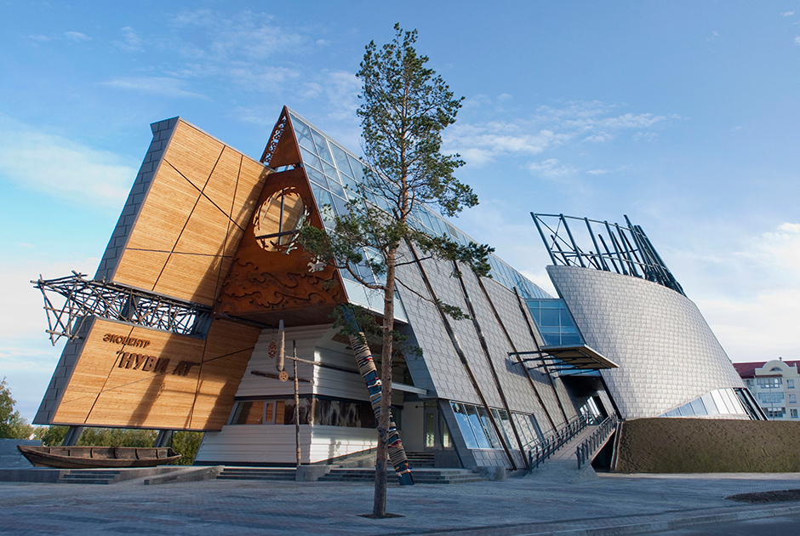
Task 1
DESCRIBE A BUILDING

Slide 7
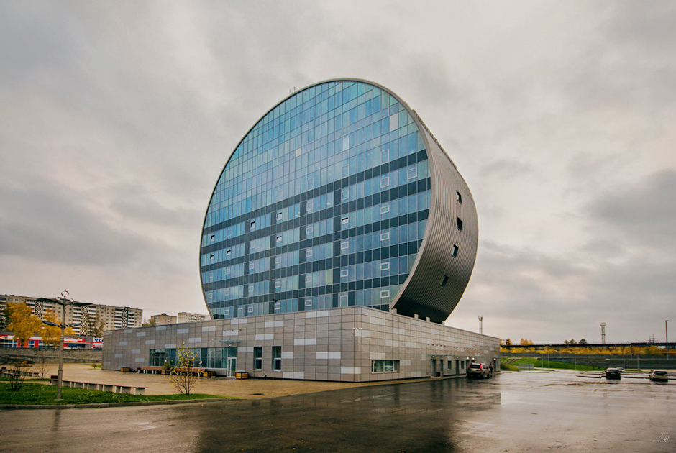
DESCRIBE A BUILDING

Slide 8
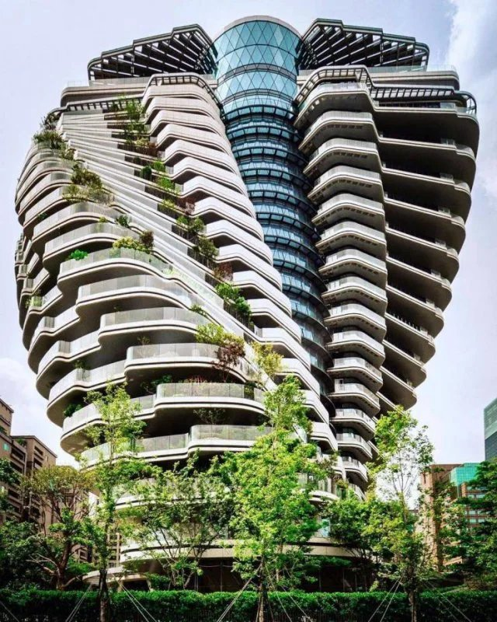
DESCRIBE A BUILDING

Slide 9
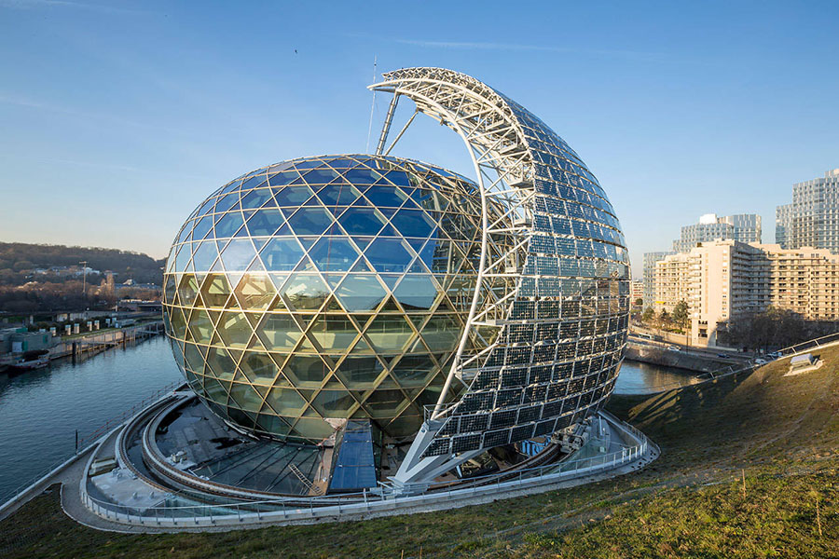
DESCRIBE A BUILDING

