Slide 1
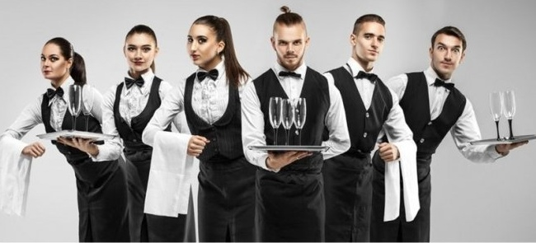
Waiter’s working day

Slide 2
Try to answer these questions
1. What does a day as Waiters and Waitresses looks like?
2.What do they do every day?
3.Things they do on a weekly or monthly basis
4.How many hours do they work?

Slide 3
Typical Day for Waiters and Waitresses
Here is a list of tasks that Waiters and do every day^
1. Check with customers to ensure that they are enjoying their meals and take action to correct any problems.
2. Collect payments from customers.
3. Write patrons’ food orders on order slips, memorize orders, or enter orders into computers for transmittal to kitchen staff.
4. Prepare checks that itemize and total meal costs and sales taxes.
5.Take orders from patrons for food or beverages.

Slide 4

Typical Day for Waiters and Waitresses
Here is a list of tasks that Waiters and do every day^
Check with customers to ensure that they are enjoying their meals and take action to correct any problems.

Slide 5
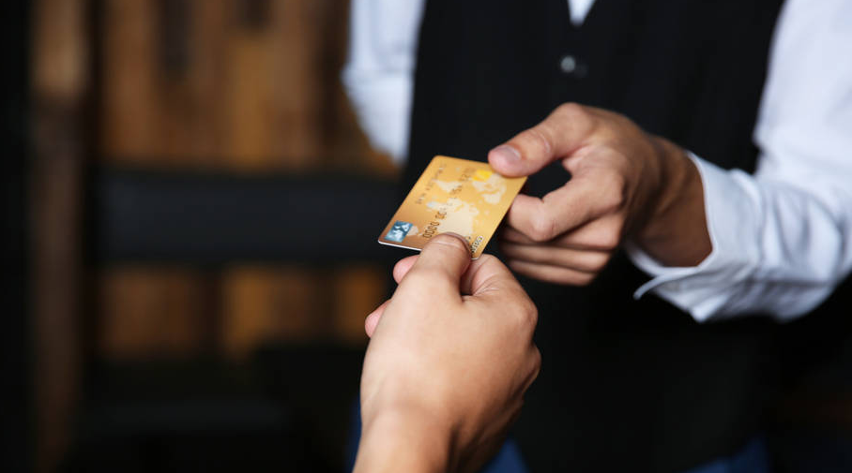
Typical Day for Waiters and Waitresses
2. Collect payments from customers.

Slide 6
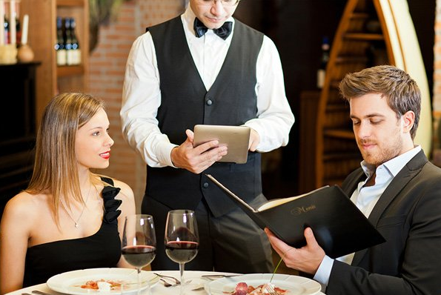
Typical Day for Waiters and Waitresses
3. Write patrons’ food orders on order slips, memorize orders, or enter orders into computers for transmittal to kitchen staff.

Slide 7
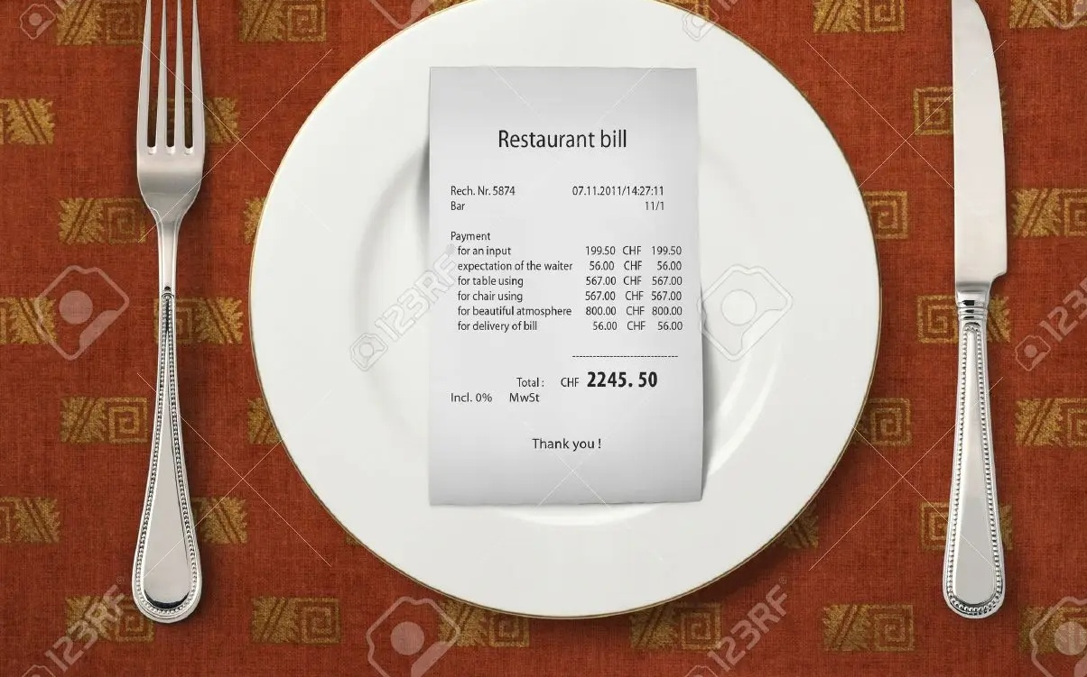
Typical Day for Waiters and Waitresses
4. Prepare checks that itemize and total meal costs and sales taxes.

Slide 8

Typical Day for Waiters and Waitresses
5.Take orders from patrons for food or beverages.

Slide 9
Tasks
- setting and arranging tables
- greeting customers and presenting them with menus and beverage lists
- taking orders and relaying them to kitchen and bar staff
- serving food and beverages
- opening bottles and pouring beverages
- clearing tables and returning dishes and cutlery to kitchen
- removing empty bottles and used glasses from tables, and refilling and replacing glasses
- collecting payments for sales and operating point of sales machines and cash registers
- may recommend wines to complement food

