Slide 1
Grammar
To be
To have
Can
There is/There are
this, that, these, those
Possessive adjectives
Possessive ‘s

Slide 4
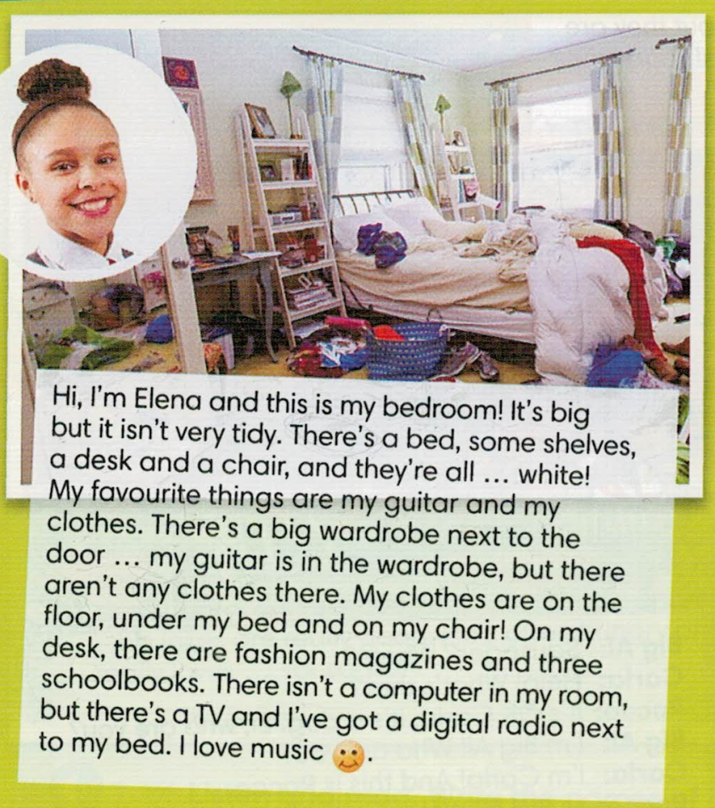

Slide 5
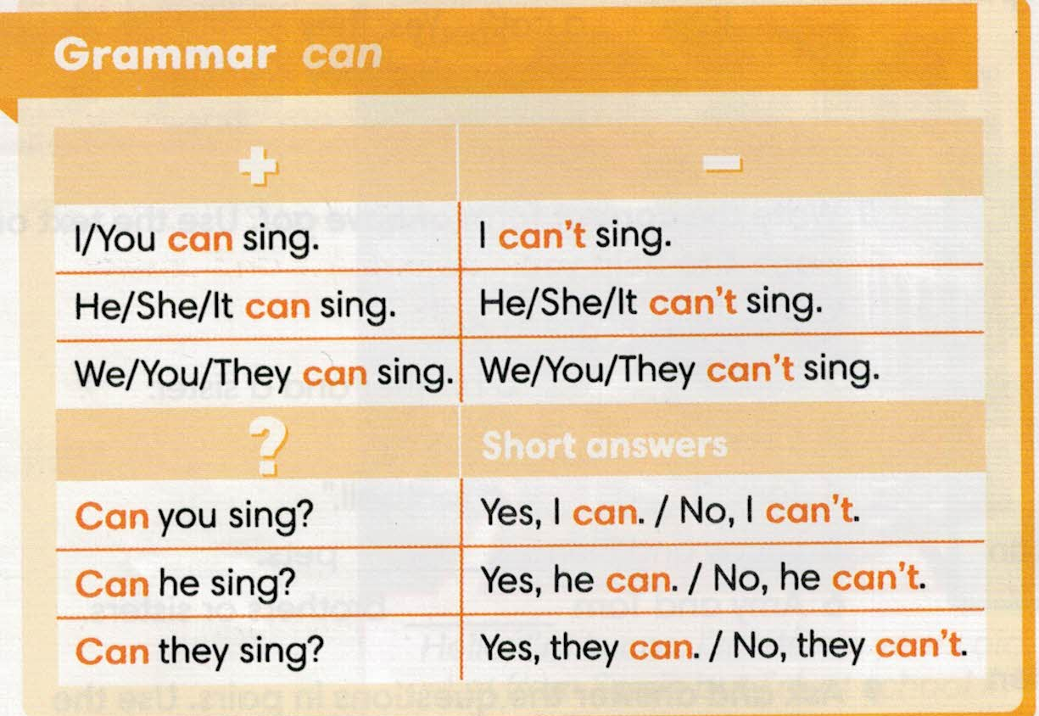

Slide 6
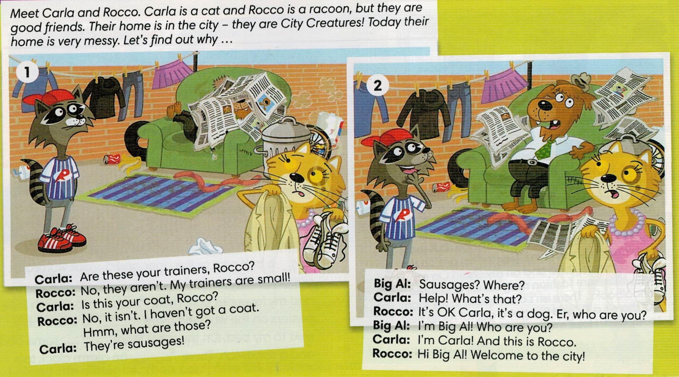

Slide 7
