Slide 1

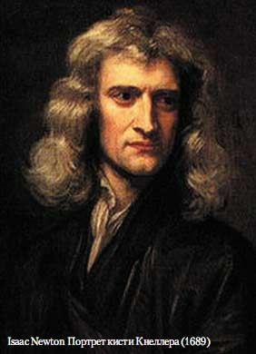
Презентация к открытому мероприятию по физике на английском языке
Isaac Newton (Исаак Ньютон)
25.12.1642 – 20.03.1727

Slide 2
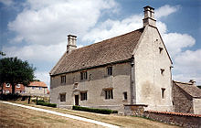
Isaac Newton was one of the world’s greatest scientists. He did research in mathematics, physics, astronomy and many other fields.
Newton was born in 1642. He worked on his family’s farm but was not really interested in farming. His father died 3 months before the birth of Isaac. In his childhood he spent much time with his grandmother. Newton didn’t have many friends and never married.
Woolsthorpe
The birthplace of Isaac Newton

Slide 3
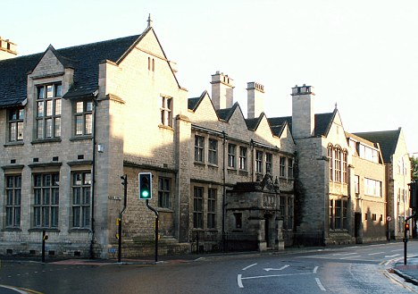
When Newton was twelve he was admitted to The King’s School, Grantham. He studied there until seventeen. Newton abhorred farming but his mother wanted him to manage a household.

Slide 4
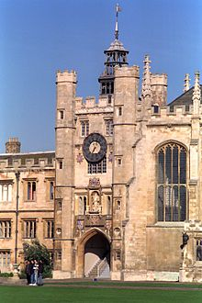
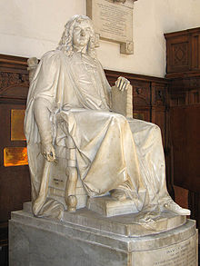
From 1661 Isaac Newton was educated at Trinity College, Cambridge . Four years later Newton discovered the generalized binomial theorem.
Newton did most of his scientific work at Cambridge, where he was a professor for many years. Although some other scientists criticized his work, he was admired throughout Europe.
Trinity College,
Cambridge
The statue of Isaac Newton in Trinity College, Cambridge

Slide 5
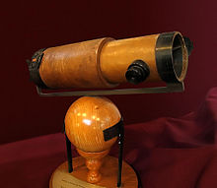
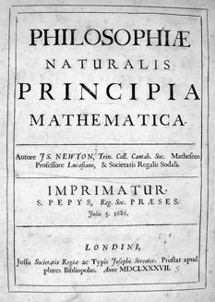
Isaac Newton made a lot of discoveries in mathematics, physics, astronomy and other sciences. One of the most famous books of Newton is Philosophie Naturalis Principia Mathematica. It was published in 1687. There are a lot of discoveries in this book including universal gravitation and three laws of motion. The first practical reflecting telescope was also invented by Newton.

Slide 6
In his book “The Mathematical Principles” Newton describes the three laws of motion:
Every moving object keeps moving until something stops it. An object that lies on the ground continues to lie there until a force sets it in motion.
Acceleration happens when a force acts on a mass. The greater the mass the more force must be applied to move the object. For example, you need more force to push a car than need to push a bike.
For every action there is an equal and opposite reaction. A rocket, for example, pushes down on the ground with its engines; the opposite action moves the rocket into the sky.
These principles were very difficult to understand at that time. Only few people really knew what Newton meant.

Slide 7
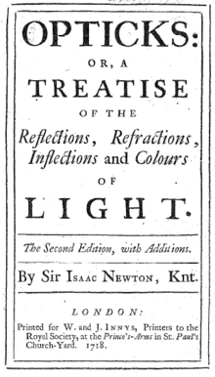
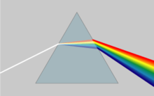
Between 1670 and 1672 he studied optics. As a result Newton showed that a prism could decompose white light into a spectrum of colors
Newton used prisms to break up light into a rainbow of colors
Isaac Newton is an author of the development of differential and integral calculus and he shares this mathematical discovery with Gottfried Leibniz

Slide 8
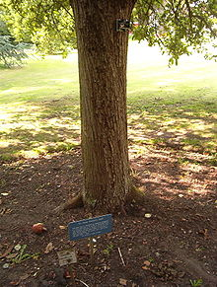
As legend has it Newton developed the theory of gravitation when he watched an apple that fell from the tree.
Reputed descendants of Newton’s apple tree, at Cambridge University BotanicGarden

Slide 9
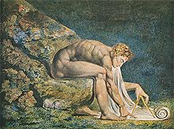
Newton also devoted a great deal of his life to alchemy. He studied it closely and believed that he was a person who had magic powers and secret wisdom to change substances and objects.
Newton wanted to keep these studies to himself; therefore he did not publish any of his alchemist works. At that time alchemy was a much-discussed topic that not everyone accepted.

Slide 10
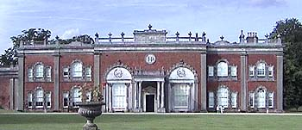
It is also known that between 1689 and 1690 and in 1701 Isaac Newton was a member of the Parliament of England. Isaac Newton never married and died intestate.
Isaac Newton spent last years of his life in the residence at Cranbury Park, near Winchester. He died in London in 1727.

Slide 11
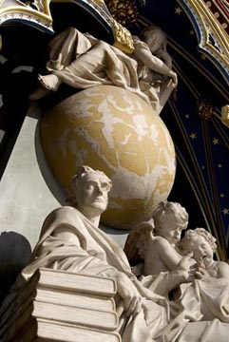
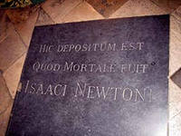
Isaac Newton was interred in Westminster Abby.
Newton was interred in Westminster Abby. Many scientists consider Newton to be the greatest genius in the history of mankind.

Slide 12
Интернет ресурсы:
1. http://www.westminster-abby
http://niistali.narod.ru/uk/Abby
http://unload.wikimedia.org/wikipedia/commons/
http://tobolsk-eparhia-press
http://www.dailymail.co.uk/new
http://wreferat.baza-referat

