Slide 1
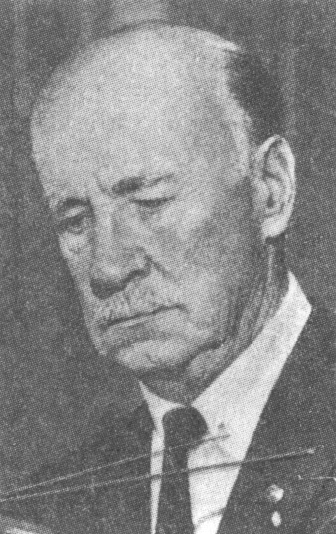
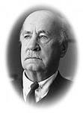
«FAMOUS PEOPLE OF SCIENCE AND ENGINEERING»
Sikorsky Igor Ivanovich

Slide 2
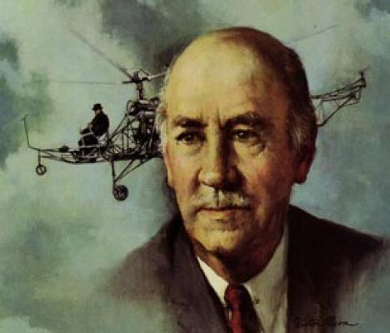
Sikorsky Igor Ivanovich was a well-known aircraft engineer and manufacturer.

Slide 3
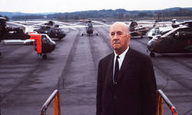
Sikorsky was born in 1889 in Kiev, in the Ukraine, and got his education at the naval college in St. Petersburg, and later in Kiev and Paris.

Slide 4
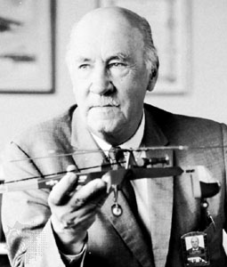
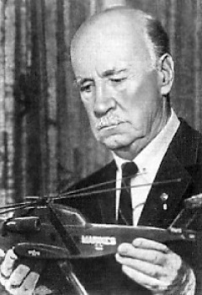
He was the first to make experiments in helicopter design.

Slide 5
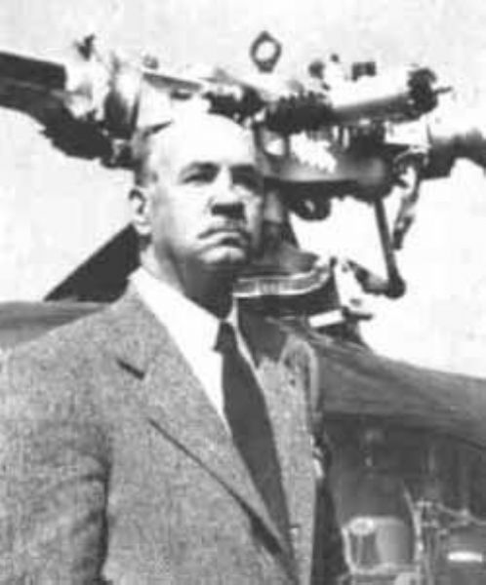
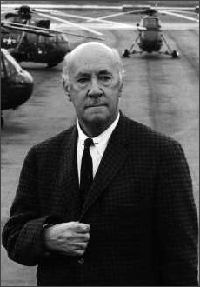
In 1913 he designed, built, and flew the first successful airplane.

Slide 6
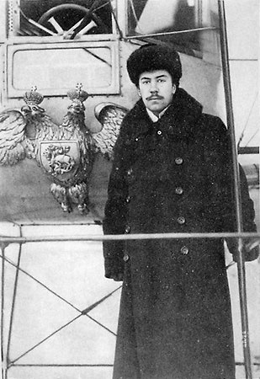
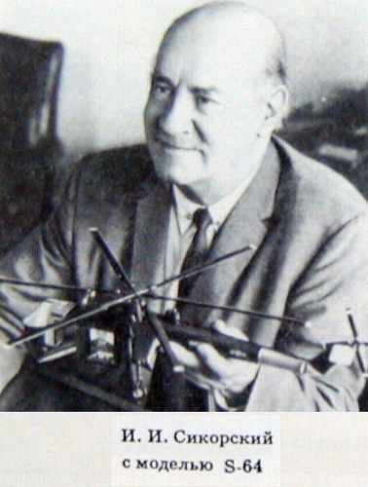
Later he built military aircrafts for Russia and France.

Slide 7
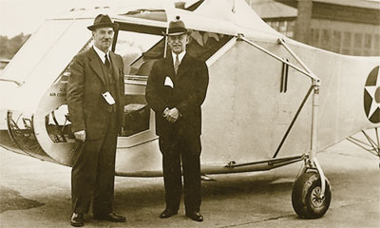
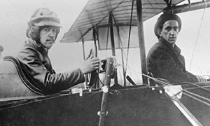
In 1919 Sikorsky moved to the United States and later helped to organize an aircraft company that produced a series of multiengine flying boats for commercial service. Sikorsky became an American citizen in 1928.

Slide 8
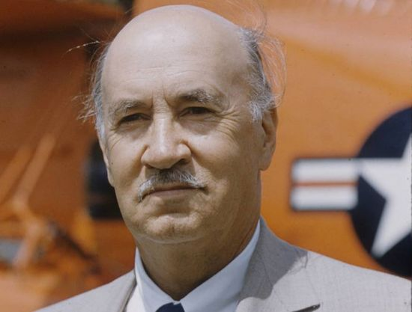
In the late 1930s he returned to developing helicopters and produced the first successful helicopter in the west.

Slide 9
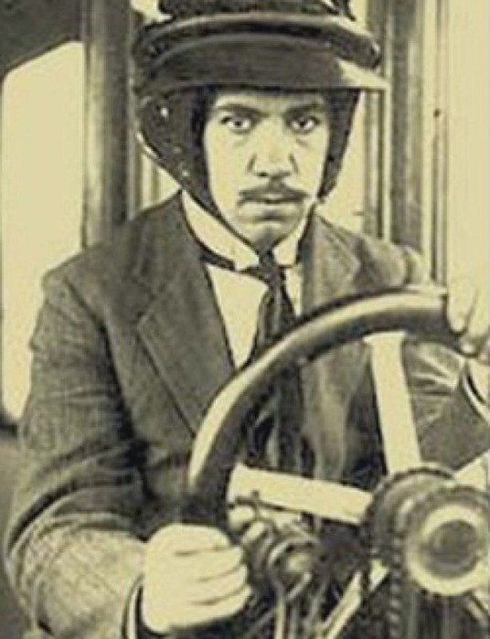
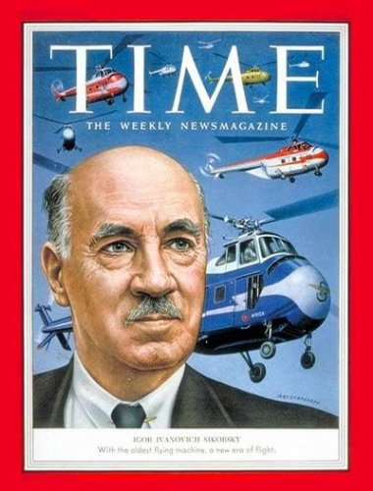
Helicopters designed by Sikorsky were used mostly by the US Army Air Forces during World War II.

Slide 10
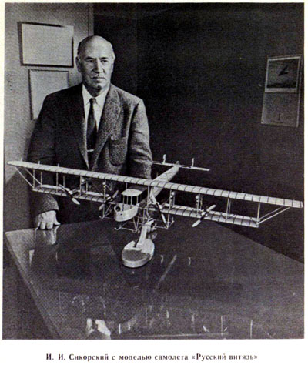
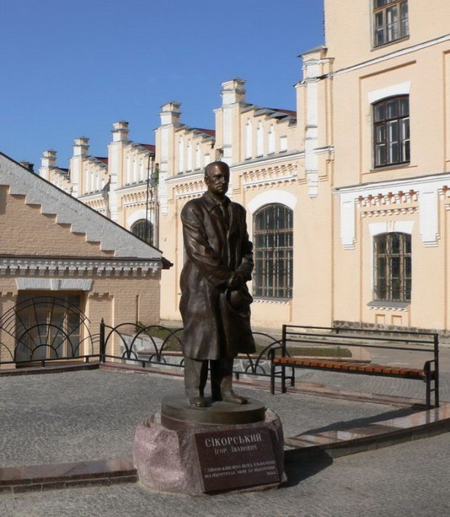
He died in 1972 at the age of 83.

