Slide 1
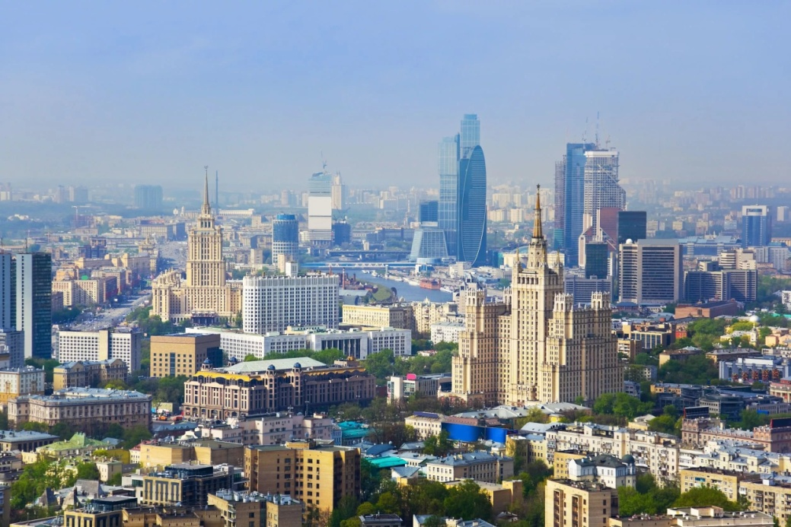
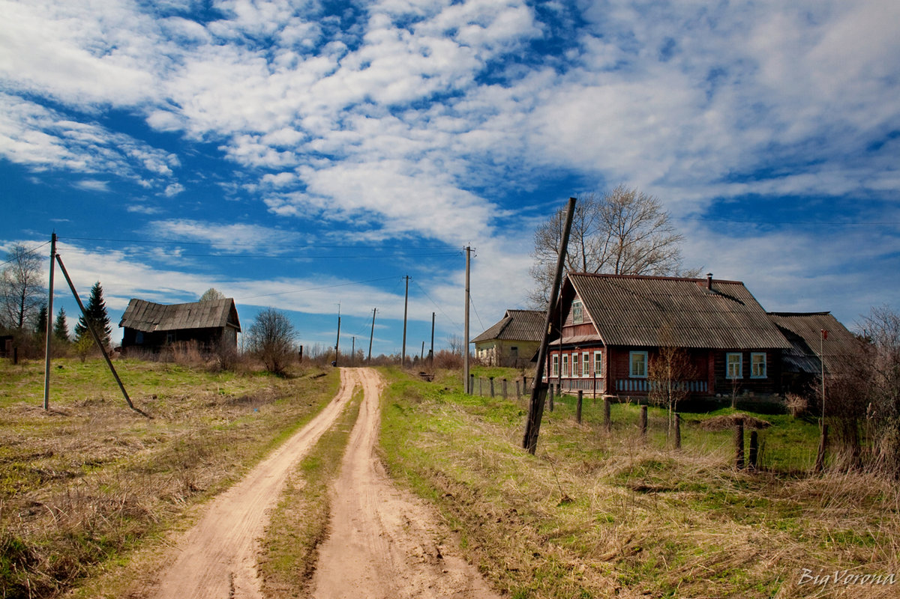
The life in the city and in the country.

Slide 2
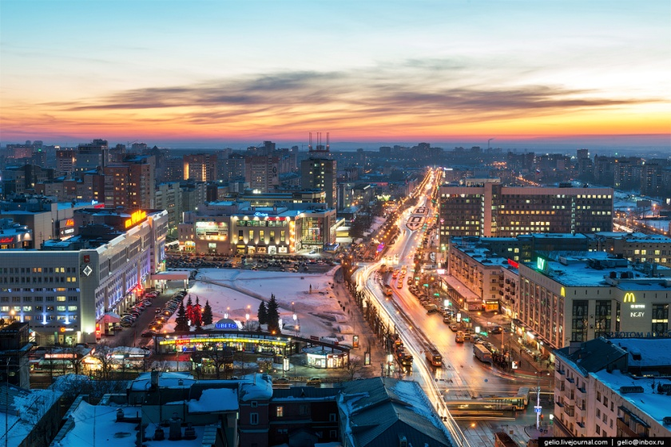
What is a City?
A city is an area in which a large number of people live fairly close together.
A city is basically a big town — the population is large in relation to the amount of land, since people often live in apartments or multi-family housing.

Slide 3
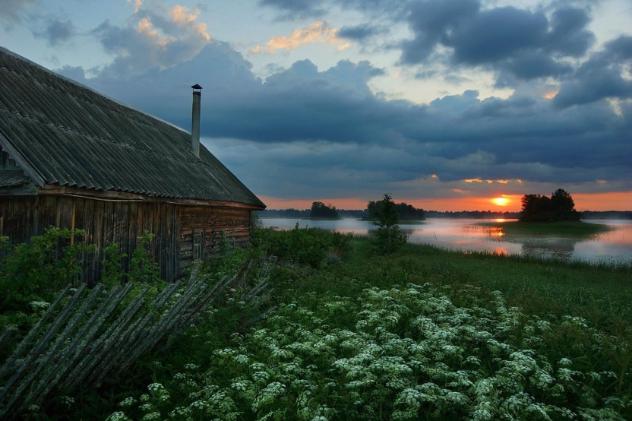
What is a country?
A country is a nation, a body of land with one government.
A country is a territory occupied by a nation.
2. Rural areas outside cities and towns are called the country.
“The country" is any place that's away from cities and rural: the country has farms and open spaces

Slide 4
Phrases for city life
-lot’s of museums, theatres and
cinemas
-beautiful parks
-everyone may find an interesting
work and earn a lot of money
-prestigious education
-a wider choice of shops, sports
facilities and health centres

Slide 5
-need much money
-good restaurants
-much pollution and traffic jams
-dangerous life for children
-a lot of crime and violence
-transport and industry
-more problems with health
-bad habits (smoking, drinking alcohol, taking drugs)

Slide 6
Phrases for country life
-the air is fresh
-there is no pollution
-eat lots of fruit and vegetables
-a healthy lifestyle
-live in their own houses with lots
of rooms
-go to the forests and gather
mushrooms and flowers

Slide 7
-spend much time in the open air
- there is nothing to do
-have to work hard all day long to grow fruit and vegetables
-no cinemas and theatres
-it is difficult to find a job
-can’t get good education

Slide 8
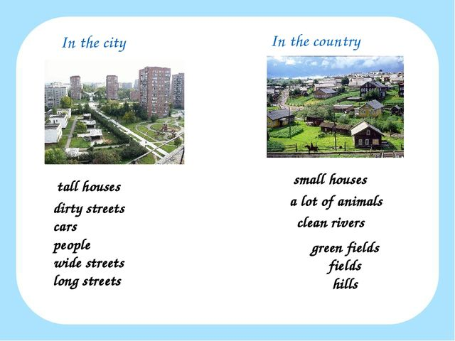

Slide 9
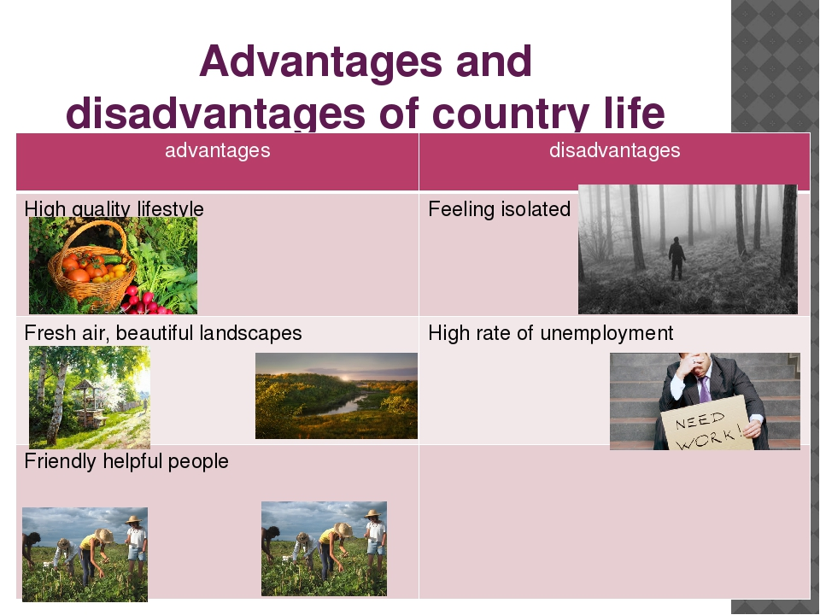

Slide 10
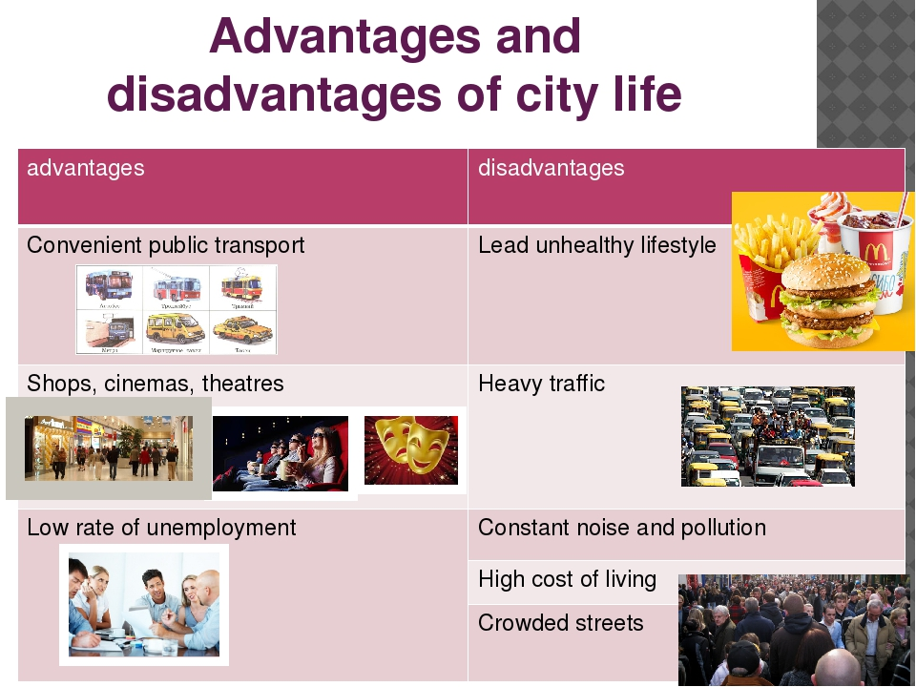

Slide 11
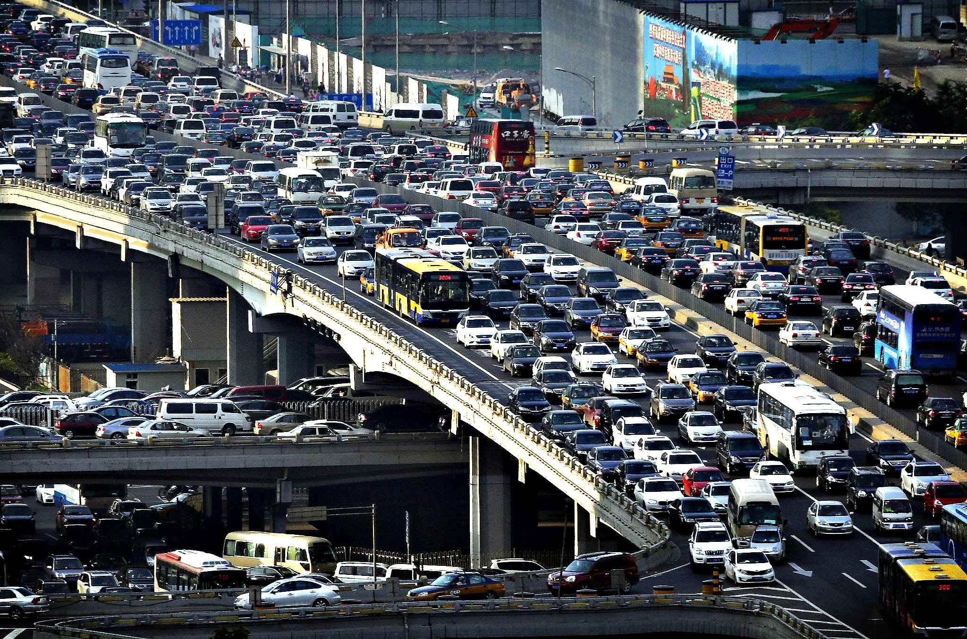
Problems of a big сity
1. Traffic jam

Slide 12
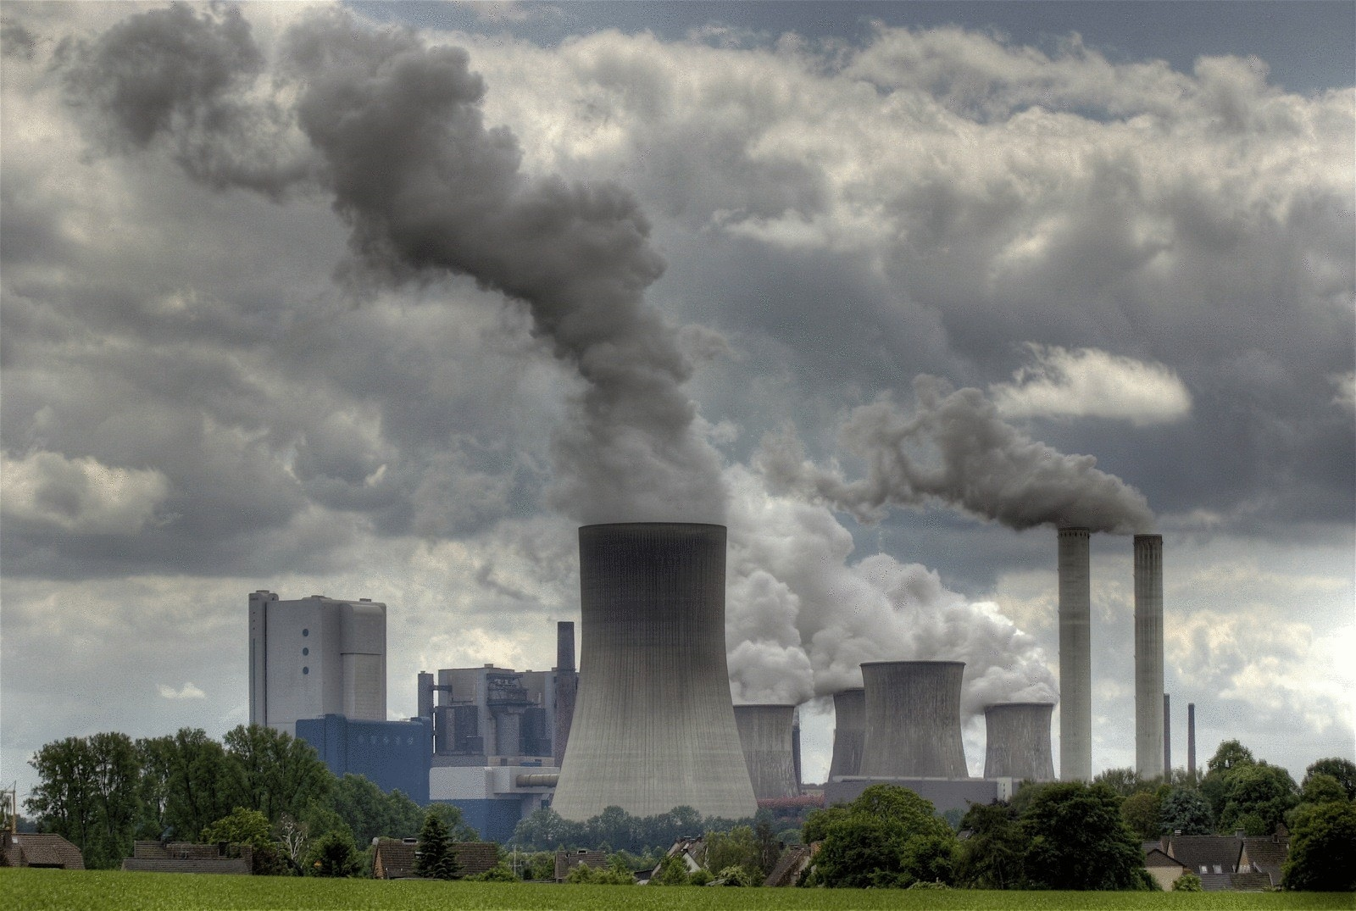
Problems of a big city
2. Air pollution

Slide 13
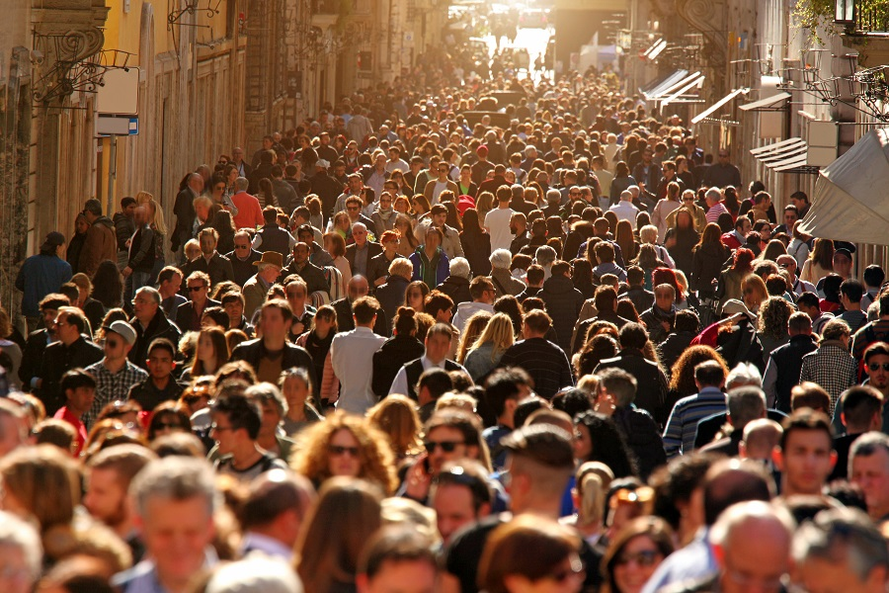
Problems of a big city
3. Crowded street

Slide 14
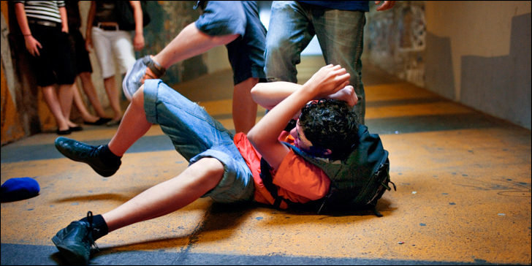
Problems of a big city
4. Social crimes

Slide 15
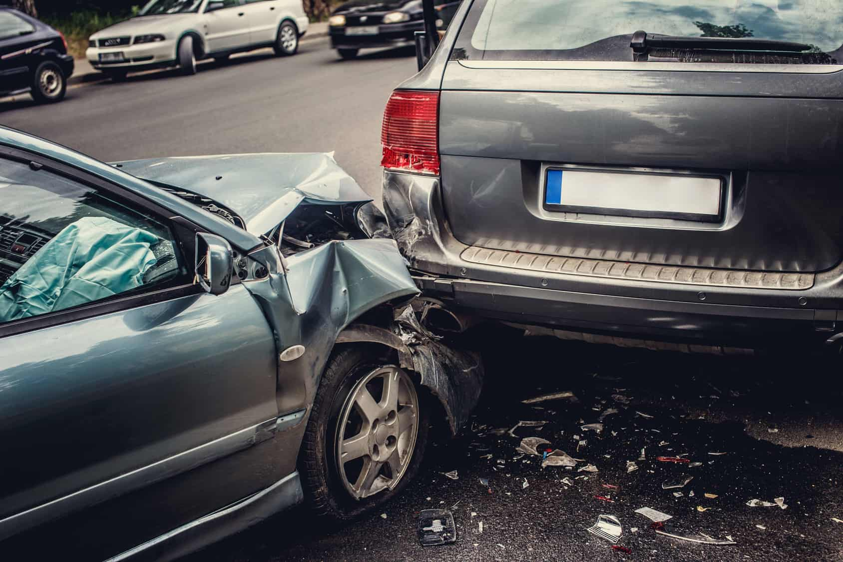
Problems of a big city
5. Accidents

Slide 16
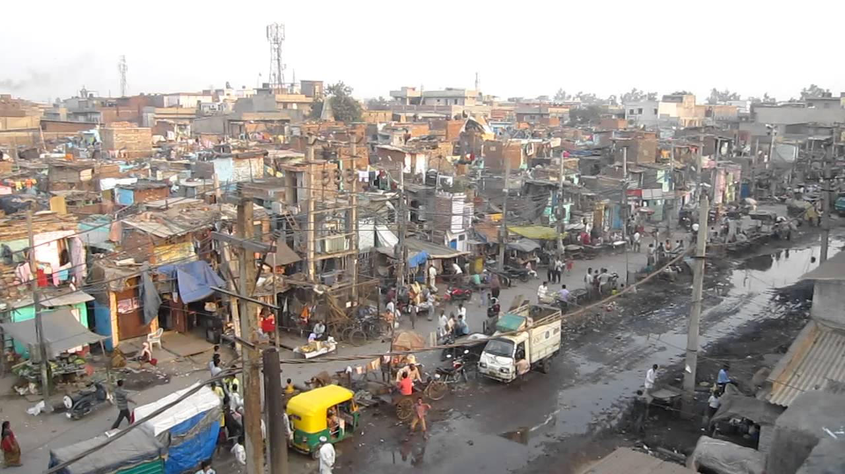
Problems of a big city
6. Slum

Slide 17

Problems of a big city
7. High expenses

Slide 18
What problems of a village do you know?

