Slide 1

A brief history of graphic design

Slide 2
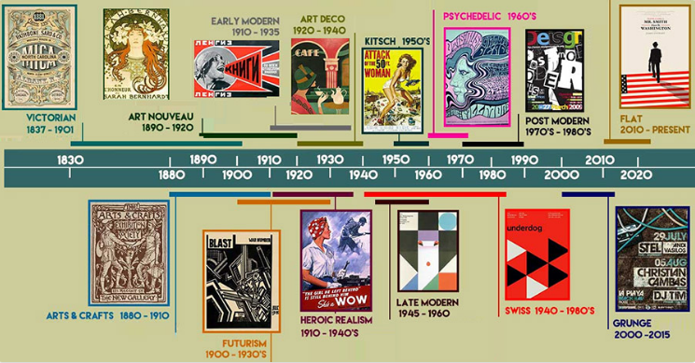
Graphic design is so much a part of our modern world that it is hard to imagine living without it.
Graphic design proper really began after the invention of the printing press in 1440, but the roots of visual communication stretch all the way back to caveman times.

Slide 3
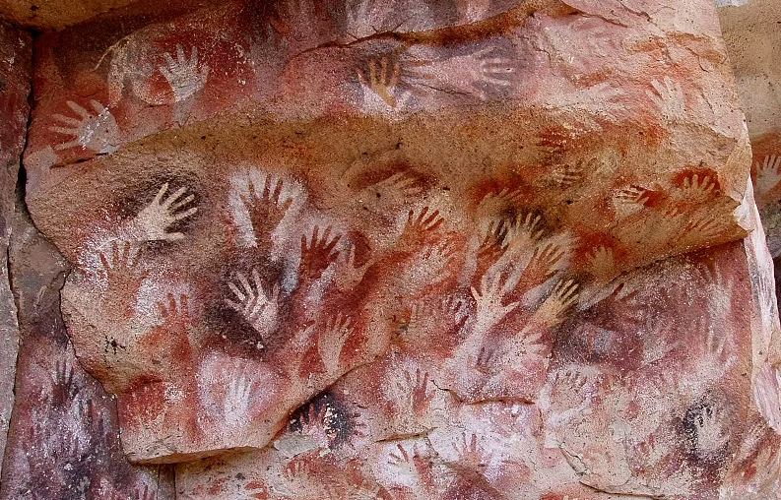
Cave paintings ~38,000 BCE
It seems like humans have always had an inherent drive towards art, evidenced by the early cave paintings dating back to prehistoric times. Subjects vary from animals to hand imprints to events like hunting, and they’ve been found all over the world
Cueva de las Manos in Perito Moreno, Argentina.

Slide 4

Sumerian written language – 3300 – 3000 BCE
Alphabets are a man-made invention. As far as we know, the Sumerians created one of the first written languages, most likely as a means of recording trader inventories to ensure couriers didn’t steal anything on deliveries.
These earliest languages were logographic—icons represented entire words instead of phonetic sounds.
An ancient Sumerian tablet bearing sad news: a letter written to the king of Lagash informing him of his son’s death in battle.

Slide 5

Advancements in Chinese printing 200 CE – 1040 CE
China holds most of the records for printing discoveries, including non-papyrus paper making, woodblock printing, and movable type—all of which occurred earlier than you might have guessed.
As far back as 200 CE, China used wood reliefs to print and stamp designs on silk clothes, and later paper. In 1040, Bi Sheng invented the world’s first movable type printing press out of porcelain, more than 400 years before Gutenburg brought a similar technology to Europe.
A woodblock print of a Chinese play from the Yuan dynasty.

Slide 6
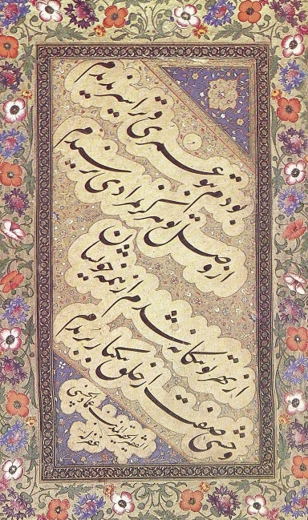
Medieval calligraphy – 700s
In the Middle Ages, typography started to take off as humanity started expanding its aesthetic horizons into the letters and words themselves. Because texts in this period were produced and replicated by hand, a little artistry made the books more valuable and set certain scholars apart from others. In Islamic cultures, typography was doubly important because figurative art was seen as sacrilegious, meaning typography was one of only a few permissible ways of artistic expression.
Famous sixteenth-century Persian calligrapher Mir Emad Hassani, demonstrating the Nasta’liq style

Slide 7
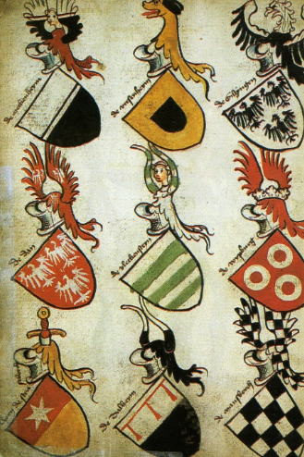
European heraldry – ~1100
Technically, the world’s first logo is the coat of arms, used as a symbol to represent family houses or territories. Scholars theorize the practice was popularized during the Crusades, where intermingling soldiers from different countries and houses incentivized a means to tell everyone apart, particularly on armor and battle flags.
15th century German coats-of-arms.

Slide 8
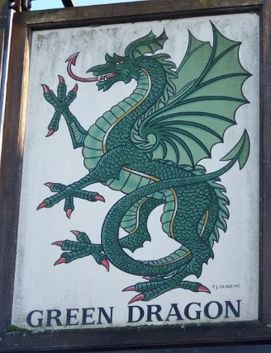
Storefront signage – 1389
In the 14th century, beer and ale were viable if not preferable alternatives for drinking water at a time when most water sources were polluted. King Richard II of England made a law that ale houses must have signs out front so the public could find them easier.
Sign outside the Green Dragon pub

Slide 9
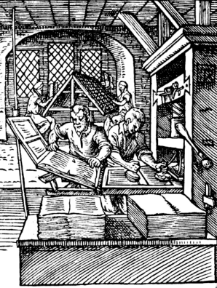
Invention of the Gutenberg press – 1439
Johannes Gutenberg brought moveable type to Europe in 1439, introducing mass communication to Western culture and forever changing civilization. With the Gutenberg press, people no longer had to rely on lengthy scholarly reproductions of books, opening up literature (and literacy) to the masses and making it affordable.
The early printing process circa 1568

