Slide 1
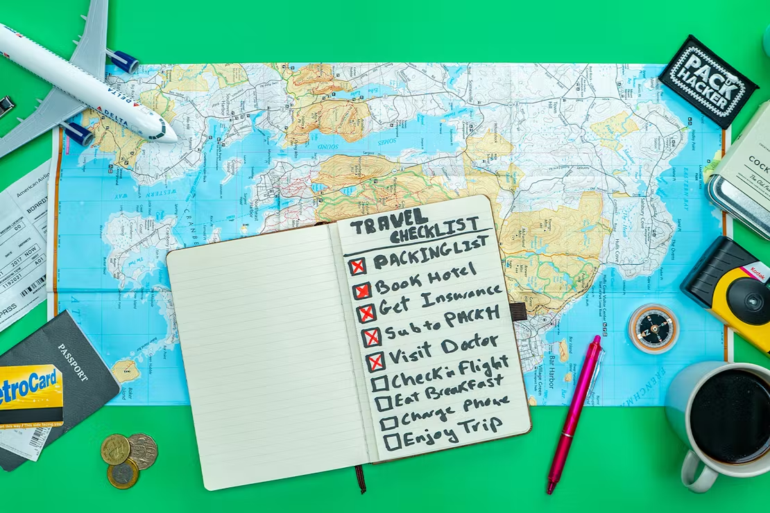
How to Plan a Trip

Slide 2
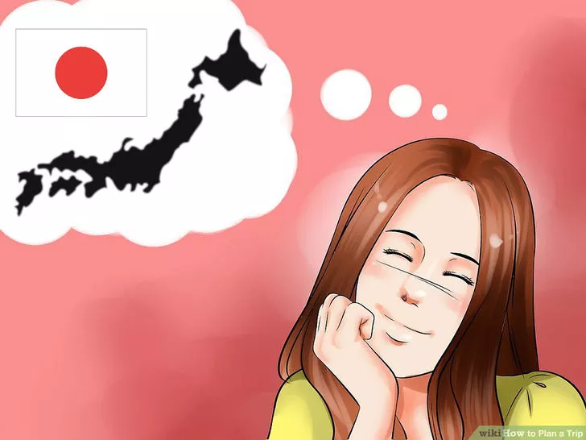
1. Choosing the When, Where, and How
A. Choose your location.
When people think to themselves, "I want to take a trip," usually they have a place in mind. Where's yours? Try to make it as specific as possible. "London" is a lot easier to plan than "England.“ Research it online and discuss it with your fellow travelers. Websites are a great place to browse travel photos, journals and videos posted by real people sharing their experiences.
Keep in mind weather and climatic conditions, merits and demerits of the place, types of recreation (beaches, culture, shopping), and facilities (transport, eating out, etc). What clothes are suitable? How removed from civilization will you be? What does your destination require?

Slide 3
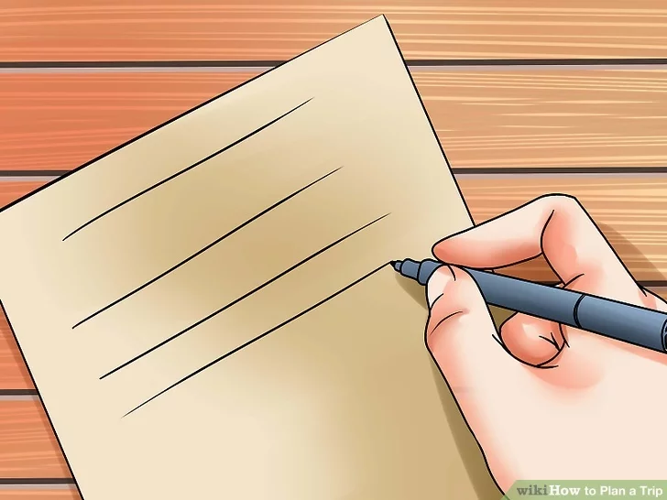
B. Choose when you want to go.
This will be determined by a number of things, but mostly your schedule. How much time can you feasibly take off work? In addition to your constraints, consider more global factors:
Do you want to go during the off-season or while tourism is booming?
When it comes to weather, do you want to deal with winter or the rainy season?
How about when it's hot and muggy?
And then there's ticket prices – if you're flying, when is it the cheapest to fly? If you are planning to fly on a long weekend, then you should book the tickets well in advance to get the best deal.

Slide 4
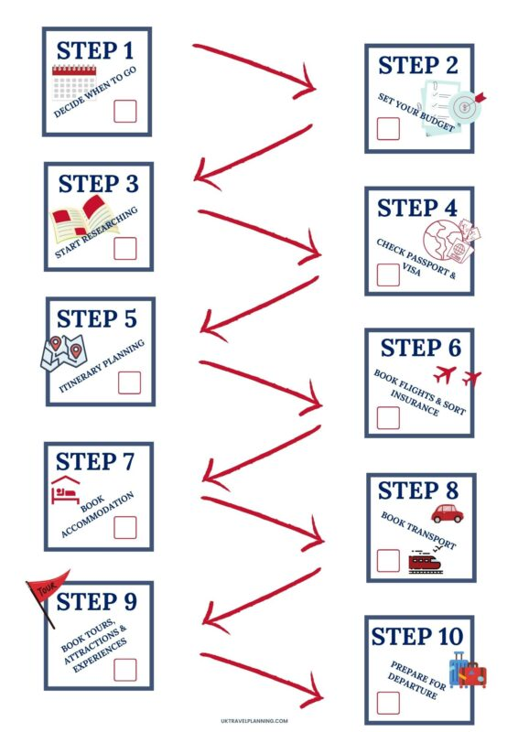
C. Plan a loose itinerary.
Planning too far ahead may backfire, because vacations hardly ever go as planned. Plan for spontaneity, but keep hints from travel guides in mind. Mark places to visit and things to do. How many days do you have? You should keep the overall schedule in mind – you do not want to end up too tired (or alternatively, bored).
Make a list. Write down the places you want to visit, including restaurants, museums, malls, and other places of interest.
Include how you're going to get around. Does your itinerary involve cab rides? Using the subway? Trekking on foot? If you are taking public transportation, make sure you know how that's done wherever you're going.

Slide 5
D. Be wary of going through a travel agent.
The largest immediate savings in planning your trip would be to use an online travel website to research, plan and book your travel adventures vs. going to a local travel agent where you live.
Travel Agents simply must charge booking fees, or they could not stay in business. Not only does a travel website pass savings to you in low overhead, they are able to rapidly check hundreds of options within a few seconds.[
The five things you can do to help yourself and your budget (that you don't need a travel agent for) are the following:
Book your flight and hotels at the same time, not separately
Be willing to fly mid-week and off-hours
Be willing to fly or land at a neighboring airport within 30 miles (48 km) of each other
Pay an all-inclusive price when possible, so that meals and gratuities are included
The actual season you travel – it will differ the rates by 30-40%.

Slide 6
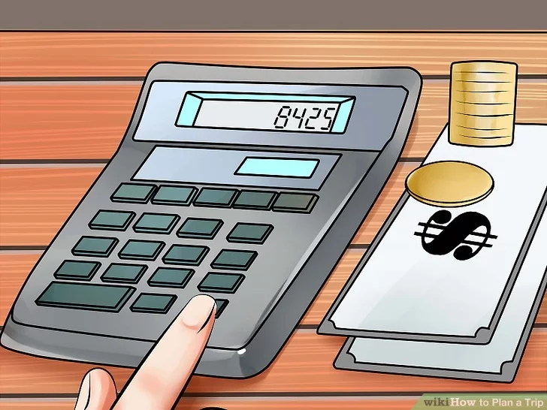
Figuring Out the Logistics
А. Assess your costs.
A large part of how much a vacation costs is what you decide to spend. Take an hour or two to figure out how much your trip would cost you and your companions. This should include airfare or gasoline costs.
Always add some wiggle room, overestimating rather than underestimating. There are always costs you don't foresee or things you want to do that you haven't accounted for.
If the trip is more than you are willing to spend, make cuts where you can. If it ultimately means cutting the trip short, so be it.

Slide 7

В. Make a budget.
Let's say you figure your trip will cost $1,500, including airfare. It's six months away. That means you have to save $250 a month for the next six months in order to meet the costs of your trip. Here are a few ideas where you can start saving:
Ditch that daily sugary latte. If you get a $4 coffee drink three times a week, that's $12 a week, and about $50 a month. That's $300 in six months right there.
Eat from home more. Restaurants are great, but they're expensive. If you cook at home, you can save money not only because it's cheaper, but because you'll have leftovers that can last you days.
Quit the luxuries for a while. That last drink on Saturday night? Pass. A movie next week? Nope. Heck, cable? Who needs it when you have Netflix? Take a look at what little things are fun, but that you could live without.

Slide 8
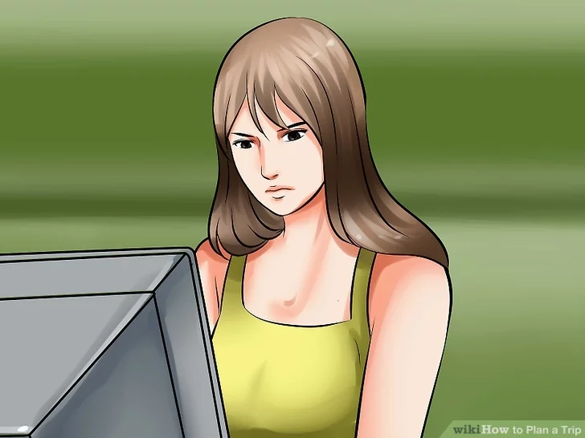
Setting Your Plans in Stone
А. Make your reservations for flights and accommodations.
Once you're exactly sure of where you want to go and when you want to go where, where you want to stay and how you want to get around, make your reservations. For flights, again, book around two months out. And don't wait till the last minute for your hotels either – you don't want them to be booked or almost-booked (because then prices skyrocket).And anything else for that matter, too. Many attractions have ticket sales online where you can skip the lines and go right in. Sure, the idea of waiting in line right now doesn't sound so bad, but for three minutes of work right now you can not waste hours of your vacation standing in a line with strangers wishing past you would've had better sense.

Slide 9
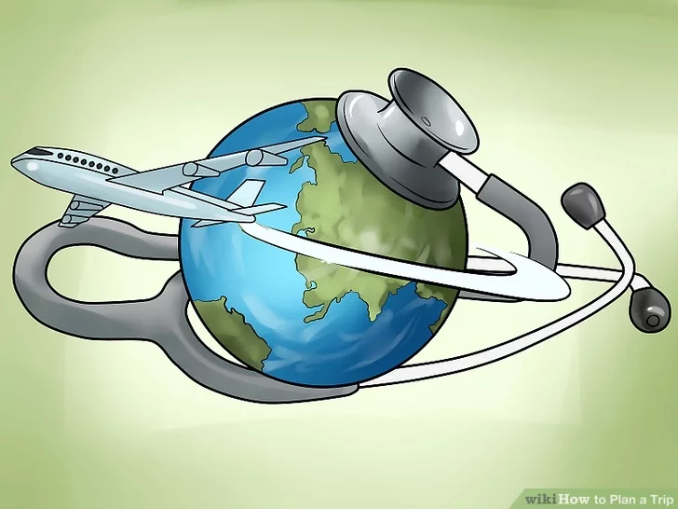
B. Consider travel insurance.
While you may not want to pay premium rates for something that might not happen, you should nonetheless have some protection in case you could not travel during the time your tickets are booked for. The average one week vacation will cost you in insurance needs approximately $75 dollars. This is not a lot of money considering the security it buys you.Only you know if you are one of these people that changes their mind often, or often does re-scheduling – or if you are one of these people that will fly out in a hurricane, no matter what!

Slide 10
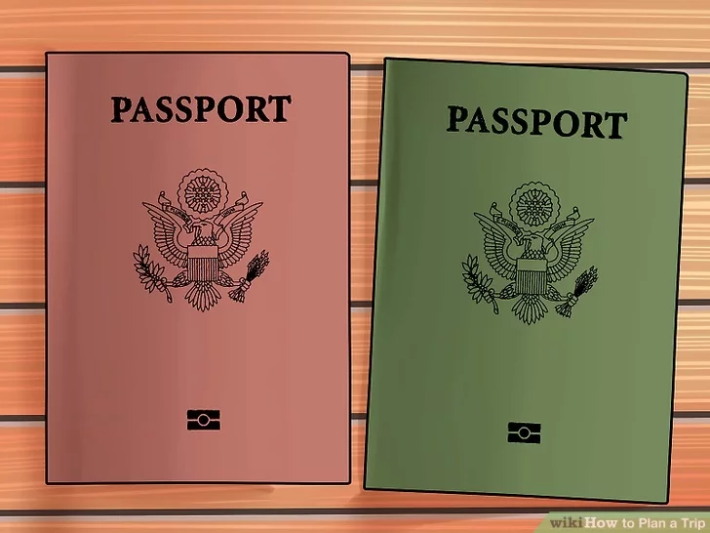
C. If traveling internationally, make sure your documents are in order.
Some countries require a visa to enter and exit the country. Does where you're going require one? If so, do this as soon as possible. If something is to come up and you don't have one, kiss your trip goodbye. Barring countries that take monetary bribes, they will tell you to turn around and get a flight back home if you don't have one. Keep your passport, travel documents, visas, and similar items in a safe pouch. You may want to make copies, too, and keep them in a safe place. It will make it so much easier to replace anything that you lost.

Slide 11
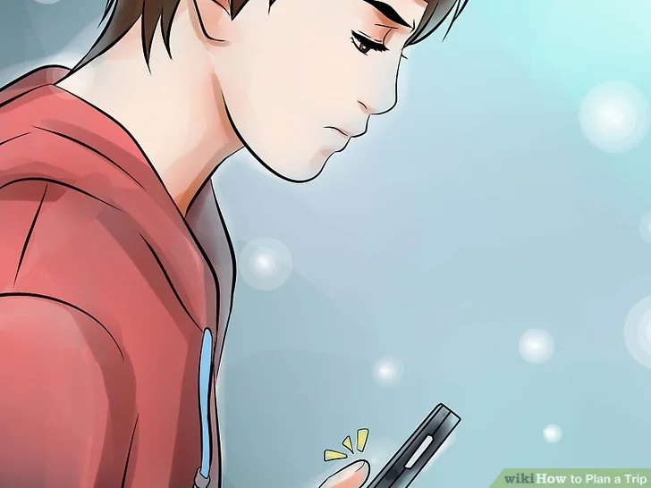
D. Notify the right parties that you're leaving.
For starters, notify a friend or family about your leaving. If possible, leave them a contact number or address. If anything goes wrong, you'll be able to hear about it. And if anything should go wrong on your end, they'll be able to take care of business back home. If applicable, put vacation notices on your e-mail, and remember to set your answering machine. Those messages will just have to wait until you get back.

Slide 12
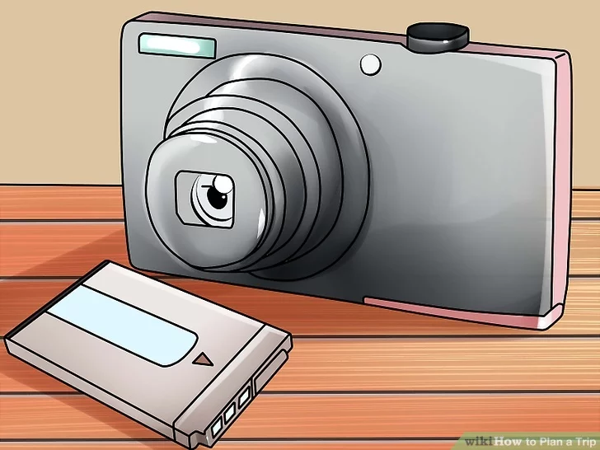
Wrapping Up the Details
A. Buy everything you'll need.
Buy film, or keep digital camera batteries on hand. Do you have the right plug-in adapter for wherever you're going? How about gear for the weather? A guidebook? A language book? What will make your trip go off without a hitch? Traveling in a car? Make sure to get lots of foodstuffs, water, and things to do.

Slide 13
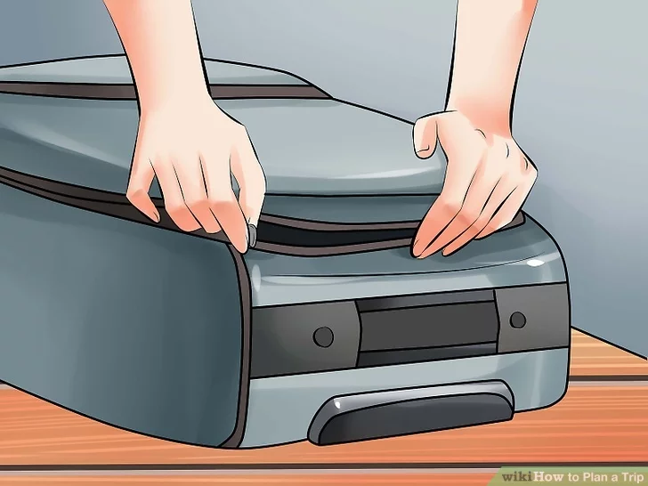
Wrapping Up the Details.
B. Pack light.
No one has ever said to themselves while on vacation, "I'm so glad I practically packed my entire closet." Leave space for shopping and buying souvenirs. Moreover, traveling with lots of luggage restricts your movement and causes discomfort – you'll be moving around a lot, and it'll only be cumbersome. Only pack the necessities. Stick to basic pieces and a couple pairs of shoes – it's really all you need in terms of clothes regardless of how long your trip is. A few basic shirts and a few basic pants, shorts, or a skirt will do the job. You can then mix and match as necessary.
Roll your clothes when packing. This will save you a ton of room and mean you can buy that authentic-looking tiki torch when the mood strikes.

Slide 14
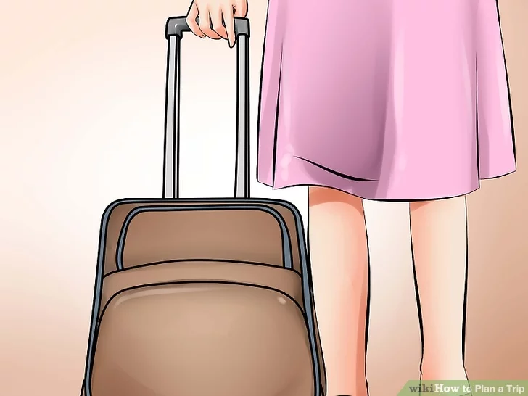
Wrapping Up the Details.
C. Go!
Itinerary? Check. Passport and documents? Check. Reservations for practically everything? Check. Now all that's left to do is get going and enjoy yourself. This is the easy part. Now it's time to relax. Don't be tempted to take work or home problems with you – then all this planning will be for naught, making it feel like you're still mentally back home. Leave that laptop and your phone off – now is all about exploring and going on an adventure.

