Slide 1
Indefinite (SIMPLE) (Present, Past, future)
ACTIVE

Slide 2
PRESENT SIMPLE
Случаи употребления:
1) Регулярные повторяющиеся действия в настоящем. (рутина)

Slide 3

For example (например):
Do you run in the morning?
I often meet them in the park.
She runs twice a week outside.

Slide 4
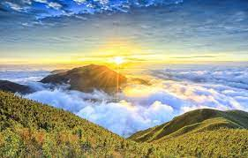
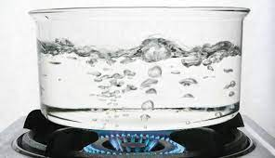
2) Для обозначения научных фактов/ общественных истин:
Water boils at 100 degrees
the sun rises in the east

Slide 5
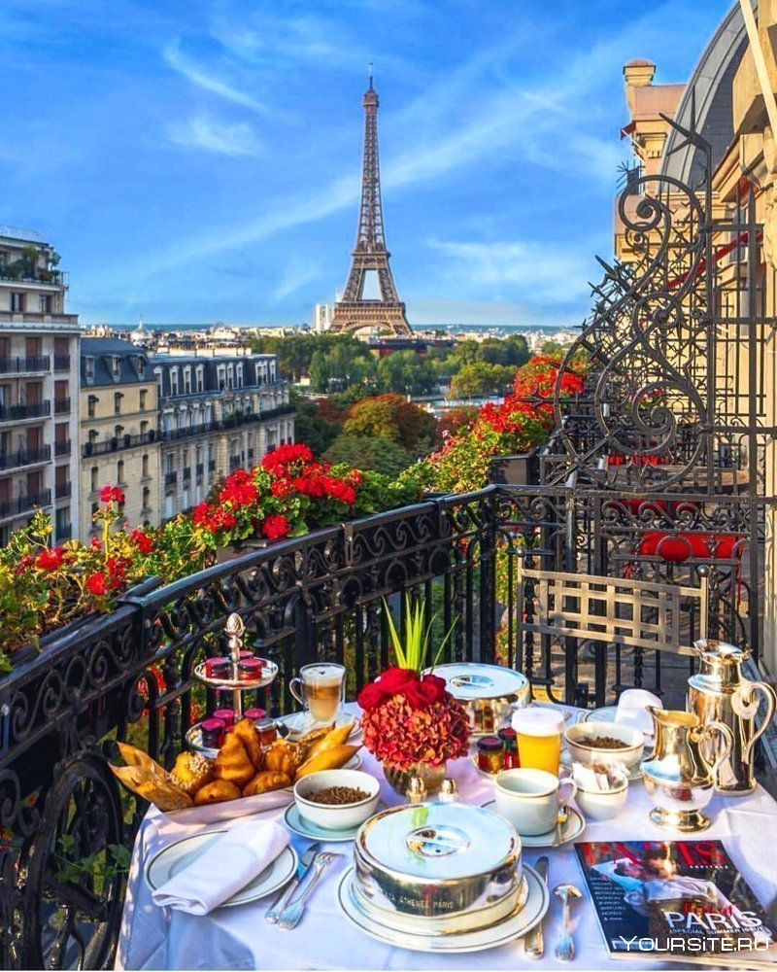
3)Для обозначения постоянных ситуаций.
My parents live in Novoross.
She lives in Paris.
We do not live in France.
Where do you live?

Slide 6
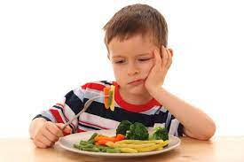
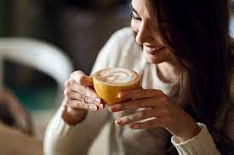
He does not like vegetables.
She likes coffee

Slide 7
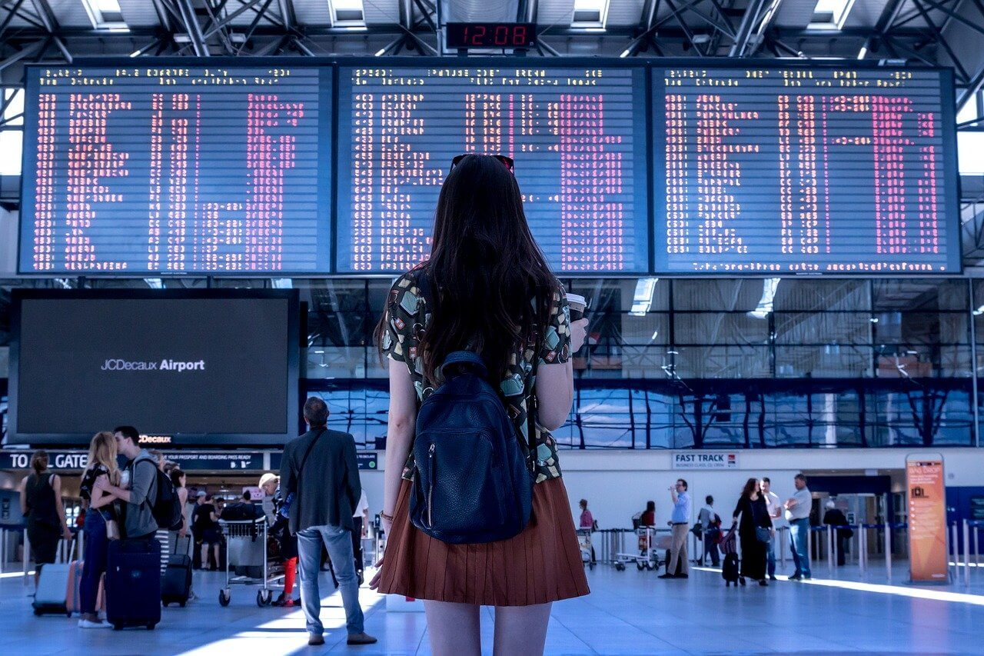
4) Для выражения будущих действий, которые будут происходить по расписанию
The plane arrives at 7 p.m. tomorrow.
The train leaves at 2 a.m.
The show starts at 9 p.m. in the evening
What time does the exhibition close?

Slide 8
Структура
PRESENT SIMPLE
+ утверждение V1/Vs(es)
- отрицание Do/Does + not + V1
? Вопрос (general, special)

Slide 9
Утвердительные предложения
Подлежащее + V1
Для 3 лица ед. ч (he, she, it) к смысловому глаголу добавляем окончание –S либо –es
Окончание –es добавляем после:
–SS, -X, -Z, -CH, -SH, -S, -O

Slide 10
For example (например):
I go to the college
You go to the college
We go to the college
They go to the college
She goes to the college
He goes to the college
It goes to …
I swim in the pool
You swim in the pool
We swim in the pool
They swim in the pool
She swims in the pool
He swims in the pool
It swims in the pool

Slide 11
Отрицательные Предложения
Подлежащее + do/does + not + V1
Do используем для I, you, we, they
Does используем для he, she, it
Not – отрицательная частица
V1- смысловой глагол в 1й форме!
* do + not = don’t / does + not = doesn’t

Slide 12
For example (например):
I don’t go to the college
You don’t go to the college
We don’t go to the college
They don’t go to the college
She doesn’t go to the college
He doesn’t go to the college
It doesn’t go to …
I don’t swim in the pool
You don’t swim in the pool
We don’t swim in the pool
They don’t swim in the pool
She doesn’t swim in the pool
He doesn’t swim in the pool
It doesn’t swim in the pool

Slide 13
ВОПРОСИТЕЛЬНЫЕ ПРЕДЛОЖЕНИЯ
General questions - общие вопросы:
Do/Does выносим на 1е место в предложении
Do/Does + подлежащее + V1
Special questions – специальные вопросы, требующие полного ответа и имеют в структуре уточняющие вопросы такие как (What/что? Who/Кто? Where/Где, Куда? When/Когда? Why/ Зачем, Почему? How/ Как?) в таких вопросах уточняющее слово мы ставим ПЕРЕД Do/Does
Спец вопрос + Do/Does + подлежащее + V1
Do you go to the college? – I do / Does he go to the college? – he doesn’t
Why do you go to the college? What do you study at college?

Slide 14
СЛОВА МАРКЕРЫ Present simple
Always – Всегда
Never – Никогда
Usually – Обычно
Generally – в целом
As a rule – как правило
Constantly – постоянно
Often – часто
Seldom – редко
Rarely – изредка
Sometimes – иногда
Every day – каждый день,
…times a week, a day, a year…

Slide 15
PRACTICE
1. He (go) to the gym twice a week.
2. She (not buy) fast food at the street.
3. We (not live) in the New York City.
4. I (visit) my grandmother every month.
5. He (help) to their grandparents.
6. you (like) video games?
7. she (help) to you with your homework?

Slide 16
ANSWERS
1. He goes to the gym twice a week.
2. She doesn't buy fast food at the street.
3. We don’t live in the New York City.
4. I visit my grandmother every month.
5. He helps to their grandparents.
6. Do you like video games?
7. Does she help to you with your homework?

Slide 17
PAST SIMPLE случаи употребления
Употребляется для обозначения действий,

Slide 18
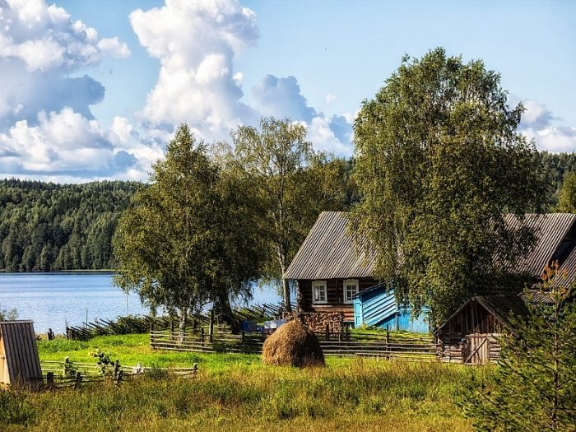
1) происходящих в прошлом регулярно:
When I was a child, we went to the village every summer.

Slide 19

2)действий, которые происходили в прошлом одно за другим (перечисление событий из прошлого)
I came home at 7, cooked dinner, watched TV and phoned Alex.

Slide 20
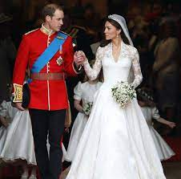
3) Однократного действия, которое произошло в неопределенном прошлом (без указания времени)
They got married 10 years ago.

Slide 21

4) Постоянных ситуаций из прошлого
When I was a student, I had long pink hair.

Slide 22
Структура
PAST SIMPLE
+ утверждение V2/V+ed
- отрицание Did + not + V1
? Вопрос (general, special)

Slide 23
Утвердительные предложения
Подлежащее + V2 или V+ed
Если смысловой глагол неправильный мы используем его вторую форму!
Если смысловой глагол правильный мы добавляем к нему окончание – ed

Slide 24
For example (например):
I went to the college
You went to the college
We went to the college
They went to the college
She went to the college
He went to the college
It went to …
I visited my grandmother
You visited your grandmother
We visited our grandmother
They visited their grandmother
She visited her grandmother
He visited his grandmother
It visited …

Slide 25
Отрицательные Предложения
Подлежащее + did + not + V1
Did используем для I, you, we, they, he, she, it
Not – отрицательная частица
V1- смысловой глагол в 1й форме!
* did + not = didn’t

Slide 26
For example (например):
I didn't go to the college
You didn't go to the college
We didn't go to the college
They didn't go to the college
She didn't go to the college
He didn't go to the college
It didn't go to …
I didn't visit my grandmother
You didn't visit my grandmother
We didn't visit my grandmother
They didn't visit my grandmother
She didn't visit my grandmother
He didn't visit my grandmother
It didn't visit …

Slide 27
ВОПРОСИТЕЛЬНЫЕ ПРЕДЛОЖЕНИЯ
General questions - общие вопросы:
Did выносим на 1е место в предложении
Did + подлежащее + V1
Special questions – специальные вопросы, требующие полного ответа и имеют в структуре уточняющие вопросы такие как (What/что? Who/Кто? Where/Где, Куда? When/Когда? Why/ Зачем, Почему? How/ Как?) в таких вопросах уточняющее слово мы ставим ПЕРЕД Did
Спец вопрос + Did + подлежащее + V1
Did you go to the college? – I did / Did he go to the college? – he didn’t
Why did you go to the college? What did you study at college?

Slide 28
СЛОВА МАРКЕРЫ PAST simple
yesterday
Last
ago
In 1985

Slide 29
PRACTICE
1. He (go) to the gym yesterday.
2. She (not buy) fast food at the street.
3. We (not live) in the New York City.
4. I (visit) my grandmother 3 days ago.
5. He (see) him last Monday.
6. you (watch) this movie?
7. she (help) to you with your homework?

Slide 30
ANSWERS
1. He went to the gym yesterday.
2. She didn’t buy fast food at the street.
3. We didn’t live in the New York City.
4. I visited my grandmother 3 days ago.
5. He saw him last Monday.
6. Did you watch this movie?
7. Did she help to you with your homework?

Slide 31
FUTURE SIMPLE случаи употребления
Употребляется для обозначения:

Slide 32
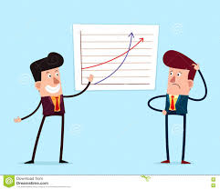
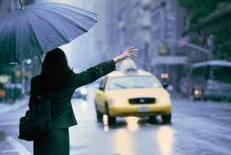
1)Спонтанных незапланированных действий:
- I don’t know how it works.
- Ok, I’ll show you.
I am tired.
I’ll take a taxi.

Slide 33

2) предсказаний
I think that you will pass the exam!

Slide 34


3) обещаний
I'll give up to smoke!
She won’t tell anybody!

Slide 35

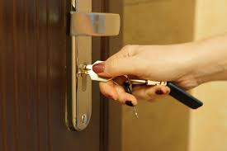
4) ПРОСЬБЫ
Will you open the window, please?
Will you close the door, please?

Slide 36
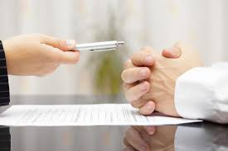

5) ОТКАЗА
He won't sign this agreement.
She won't drink this coffee.

Slide 37
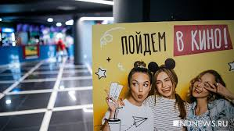
6) ПРЕДЛОЖЕНИЯ
Will you come with us to the cinema?

Slide 38
Структура
FUTURE SIMPLE
+ утверждение Will/Shall + V1
- отрицание Will/Shall + not + V1
? Вопрос (general, special)

Slide 39
Утвердительные предложения
Подлежащее + Will/Shall + V1
Shall для I, we
Will для you, we, they, he, she, it
Смысловой глагол в 1й форме!
Сокращение ‘ll (I’ll, you’ll, we’ll, she’ll…)

Slide 40
For example (например):
I shall go to the college
You will go to the college
We shall go to the college
They will go to the college
She will go to the college
He will go to the college
It will go to …
I shall play in the room
You will play in the room
We shall play in the room
They will play in the room
She will play in the room
He will play in the room
It will play in the room

Slide 41
Отрицательные Предложения
Подлежащее + will/shall + not + V1
Not – отрицательная частица
V1- смысловой глагол в 1й форме!
* will + not = won’t
shall + not = shan’t (редко)

Slide 42
For example (например):
I shall not go to the college
You will not go to the college
We shall not go to the college
They will not go to the college
She will not go to the college
He will not go to the college
It will not go to …
I shall not play in the room
You will not play in the room
We shall not play in the room
They will not play in the room
She will not play in the room
He will not play in the room
It will not play in the room

Slide 43
ВОПРОСИТЕЛЬНЫЕ ПРЕДЛОЖЕНИЯ
General questions - общие вопросы:
Will/shall выносим на 1е место в предложении
Will/Shall + подлежащее + V1
Special questions – специальные вопросы, требующие полного ответа и имеют в структуре уточняющие вопросы такие как (What/что? Who/Кто? Where/Где, Куда? When/Когда? Why/ Зачем, Почему? How/ Как?) в таких вопросах уточняющее слово мы ставим ПЕРЕД Will/shall
Спец вопрос + Will/shall + подлежащее + V1
Will he go to the college? – he will / Will she go to the college? – she won’t
Why will you go to the college? What will you study at college?

Slide 44
СЛОВА МАРКЕРЫ FUTURE simple
soon (скоро)
later (позже)
as soon as (как только)
tomorrow (завтра)
tonight (вечером)
next week (на следующей неделе)
next year (на будущий год)
in a month (через месяц)
in three days (через три дня)
in 2026 (в 2026 году)

Slide 45
PRACTICE
1. He (go) to the gym in a day.
2. She (not buy) this thing.
3. We (not live) in the New York City.
4. I (visit) my grandmother as soon as possible.
5. He (see) him tomorrow.
6. you (watch) this movie?
7. she (help) to you with your homework?

Slide 46
ANSWERS
1. He’ll go to the gym in a day.
2. She won’t buy this thing.
3. We won’t live in the New York City.
4. I’ll visit my grandmother as soon as possible.
5. He’ll see him tomorrow.
6. Will you watch this movie?
7. Will she help to you with your homework?

Slide 47
THANKS FOR YOUR ATTENTION

