Slide 1

PRESENT
SIMPLE
and
PRESENT CONTINUOUS

Slide 2
PHONETIC EXERCISES
[s] walks, eats, makes, keeps
[z] goes, finds, reads, smells
[iz] watches, misses, washes, mixes
[ŋ] sleeping, talking, playing, writing

Slide 3
PHONETIC EXERCISES
Task: read after me and find the forms of Present Simple and Present Continuous.
RAIN by R. STEVENSON
The rain is raining all around,
It falls on field and tree
It rains on the umbrella here
And on the ships at sea.

Slide 4
LET’S CHECK

Slide 5
The forms of Present Simple and Present Continuous
RAIN by R. STEVENSON
The rain is raining all around,
It falls on field and tree
It rains on the umbrella here
And on the ships at sea.

Slide 6
LET’S TALK ABOUT THE RULES
PRESENT SIMPLE
PRESENT CONTINUOUS
We use Present Continuous to describe the actions which takes place right now.
For example:
I am listening to the teacher now.
We use Present Simple to describe the action which takes place regularly, every day.
For example:
I go to school every day.

Slide 7
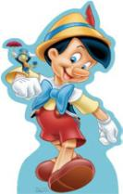
Pinocchio prepared a table for us.
Is it right? Try to correct mistakes.
PRESENT SIMPLE | PRESENT CONTINUOUS
to be + V ing | every day
now | at the moment
often | do - does
listening | writes
seldom | always
He She Vs it | usually

Slide 8
LET’S CHECK

Slide 9
Present Simple | Present Continuous
often | to be + V ing
seldom | at the moment
do - does | listening
He She Vs it | now
writes
usually, always

Slide 10
MAKE UP INTERROGATIVE AND NEGATIVE SENTENCES:
He goes to school every day.
Does he go to school every day?
He doesn’t go to school every day.
2. She is listening to music now.
Is she listening to music now?
She is not listening to music now.
3. Ted likes swimming very much.
Does Ted like swimming very much?
Ted doesn’t like swimming very much.
4. We play football very well.
Do we play football very well?
We don’t play football very well.

Slide 11
IT IS HIGH TIME
TO HAVE A REST!!!

Slide 12
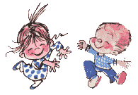
With my foot I tap, tap, tap,
With my hands I clap, clap, clap,
Right foot first, left foot then,
Round and round and back again.
http://www.animationlibrary.com
http://www.ilovewavs.com

Slide 13
FIND THE MISTAKES:
1. He go to school every day.
He goes at school every day.
2. She are listening to the radio now.
She is listening to the radio now.
3. Do he like swimming?
Does he like swimming?
4. I is a student.
I am a student.

Slide 14
5. She live in Moscow.
She lives in Moscow.
6. Kate is swim in the swimming pool.
Kate is swimming in the swimming pool.
7. It are snowing.
It is snowing.
8. Does you like to read books?
Do you like reading books?

Slide 15
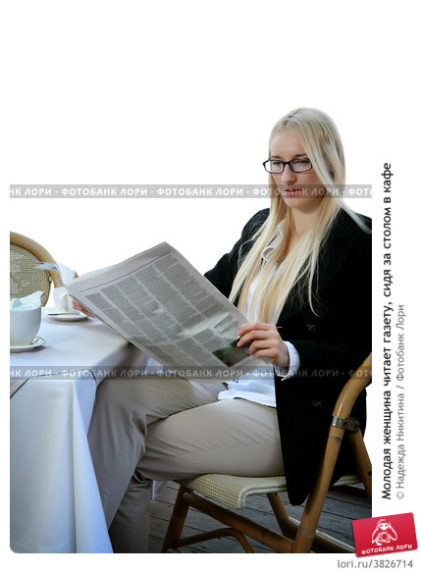
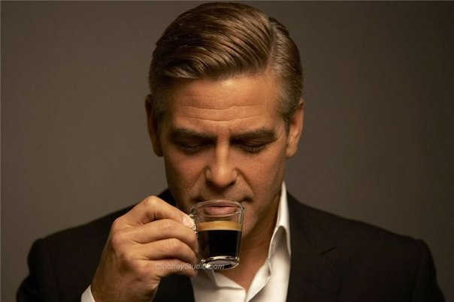
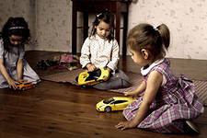
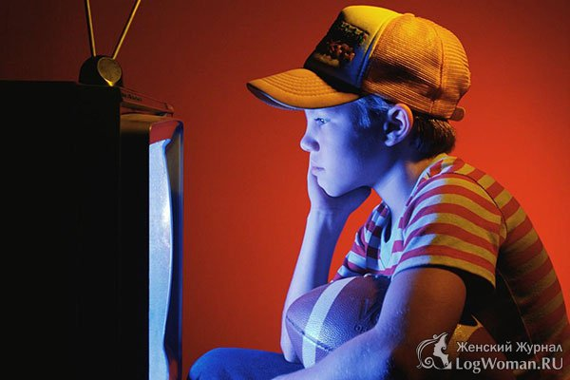
Listen to the text and write down the forms of Present Continuous and Present Simple:

Slide 16
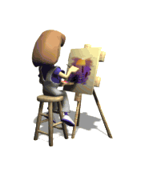
DESCRIBE THE PICTURES IN ONE SENTENCE

Slide 17
SHE IS DRAWING NOW

Slide 18
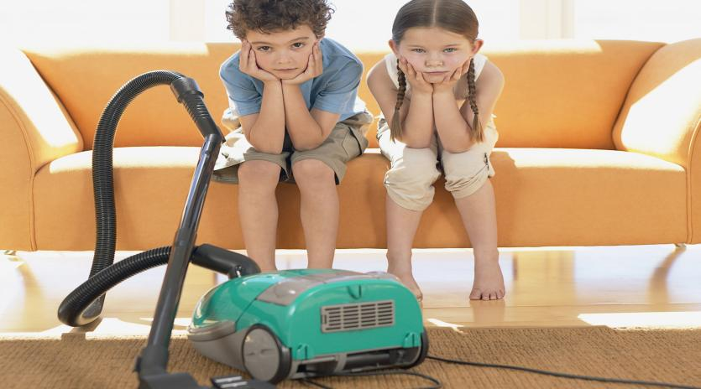
EVERY SUNDAY

Slide 19
THEY CLEAN THE ROOM EVERY
SUNDAY

Slide 20
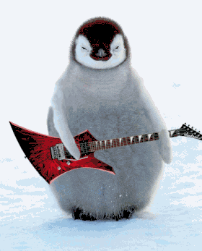
NOW

Slide 21
THE PENGUIN IS PLAYING THE GUITAR

Slide 22

NOW

Slide 23
SHE IS SLEEPIG NOW

Slide 24
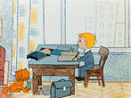
USUALLY

Slide 25
HE USUALLY DOES HIS HOMEWORK

Slide 26
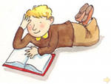
OFTEN

Slide 27
HE OFTEN READS BOOKS

Slide 28
CHOOSE between Present Continuous and Present Simple
1) I …. (to listen) to the radio now.
2) I … (to go) to school every day.
3) I usually … (to do) my homework in the evening.
4) I often … (to get up) at 7 o’clock.
5) He …. (to write ) a letter now.
6) Ann … (to drive) a car at the moment.
7) Denis always … (to work) very hard at school.
8) I … (to have) my music lessons on Sundays.
9) He … (to be) a student.
10) He … (to have) many books at home.

Slide 29
CHECK!!!
Am listening
Go
Do
Get up
Is writing
Is driving
Works
Have
Is
has

Slide 30
IT’S TIME TO WORK
WITH CROSSWORD

Slide 31
Present Simple & Present Continuous
CROSSWORD
Crossword
Across:
 | 1. The baby often … (to sleep). 2. She …. (to write) a letter now. 3. Tom and Kate …(to eat) their breakfast at the moment. 4. Steve … (to go) to school every day. 5. They … (to leave) home at six o’clock in the morning. 6. Look! The house …. (to burn). 7. Bob and Mike … (not /to teach) at the moment.
¹
 |  |  | ²
 |  |  |  | ³
 | ⁴
⁵
 | ⁶
 |  |  |  | ⁷

Slide 32
LET’S CHECK!!!

Slide 33
Sleeps
Writing
Eating
Goes
Leave
Burning
teaching

Slide 34
HOMEWORK
Make up a project p.39

Slide 35
Goodbye

