Slide 1
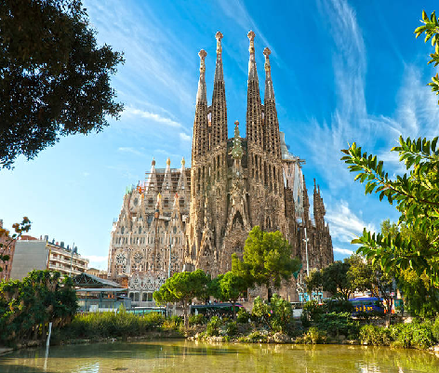
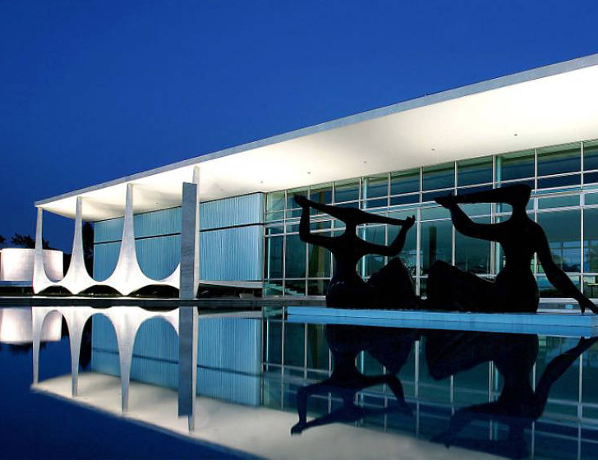
« Famous Architects and Designers»

Slide 2
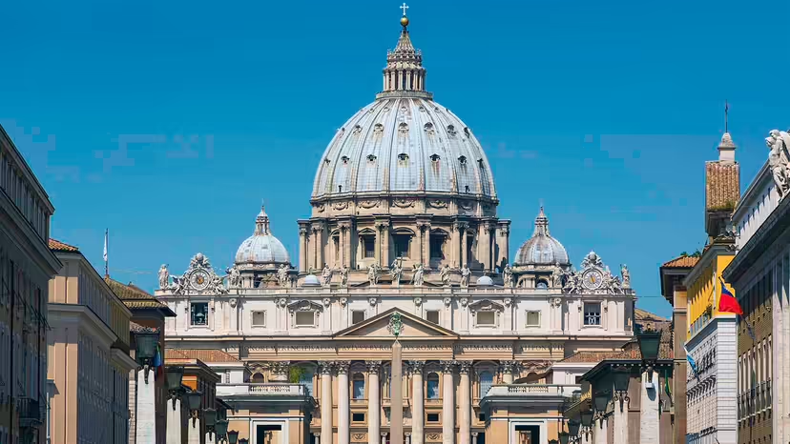
Michelangelo
Although known today more for his painting and sculpture, Michelangelo was also a master architect. In fact, he was among the first to depart from the classical style and defy traditional expectations.
Michelangelo's most famous contribution to architecture is probably the dome of St. Peter's Basilica of Vatican City. It stands as one of the most recognizable landmarks in the world.

Slide 3
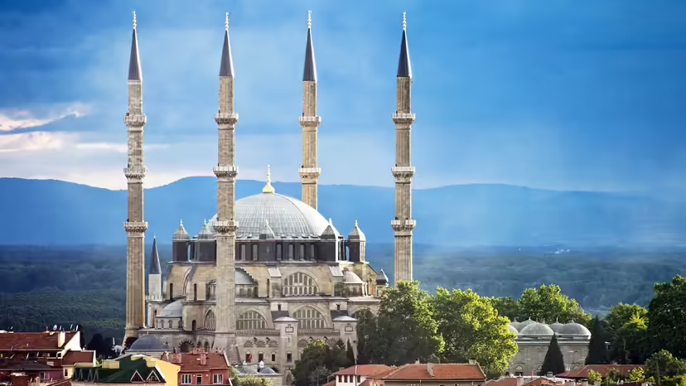
Mimar Sinan
Michelangelo's contemporary in the Ottoman Empire was Mimar Sinan. Working in the 16th century, Sinan designed more than 300 structures, including mostly mosques but also palaces, schools and other buildings. Unquestionably the most influential Turkish architect in history, Sinan perfected the design of the domed mosque, which was an important symbol of both political power and the Islamic faith in the Ottoman Empire.
His masterpieces include the Edirne Selimiye Mosque in Edirne, Turkey, as well as the Süleymaniye Mosque in Istanbul, Turkey.

Slide 4
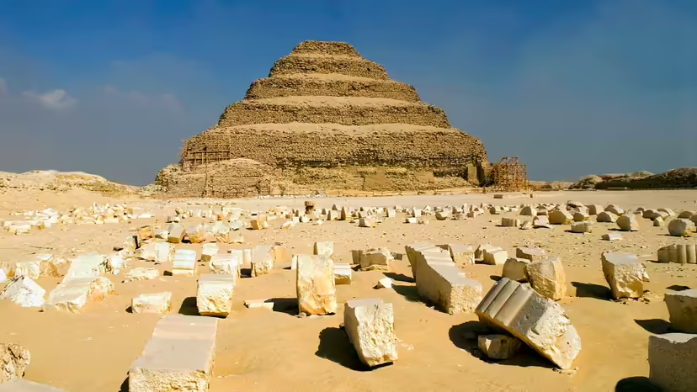
Imhotep
Imhotep lived sometime between 2667 B.C.E. and 2648 B.C.E. Although he was born a commoner, Imhotep rose to become chief architect to Pharaoh Djoser of the Third Dynasty of Egypt and is known as the first architect, among other distinctions. Imhotep is credited with designing the pharaoh's tomb, the Step Pyramid at Saqqara. The world's first pyramid, according to Discovering Egypt, it consisted of multiple mastabas (flat-roofed structures with sloping sides that had been the traditional pharaoh burial structures) one stacked atop the next becoming smaller each time. The result is a 204-foot-tall (62 meters) step structure surrounded by a massive complex that overlooked Memphis, the ancient capital. The tomb lies below the pyramid.

Slide 5
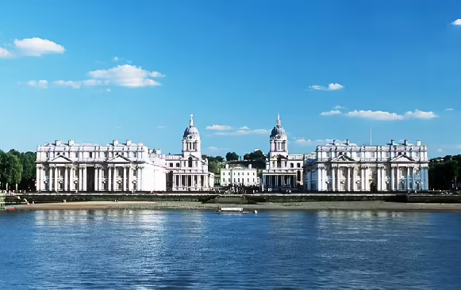
Sir Christopher Wren
Under normal circumstances, Sir Christopher Wren would probably be known as a great architect, but he might not have gone down in history as among the most famous architects that ever lived. As it happened, however, Wren was in the right place at the right time, and he possessed the right talent. In the 1660s, he was commissioned to design the Sheldonian Theatre at Oxford and visited Paris to study French and Italian baroque styles. In 1666, Wren had completed a design for the dome of St. Paul's Cathedral in London. One week after it was accepted, however, the Great Fire of London raged through the city, destroying most of it — including the cathedral. Other famous buildings designed by Wren included the Greenwich Hospital, which later became the Royal Naval College, and the façade of Hampton Court Palace, both in London.

Slide 6
Sir Christopher Wren
Under normal circumstances, Sir Christopher Wren would probably be known as a great architect, but he might not have gone down in history as among the most famous architects that ever lived. As it happened, however, Wren was in the right place at the right time, and he possessed the right talent. In the 1660s, he was commissioned to design the Sheldonian Theatre at Oxford and visited Paris to study French and Italian baroque styles. In 1666, Wren had completed a design for the dome of St. Paul's Cathedral in London. One week after it was accepted, however, the Great Fire of London raged through the city, destroying most of it — including the cathedral. Other famous buildings designed by Wren included the Greenwich Hospital, which later became the Royal Naval College, and the façade of Hampton Court Palace, both in London.

Slide 7
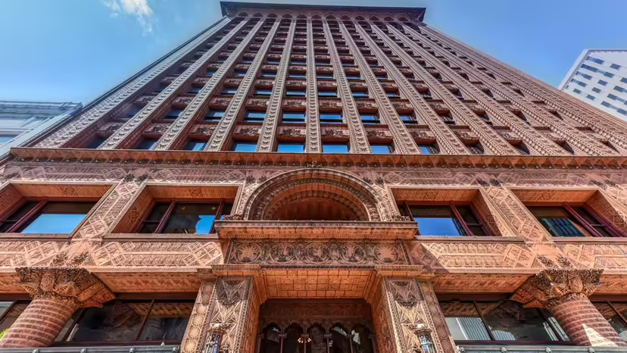
Louis Henry Sullivan
Known for the principle of "form follows function," Louis Henry Sullivan was anxious to break free from tradition and became influential in forging a distinctly American architecture. Similar to Sir Christopher Wren, Sullivan benefited from a great fire. The Great Fire of 1871 in Chicago resulted in a construction boom and afforded architects like Sullivan with work for the decades to come. As a young man, he worked briefly in the offices of famed architects Frank Furness and then William Le Baron Jenney. He was only 24 years old when he became a partner in Dankmar Adler's firm in 1881. Although most of his work was done in Chicago, his most famous work is the 10-story Wainwright Building in St. Louis, built in 1890, and the 16-story Guaranty Building in Buffalo, built in 1894.

Slide 8
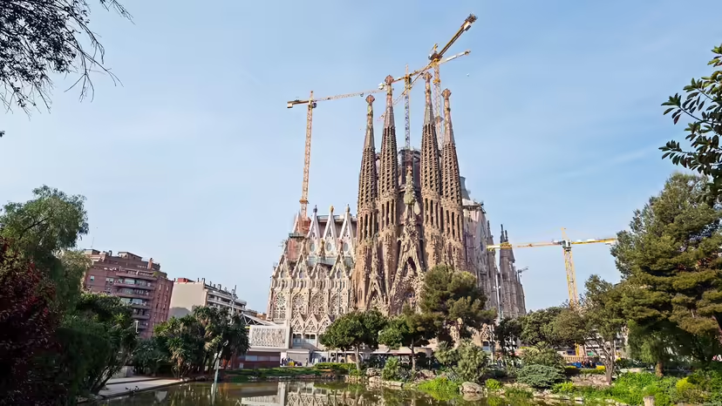
Antoni Gaudi
Fueled by a faith in God and a love of nature, the Spanish architect Antoni Gaudi developed a style all his own. Born in 1852 in the Catalonia region of Spain, Gaudi was a fervent Catholic who believed that he could glorify God by deriving his inspiration from nature, God's creation.
The Cathedral of the Sagrada Familia in Barcelona stands as his most famous work. However, the cathedral was unfinished at his death in 1926 and, although work continued, the cathedral remains unfinished to this day.

Slide 9
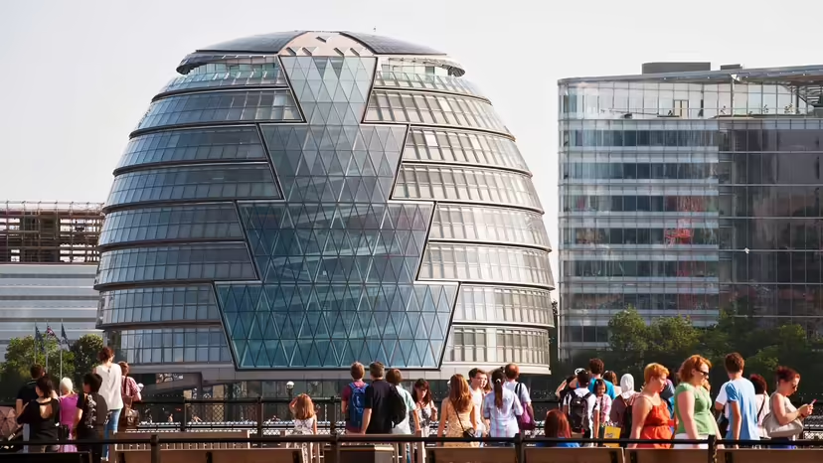
Norman Foster
When he became the 1999 Laureate of the Pritzker Architecture Prize, Sir Norman Foster had not yet even completed some of his most iconic buildings. He was born in Manchester, England, in 1935 and studied at the University of Manchester and Yale University, where he earned a master's degree in architecture. Before launching his firm Foster + Partners in 1967, he worked with Richard and Su Rogers, as well as his wife Wendy Foster, at the firm they founded together, Team 4. But visitors to London may be most familiar with his local projects like the Great Court of the British Museum, the Millennium Bridge, London City Hall and The Gherkin.

Slide 10
Answer these questions:
Do you know any Famous Architects?
What examples of famous architecture can you give?
What is better modern architecture or last architecture?

