Slide 1
SHOPS
AND SHOPPING

Slide 2
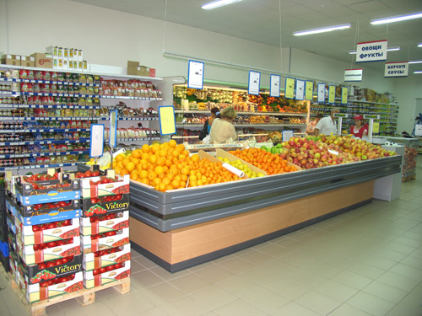
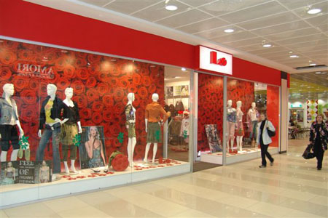
Shops
When we want to buy something, we go to a shop. There are many kinds of shops in every town or city.

Slide 3
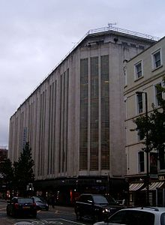
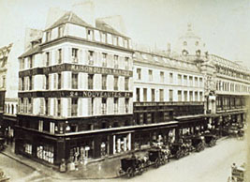
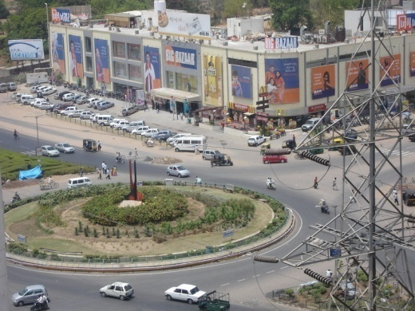
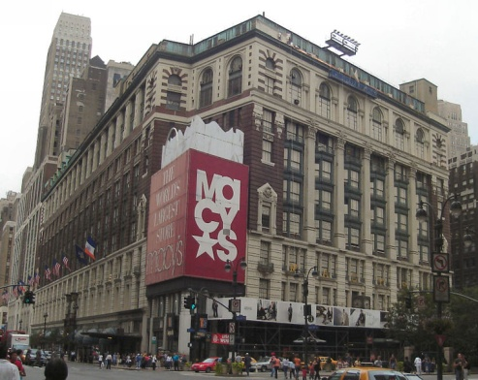
Department store
Le Bon Marché department store in Paris, 1867
Big Bazaar at Ahmedabad, India.
Kendals department store in Manchester, England.
The Macy's department store in New York City
Department store is a large shop with many departments for different kinds of goods.
A department store, for example, is composed of departments: clothes, shoes, sports goods, toys, china and glass, electric appliances, cosmetics, cameras, records, etc.
You can buy everything you like there.

Slide 4
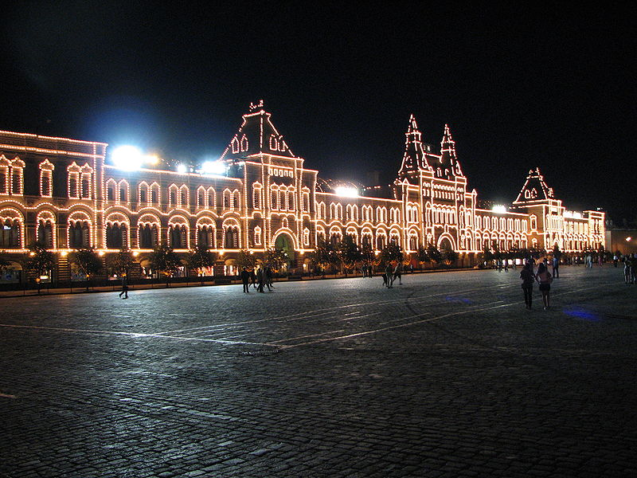
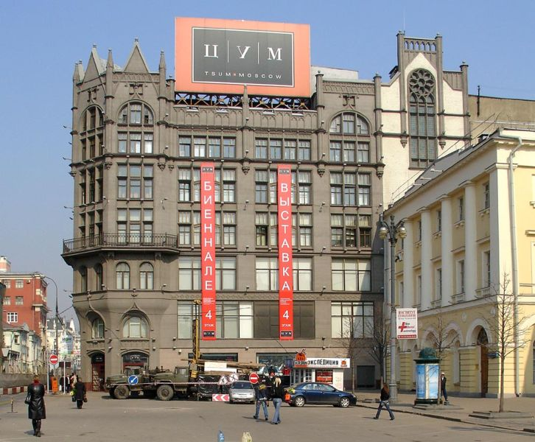
Department store
The most famous department store in Russia are GUM and TsUM in Moscow. Other popular stores are Mega (shopping malls), Stockmann, and Marks & Spencer and others.

Slide 5
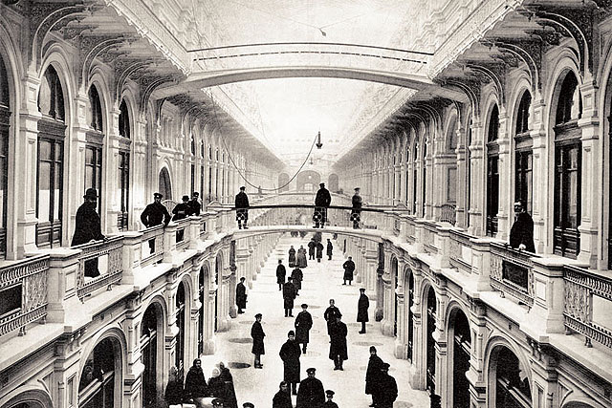
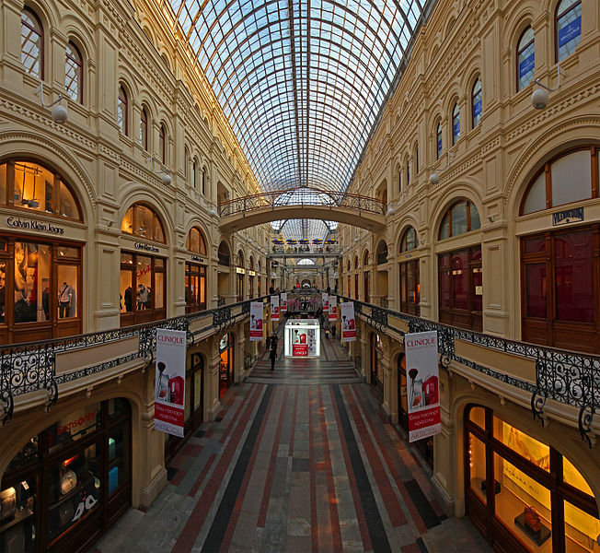
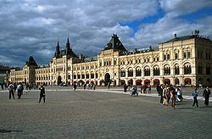
Department store - GUM
1893
GUM (meaning "main department store") is a large store in Kitai-gorod of Moscow, facing Red Square. It is actually a shopping mall. Prior to the 1920s the place was known as the Upper Trading Rows (Russian: Верхние торговые ряды).
The most famous department store in Russia is GUM in Moscow, followed by TsUM and the Petrovsky Passage. Other popular stores are Mega (shopping malls), Stockmann, and Marks & Spencer.

Slide 6
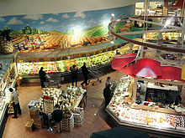
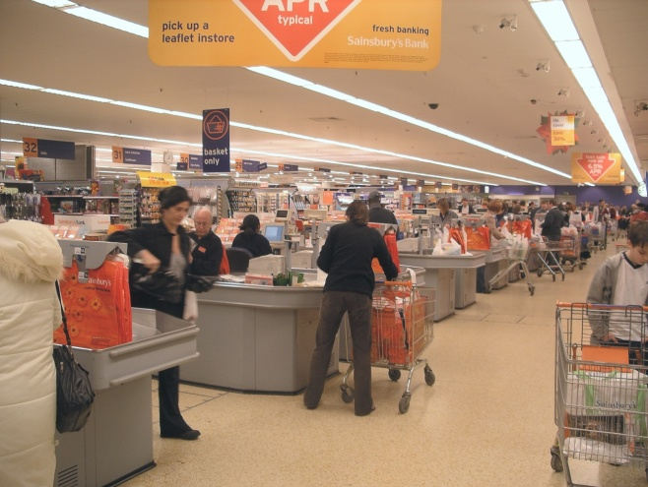
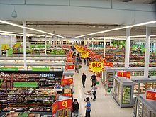
Supermarket – self-service shop
In a supermarket we can also buy many different things at once: sausages, fish, sugar, macaroni, flour, tea. In a supermarket the buyer goes with a basket and puts into a basket that he wants to buy.
The concept of a self-service grocery store was developed by American entrepreneur Clarence Saunders. His first store opened in Memphis, Tennessee, in 1916.

Slide 7
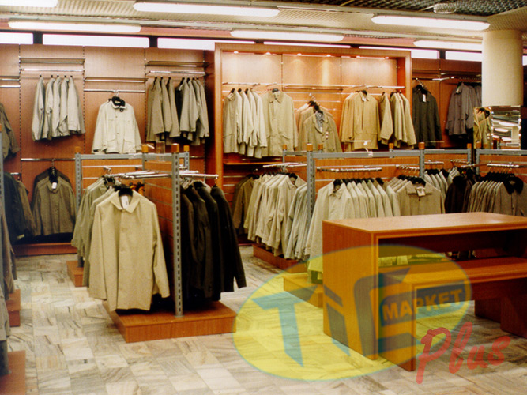
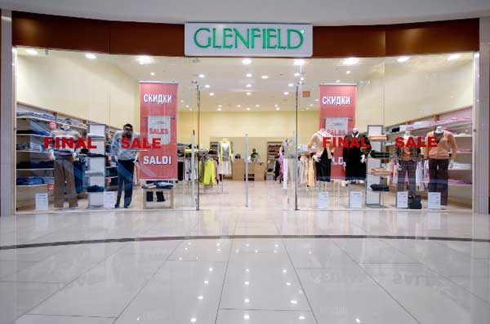
Men's and women's clothing stores
In the women's clothing department you can find dresses, costumes, blouses, skirts, coats, beautiful underwear and many other things.
In the men's clothing department you can choose shirts, trousers, overcoats, etc.
Also it is possible to buy sweaters, cardigans, woolen jackets.

Slide 8
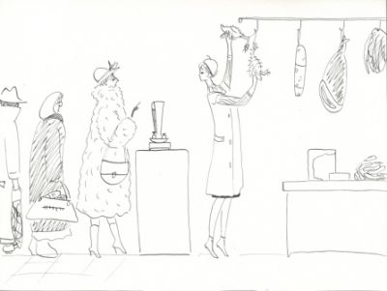
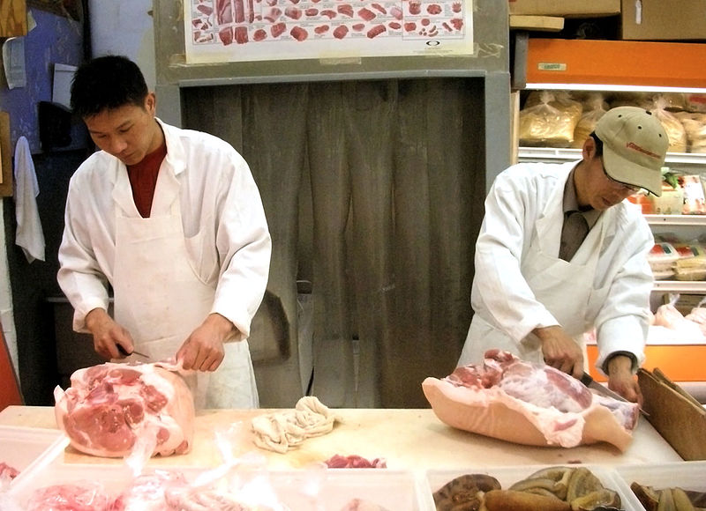
Butchers
At the butcher's there is a wide choice of meat and poultry.

Slide 9
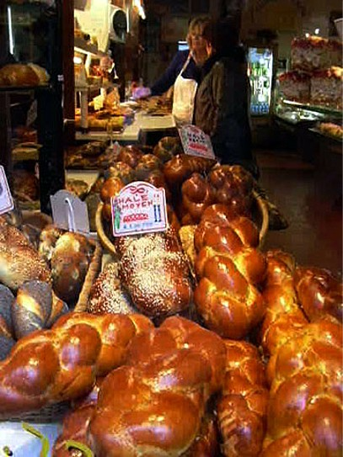
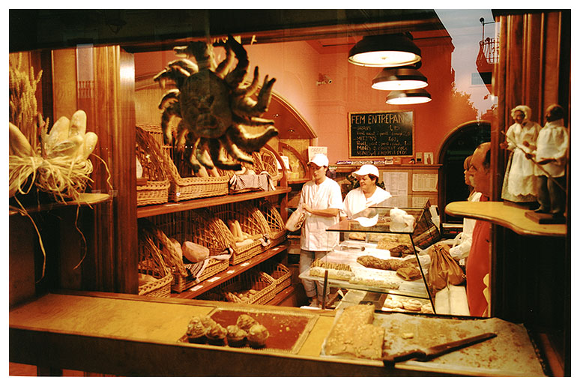
Baker
At the bakery you buy brown and white bread, rolls, biscuits.

Slide 10
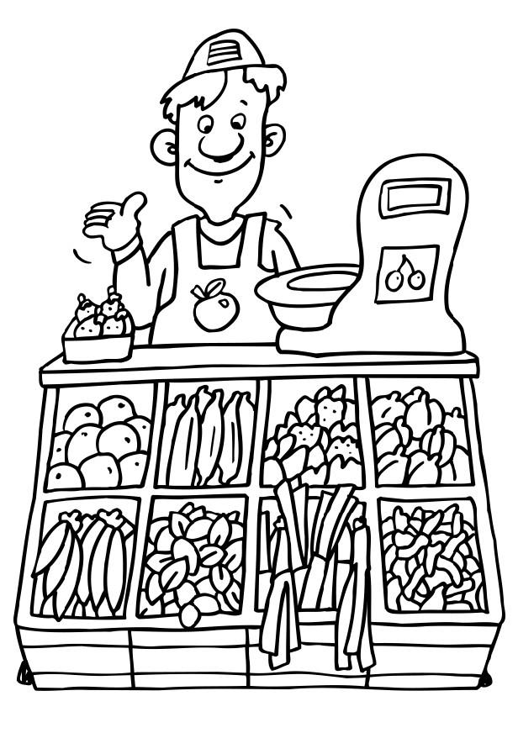
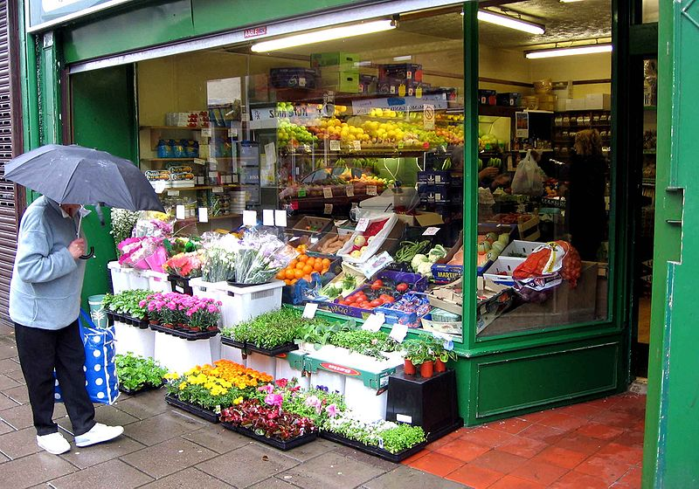
Greengrocer
Another shop we go to is the greengrocery which is stocked by cabbage, potatoes, cucumbers, carrots, green peas and apples, oranges.

Slide 11
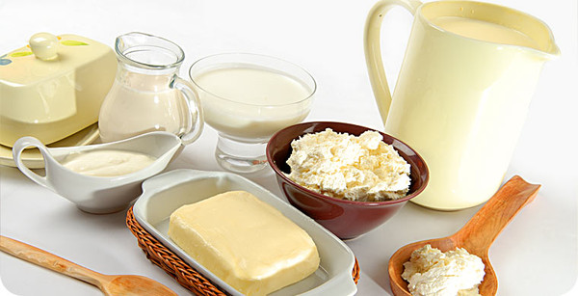
Dairy shop
If you call round at a dairy shop you can buy milk, cream, cheese, butter and many other products.

Slide 12
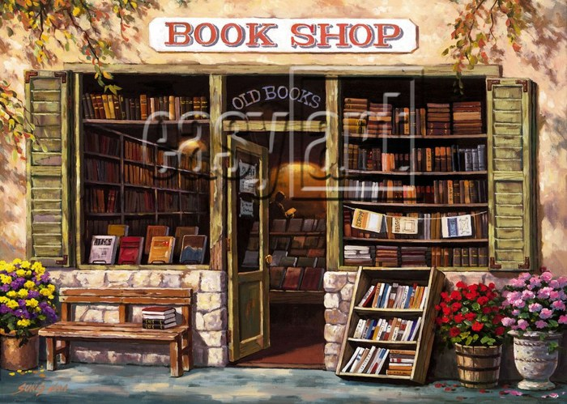
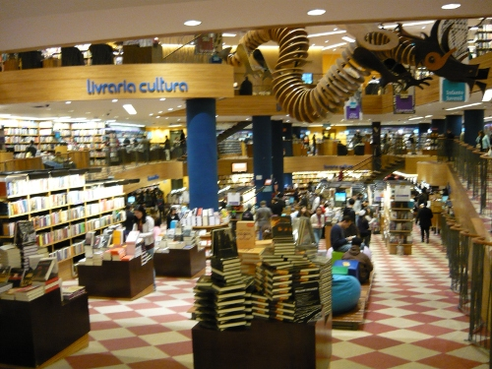
Bookshop (Bookstore)
If we need to buy the book we go to a bookshop

Slide 13
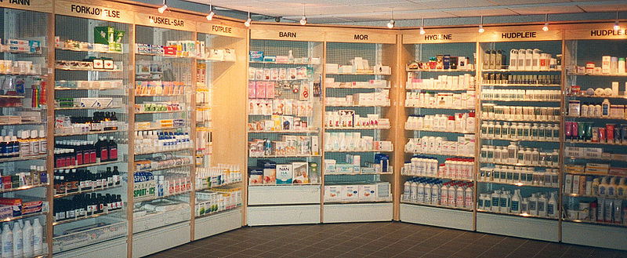
Pharmacy
Medicines are on sale in a pharmacy

Slide 14
Other types of shops
There are many other kinds of shops:
Grocer (UK) / Grocery store (USA) | Гастроном
Fishmonger | Рыбный магазин
Chemist (UK) / Drugstore (US) | Аптека
Pharmacy | Аптека
Newsagent | Газетный киоск
Stationer | Магазин канцелярских товаров
Optician | Оптика
DIY (Do It Yourself) store | Магазин «Сделай сам»
Hardware shop / Hardware store / Ironmonger | Магазин хозтоваров
Corner shop (UK) | «Магазинчик на углу»
Delicatessen (deli) | Кулинария
Market | Рынок
Petshop | Зоомагазин
Tea shop (UK) | Чайный магазин, чайная
Petrol station (UK) / Gas station (US) | Автозаправочная станция (АЗС)

Slide 15
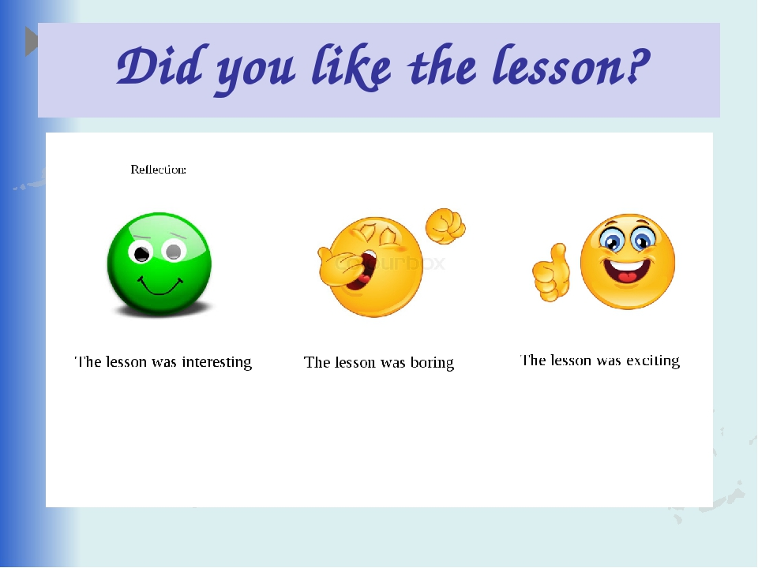

Slide 16


