Slide 1


The 28 th of February
tongue twister

Slide 2


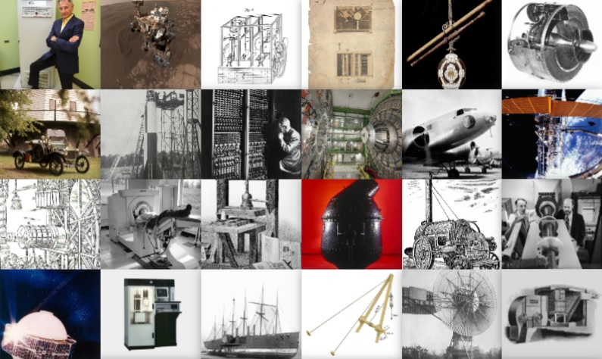
Did you guess what we are going to speak about?

Slide 3



Science and achievements

Slide 4

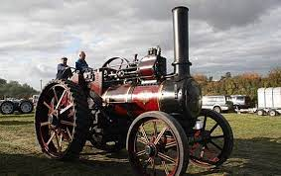
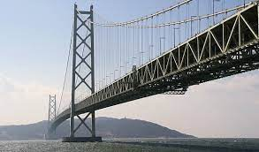
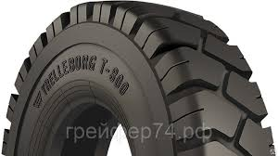
Let`s read and write new words.
1
2
3
The steam engine |ˈendʒɪn|
паровой двигатель
The suspension bridge |səˈspenʃ(ə)n| подвесной мост
The pneumatic tyre |njuːˈmætɪk| пневматическая шина

Slide 5
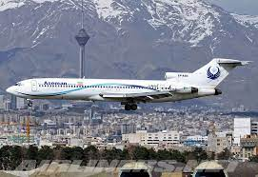
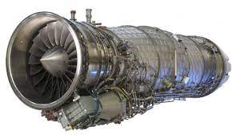
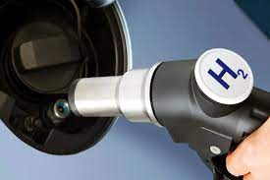
Let`s read and write new words.
4
5
6
The jet engine реактивный двигатель
The hydrogen fuel |ˈhaɪdrədʒ(ə)n| водородное топливо
The scheduled flight |ˈʃedjuːld| рейсовый полёт

Slide 6
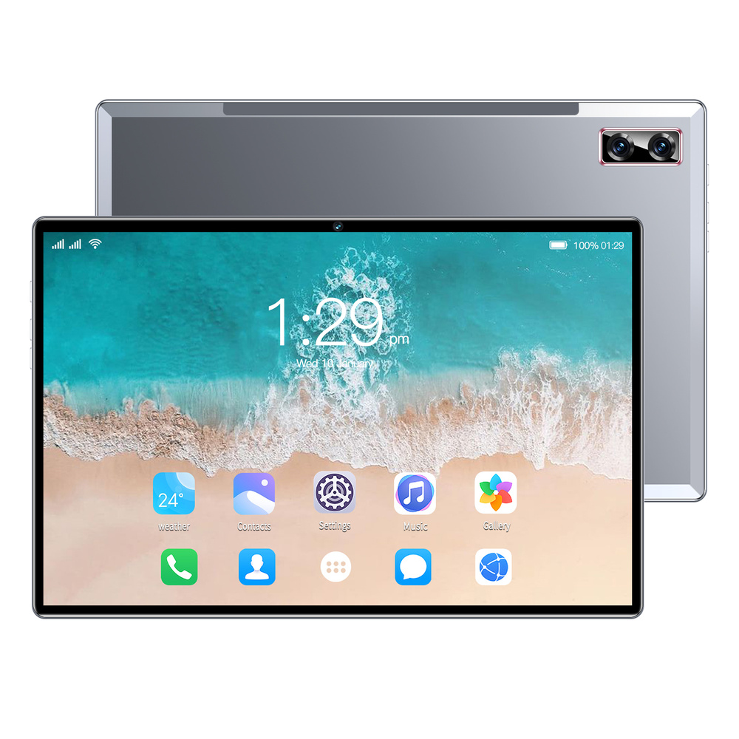
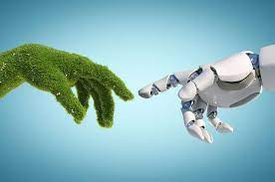

Let`s read and write new words.
7
8
9
artificial |ɑːtɪˈfɪʃ(ə)l| искусственный
liquid repellent coating |ˈlɪkwɪd| |rɪˈpel(ə)nt| водонепроницаемое покрытие
The tablet |ˈtæblɪt| планшет

Slide 7



Let`s read and write new words.
10
11
12
significant |sɪɡˈnɪfɪk(ə)nt|
знаменательный, важный
to develop развивать, совершенствовать
sustainable |səˈsteɪnəb(ə)l| устойчивый экологичный

Slide 8
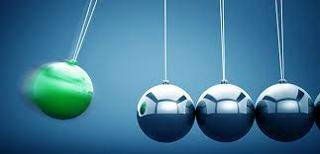
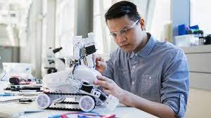
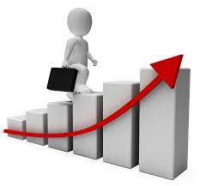
Let`s read and write new words.
13
14
15
to impact on влияние на
to invent изобретать, создавать
to improve улучшать, совершенствовать

Slide 9

the television set | the first scheduled international flight service | iPod design | the camera
the car | the first automatic landing with passengers | the World Wide Web | the motor racing circuit
the supersonic passenger plane | Formula One | nuclear power | the computer

Slide 10


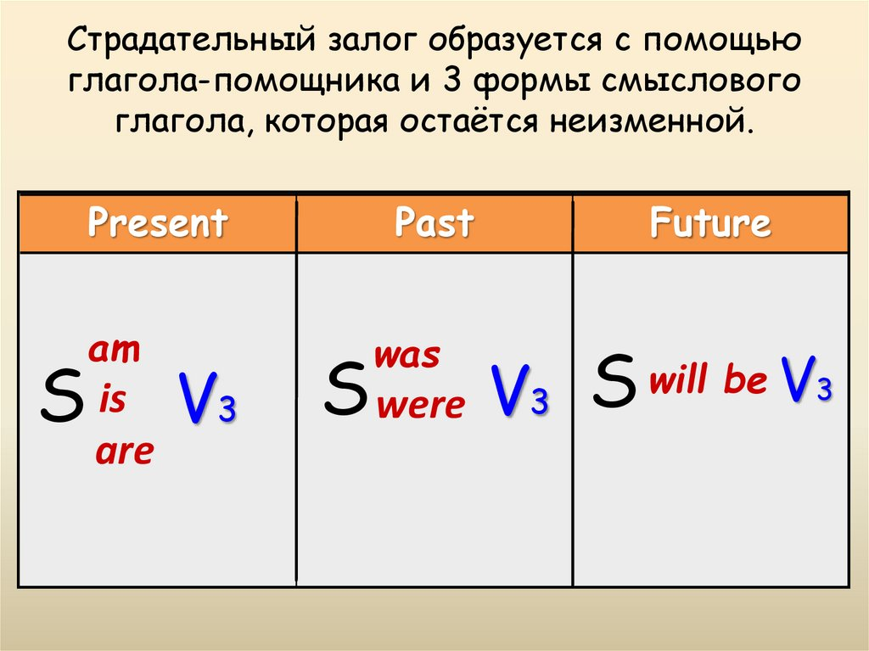
"

Slide 11
British innovation in transport. Throughout the years, British inventors have made a significant contribution to transport, and this continues to this day. From tractors to trains, the steam engine was a popular way of powering all kinds of machinery during the industrial revolution. In 1765, the steam engine was developed (by the Scotsman James Watt and his contemporaries) to greatly improve its efficiency. This had a huge impact on industry in Britain and throughout the world, and later, in 1928, Britain pioneered another type of engine. The jet engine was invented by Frank Whittle –the man who some people say ‘shrank the world’ by enabling people to travel by aircraft. Before cars, cycling was a preferred method of getting around. The Penny Farthing bicycle was invented in 1871 by James Starley, and was very popular in Victorian times. It was named after the ‘penny’ (a large coin) and the ‘farthing’ (a smaller coin) because the front wheel was much bigger than the back wheel, and therefore the bicycle represented the two coins in appearance. Riding a bike became a more comfortable experience when the pneumatic tyre was invented in 1885. Since then, pneumatic tyres have become ubiquitous and are now used on all
modern bikes –including motorbikes. Unlike environmentally friendly bicycles, however,
motorbikes produce pollutants which some people believe are responsible for global warming. In 2005, the hydrogen fuel cell motorbike was designed to address this problem. Although the current price for this kind of motorbike is very high, they will become more affordable as demand for them increases, and scientists predict that, in the future, all major car manufacturers will be mass-producing hydrogen fuel vehicles. Londoners, and visitors to the capital city, are likely to be very familiar with ‘The Tube’, which carries more than one billion passengers every year. The subway train was invented in 1865 and London was the first city to have an underground railway system. Countries throughout the world soon replicated the idea and there are now approximately 160 similar systems in operation internationally. In the future, transport may be taken to a much greater extreme and, in the same way that Frank Whittle shrank the world with the jet engine, spacecraft looks set to shrink the universe. The idea of space travel was invented in 2009 and people have already bought tickets for the British company Virgin space flights, which are scheduled for 2013.

Slide 12
Listen to 5 speakers and choose
what they are talking about:
1/ Speaker_______tells about his/her favourite gadget.
2/ Speaker_______explains why gadgets can be useful.
3 /Speaker_______does’t think that using gadgets a lot is a great idea.
4/ Speaker_______talks about the latest technologies.
5/ Speaker_______tells how he\she taught their grandparents to use gadgets.

Slide 13

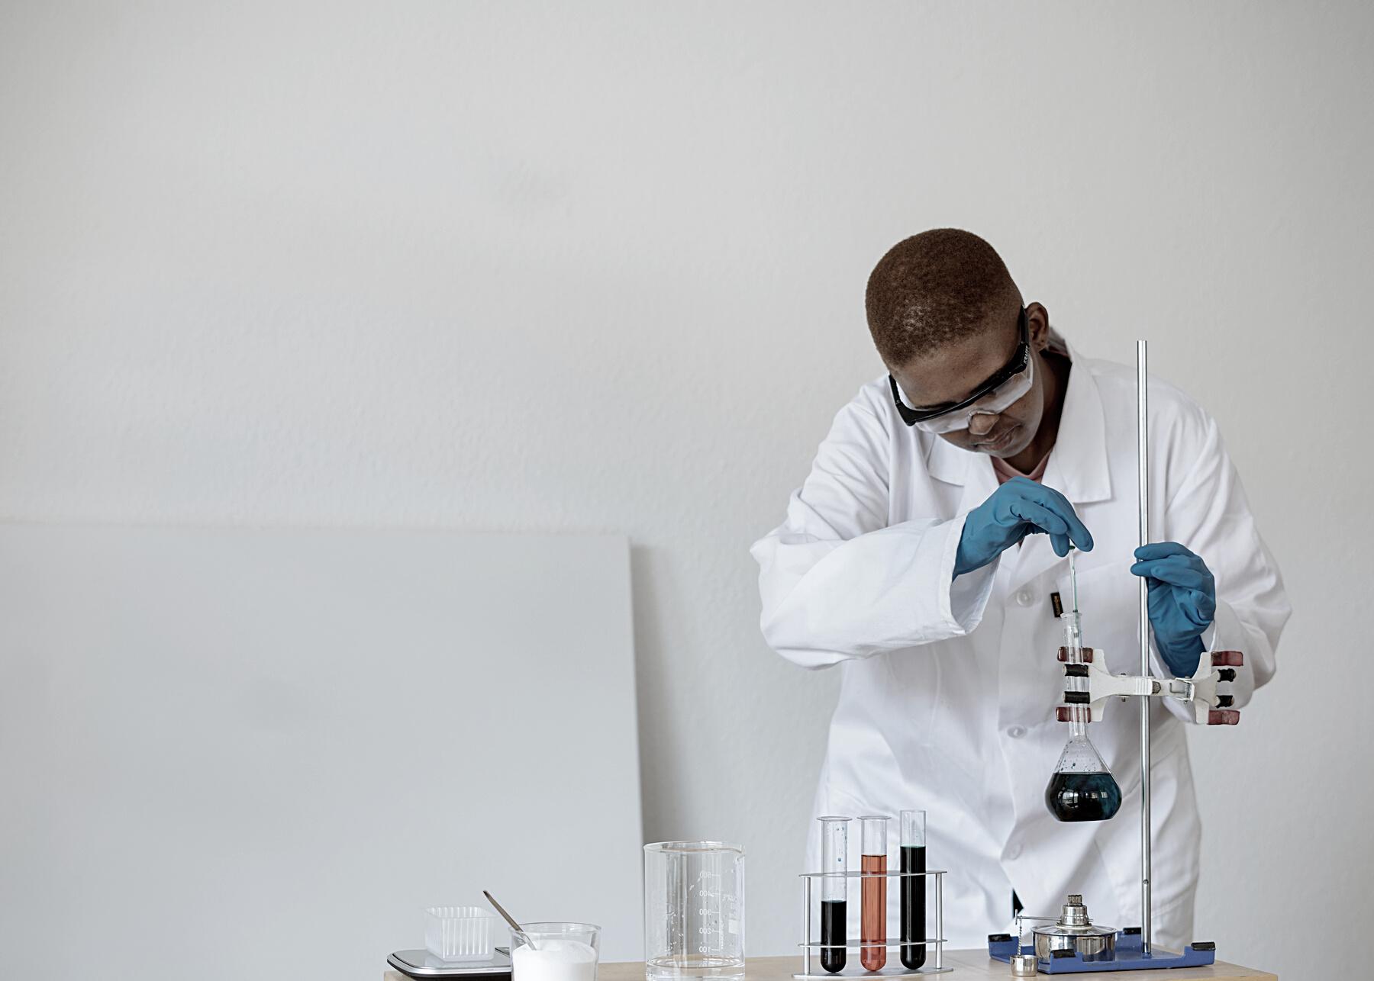
THANK YOU!
Today I have learnt …
It was interesting to know that …
I want to know more about …
.

