Slide 1

Conflict resolutions

Slide 2
The plan of the lesson:
To repeat the lexical material
To learn types of conflicts
To learn conflict resolutions

Slide 3
What is a conflict?
Read the texts and answer the
questions:
1.What is a conflict?
2. What are the reasons of
conflicts?

Slide 4
What is a conflict?
Conflict is a natural part of any
relationship.
Conflict is an ​active disagree-
ment between people with
​opposing opinions or ​
principles.

Slide 5
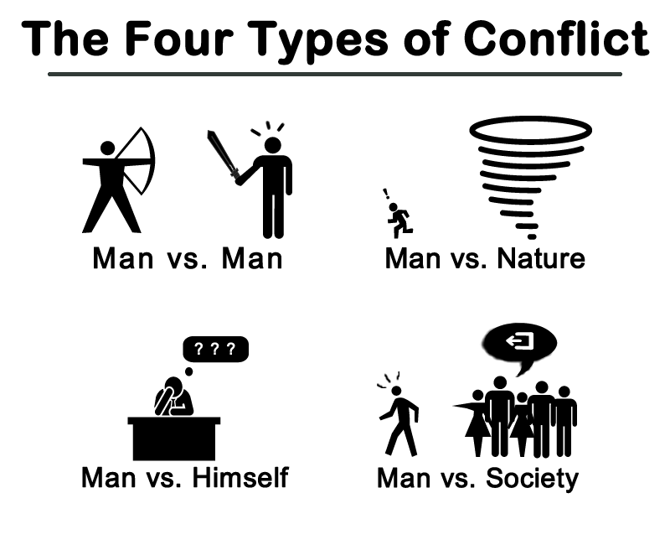
The types of conflict
The types of conflict

Slide 6
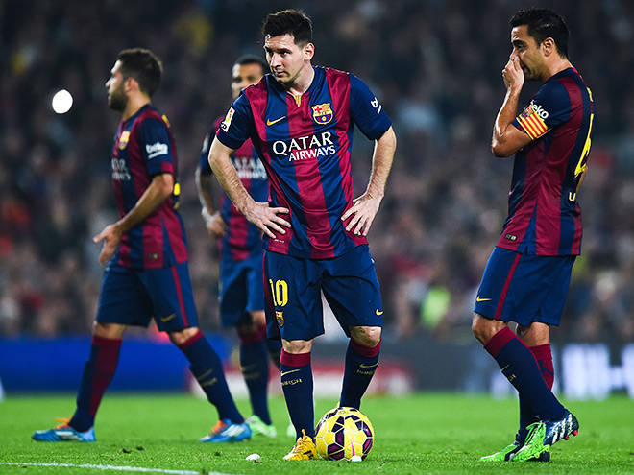

Types of conflict
Sport conflict
War or political
conflict

Slide 7


Types of conflict
Conflict on the
work
Conflict between
friends

Slide 8
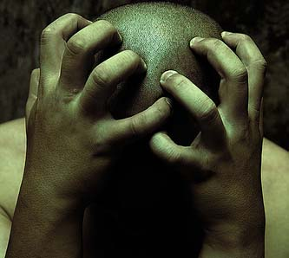

Types of conflict
Conflict within an
individual
Family conflict

Slide 9
What conflict resolutions do you know?

Slide 10


Slide 11
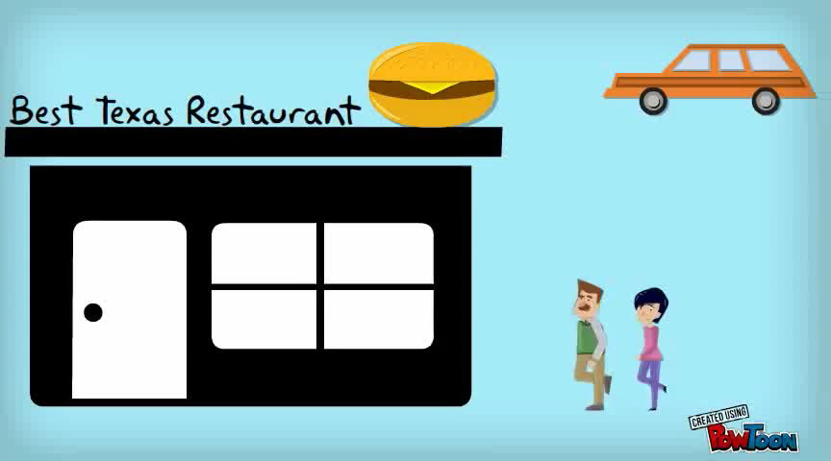

Slide 12

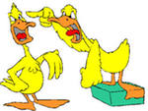

Role-playing

Slide 13


