Slide 1
Данная презентация предназначена для ознакомления, изучения и сравнения Русских и Английских традиций и праздников
для вторых курсов всех специальностей.

Slide 2
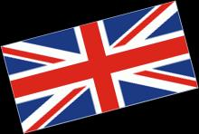
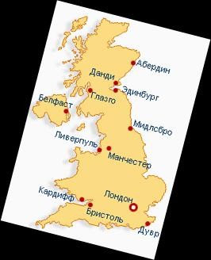
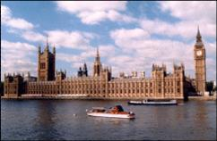
Traditions and holidays of Great Britain

Slide 3
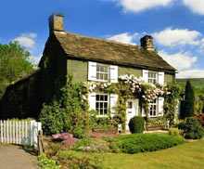
English Traditions
state traditions
national holidays
religious holidays
public holidays
concerning private life (child's birth, wedding, marriage)
traditional ceremonies

Slide 4
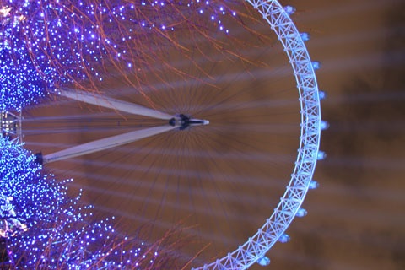
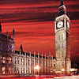
Holidays
New Year
The most common type of celebration is a New Year party

Slide 5
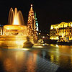
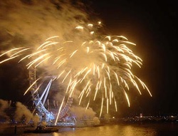
New Year
Every year the people of Norway give the city of London a present – a big Christmas tree
Some people make New Year Resolutions:
I'll get up early every morning next year.
I'll clean, my shoes every day.

Slide 6
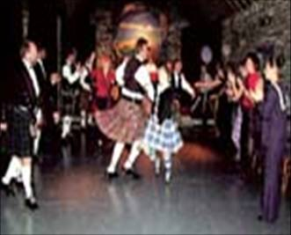
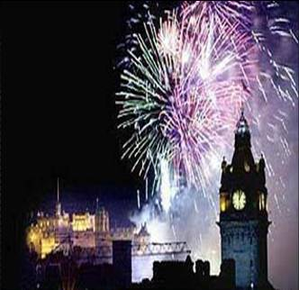
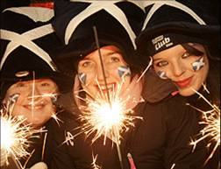
Hogmanay celebrations
Festival in Scotland
It is not clear where the word «Hogmanay» comes from, but it is connected with the provision of food and drink for all visitors to your home on 31st of December

Slide 7
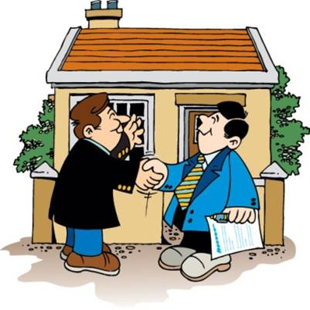
First Footing
The first visitor who comes into a house in the New Year morning is called the First Foot

Slide 8
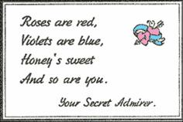
ST. VALENTINE’S DAY – FEBRUARY 14
On this day, people send Valentine cards to their husbands, wives, girlfriends and boyfriends. You can also send a card to a person you do not know.

Slide 9

PANCAKE DAY
It takes place in spring and people not only eat pancakes everywhere but run with them.

Slide 10

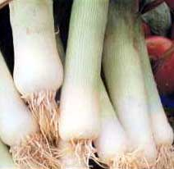
ST. DAVID’S DAY
On the 1st of March each year one can see people walking around London with leeks pinned to their coats. А leek is the national emblem of Wales.
A leek

Slide 11
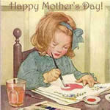
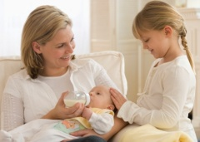
MOTHERS’ DAY
People visit their mothers if possible and give them flowers and small presents. If they cannot go they send a “Mothers’ Day card”.

Slide 12
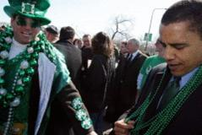
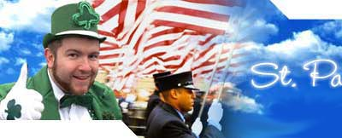
ST. PARTRICK`S DAY
It is not a national holiday.
It’s an Irish religious holiday.
St. Patrick is the patron of Ireland.
Irish and Irish Americans celebrate the day.

Slide 13
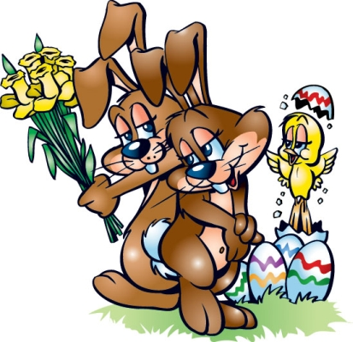
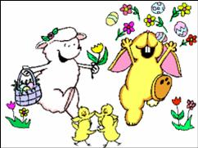
EASTER
Many modern Easter symbols come from ancient time.
The egg was a symbol long before the Christian era.
The Easter bunny is also originated in pre-Christian time.

Slide 14
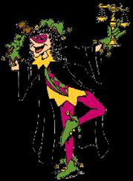
APRIL FOOLS’ DAY
This is a very old tradition from the Middle Ages. At that time the servants were masters for one day of the year.
Now April Fool’s Day is different. It is a day for jokes and tricks.

Slide 15

MAY DAY IN GREAT BRITAIN
May 1st is not a public holiday in Great Britain
On May Sunday workers march through the streets and hold meetings.

Slide 16
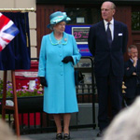
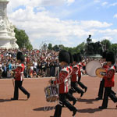
TROOPING OF ТНE COLOUR
On the Queen’s official birthday, there is a traditional ceremony called the Trooping of the Colour. It is a big parade with brass bands and hundreds of soldiers at Horse Guard’s Parade in London.

Slide 17
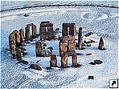
MIDSUMMER`S DAY
Midsummer's Day, June 24th, is the longest day of the year.
On that day you can see a very old custom at Stonehenge.
Stonehenge is one of Europe's biggest stone circles.

Slide 18
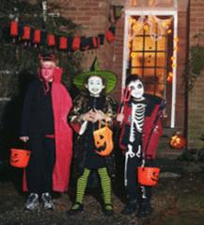
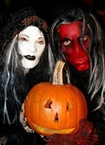
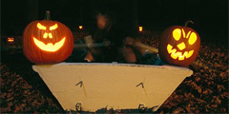
HALLOWEEN
On October 31st British people celebrate Halloween. It is the most colourful and exciting holiday of the year.
Halloween is a time for fun.

Slide 19
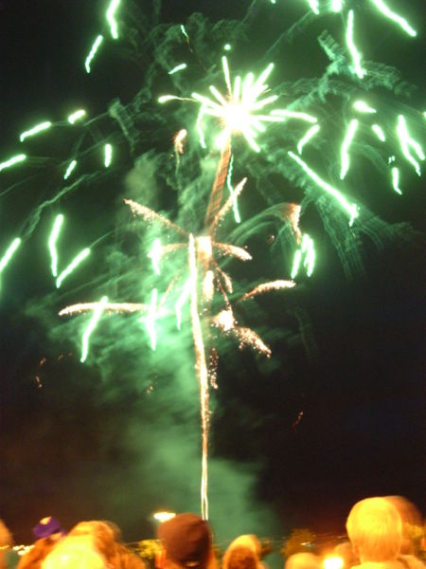

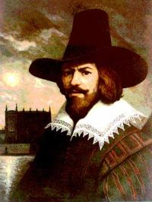
GUY FAWKES NIGHT— NOVEMBER 5
Guy Fawkes Night is one of the most popular festivals in Great Britain. It commemorates the discovery of the so-called Gunpowder Plot, and is celebrated throughout the country.

Slide 20

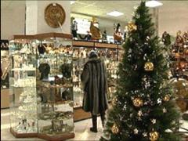
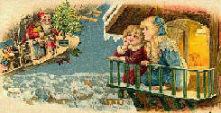
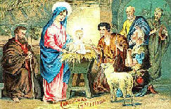
CHRISTMAS CELEBRATIONS
The most popular holiday in Britain is Christmas. People give each other presents and send Christmas cards. The traditional English dinner on Christmas is turkey and pudding.

Slide 21
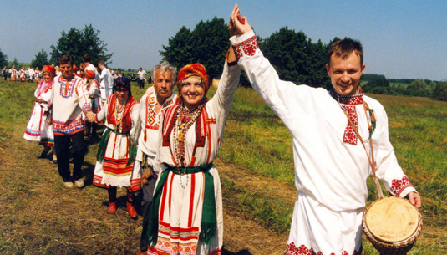
Russian tradition

Slide 22
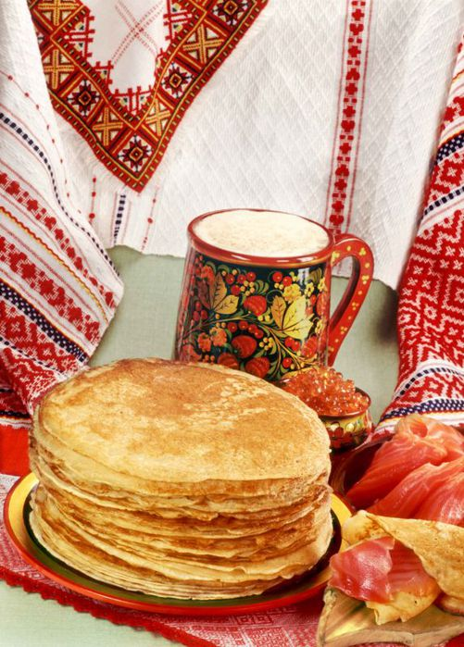
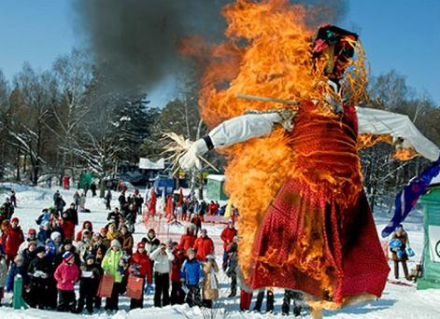
Russia is indeed a unique country, which, along with highly developed modern culture carefully preserves the national traditions deeply rooted not only in Christianity but also in paganism. The Russians still celebrate pagan holidays, believe in many of the popular superstitions and legends.

Slide 23
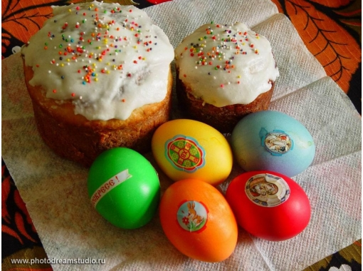
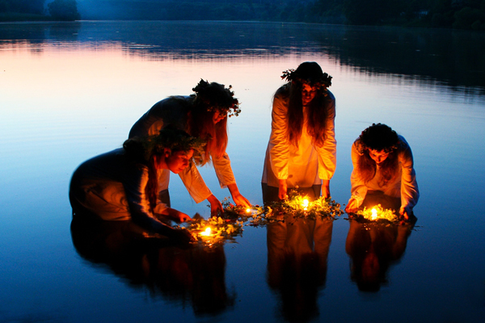
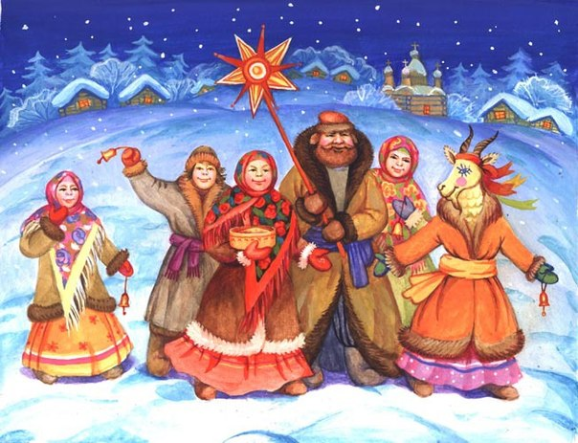
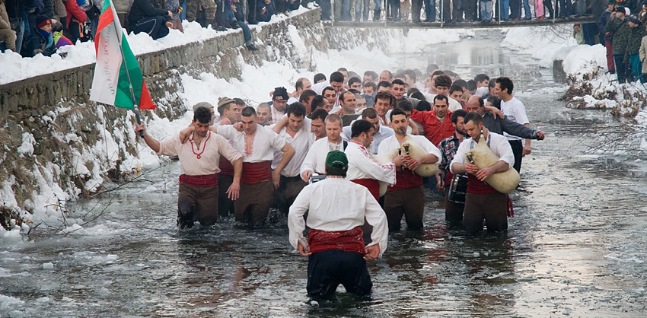
Christianity gave Russians such great holidays like Easter , Christmas and Baptism , and paganism – pancake day and Ivan Kupala.

Slide 24
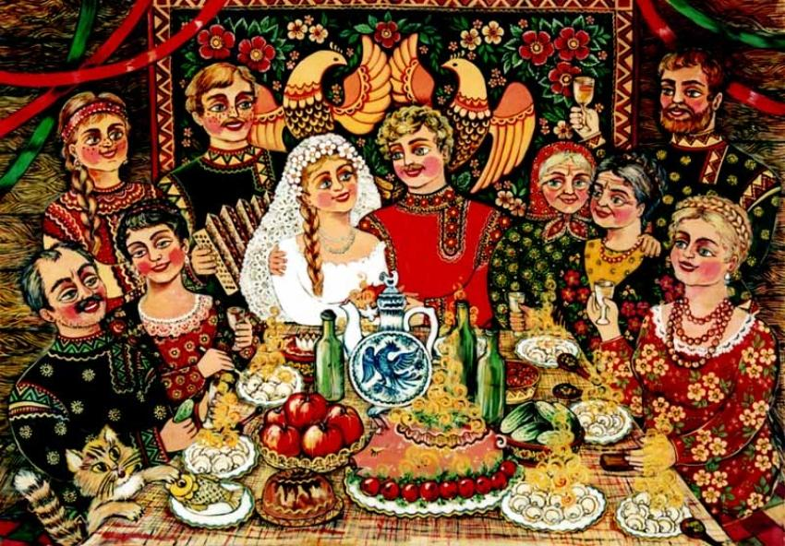
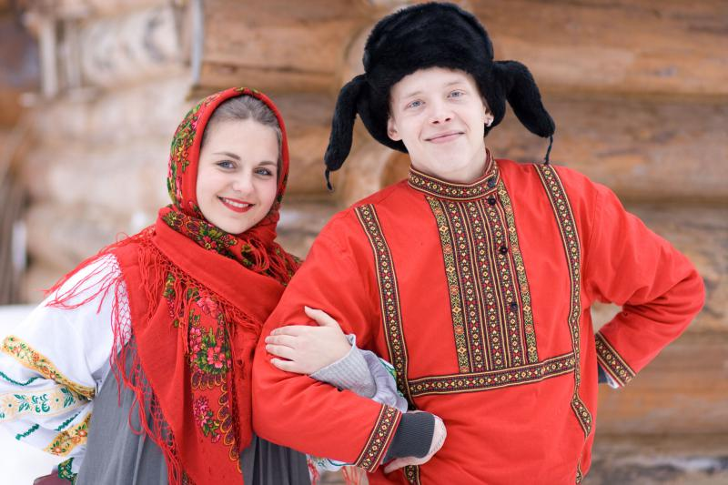
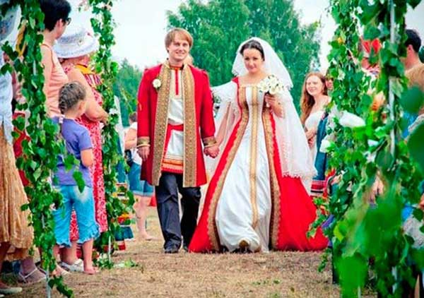
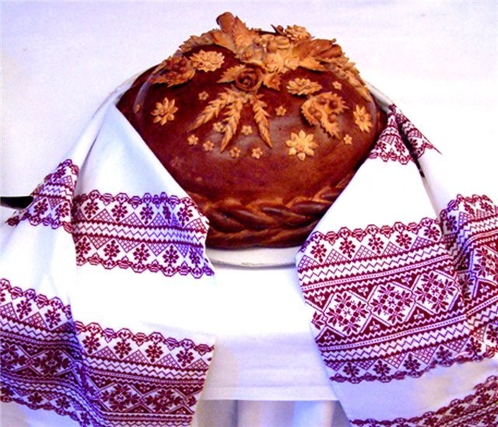
Among the Russian traditions, the wedding traditions that have been passed down from generation to generation.

Slide 25
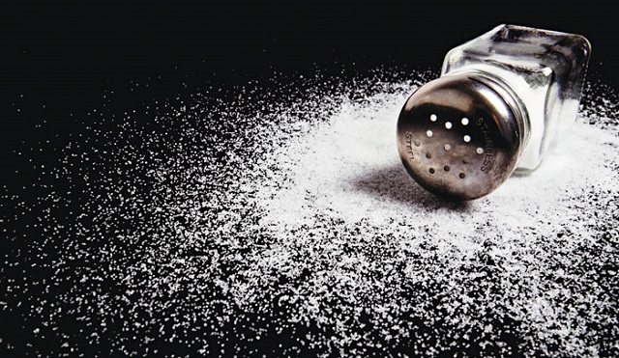
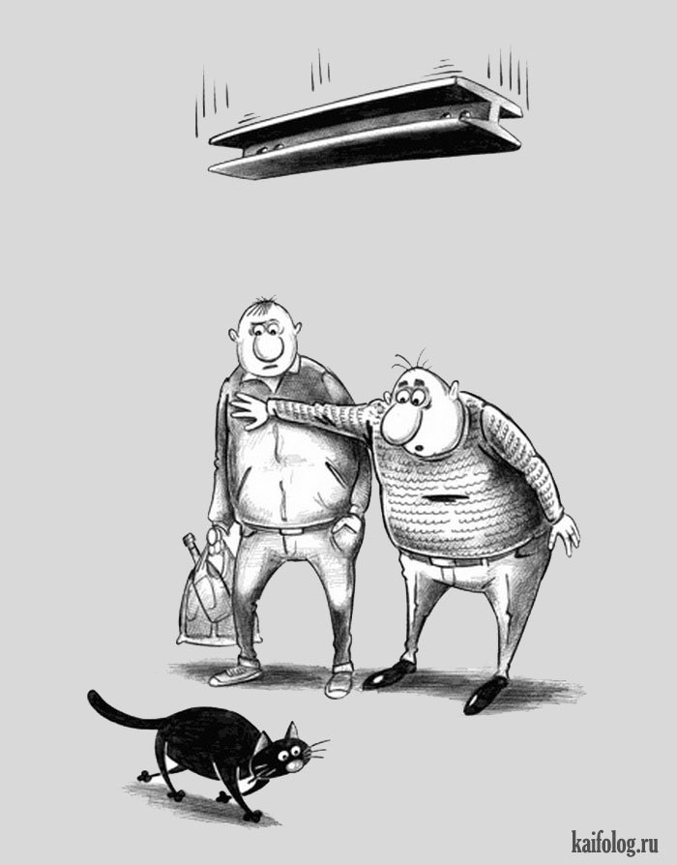
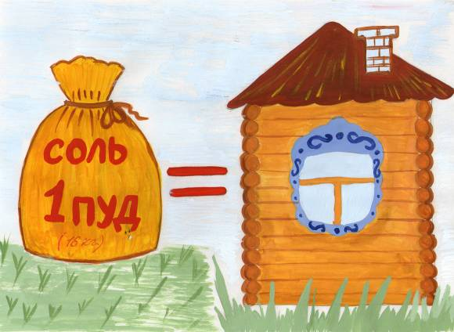
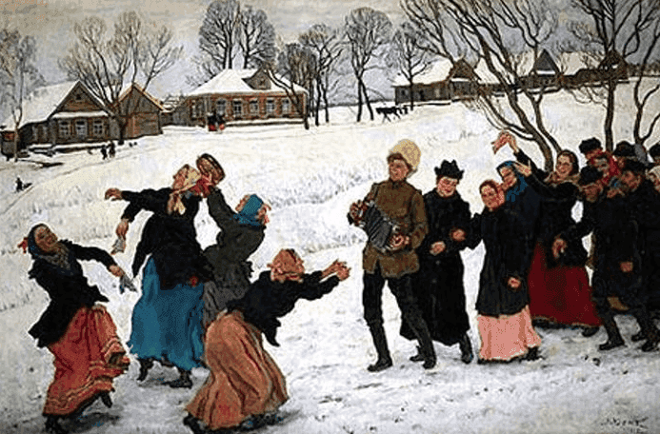
In Russia since olden times people believe in different omens. Signs were in Russia for a long time. And during this time, they appeared quite a large number.

Slide 26
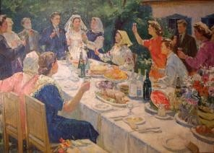
The holiday table is not only breaking from the caterer, but also push him very long and not always friendly toast, so are these competitions.

Slide 27
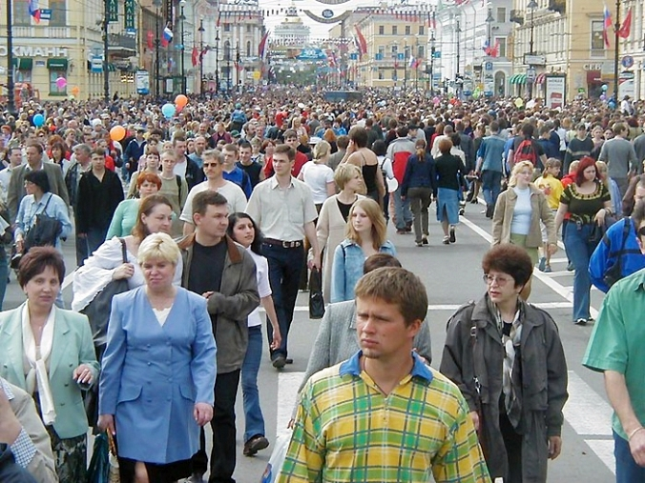
Russians almost never smile, especially in conversation with strangers, the question is why Russians don't smile is probably the most incomprehensible Russian soul for foreigners. The answer is quite simple. The first is a smile in Russian communication is not a signal of politeness. Smiling man may even arouse suspicion, and suddenly he's laughing at us, and that only is Russian proverb "Laughter for no reason — sign fool".

Slide 28
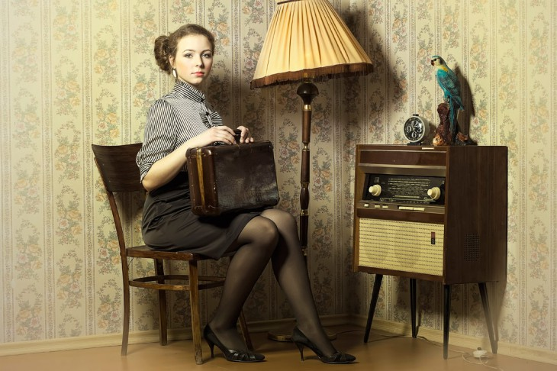

Traveling abroad Russians are always seen, even among themselves they have to talk very quietly, drinking strong drink, they become much louder foreigners. Before the trip, there is a strange custom to "sit down on the track."

Slide 29

Russia is an amazing country with amazing people ! Only in it you will find a surprising number of traditions , customs and colorful Festivals with delicious food and cheerful feasts.

