Slide 1
Тема:«Современное строительство»
Цель: Ознакомить студентов с технологией строительства на примере города Москва
Преподаватель : Бондаренко Л.М.

Slide 2
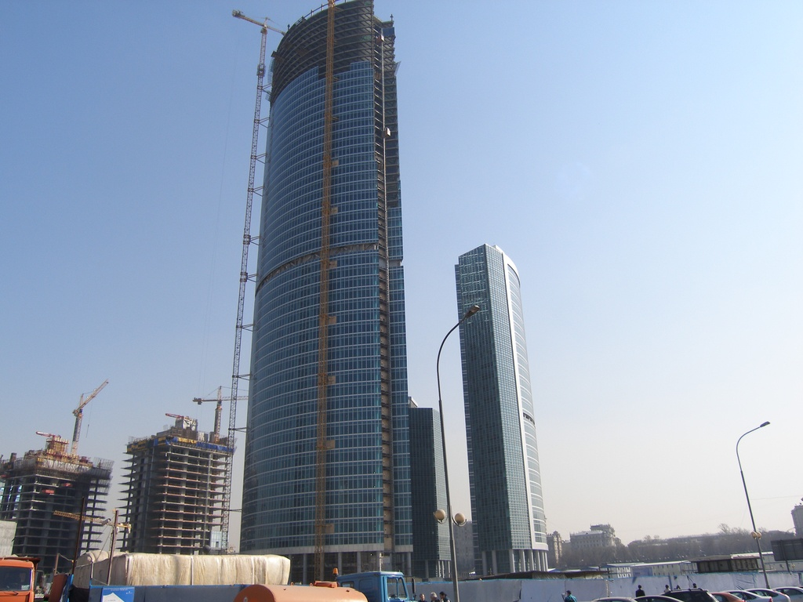
"Russia" is above all
Today in the Moscow International Business Center "Moscow City" begins construction of the tower "Russia"

Slide 3
high Moscow
More than six years ago, the mayor of Moscow, Yuri Luzhkov, laid the first stone "a message to posterity " at the base of high-rise on Davydovskaya Street to the west of the capital. So was the start of the program " New Ring of Moscow", which involves the construction of approximately 200 buildings in 60 areas of the city. The program , valued at 5.5 billion U.S. dollars, designed for 15 years and provides for the construction of high-rise multi- residential, hotel and office complexes. High-rise buildings will be erected in the middle and peripheral zones of Moscow , that is built on the territories of 60 - 70s . In St. Petersburg, also developed projects of construction of skyscrapers. Particular controversy is the construction of a 300- meter facilities " Gazprom- City" . Keep up with the two Russian capitals and regions . High-rise buildings designed in Khabarovsk, Tomsk, Chelyabinsk, in the plans - a skyscraper in the city of Grozny .

Slide 4
High-rise silhouette of the capital
Sooner or later it had to happen. In Moscow high-rise construction boom . As the price of land is growing, much more profitable to develop the city upwards than outwards . One of these decisions on the arrangement of the capital was the project " New Ring of Moscow". It is based on the principle of polycentric development of the metropolis. Moscow Mayor Yuri Luzhkov took on this tough position - the center of the capital turned into a concrete jungle is impossible. That is why the Kremlin will forever remain a dominant center , which is easily visible from many points of the city center , and modern high-rise architecture works will greet guests at the entrance to the capital - in the sections between the Third Ring Road and Ring Road .

Slide 5
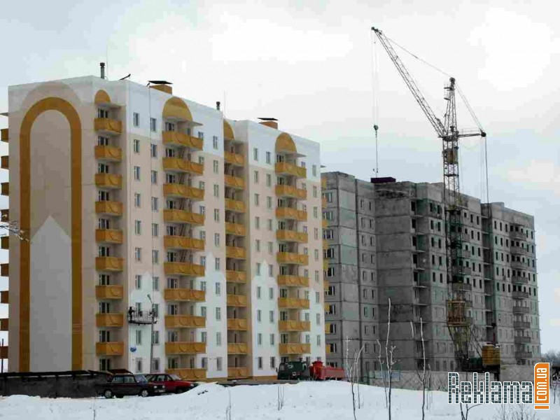
Fire safety of high-rise buildings

Slide 6
At the meeting in April 2006, the international conference on high-rise construction , the head of the Moscow Committee Alexander Kuzmin said that in the coming years in Moscow could be built 140 high-rise buildings. This will take place in accordance with the Moscow government urban planning program " New Ring of Moscow". However, the implementation of these projects involve the need to solve complex tasks to ensure the safety of every high-rise facility . It is no secret that with the increase in the size of any building structure increases the probability of occurrence of situations that are dangerous to human life and the integrity of the building.

Slide 7
Window design for high-rise buildings in Moscow
In recent years, Moscow significantly increased the volume of housing construction height of 50 - 70 m (23-25 ​​floors). Their construction has become almost massive. Work is underway on the design and construction of various administrative areas of the city have higher buildings - more than 75 m in height. The height of residential buildings in accordance with the city program "New Ring of Moscow" is scheduled to lift up to 50 or more floors

Slide 8
Hard-monitoring
In industrialized countries, increasingly widespread acquires high-rise building . However, there is growing concern about the potential for residents of the harmful effects of the construction of skyscrapers on the ecology of the urban environment. And it is a growing concern demanded by designers and architects to lay such technical regulations and standards , technologies that would provide reliable environmental safety in the construction of skyscrapers. These technologies have already called "green" . And they are subject to the requirements laid down in the environmental legislation in a number of leading Western countries . This was told by our British colleagues of International Construction.

Slide 9
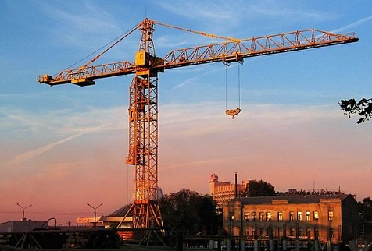
High-rise again under the supervision of
As is well known, high-rise building is rapidly developing today in all major cities of Russia. Challenging science master builders of skyscrapers from Kaliningrad to Vladivostok. The benchmark for a "leaving behind a cloud" is, as usual, Moscow. After all, the first skyscraper in the country have come out here in the late 1940s.

Slide 10
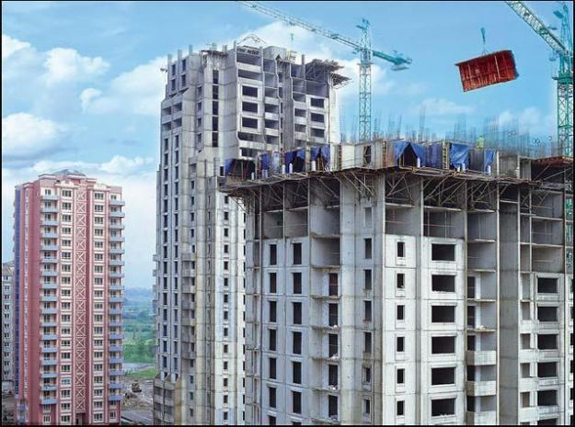
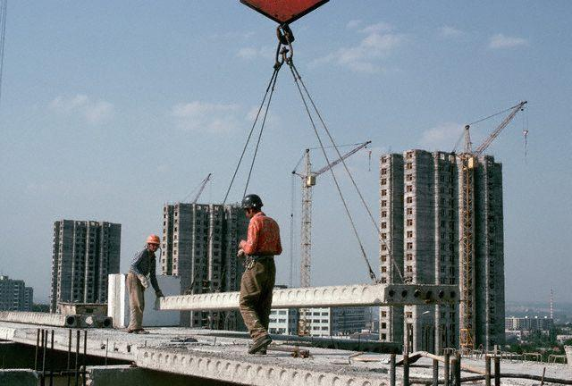
200 skyscrapers over 8 years
Sitting in another traffic jam and choking smog, many Muscovites certainly remember sometimes unkind word architects and designers: surely it was impossible to build the city so that the roads were roomier, and the streets are greener?

Slide 11
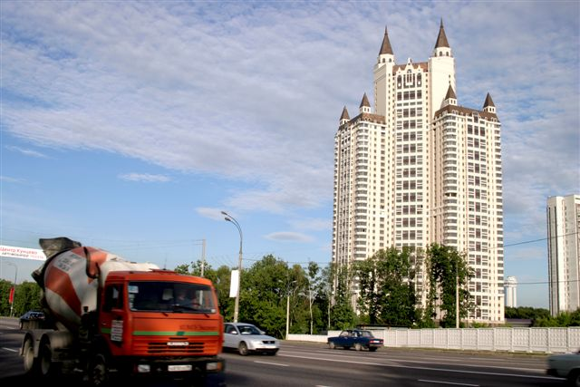
On the impact of wind on tall monolithic building
This article briefly describes the features of aerodynamics of high-rise buildings, as well as the views expressed by some experts of the Institute aerodynamic problems in the area of high-rise housing that need to be solved in the short term.

Slide 12
Improving the reliability of high-rise buildings in the city of Moscow on the basis of the experience of conversion solutions
Many questions would be removed, if conducted scientific and technical research on the construction of high-rise buildings, as it was in the design of protective structures, where the main provisions tested at full-scale test facilities and units at the sites and models in the laboratory.

Slide 13
Solid Foundation "Moscow"
Often , talking about building in Moscow, we journalists can easily rush sonorous epithets , not worrying about what other word from too frequent use lose their original meaning, are diminished . It costs a profession. Because I can not say how many of the really unique investment - building projects have received in the press so much appreciated , but what is happening today in the Krasnopresnenskoj waterfront , in fact still does not have analogues . This construction is ambitious in its scope and used the latest technology .

Slide 14
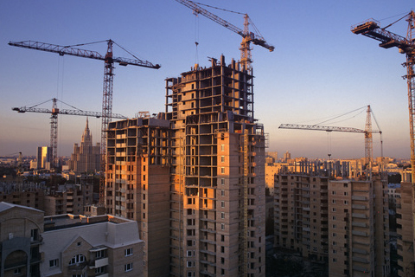
The composition of high-strength concrete for building construction
During the XX century. in the development of mega-cities observed a pronounced trend away from low-rise to high-rise construction. The main reasons were population growth, and rising land and search for new and meet the spirit of the time, architectural forms.

Slide 15
Not above the 17th floor
In the Moscow region will no longer build houses higher than 17 floors. Only in a few cases, the authorities will allow the construction of high-rises, such as in the case of large multi-storey building areas. But this would require a special commission conclusion of the Ministry of Construction. This decision was made public at a collegium of the Ministry of the building complex of the Moscow Region, which was held in Lyubertsy.

Slide 16
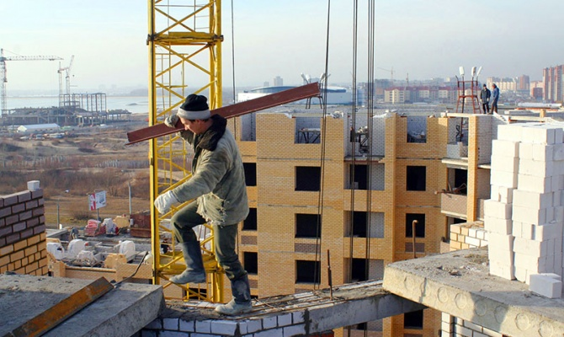
Typical errors in the high-rise construction sites
Issues of quality of construction and installation works and the materials used, products and designs in the construction of high-rise buildings are crucial in ensuring the reliability and durability of structures and complex security buildings in general.

Slide 17
Integrated security and anti-terrorist protection of high-rise buildings and unique structures
The Government of the capital is focused on providing high-rise safety and unique objects. That is why , in accordance with the decision of the interdepartmental committee ( IDC) recently held municipal scientific and practical conference "Integrated security and anti-terrorist protection of high-rise buildings and unique structures of Moscow ." It was conducted for the consolidation of efforts to develop a unified organizational and technical policy in the field of integrated security and anti-terrorist protection of high-rise buildings and unique structures of Moscow, regulatory framework of the scope of anti-terrorism protection during design and construction . Conference was organized by the city government and the World Academy of Integrated Security ( WASCS ) .

Slide 18
Moscow exclusive heights and innovation: a set of "The Tower" Federation "- a project of the XXI century
Multifunctional office - recreational complex "Federation", erected in the Moscow International Business Center "Moscow City", aims to become one of the most prestigious and impressive office buildings in the capital, and the highest in Europe.

