Slide 1

"Праздники и
традиции
Великобритании"

Slide 2

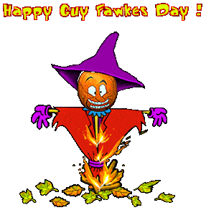

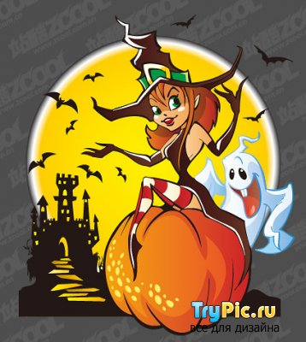
Christmas,
holidays,
New Year tree,
greeting cards,
Santa Claus,
Easter,
Christmas,
New Year’s Day,
Halloween,
Guy Fawkes’ Night.

Slide 3
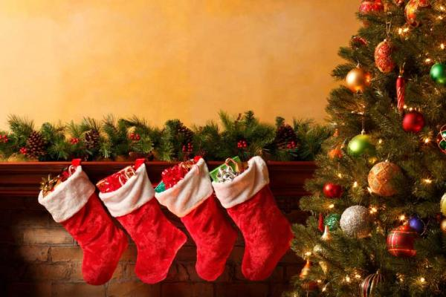
Christmas Day is celebrated on December 25.People of different countries celebrate Christmas in various ways. Christmas is a time for eating. The traditional food is turkey, Christmas cake, Christmas pudding made of fruit. Candles at Christmas also go back to those times. People believed then that their light helped them to forget the darkness of winter. Now Christmas Tree stands in everybody’s living room at Christmas. A lot of people go to Trafalgar Square to see the Christmas tree.

Slide 4
They have a New Year party at home. When Big Ben strikes 12 they drink a toast for the New Year. Christmas Day is celebrated on December 25. People of different countries celebrate Christmas in various ways. Christmas is a time for eating. The traditional food is turkey, Christmas cake, Christmas pudding made of fruit. Candles at Christmas also go back to those times. People believed then that their light helped them to forget the darkness of winter.

Slide 5
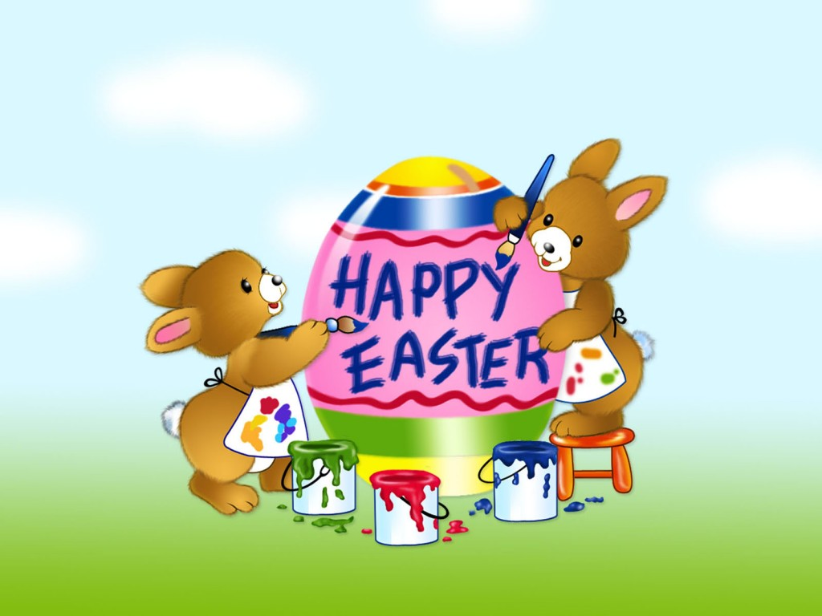
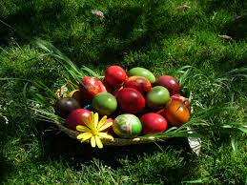
Easter Sunday is the day when Christians celebrate Christ’s return
to life and victory over dearth. On this day many people go to church.
Children get presents of chocolate Easter eggs.
Easter always means spring, new life after winter,
flowers, green trees, young animals, especially lambs and chicks.
Some time ago it was a tradition
to make new clothes and hats
for Easter.

Slide 6
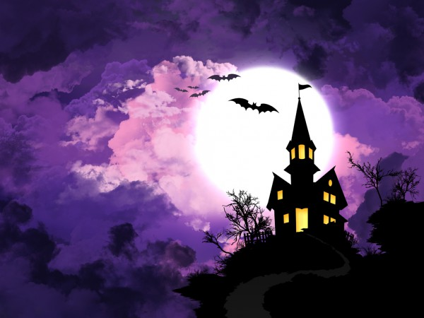
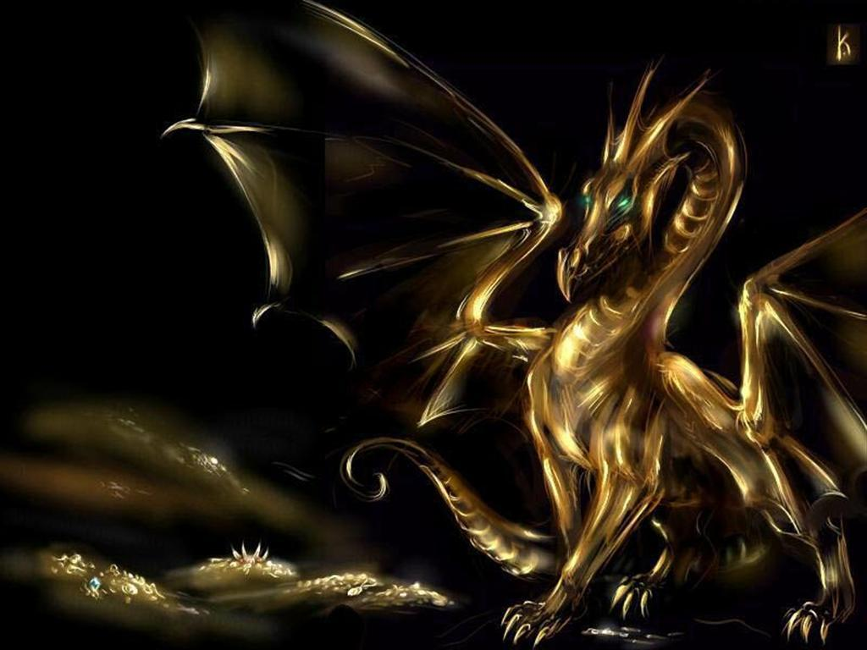
Celebrating Halloween is a very old traditions. Long ago people thought that on 31st October spirits of the dead came back. That’s why now some people dress up as witches and ghosts. They make Lamps of pumpkins. Sometimes children go out in groups, knock on people’s door and say «Trick or treat». They usually get a treat, some sweets or nuts. People also have Halloween parties where they often play games.

Slide 7
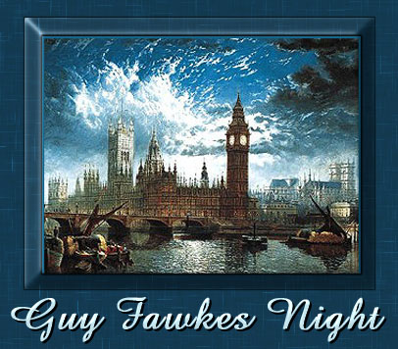
Guy Fawkes’ Night is on 5 November. That day in 1605 some conspirators wanted to blow up the Houses of Parliament and kill King James I and his ministers. Guy Fawkes was one of them.

Slide 8
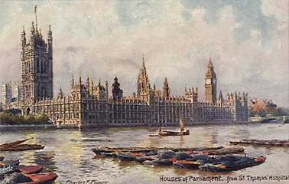
But they couldn’t do that because the King’s men
caught Guy Fawkes and killed him.
Not many people think about those events now
and they enjoy celebrating the day with their
celebrating the day with their friends and families.
On 5 November when it gets dark ,
people go out into the streets and
watch beautiful fireworks.
In the country they often make big
bonfires and gather near them.

Slide 9
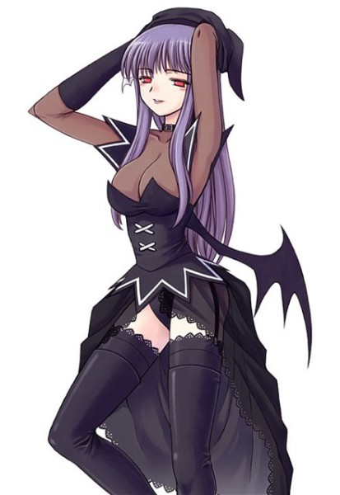
LISTENING
Each country has its own set of national holidays and traditions.
When somebody is learning a foreign language it is very important to know the holidays and traditions of the countries where this language is spoken.
This will give one a better understanding of the culture of these
countries.On October 31 Halloween is celebrated.
This is the eve of All Saints' Day.
Halloween is traditionally associated with telling ghost
stories and bonfires. In the past, people believed that all
witches, ghosts and other evil spirits wanted to take over
the world on that day. To scare away the spirits, people started
to get dressed in costumes, put on spooky masks, light bonfires
and put jack-o-lanterns in front of their homes.
Today, in many schools pupils organize jack-o-lantern contests.
Jack-o-lantern is a hollow pumpkin with holes cut out
to represent a human face.

Slide 10
People in Britain celebrate Christmas on 25 December . They celebrate it as the day
when Jesus Christ was born.It is often cold , wet, and foggy at Christmas.
Families decorate their homes and Christmas tree. The day before Christmas is
Christmas Eve. It is a very busy day for families in cakes,hang stockings near the
fireplace. Children often write letters to Father Christmas with their wishes .
They believe while they are sleeping ,Father Christmas comes to visit.
He is a kind old man in red clothes with a big sack of toys. He puts sweets and small toys
in the children’s stockings. On Christmas Day everyone open presents and sits down
to the table to have a big dinner. Families usually have turkey or goose with vegetables.
After dinner the families gather in the living room to Queen of England on TV.
At tea time in the afternoon they drink tea with the Christmas cake.
During the holiday carolers go from house to house in the evening.
They ring handballs and sing carols, Christmas songs. People gives the carolers pies ,
nuts, fruit or little money.
The day after Christmas is Boxing Day. But there’s no fighting on that day.
The name «boxing» comes from the times when
people put money for the poor in the church boxes. Ten on 26 December the poor
got that money. Now people often use this day to give some money to people who
helped them during the year.

Slide 11

1.In England it is often rainy at Christmas.
2.Father Christmas visits children on Christmas Eve.
3.On Christmas day you can hear Queen of England on TV.
4.People eat the Christmas cake on the day after Christmas.
5.There are a lot of fights on Boxing day.

Slide 12
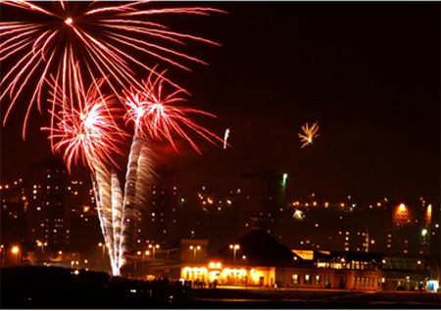
THE LESON IS
OVER!
THANK YOU!

