Slide 1
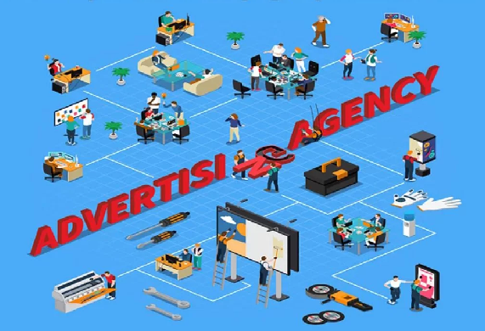
Advertising Agencies

Slide 2

Full service Agencies
A full-service agency is a fully integrated marketing and advertising agency that provides a complete set of services.

Slide 3
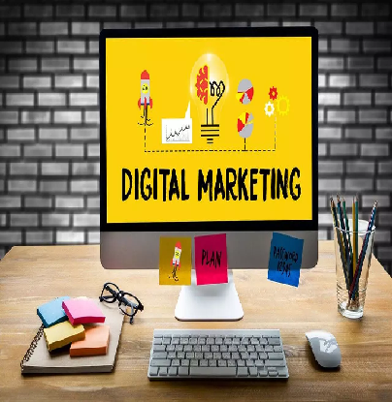
Interactive Agencies
An interactive agency, also known as a digital agency, is similar to a traditional advertising agency.

Slide 4

Creative Boutiques
A boutique agency in marketing is one that's small and specific. It's often composed of a team of talents that's highly skilled and that works together smoothly and efficiently. A creative agency like this can be far more nimble than larger agencies that rely on multiple teams in multiple locations.

Slide 5
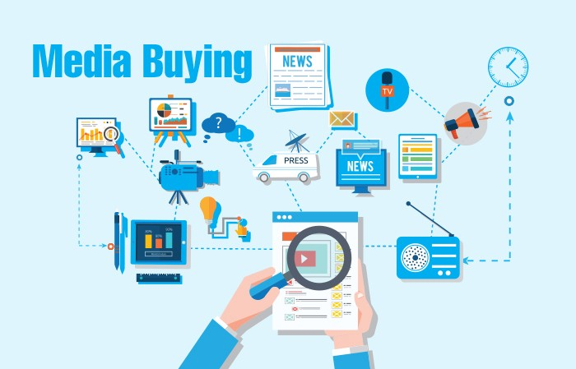
Media Buying Agencies
Media buying is a process used in paid marketing efforts. The goal is to identify and purchase ad space on channels that are relevant to the target audience at the optimal time, for the least amount of money. Media buying is a process relevant to both traditional marketing channels (television, radio, print) and digital channels (websites, social media, streaming).

Slide 6

In-House Agencies
An in-house ad agency, also called internal marketing, is a marketing department that operates within a business solely for that business's brand. The business using the in-house ad agency's services also owns the agency. Many business outsource their marketing to an outside advertising agency, while others build a team of full-time employees to handle marketing needs.

