Slide 1
Sources of water supply

Slide 2
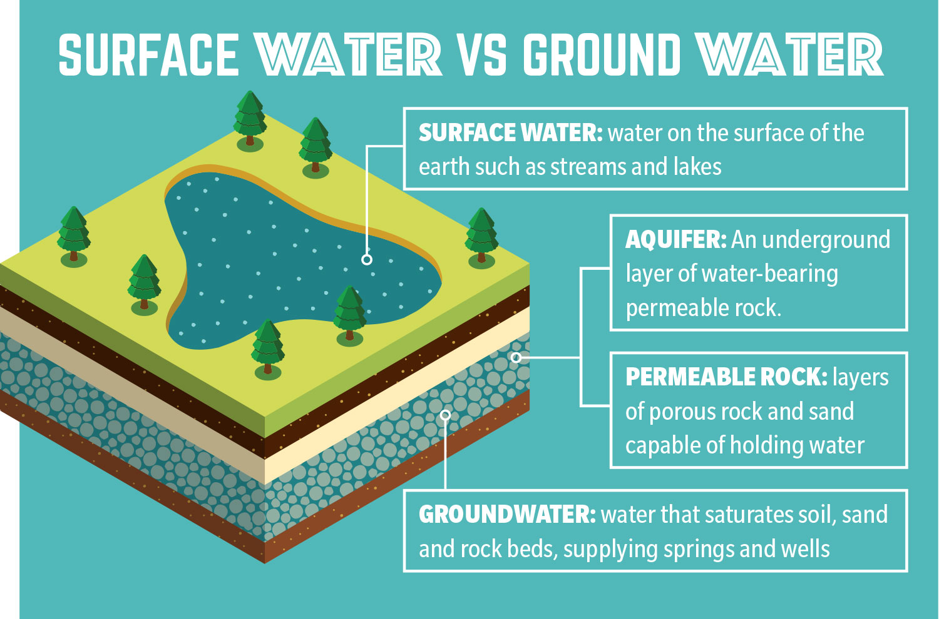
Surface water and groundwater are both important sources for community water supply needs.

Slide 3
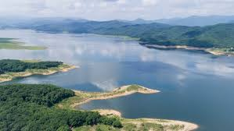
Surface water
Surface water is any body of water above ground, including streams, rivers, lakes, wetlands, reservoirs, and creeks. The ocean, despite being saltwater, is also considered surface water.
Surface water participates in the hydrologic cycle, or water cycle, which involves the movement of water to and from the Earth’s surface.

Slide 4
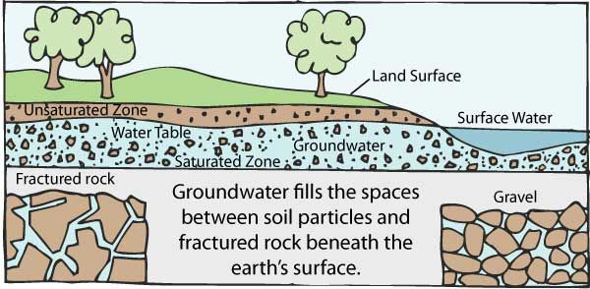
Groundwater
Groundwater is the water found underground in the cracks and spaces in soil, sand and rock. It is stored in and moves slowly through geologic formations of soil, sand and rocks called aquifers.

