Slide 1
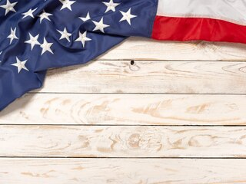
Geografic position of USA

Slide 2
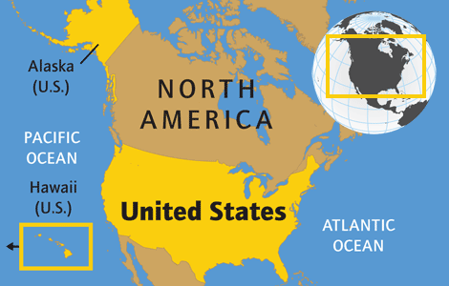
The United States of America is situated on the western hemisphere, the biggest part is located on the continent of North America.

Slide 3
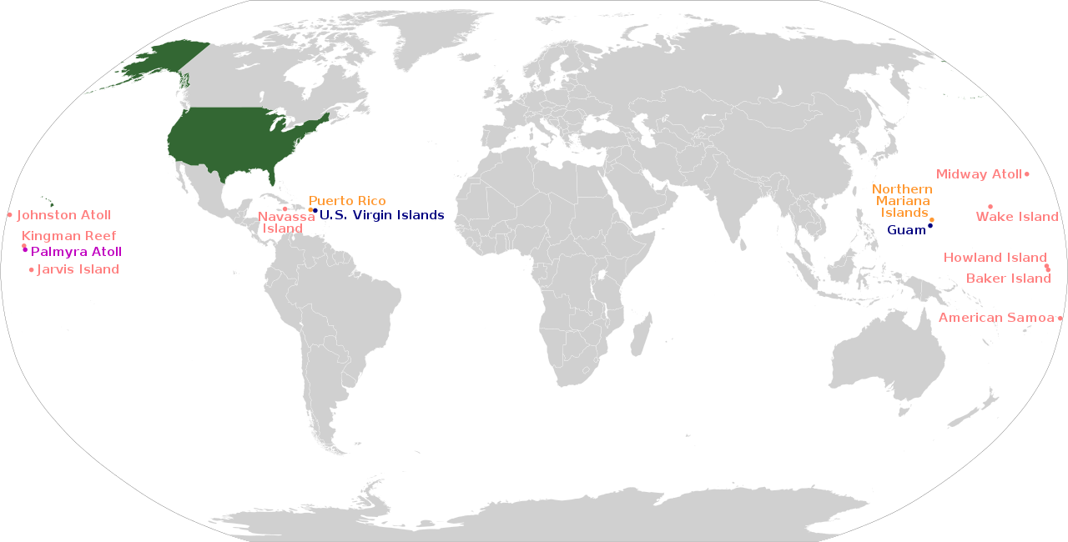
The USA has territories that are not part of any state, but belong to it.

Slide 4
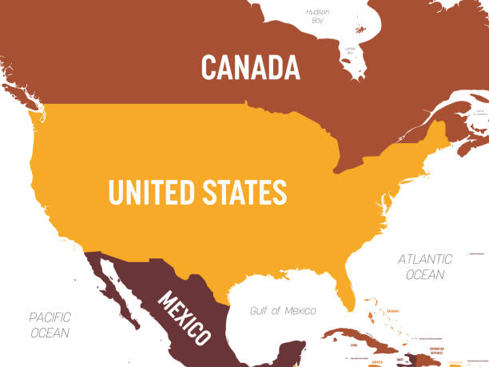
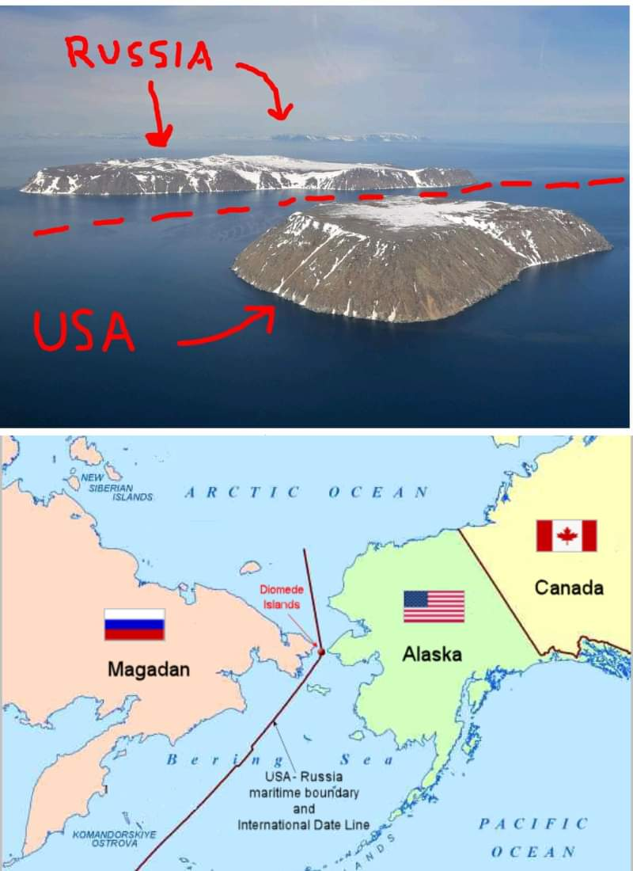
It borders on Canada in the north and Mexico in the south. The USA also has a sea border with Russian Federation.

Slide 5
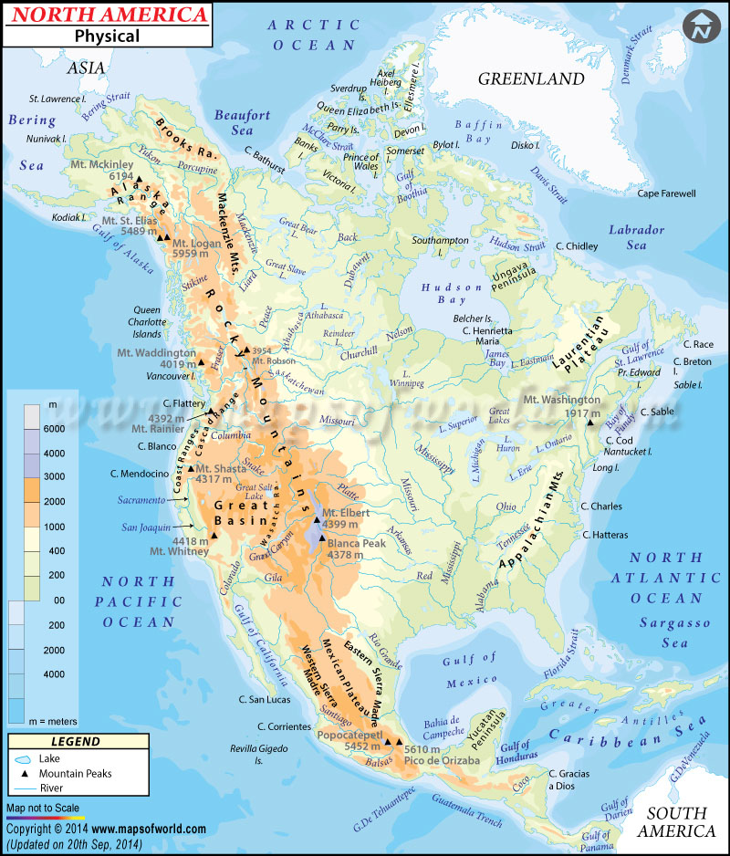
It is washed by the Atlantic Ocean in the east, by the Pacific Ocean in the west, by the Arctic Ocean in the north and by the Gulf of Mexico in the south.

Slide 6
The surface of U.S.A.

Slide 7
Surface
There are several large physiographic regions on the territory of the United States. In the east, along the coast of the Atlantic Ocean, the Appalachian mountain system stretches. To the west and south of it, the surface levels off, forming low-lying areas through which the largest rivers of the United States flow. Further to the west, the area passes into vast plains and prairies, called the Great Plains, which precede the mountainous regions of the Cordillera. Mountain ranges occupy the entire western part of the country and break off quite sharply to the Pacific coast.

Slide 8
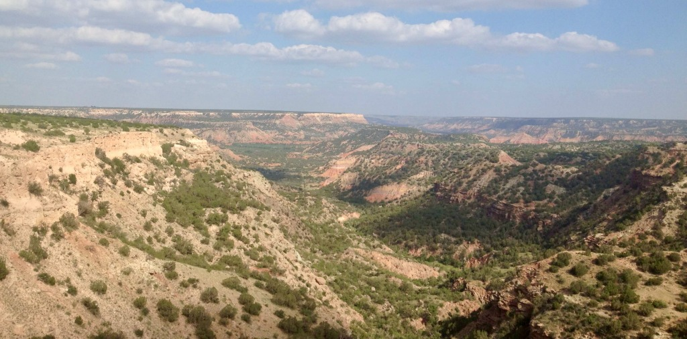
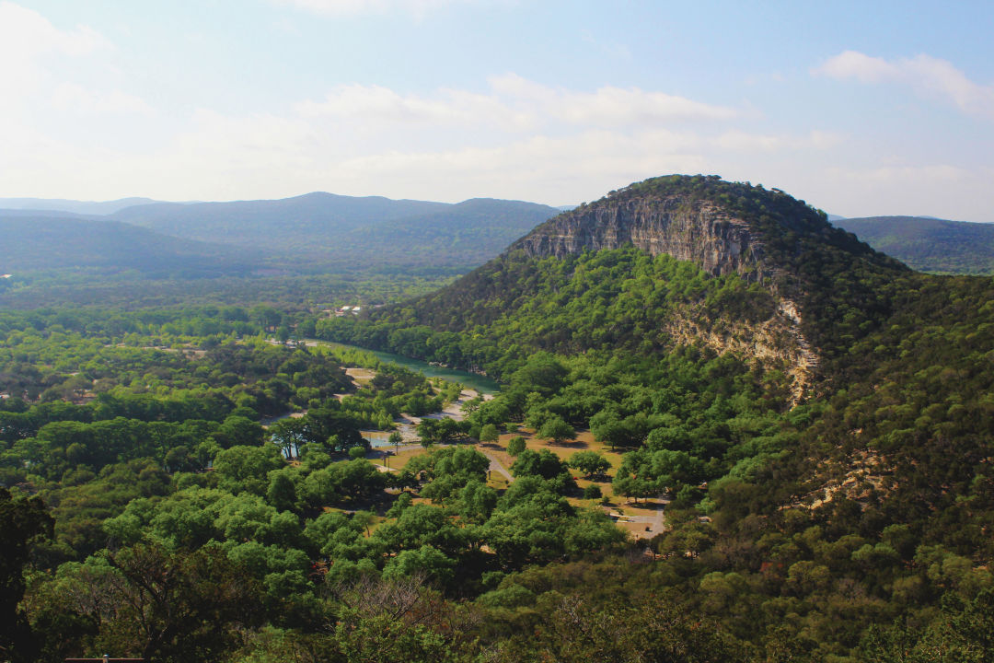
The Great Plains
The Great Plains begin at 97-98° west longitude and are essentially the foothills of the Cordillera Plateau. The height of the plains rises from 500 to 1600 m when moving west. The plateau is strongly dissected, in some places the network of valleys is too dense for their economic use. In the north are Badlands - "bad lands", almost devoid of soil cover. Further south are the Sand Hills in Nebraska. Kansas is home to the low Smoky Hills and Flint Hills, as well as the Red Hills. The southern part of the plains is occupied by the Llano Estacado and the Edwards Plateau.

Slide 9
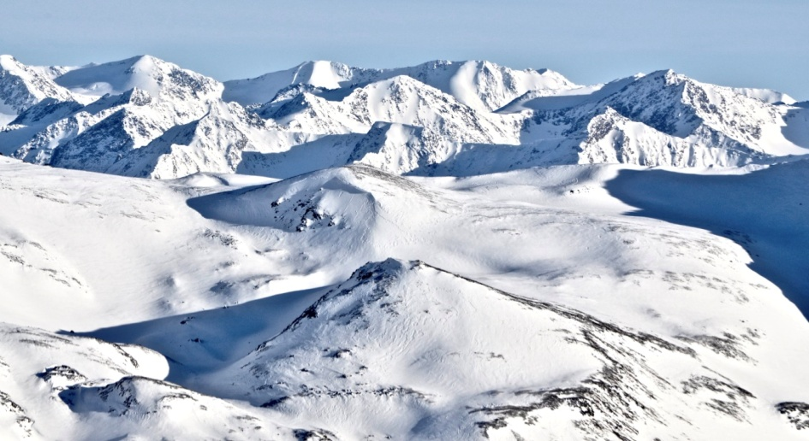
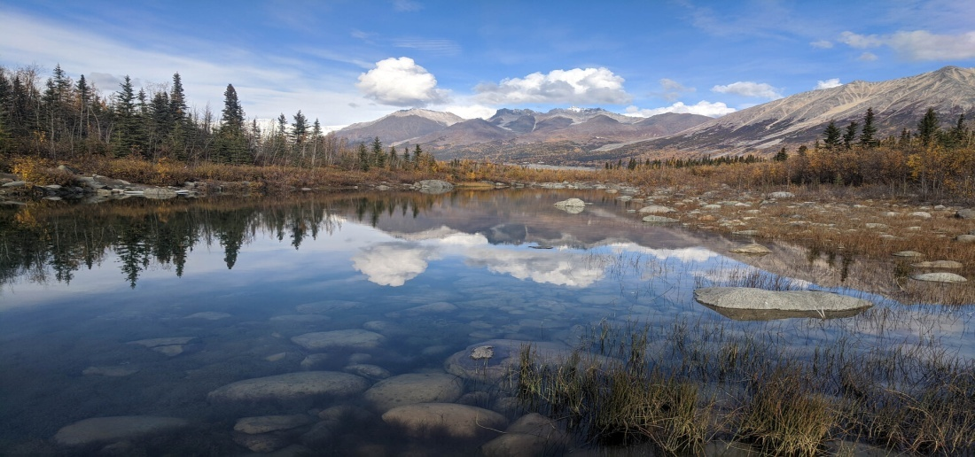
Alaska
Most of the territory of the state of Alaska is occupied by mountain ranges stretched from west to east. The northern part of the state is occupied by the flat Arctic Lowland, framed on the south by the Brooks Range, which includes the De Long, Endicott, Philip Smith and British Mountains. In the central part of the state, the Yukon plateau is located, along which the river of the same name flows. The Aleutian Range arcs around the Susitna River Valley and continues as the Alaska Range, forming the Alaska Peninsula and the Aleutian Islands. Along the coast of the Gulf of Alaska stretch the Chugach Range, the St. Elias Range and the Wrangell Mountains.

Slide 10
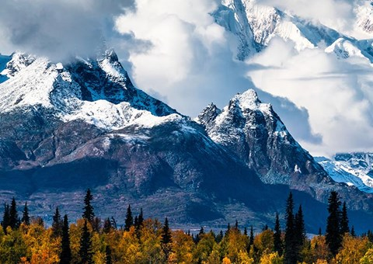
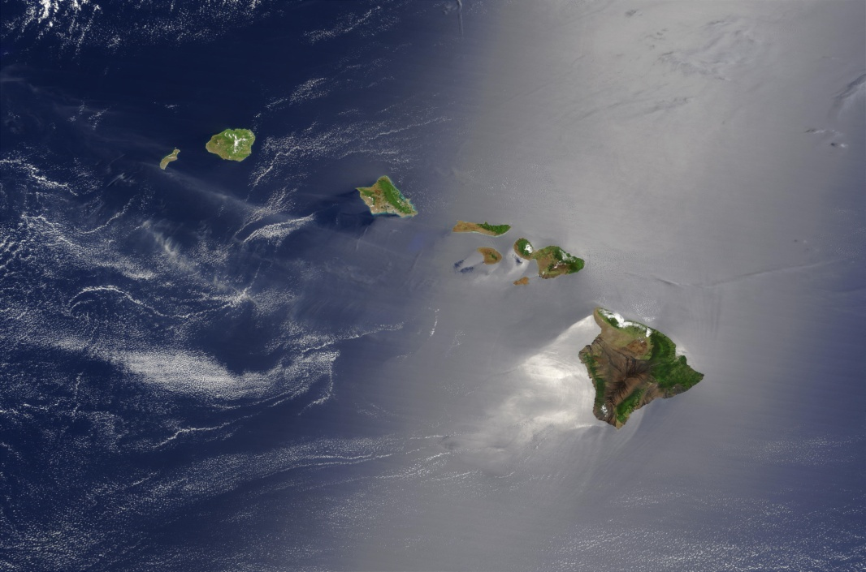
Most of Alaska is occupied by the northern Cordillera ranges. The Hawaiian archipelago is a series of volcanic islands up to 4205 m high. In the USA, 104 mountain peaks have an absolute height of more than 4000 meters and a relative height of more than 500 meters.

Slide 11
CLIMATE OF THE USA

Slide 12
The United States is situated in the central part of North America. In the south it is washed by the Gulf of Mexico, in the west by the Pacific Ocean and in the east by the Atlantic.

Slide 13
The climate varies from southern Arizona and southern Florida, where there is almost no winter, to the territories of the states of Montana, North and South Dacota with their long and very cold winters.

Slide 14
The climate of the USA is very difference. In most of the USA, the climate is temperate. Along the western coasts, summer and winter temperatures do not change much. In some place, the average temperature difference between January and July is not more than 10 degrees Celsius.

Slide 15
In the north central part of the country the difference between winter and summer temperatures is very great - 36 degrees Celsius and even more. The coldest days of January may be 40 degrees Celsius and the hottesdays of July may be 45 degrees Celsius.

Slide 16
In the eastern part of the USA, the difference in summer and winter temperature is also very distinct, but not so extreme. In the south-eastern part of the country, the climate is temperate, spring doesn’t differ from winter, but in summer the temperature may be very high.

Slide 17
To the west of the Rocky Mountains, in the direction from the the Canadian border to the border Mexico, There are vast territories where almost no trees grow. In this part of the country there are deserts that receive only 12-13 centimeters of rainfall a year. To the west of the Sierra Nevada Mountains, there are places where 250 centimeters of rainfall annually.

Slide 18
The state of Hawaii is located in a tropical zone. The average annual temperature is about 24 degrees Celsius. In some places in Alaska, the temperature may drop to 43 degrees Celsius, and may drop to 30 degrees in other. In the north, more than 11 meters of snow can fall every year.

Slide 19
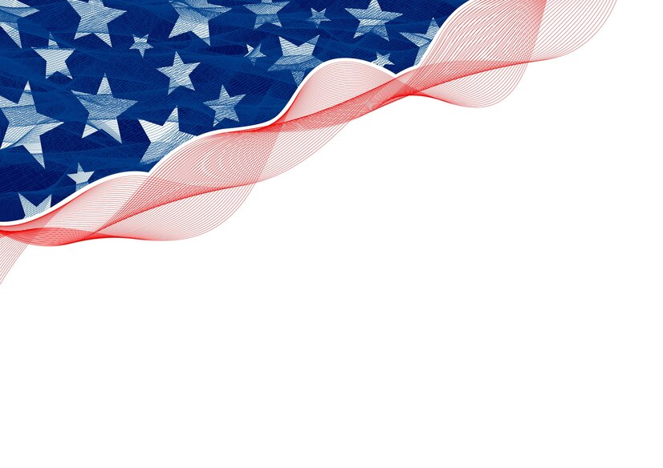
American History

Slide 20
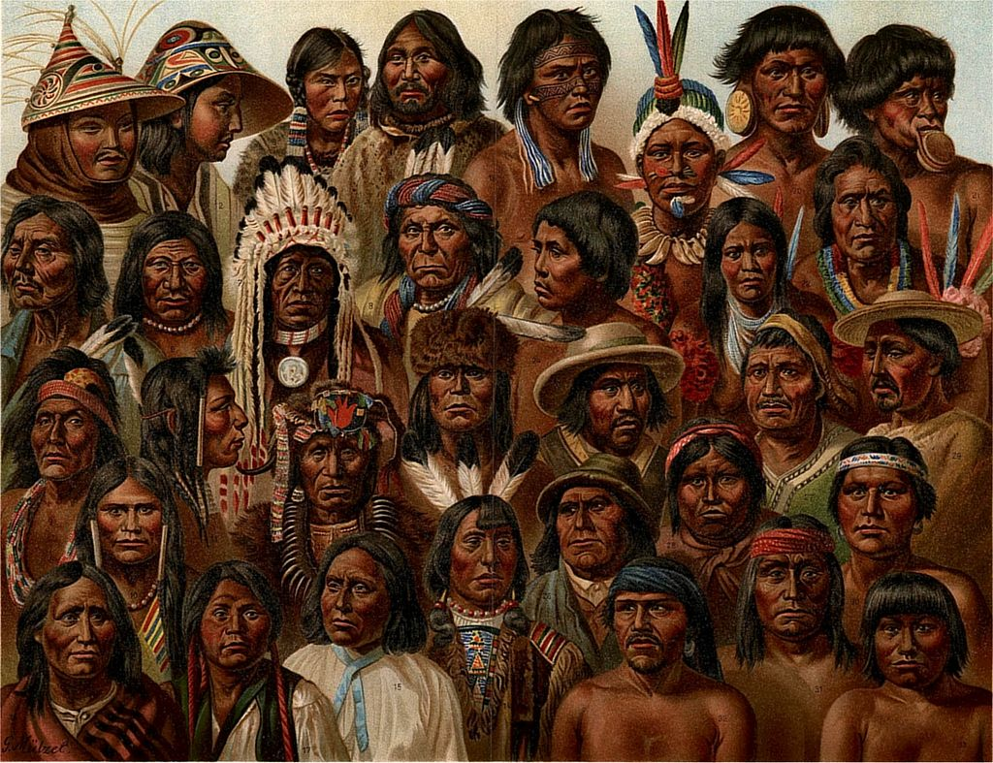
First population
The history of the United States of America begins with the settlement of the North American continent by man around 15,000 BC. e. Gradually, numerous Indian cultures formed on the continent.

Slide 21
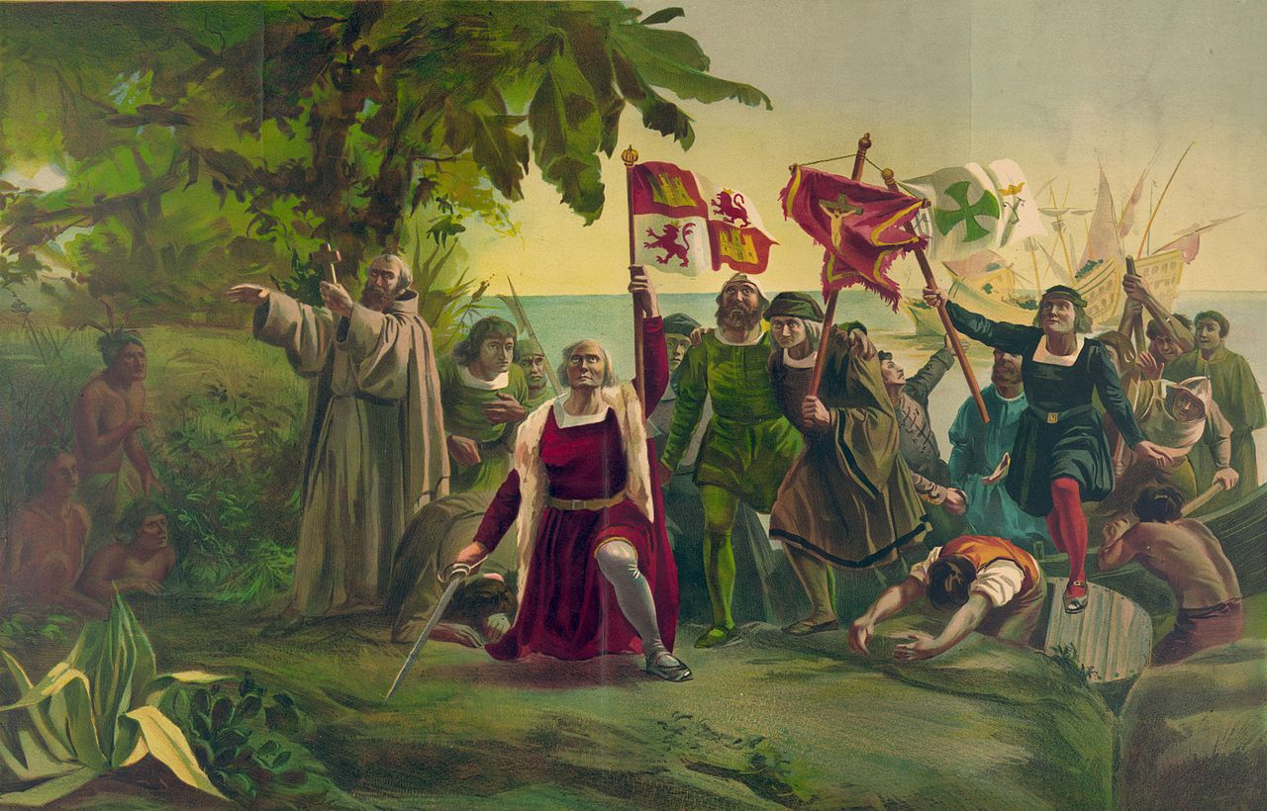
Discovery of America
In 1492, Christopher Columbus visited the islands of the West Indies, and during his second trip in 1493, he personally landed on the island of Puerto Rico, after which the existence of America became known in Europe.

Slide 22
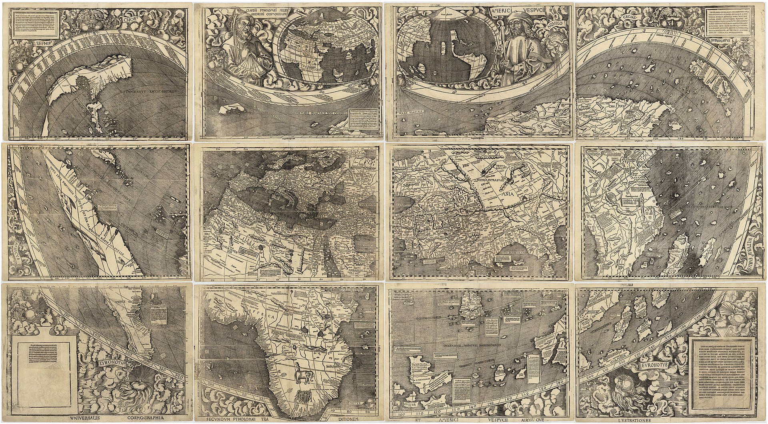
First Map
The Waldseemüller Map or Universalis Cosmographia is a geographical map published in April 1507 by the cartographer Martin Waldseemüller (1470-1521). It is one of the first maps to accurately label latitude and longitude, as well as the first map to bear the name "America".

Slide 23

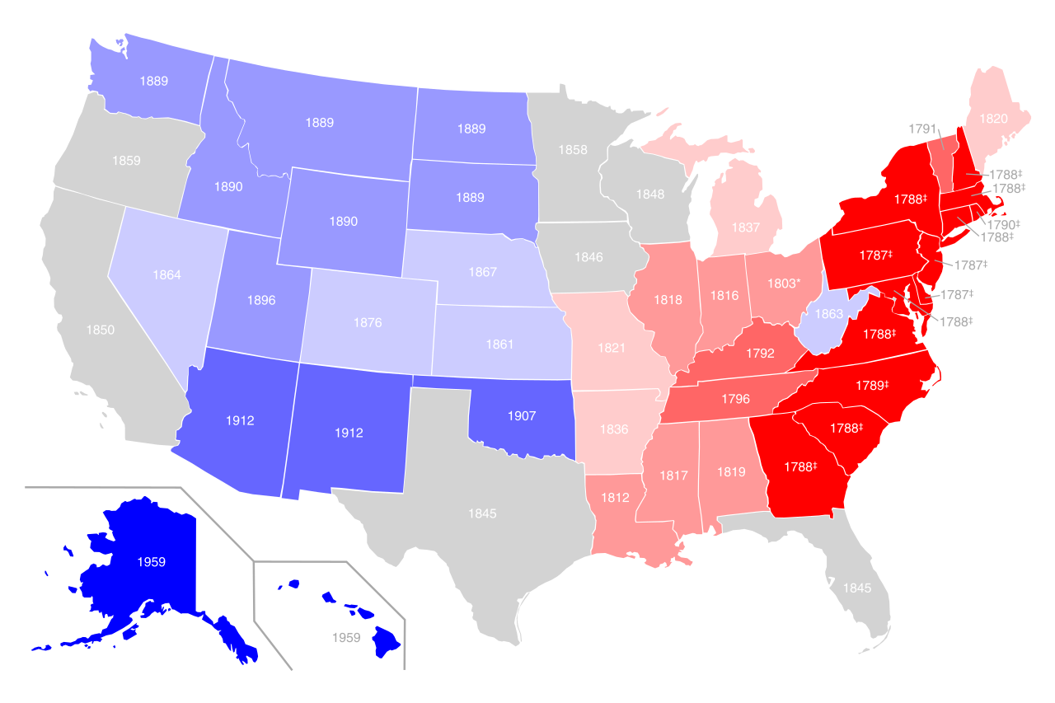
America's Construction
At the dawn of its independence, the United States in 1776 consisted of only thirteen provinces that were part of British North America.
The main territory of the United States was formed by 1912, when the last state, Arizona, was formed in their continental part. By this time, the territory of the states of Alaska and Hawaii also belonged to the United States, but in the status of states they were admitted to the Union in 1959.
Territorial growth of the United States from 1776 to 1959. The year the state became federal is indicated.

Slide 24
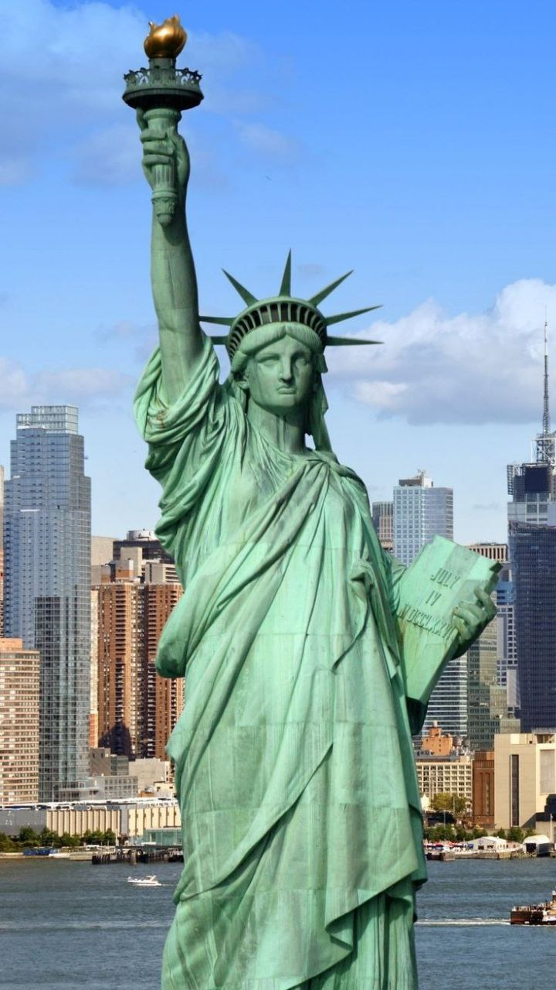
US Independence
The basis of the US Constitution is the text approved in 1788, which included the Declaration of Independence of the United States, which was adopted on July 4, 1776 during the war, which lasted until 1782.
After 1 century, in honor of the centenary of US independence, France gave America the famous Statue of Liberty.

Slide 25
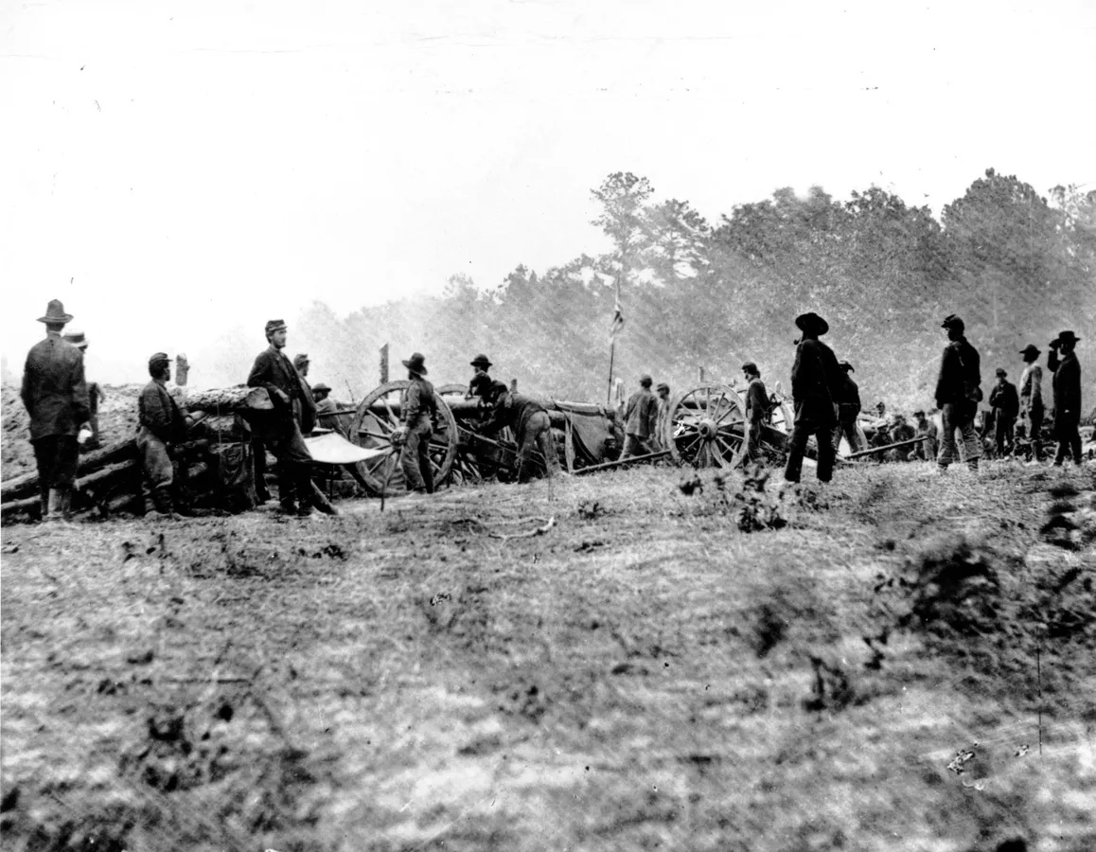
Slavery
In 1865, an amendment was made to the constitution to prohibit slavery in the country. The prohibition of slavery affected most of the American South, which provoked the collapse of the state and civil war in 1861-1865.
The main result of the war was the famous 13th Amendment to the US Constitution, which abolished slavery throughout the country. This was a major step towards equality in American society.

Slide 26
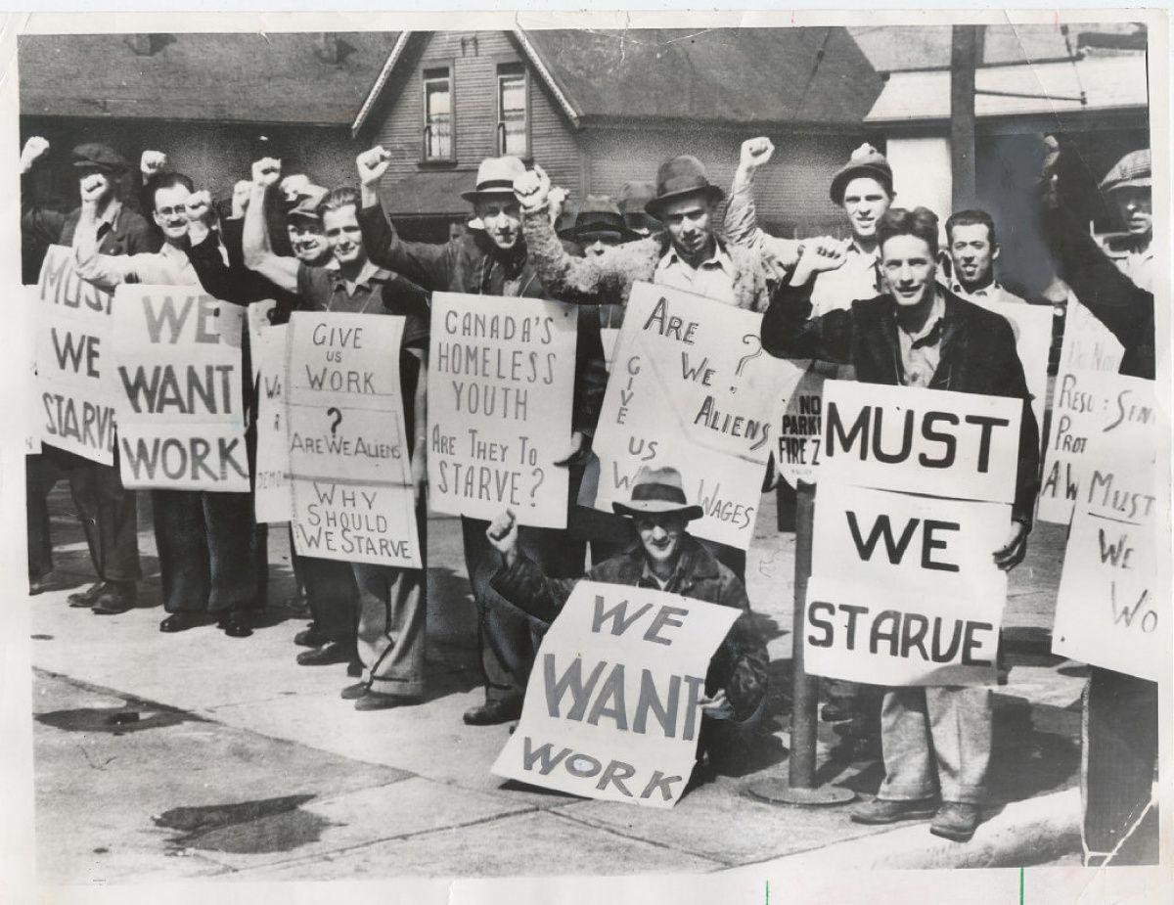
Great Depression
After the Civil War, the United States experienced rapid economic growth, rising living standards, and an era of progressivism. It ended with the advent of the Great Depression in 1929.
The measures taken by the government supported citizens who suffered during the period of economic decline, which marked a new stage in the creation of a welfare state in the United States.

Slide 27
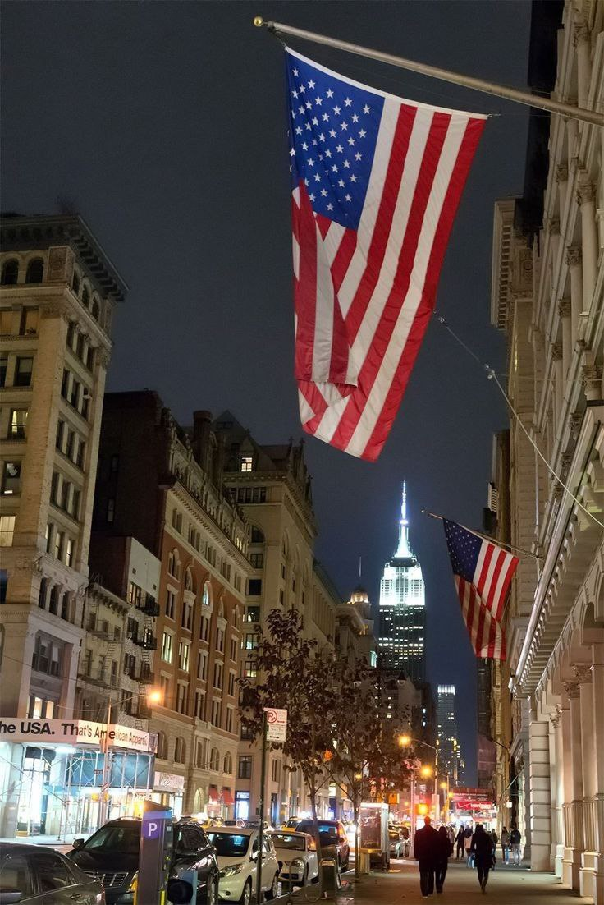
The recovery of the American economy was helped by government military orders, which increased dramatically with the outbreak of World War II and then the Cold War, which led to the transformation of the United States into a world superpower.

Slide 28
Martin Luther King Jr. Day
Prepared
Student of the group
IP-11-22
Yushkova Vera

Slide 29
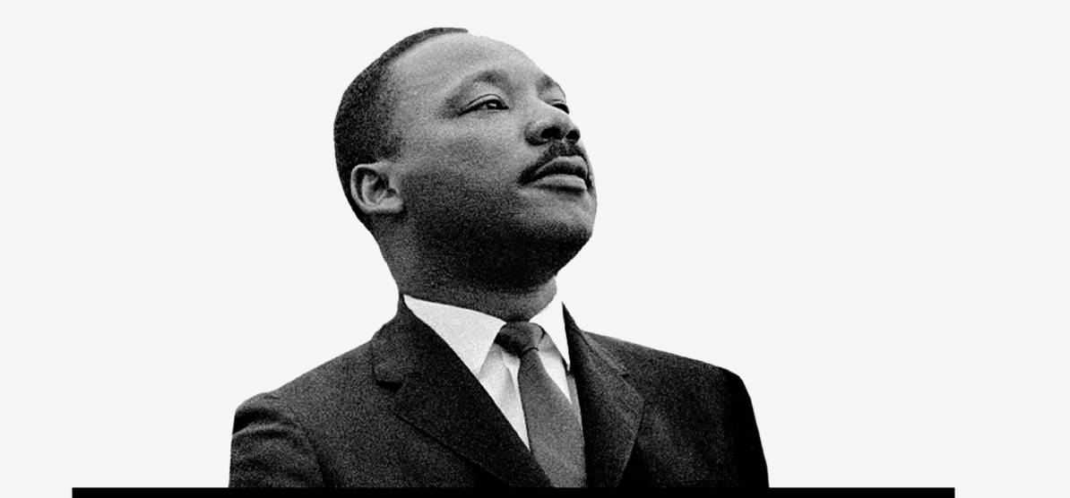
Martin Luther King Jr. Day
Martin Luther King Jr. was born in Atlanta, Georgia on the 15th of January, 1929. originally named Michael, his name was changed to Martin in honour of the founder of the protestant reformation, Martin Luther. He grew up in an era of racial oppression and government-sanctioned segregation. These injustices had a profound effect on his life.

Slide 30

He became a community leader and began speaking out against oppression. In response to Rosa Parks arrest in 1955, he organized the 381 day Montgomery bus boycott. This led to the supreme court ruling that segregation transportation was unconstitutional. King was a proponent of non-violent protest - a philosophy he adopted from Mohandas Gandhi.

Slide 31
In 1965 he participated in the March at Selma for African American voting rights. In 1968 in Memphis he gave his last speech. The next day, April 4th King was shot atop the 2nd-floor balcony on the Lorraine Motel in Memphis. Almost immediately, race riots and protest erupted across the country. King's funeral was attended by more than 100 thousand people.

Slide 32
Martin Luther King Jr. Day
King was posthumously awarded the Presidential Medal of Freedom and a Congressional Gold Medal of Honor. In 1983, the 3rd Monday of every January was declared Martin Luther King Jr. The day a public holiday in the United States.

Slide 33
States of the USA

Slide 34
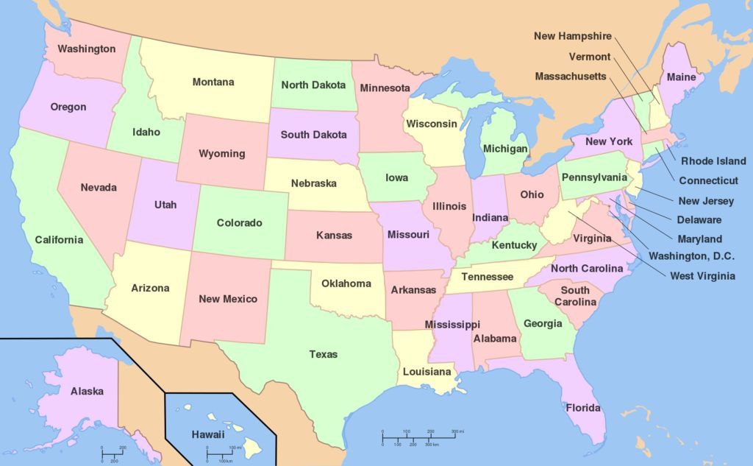
The United States of America includes 50 states. Each state has a governor. Each state can make its own laws.

Slide 35
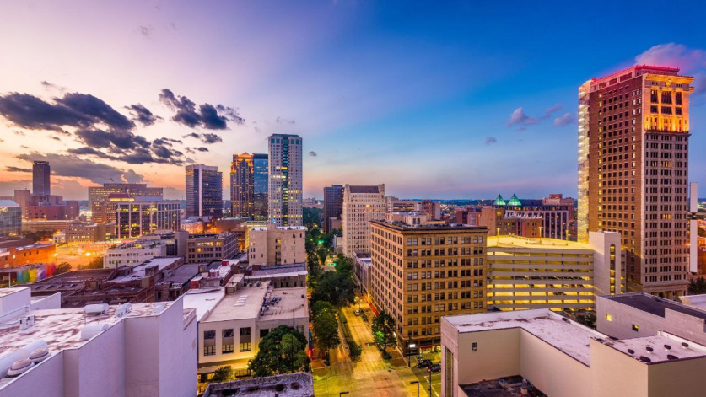
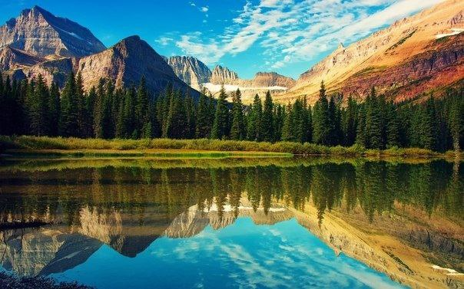
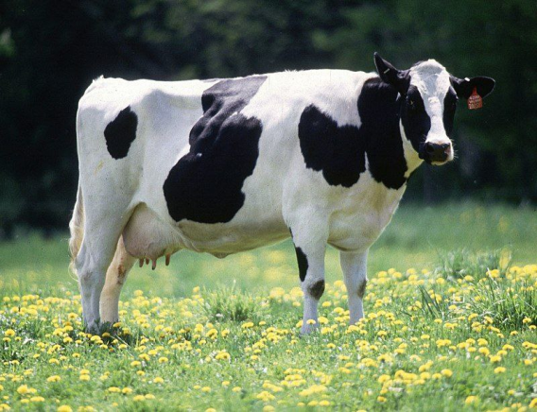
Interesting facts about states of the USA
The official drink of Alabama is an alcoholic drink.
Montana has three times as many cows as people.

Slide 36
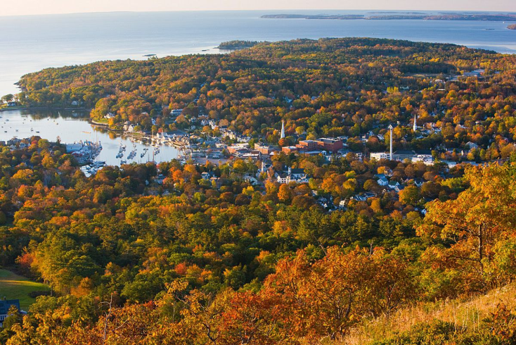
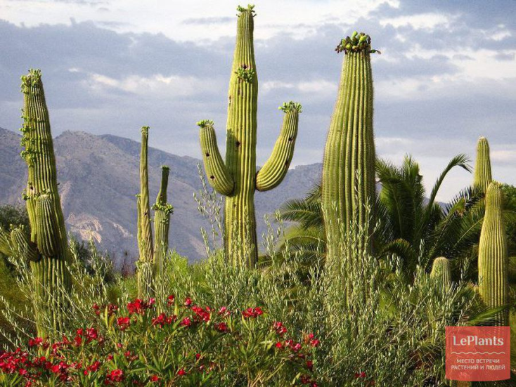
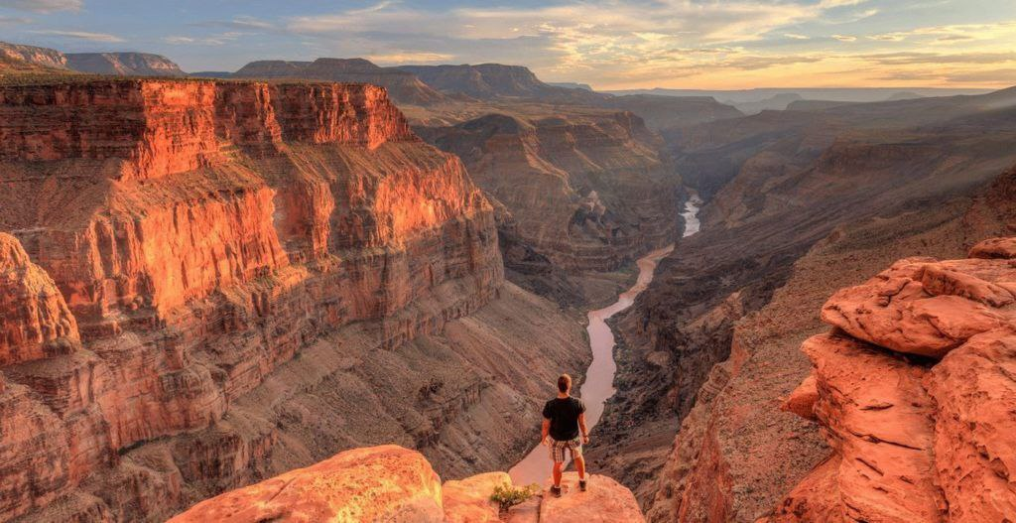
Maine is the most law-abiding state.
You can go to jail for cutting cacti in Arizona.

Slide 37
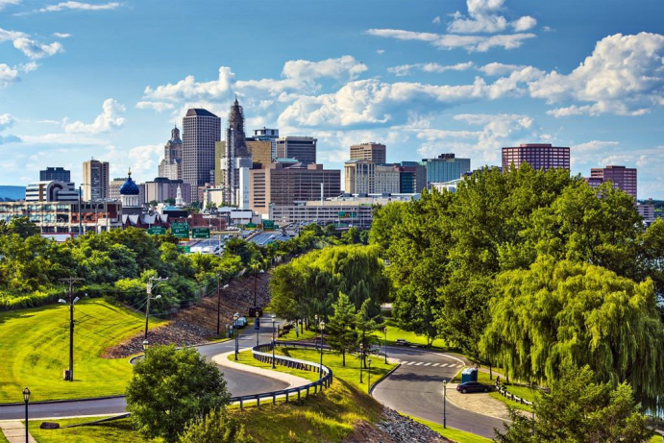
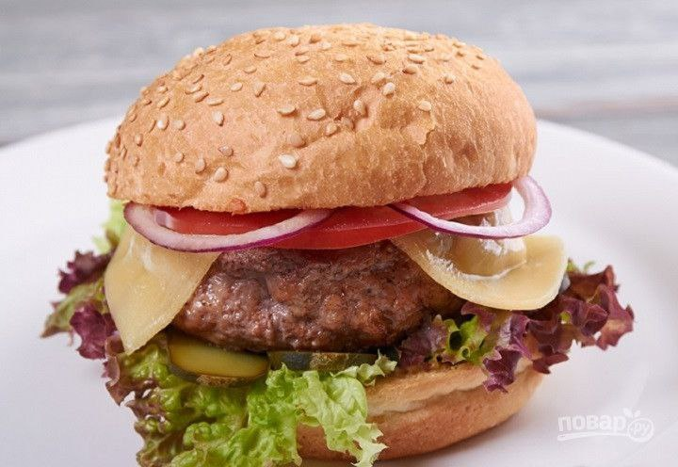
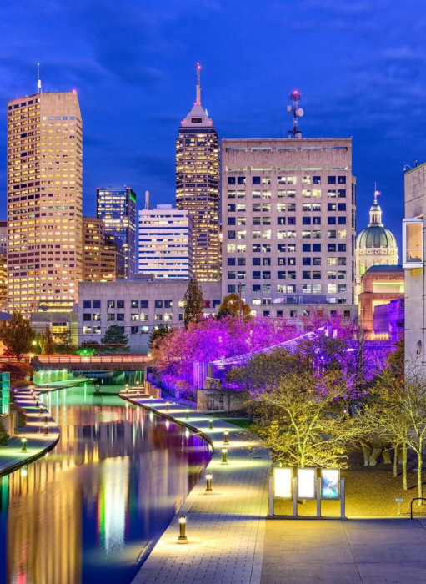

Connecticut is considered the birthplace of the American hamburger.
Indiana is the birthplace of popcorn

Slide 38
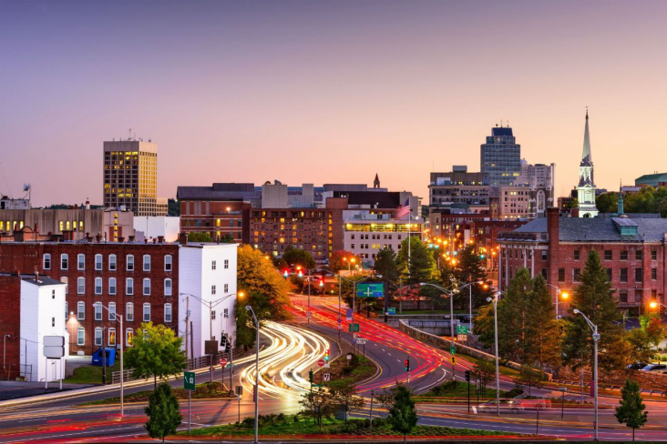
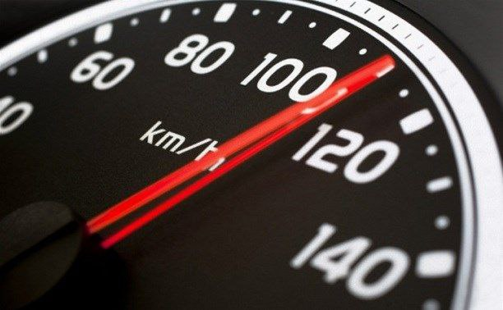
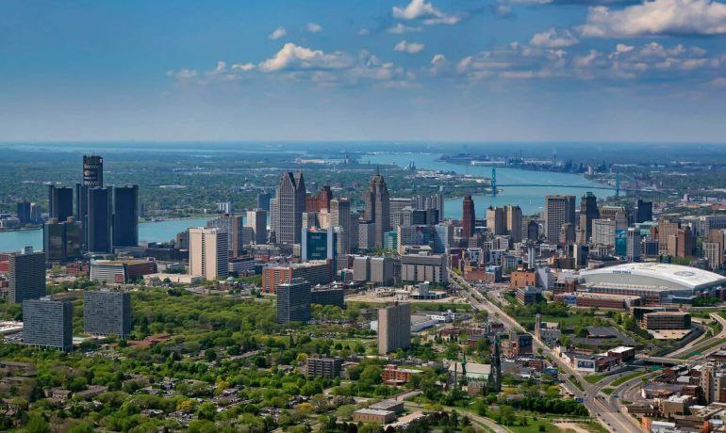

Massachusetts has the highest number of speeding tickets.
Michigan is the state of magic.

Slide 39
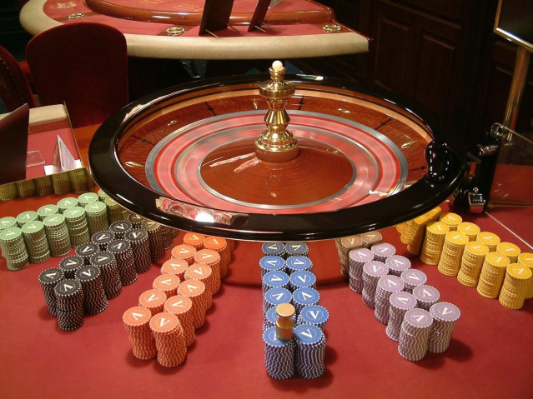
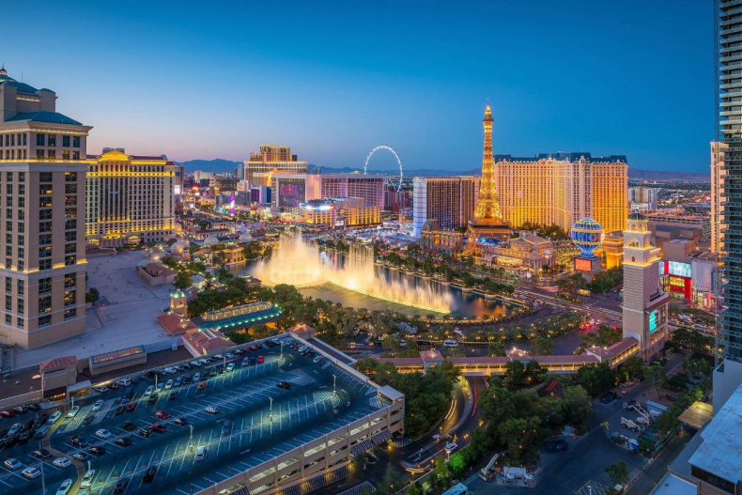
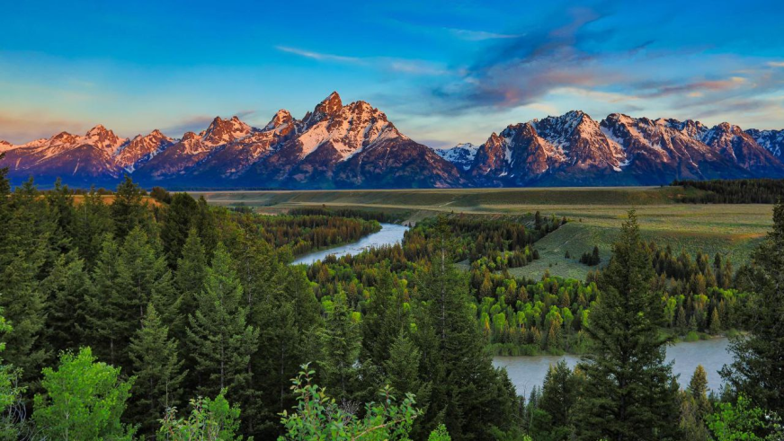
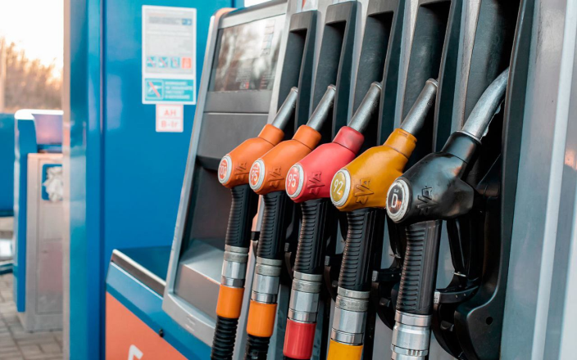
Nevada is the casino capital of the world.
Wyoming spends the most gasoline.

Slide 40
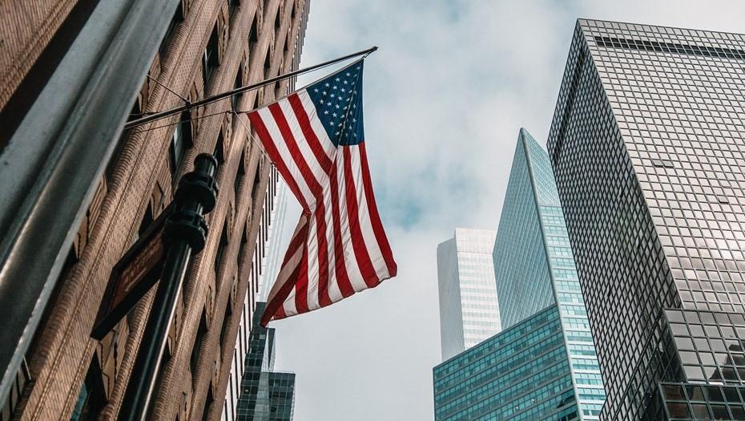
Goverment of the United States
40

Slide 41
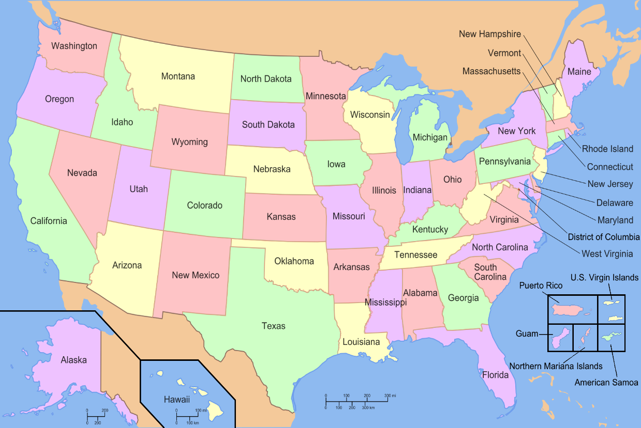
Federal structure
According to its state structure, the United States of America is a federal presidential republic, which includes 50 states and the Federal District of Columbia. In addition, a number of island territories are subordinate to the United States.

Slide 42
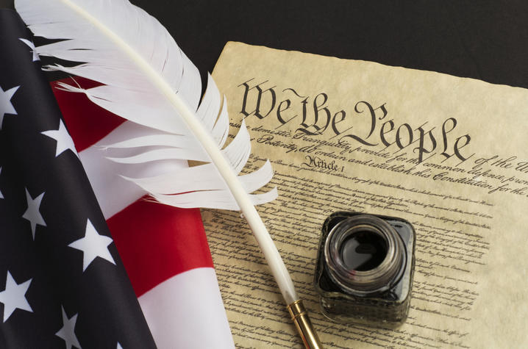
Legal system
The main document of the country is the constitution. It has a clear list of tasks that the central government decides. Matters not included in the constitution are dealt with by the states.

Slide 43
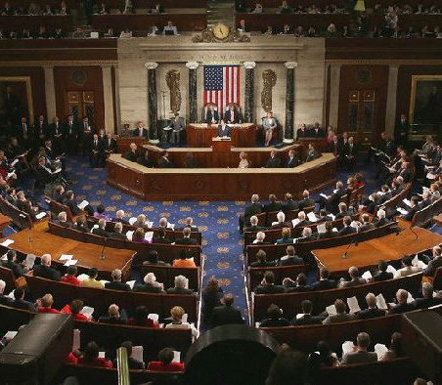
Features of the Congress
The highest federal authority in the United States is Congress. It consists of two chambers: lower and upper. The upper house is called the Senate and the lower house is called the House of Representatives. They are formed on an elective basis. The Senate has two senators from each state.
The functions of the US Congress include: control over the activities of government agencies, the introduction of uniform taxes for all states, the payment of debts, the declaration of war, the formation of an army.

Slide 44
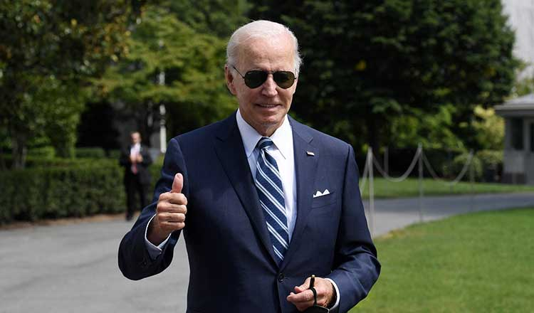
Powers of the President
The presidential form of government assumes that the first person of the state is also the head of the executive branch. The president has very broad powers:
supreme commander
work with the state budget
conducting foreign policy
The political regime in the United States assumes that the vice president and the president must live in different states. In the event of the death of the head of state, the vice-president immediately takes the vacant post and at the same time retains the position of head of government. Similarly, if the president is sick.

Slide 45
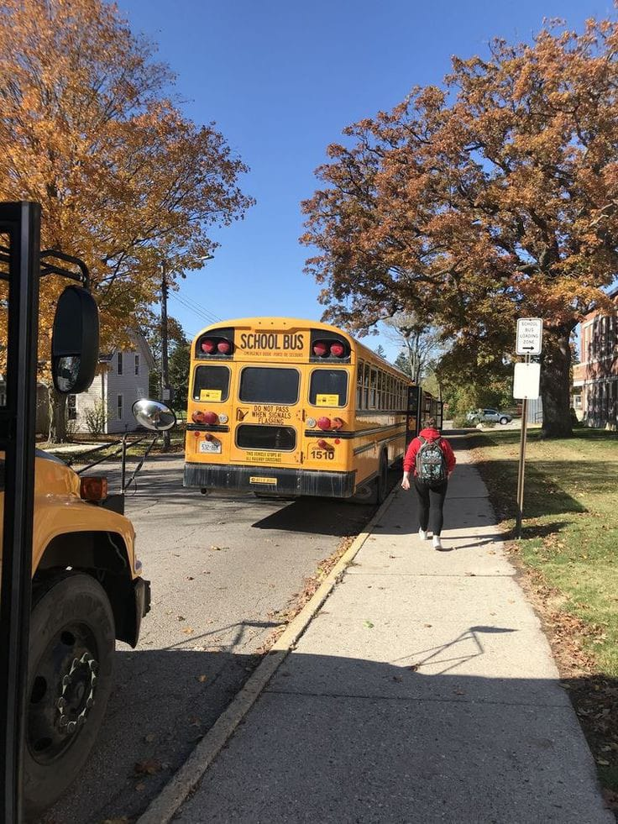
Education in USA
Notes:
Междустрочный интервал + номера страниц

Slide 46
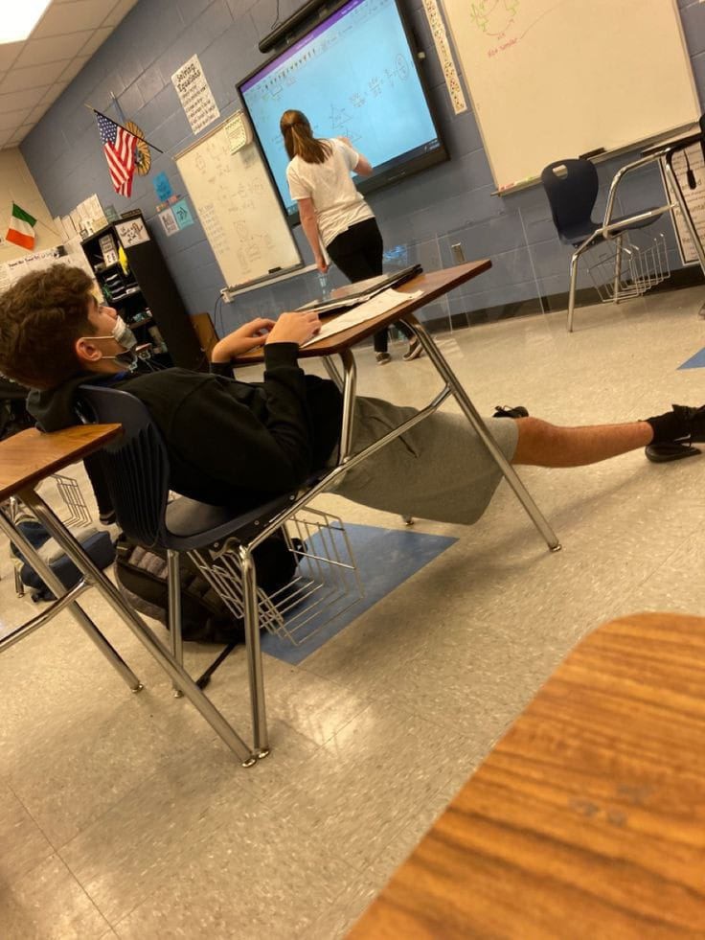
In most school education is divided into 3 levels:
Elementary – grades 1 to 5
Middle school – grades 6 to 8
High school – grades 9 to 12

Slide 47
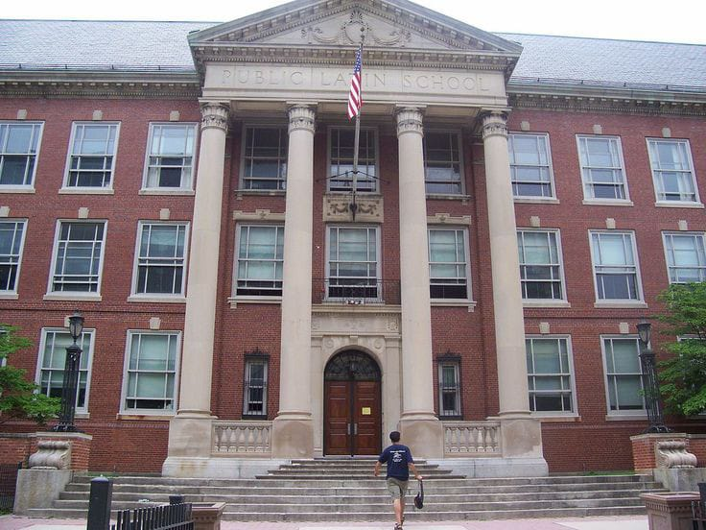
There are three types of schools in the United States:
Public
Private
Home schools

Slide 48
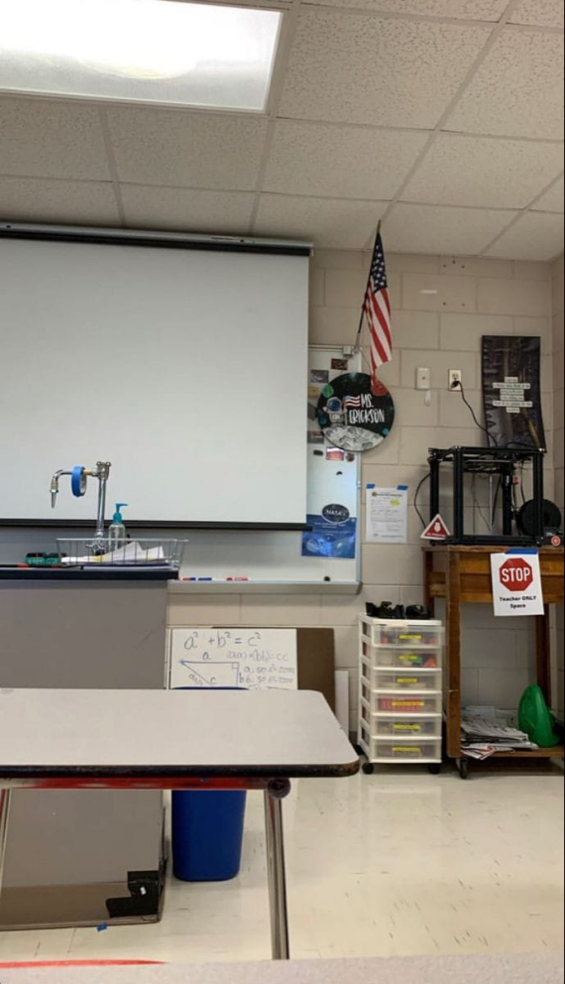

Public school is financed by federal, state, and local government. Parents don’t pay for education

Slide 49
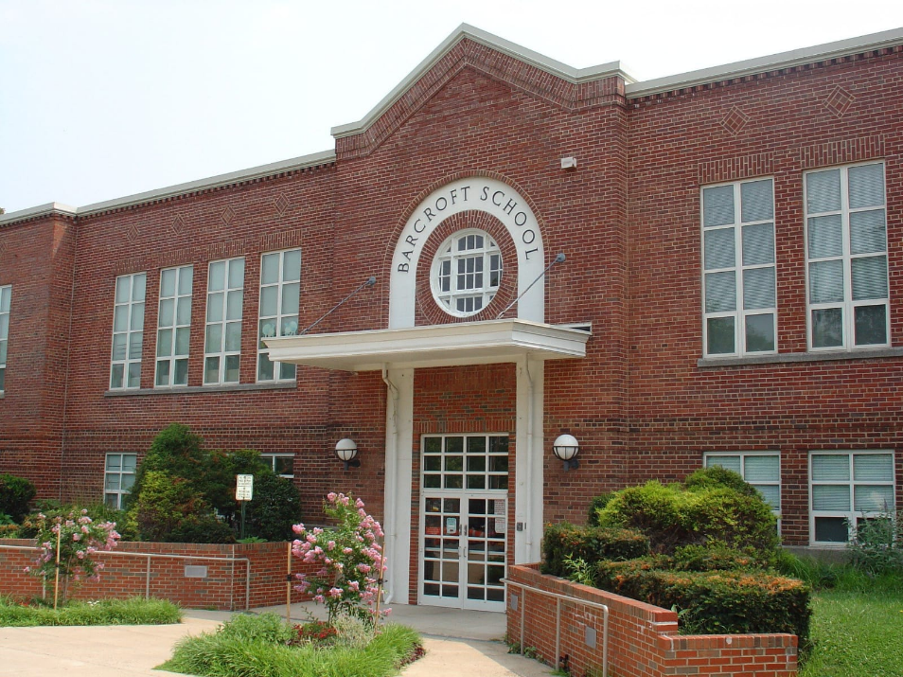
Private schools can choose their own curriculum and set their own rules. This is a paid education.

Slide 50


Children with special disabilities, athletes and others study at home education

Slide 51

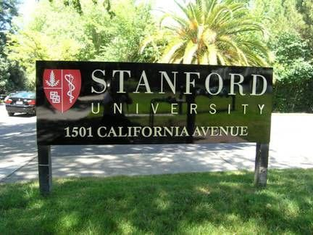
After high school, children have several options:
They can choose a 4-year college or university program and get the professional education
Children can choose a 2-year program in college and get prepared for their future career choice

Slide 52


Graduates of high schools can choose to serve in the US armed forces.
If children are not ready to continue their education, they can have a gap year

Slide 53


Аttractions of USA

Slide 54

Mount Rushmore
The famous mountain on which the portraits of four of the most famous US presidents are carved: George Washington, Thomas Jefferson, Theodore Roosevelt and Abraham Lincoln.

Slide 55

Washington monument
This is the central monument of Washington, built as a symbol of government between the Capitol and the White House.

Slide 56

Yellowstone caldera
Yellowstone is known for its geysers, beautiful landscapes and unspoilt nature. Here you can see unique caves, clear lakes, canyons and rivers

Slide 57






















ATHLETES
FROM THE USA

Slide 58










SWIMMING
Created by:

Slide 59




SWIMMING
MICHAEL PHELPS
THE CHAMPION BEGAN SETTING RECORDS AT THE AGE OF 16. IN TOTAL, HE HAS 28 OLYMPIC MEDALS AND 29 INDIVIDUAL WORLD RECORDS IN HIS ARSENAL.

Slide 60






FUN FACT
MICHAEL DRINKS A VERY LARGE AMOUNT OF WATER A DAY. THE GUINNESS BOOK OF RECORDS EVEN INCLUDED A CASE WHEN HE DRANK 91 LITERS PER DAY, THAT IS, MORE THAN HE WEIGHS.

Slide 61

BASKETBALL
Created by:
Fits Yana

Slide 62


BASKETBALL
SWIMMING
MICHAEL JORDAN
THE BEST BASKETBALL PLAYER IN HISTORY (ACCORDING TO ESPN experts ). Played as an attacking defender . Jordan was instrumental in popularizing basketball and the NBA around the world in the 1980s and 1990s . Two-time Olympic champion .

Slide 63



FUN FACT
MICHAEL JORDAN'S PARENTS WERE UNDER 173 CM TALL, AND THE HEIGHT OF THE LEGENDARY BASKETBALL PLAYER IS 198 CM.

Slide 64




Slide 65


SNOWBOARDING
Created by:
Yana Fits

Slide 66



SNOWBOARDING
SHAUN WHITE
SHAUN WHITE IS AN AMAZING THREE-TIME OLYMPIC GOLD MEDALIST AND ALSO HOLDS THE RECORD FOR THE MOST X GAMES GOLD MEDAL HOLDER BY A SNOWBOARDER. HE HAS ALSO WON THE EXCELLENCE IN SPORTS PERFORMANCE YEARLY AWARD (ESPY AWARD).

Slide 67


FUN FACT
AMERICAN SNOWBOARDER SHAUN WHITE, KNOWN AS THE “FLYING TOMATO” BECAUSE OF HIS LONG RED HAIRETBALL

Slide 68




Slide 69



CONCLUSION
THE UNITED STATES OF AMERICA IS A SPORTS POWER. SPORTS. AMERICAN ATHLETES TRADITIONALLY LEAD IN SO MANY EVENTS AT THE WORLD CHAMPIONSHIPS AND RANK FIRST AMONG ALL NATIONAL TEAMS IN THE NUMBER OF MEDALS WON AT THE OLYMPIC GAMES (MORE THAN TWO AND A HALF THOUSAND).

Slide 70
THE END

