Slide 1
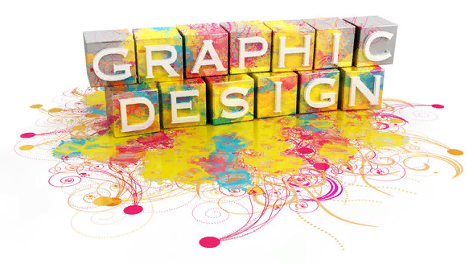
Graphic design
Plan:
What is graphic design?
History of graphic design
Types of graphic design

Slide 2
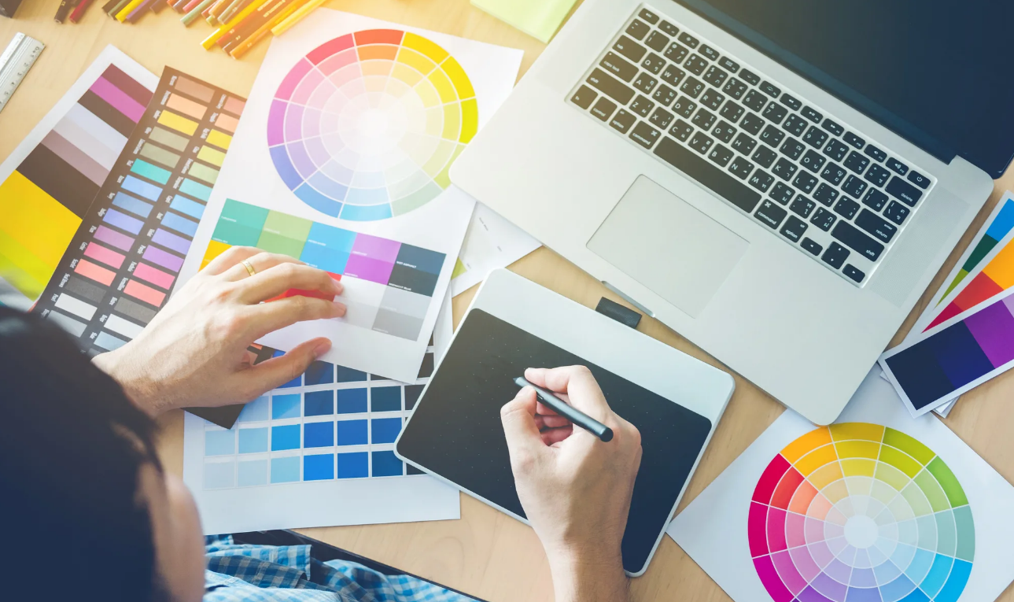
1. What is graphic design?
Graphic design is the practice of composing and arranging the visual elements of a project.
Designing the layout of a magazine, creating a poster for a theatre performance, and designing packaging for a product are all examples of graphic design.

Slide 3
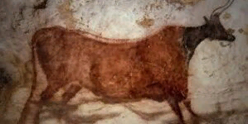
2. History of graphic design
The history of graphic design goes back so far it spans all of the development of art. The earliest documented visual communications emerged in 3,600 BC, which is when graphic design may be found.

Slide 4
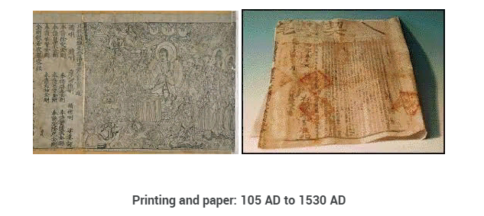
The idea of printing originated with the discovery of paper in 105 AD by a Chinese man. Character placement for printing was made possible by the invention of moveable type nearly a thousand years later (1045 AD).

Slide 5
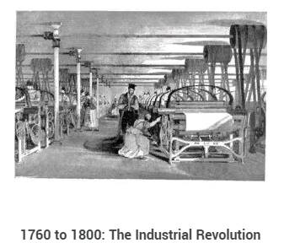
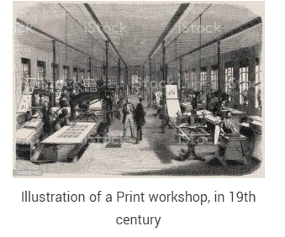
By 1276, a paper mill had made its way to Fabriano, Italy, bringing printing to Europe for good.
Two hundred years after the first paper mill entered Europe, in 1450, the method of printing type in books was seen to be ideal. In 1460, the first printed book with images appeared shortly after. In the 1760s, the Industrial Revolution began, ushering in a new era for graphic design.

Slide 6
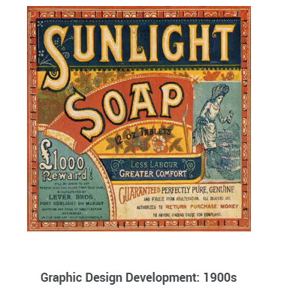
Graphic design has been making its way into corporate procedures since the Industrial Revolution, but in the 1900s, its use surged. Businesses started developing logos to help brand their companies as the advertising sector and color printing expanded.

Slide 7
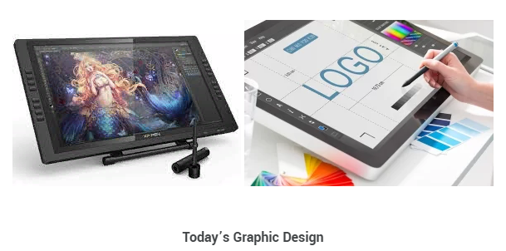
Graphic design today primarily relates to creating images for publications including magazines, books, ads, and digital posters. This intricate area of design deals with the fine skill of conveying concepts through both text and images. Although some graphic designers still work with paintings and drawings, most graphic design is now done with digital tools.

Slide 8
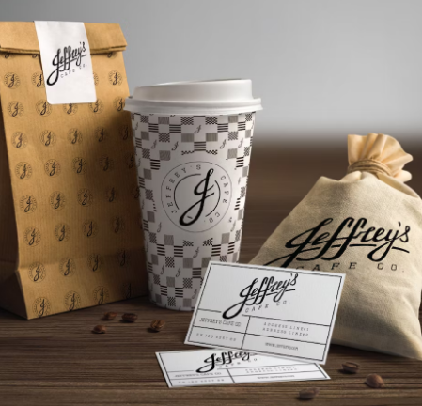
3. Types of graphic design
1. Visual identity graphic design
A brand is a relationship between a business or organization and its audience. A brand identity is how the organization communicates its personality, tone and essence, as well as memories, emotions and experiences.
Designers that specialize in visual identity graphic design collaborate with brand stakeholders to create assets like logos, typography, color palettes and image libraries that represent a brand’s personality.

Slide 9
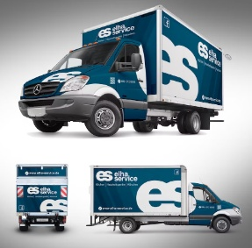
2. Marketing & advertising graphic design
All companies depend on marketing efforts to gain traction and attract their target audience. The strategy used by marketing designers is based on consumer awareness and the decision-making process. Visual content is often more engaging, hence the graphics used should effectively promote and communicate with the audience.
Examples of marketing graphic design
Postcards and flyers
Magazine and newspaper ads
Posters, banners and billboards
Infographics
Brochures (print and digital)
Vehicle wraps
Signage and trade show displays
Email marketing templates
Menus
Social media ads, banners and graphics

Slide 10
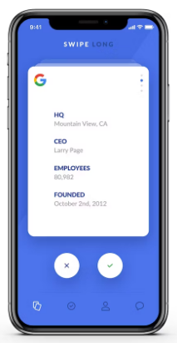
3. User interface graphic design
A user interface (UI) is how a user interacts with a device or application. UI design is the process of designing interfaces to make them easy to use and provide a user-friendly experience.
Examples of user interface graphic design
Web page design
Theme design (WordPress, Shopify, etc.)
Game interfaces
App design

Slide 11
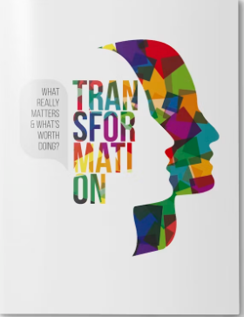
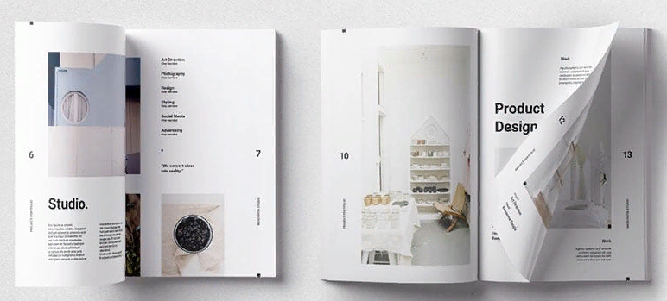
4. Publication graphic design
Publications are long-form pieces that communicate with an audience through public distribution. They have traditionally been a print medium. Publication design is a classic type of design—think books, newspapers, magazines and catalogs.
Examples of publication graphic design
Books
Newspapers
Newsletters
Directories
Annual reports
Magazines
Catalogs

Slide 12
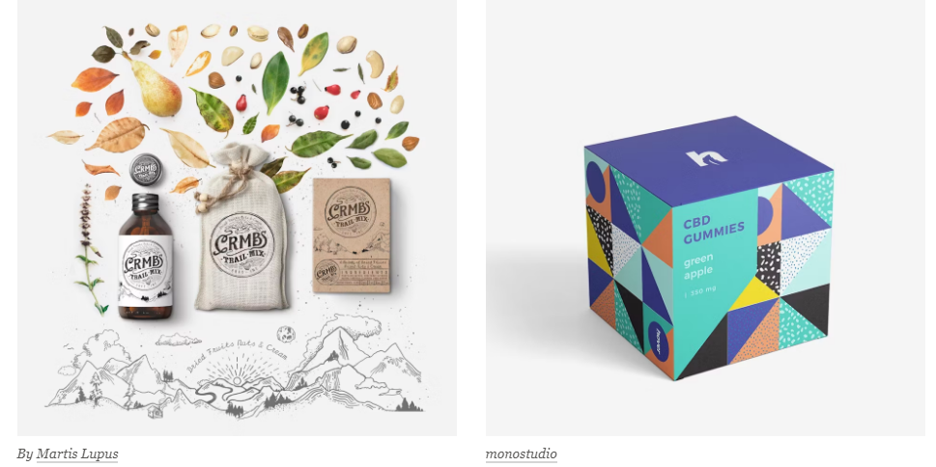
5. Packaging graphic design
Most products require some form of packaging to protect and prepare them for storage, distribution, and sale. But packaging design can also communicate directly to consumers, which makes it an extremely valuable marketing tool. Every box, bottle and bag, every can, container, or canister is a chance tell the story of a brand.
Packaging designers create concepts, develop mockups and create the print-ready files for a product.

Slide 13
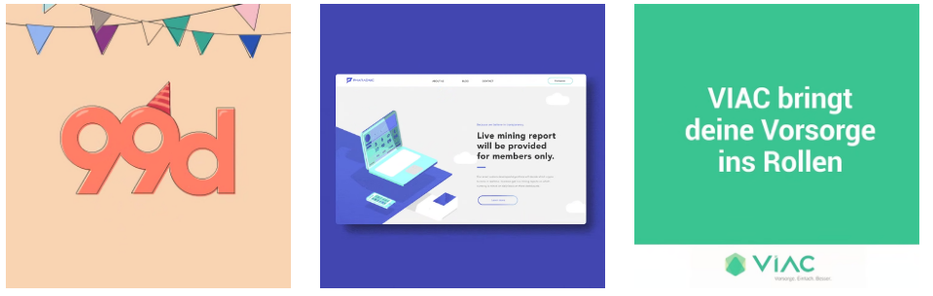
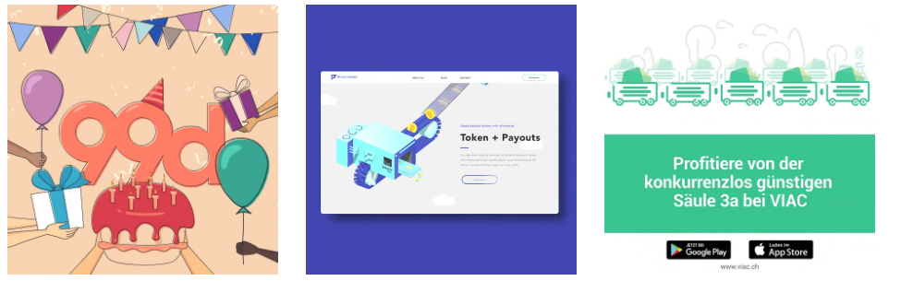
6. Motion graphic design
Simply put, motion graphics are graphics that are in motion. This can include animation, audio, typography, imagery, video and other effects that are used in online media, television and film. The medium’s popularity has skyrocketed in recent years as technology improved and video content became king.
Examples of motion graphic design
Title sequences and end credits
Advertisements
Animated logos
Trailers
Promotional videos
Websites, Apps,Video games
GIFs

Slide 14

7. Environmental graphic design
Environmental graphic design visually connects people to places to improve their overall experience by making spaces more memorable, interesting, informative or easier to navigate. Environmental design is a broad type of design.
Examples of environmental graphic design
Signage
Wall murals
Museum exhibitions
Office branding
Public transportation navigation
Retail store interiors
Stadium branding
Event and conference spaces

Slide 15
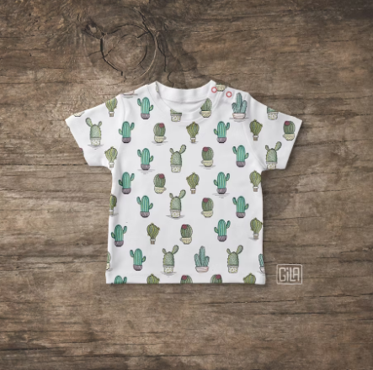
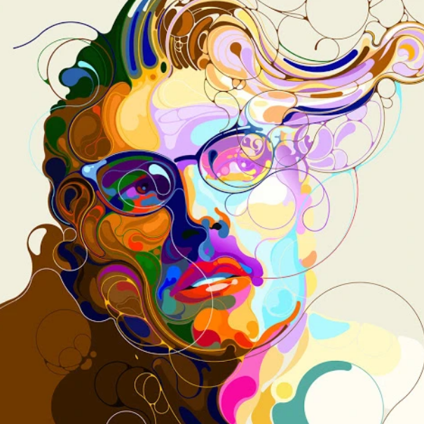
8. Art and illustration for graphic design
Graphic art and illustration are often seen as being the same as graphic design, however, they’re each very different. Designers create compositions to communicate and solve problems, graphic artists and illustrators create original artwork. Their art takes a number of forms, from fine art to decoration to storytelling illustrations.
Examples of art and illustration for graphic design
T-shirt design
Motion graphics
Stock images
Graphic novels
Video games,Websites
Comic books, Album art
Book covers, Picture books

