Slide 1
The history of the development of the hospitality industry

Slide 2
Vocabulary list
hospitality гостеприимство
to be bundled together быть взаимосвязанным
to provide обеспечивать
weary уставший
increased возросший
response ответ
to influence влиять
leisure отдых, досуг
inn таверна
to appear появляться
to create создавать
hierarchy иерархия
culinary кулинарный
chef шефповар
explosion взрыв, быстрый рост
luxury роскошь
to cater to обслуживать
to introduce представлять
convenience удобство
private bathroom ванная комната в номере
advance успех, прогресс
to allow позволять
to dominate доминировать
to consider рассматривать
to experience испытывать
due to благодаря, изза
salary зарплата
retirement пенсия
to remain оставаться

Slide 3

The history of the development of the hospitality industry in Russia
In the Old Russian language, the word «гость» appeared in the XI century and meant "visiting merchant".

Slide 4
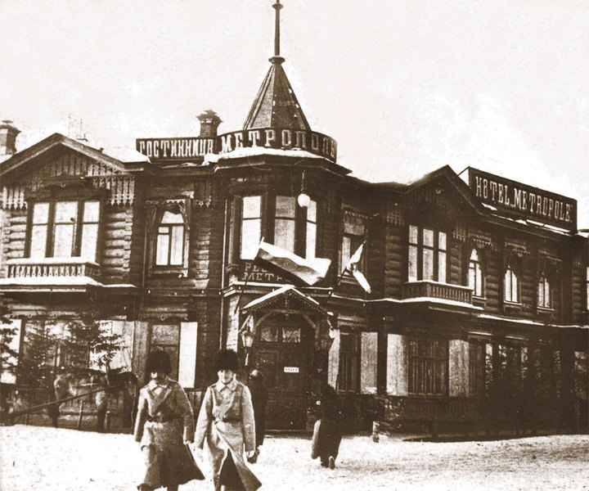

Slide 5

A regulation that regulated the rules for the maintenance of hotels, restaurants and inns

Slide 6
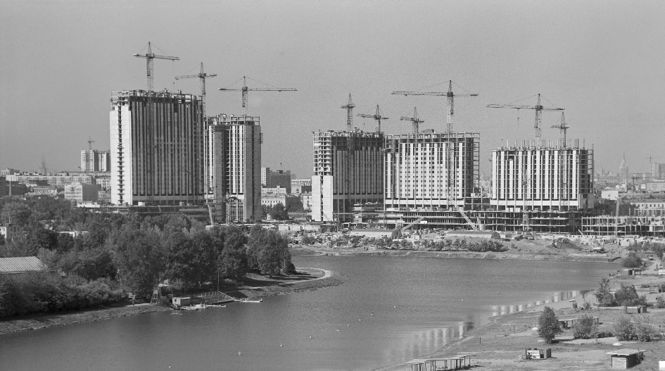
«Izmailovo» Hotel complex, 1980, USSR

Slide 7
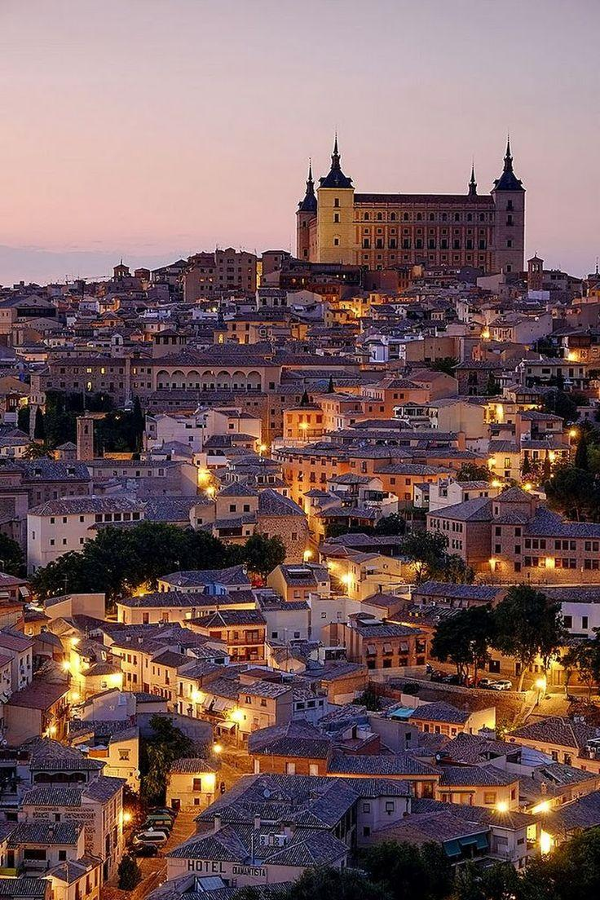
History of the development of the hospitality industry in Spain

Slide 8
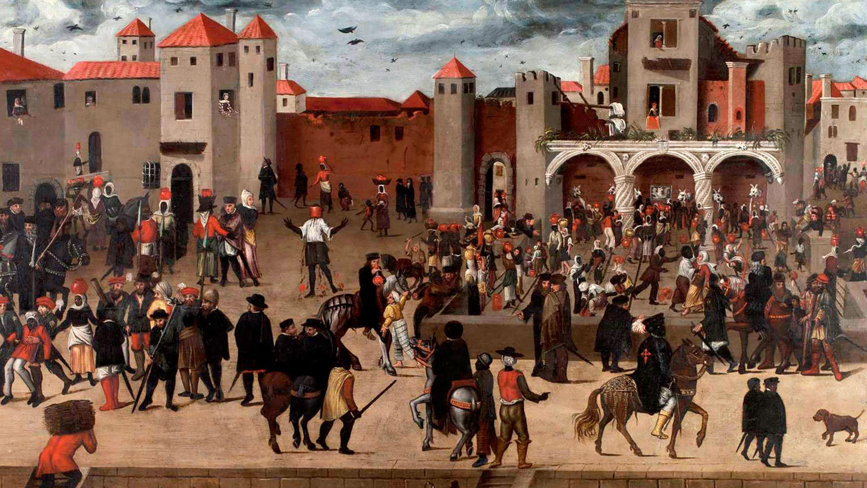
The hotel industry in Spain has a rich history that dates back to the times of the Roman Empire. During the Renaissance and the period of colonization of the New World in the 16th-17th centuries, Spain became one of the major world powers. This contributed to the development of the hotel business, as a large number of people came to the country for trade and diplomatic purposes.

Slide 9

Beginning in the 19th century, the first modern hotels began to appear in Spain, such as the Gran Hotel de L’Eixample in Barcelona and the Hotel del Príncipe in Madrid. These hotels offered their guests comfortable rooms, restaurants, swimming pools and other amenities, making them popular among tourists and business people.

Slide 10
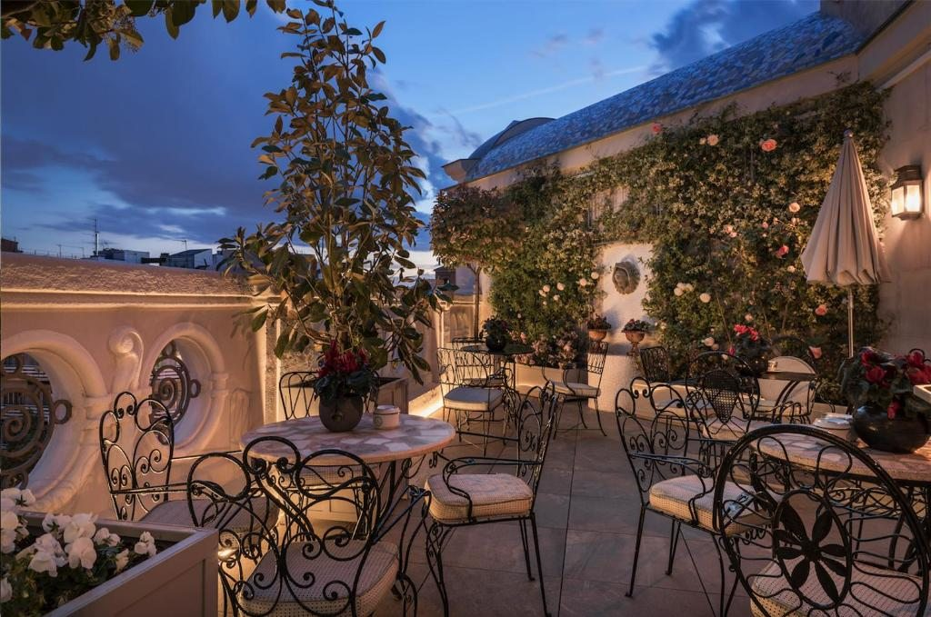
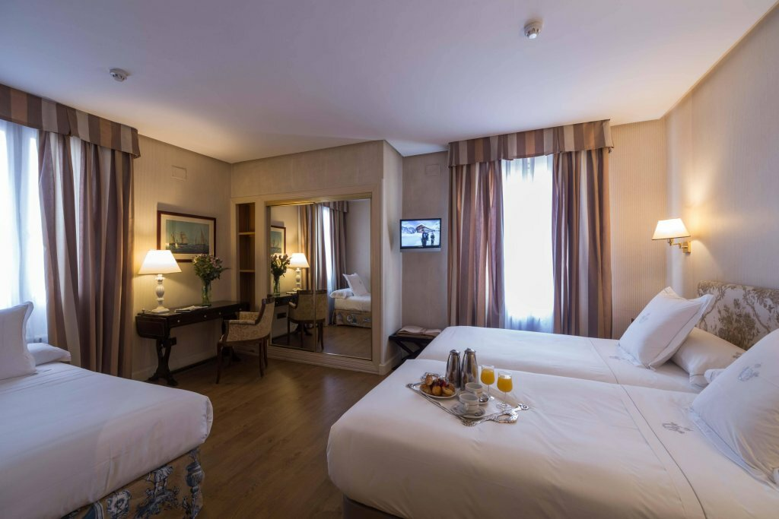

Slide 11
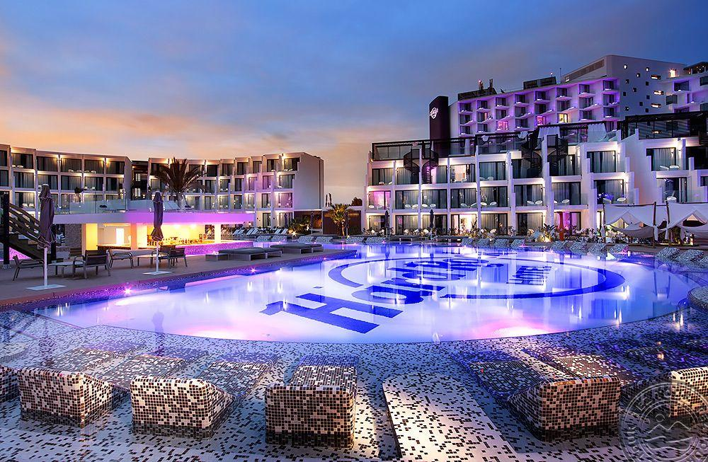
Today, the hotel industry in Spain continues to develop, offering an increasing variety of accommodation options for tourists, businessmen and other guests of the country. Spain has more than 80,000 hotels of various categories, from small family hotels to luxury five-star resorts.

Slide 12
History of the hospitality industry development in Armenia

Slide 13
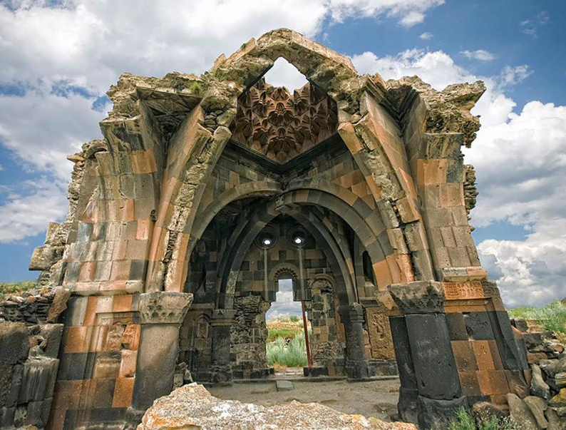
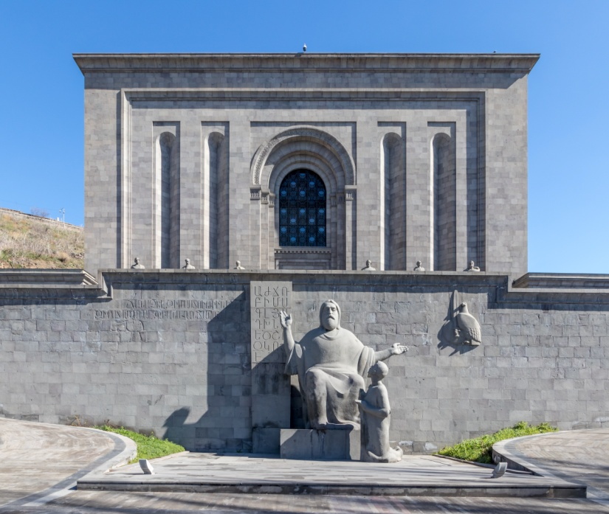
Armenia is an ancient country with a unique history. There are many ancient architectural monuments (mostly dilapidated) preserved in Armenia, which may be of great interest to tourists. The history of Armenia is also reflected in ancient Armenian manuscripts stored in a unique museum-book depository - Matenadaran.

Slide 14
In order to ensure a stable growth in the number of international tourists, the priority task is to promote Armenian tourism products on the international tourism market - by forming an idea of the Republic of Armenia as a country favorable and attractive for tourism, as well as integration into the international tourism market.
To solve this problem, the Armenian Tourism Development Agency (AART) CJSC was established in 2001, the main function of which is marketing and promotion of the tourism product of Armenia.

Slide 15
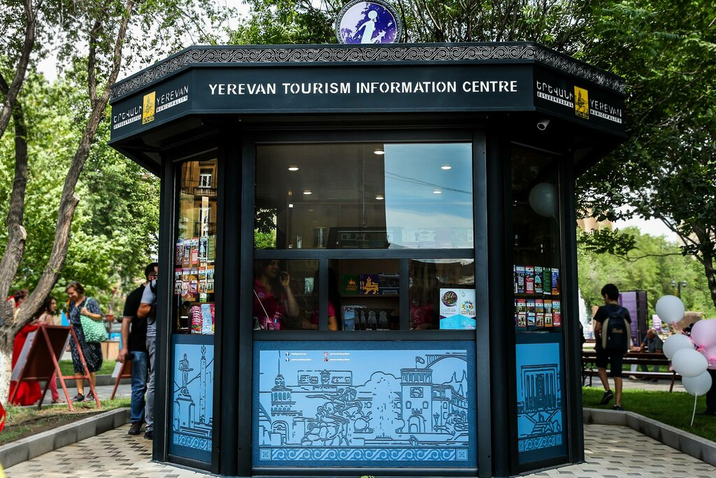
In order to provide information and consulting services to tourists, the first tourist information center "Armenia" was established in 2001, which contains a lot of advertising materials and information necessary for tourists about Armenian tourist products, which increases the detailed awareness of tourists and facilitates emerging problems.
As part of the implementation of the marketing policy, Armenian tourism products are presented at major international tourism exhibitions and fairs

Slide 16
In order to conduct educational tours during 2005, tour operators from Belgium and Japan, as well as groups of journalists from leading newspapers and magazines in Europe specializing in tourism were invited to Armenia.
Over the past 2006, within the framework of the annual tourism development program, the process of developing information and advertising support for the tourism sector continued: a lot of advertising materials were printed, participation in international tourism exhibitions was ensured, and since March 2007, advertising and informational videos about Armenia have been broadcast on CNN and EuroNews TV channels.

Slide 17

The Fund for the Development of Tourism in Armenia operates in Yerevan. 41 travel agencies and 4 tour operators can provide services to tourists.33 limited liability companies are also engaged in tourism issues in Yerevan.

Slide 18
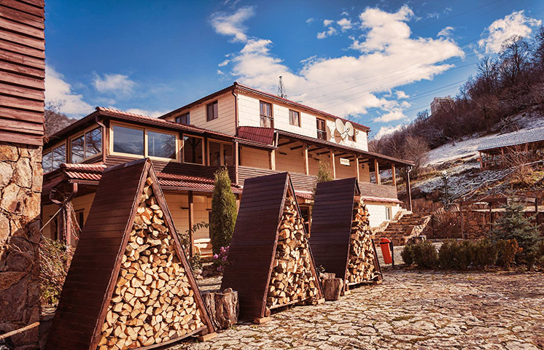
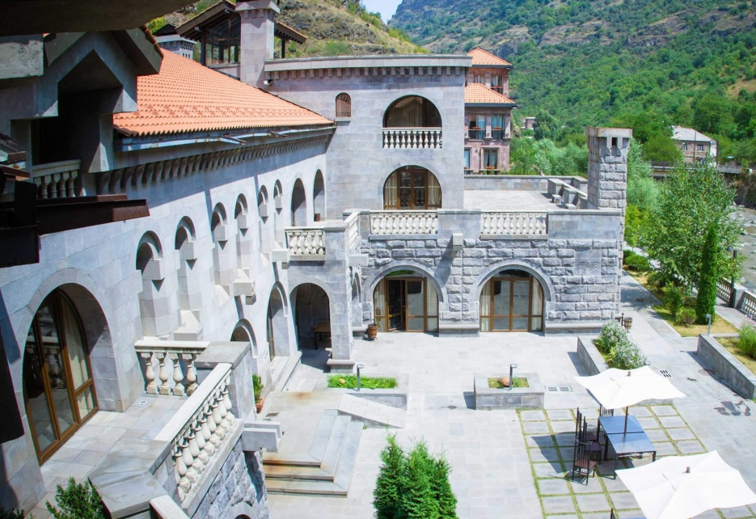

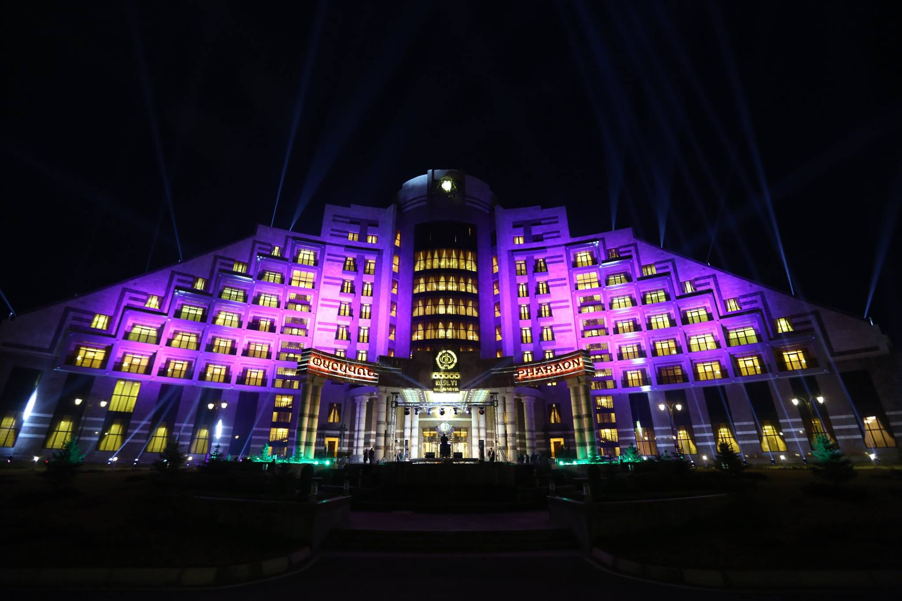
Hotels in Armenia

Slide 19



History of the hospitality industry in India

Slide 20
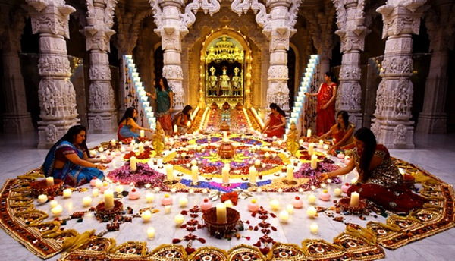
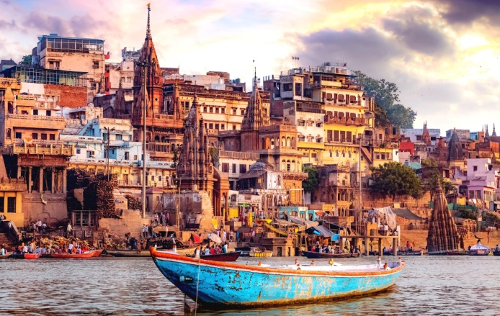
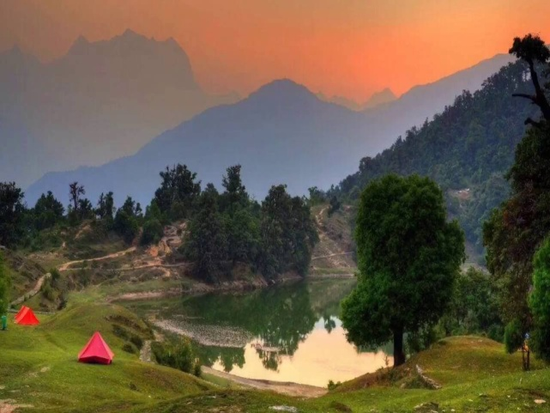
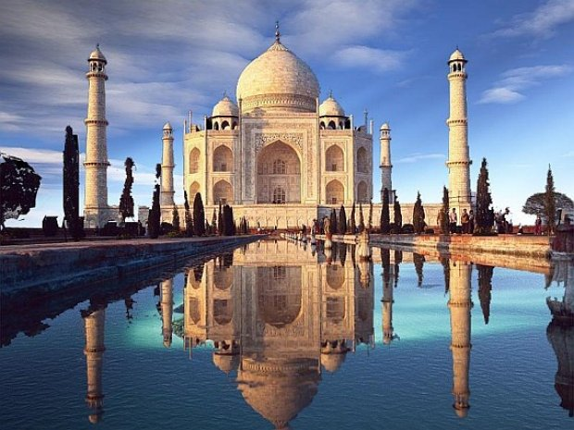
What attracts us to India!?
India is an incredibly beautiful country. It is as if she was transferred from the world of dreams to reality: majestic palaces, ancient temples, jungles with lush vegetation, huge waterfalls with crystal water, Indian women in bright saris... In addition, do not forget that it is here that the three most famous sights in the world are located: Taj Mahal, Himalayas, Ganges!
Firstly, simply because in such an exotic India for us, the rest turns out to be more complete. Climate, nature, local population, other culture and customs

Slide 21
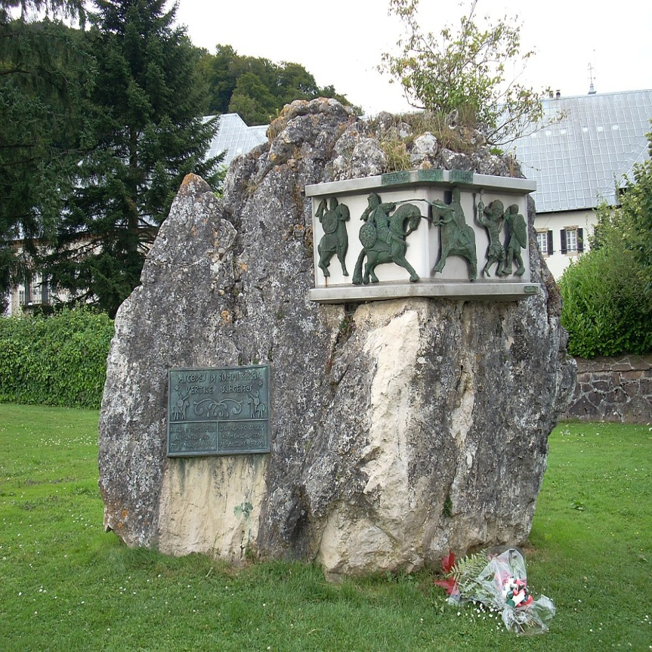
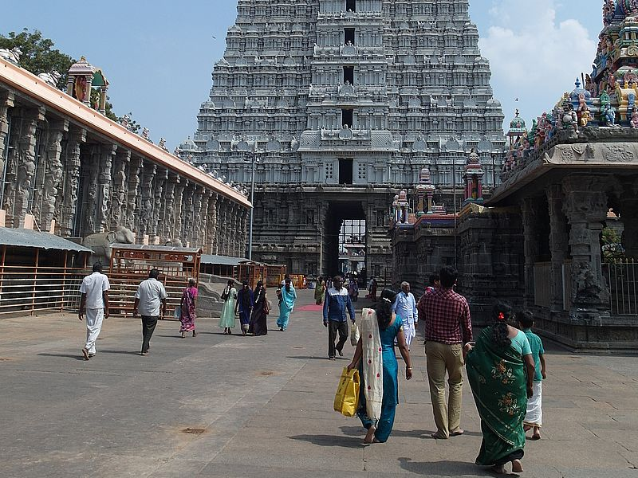
The history of the emergence of hotels and hotel business is connected with all kinds of travel, trips made by people. And people who found themselves far from their places of permanent residence had to take care of providing themselves with food, shelter and rest.
The development of hospitality enterprises in the Middle Ages was greatly influenced by religious traditions. During this period, the number of people who made pilgrimages to holy places increased dramatically.
The Church obliged monasteries to provide hospitality to pilgrims, to organize overnight accommodation for them, to provide food. One of these houses, the abbey in the Ronselval Gorge, provided travelers with a warm welcome at the gate, free bread, the services of a barber, a shoemaker, fruits and nuts from the bins of the abbey and much more.

Slide 22
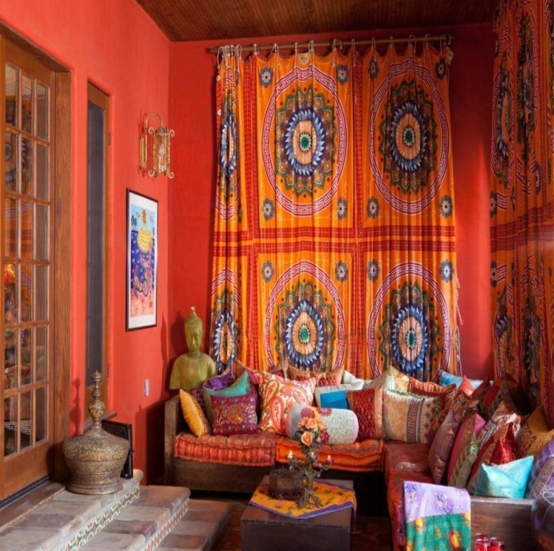
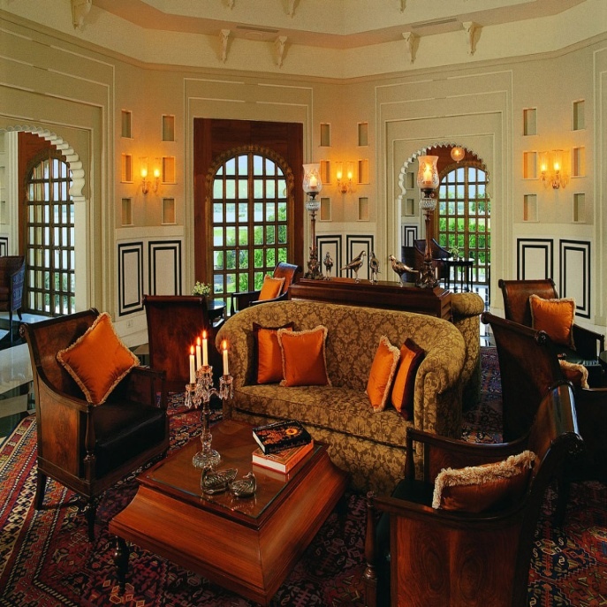
All hotels and inns in India are divided into "Indian" and "Western" style.
The "Indian" style differs from the Western one:
a) standing toilet, b) less clean, c) hot water in buckets or toilet and bathroom alone on the floor, d) linen is almost not changed.
There are a lot of "Western" style hotels and inns in tourist places. The price varies depending on the amenities. Not all hotels have a restaurant. But everywhere you can order room service.

Slide 23


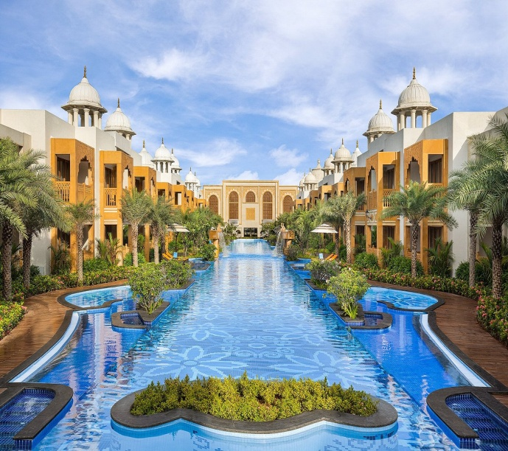
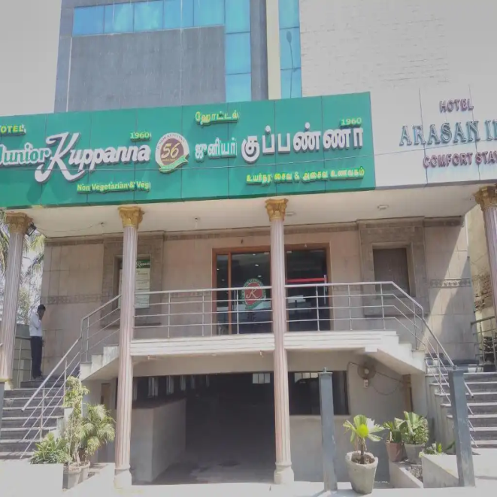


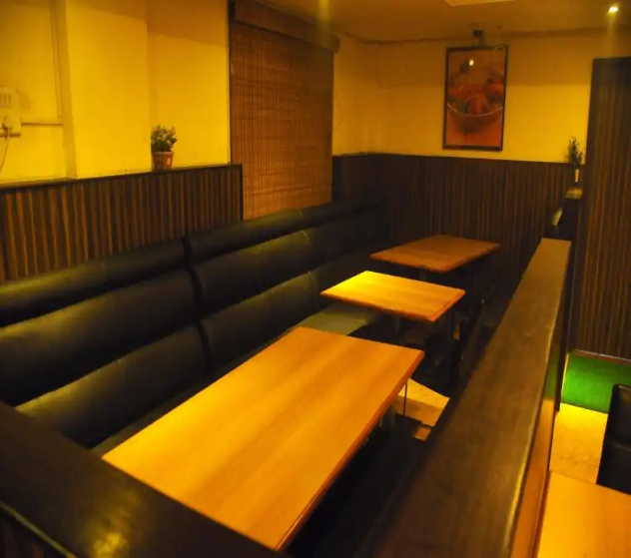
5 Star Hotel in India
Hotel without stars in India
Kaldan Samudhra Palace
Сhennai city
ARIKAN INN Hotel
city. Mahabalipuram

Slide 24
Indian Hospitality Industry
Hospitality industry in India is one of the (1) ______
growing industries of the country. While there are many
Indian names like Oberoi, Taj, Leela, ITC that have
already (2) ______ a big market share; international
brands are also on a spree of expansion. India has seen a
huge growth in its hospitality sector in recent years.
Almost all the big brands have (3) _____ hundreds to
thousands of new rooms in their room inventory and
most of them have (4) _______ plans for expansion.
Hospitality industry has (5) _______ a fourfold growth
since 2000. One of the important (6) _______ of this
growth is that India has (7) ______ as one the popular
business destinations in South Asia. Growth in IT as well
as India’s potential to become one of the (8) _______
tourist destinations in the world (9) _____ all major
global hospitality brands towards India. Today, India
(10) ______ more than 30 hotel brands, which are
(11) _______ even in the small towns of the country.
FAST
CAPTURE
ADD
FAR
SEE
REASON
EMERGE
GOOD
ATTRACT
HOST
EXPAND

