Slide 1
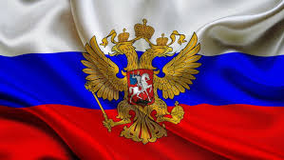
Presentation

Slide 2
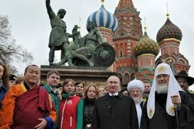

DAY OF PEOPLE UNITY
Notes:
We are strong and powerful!

Slide 3
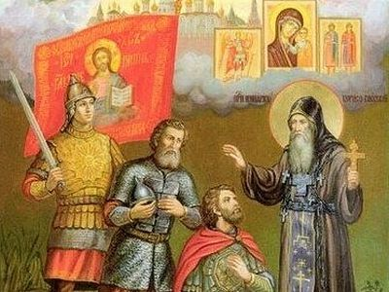
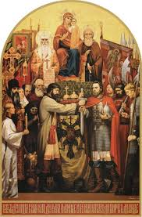
We must remember our History
Notes:
The Russian Church supports and blesses to protect Mother Russia

Slide 4
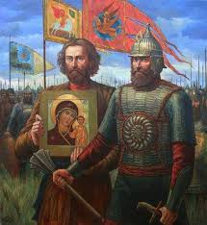
History of Russia tell us
The Day of National Unity was established in memory of the events of 1612, when the people's militia led by Kuzma Minin and Dmitry Pozharsky liberated Moscow from the Polish interventionists. Historically, this holiday is associated with the end of the Time of Troubles in Russia in the 17th century. We need our country, each of us. Only together we are strength, only together we will overcome everything. The story is being created here and now, we are making history.
Notes:
KUZMA MININ AND DMITRY POZHARSKY
How it all began

Slide 5
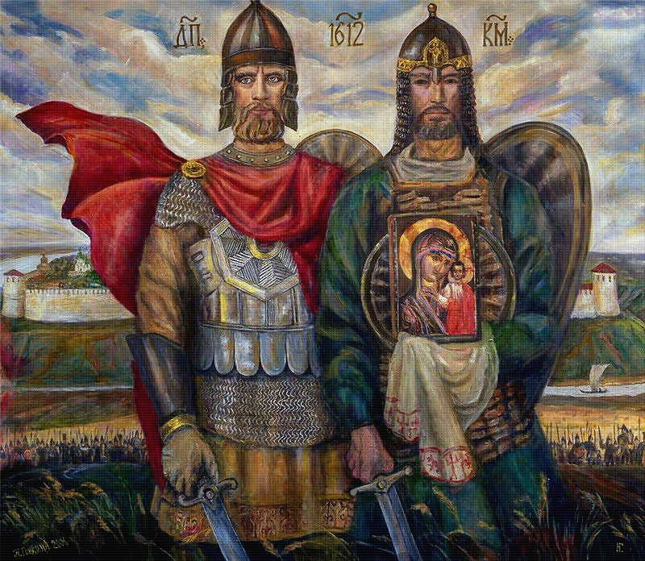
Notes:
We must be proud of them

Slide 6
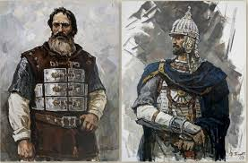
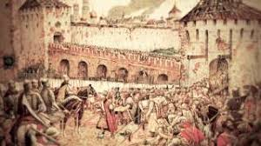
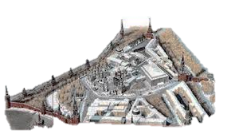
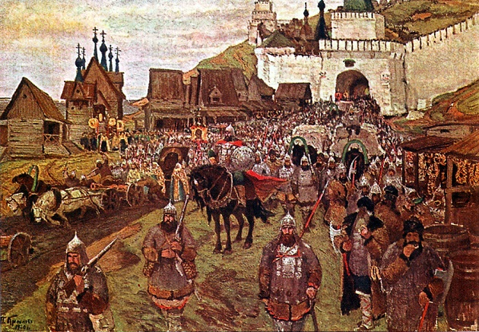
Historical moments 1
Notes:
Historical moments. 17 century

Slide 7
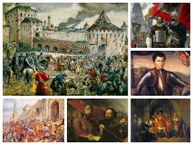
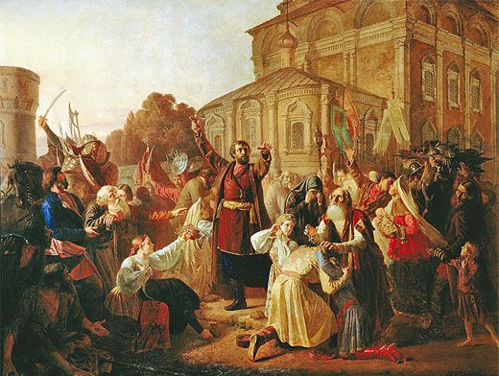
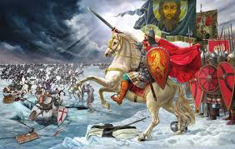
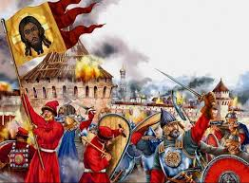
Historical Moments 2

Slide 8
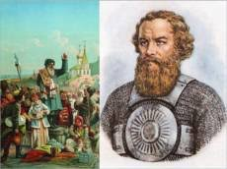
Kuzma Zaharovich Minin
(late 16th century-May 21, 1616) - Kuzma Minin Zaharovich, nicknamed "Suhoruk"-one of the liberators of the Fatherland from the Poles in 1612
Notes:
One of the Russian Hero

Slide 9
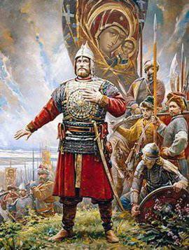
Dmitry Mikhailovich Pozarskij
Prince Dmitry Mikhailovich Pozarskij (November 1, 1578-April 30, 1642) was a Russian national hero, politician, head of the second Militia who liberated Moscow from the Polish-Lithuanian invaders
Notes:
One of the Russian Hero

Slide 10
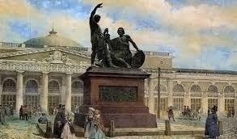
Monument of Minin and Pozharsky
Feat of this people reflected in the work of Ivan Martos. Majestic views of the monument against the backdrop of graceful Cathedral of Basil blessed gives pride and peace of mind . For such creation feel real pride for that you go on the land on which these people were ...

Slide 11
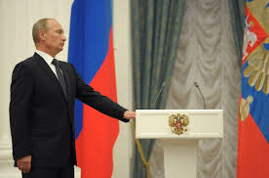
Russian President Putin
President Vladimir Putin reestablished the holiday in order to replace the commemoration of the October Revolution, known as the Day of Great October Socialist Revolution during Soviet period and as the Day of Accord and Conciliation in post-Soviet times,[which formerly took place on November 7. His decision angered some sections of the public, particularly the Communist Party, who continued with celebrations on November 7. Putin's predecessor, Boris Yeltsin took a limited action of changing the name of the holiday; by completely removing it, Putin initiated a controversy that continues today.
Notes:
President Vladimir Putin

Slide 12
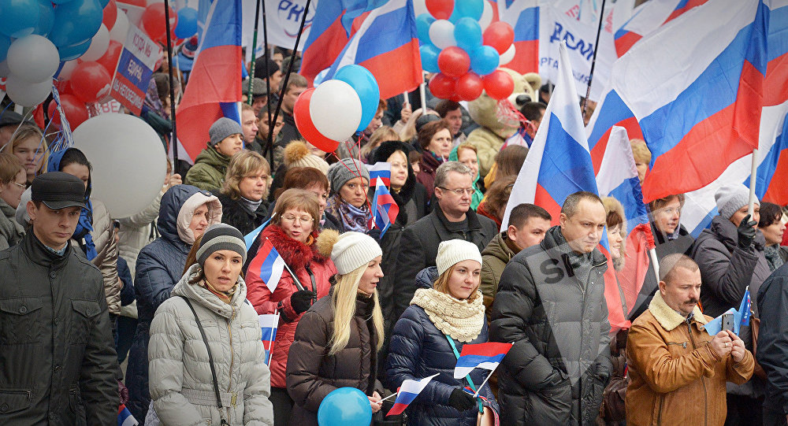
At the present time
Notes:
Celebrating the Day of Unity
Demonstration on the Red Square

Slide 13
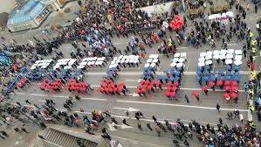
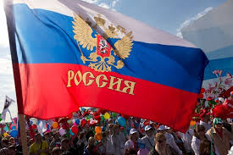
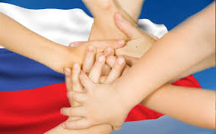
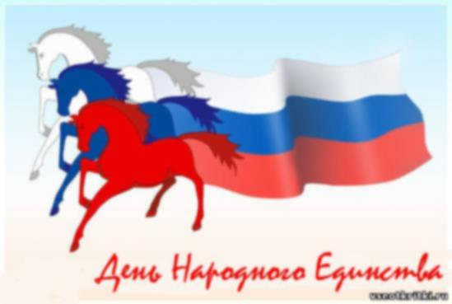
The national flag of Russia
Notes:
State colors of the flag of the Russian Federation

Slide 14
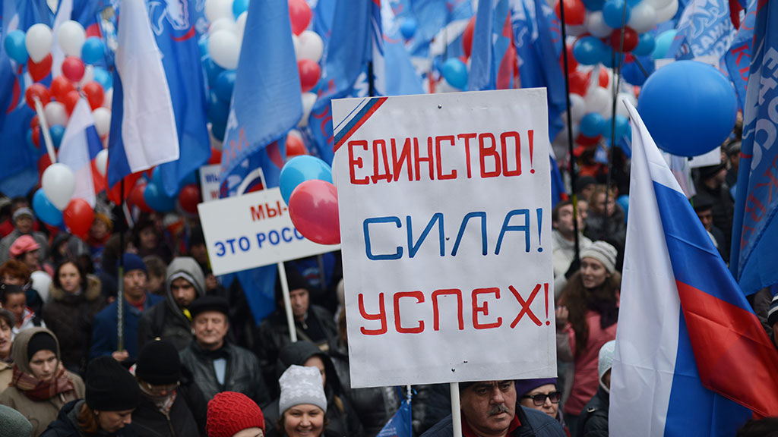
Unity! Powerful! Success!
Notes:
One of the famous motto – Unity! Powerful! Success!

Slide 15
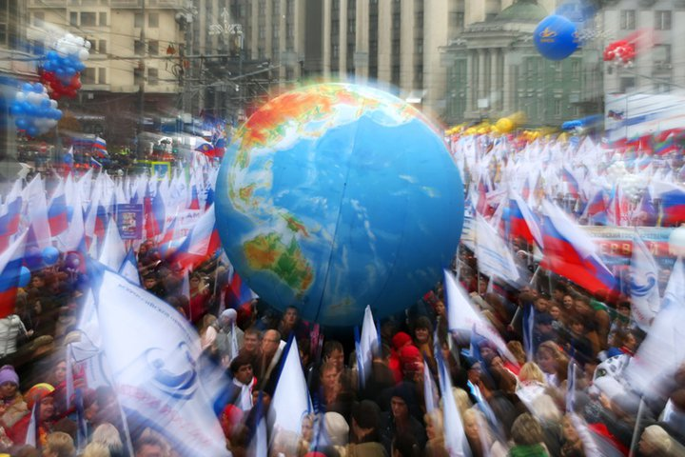
We are strong and powerful!
Notes:
Only together we will keep a peaceful future!

Slide 16
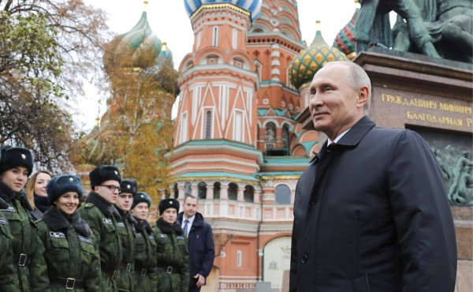
Thank you for your attention!

Slide 17
Используемые материалы:
https://en.wikipedia.org/wiki/Unity_Day_(Russia)
https://themoscowtimes.com/photogalleries/russia-celebrates-national-unity-day-56017
https://themoscowtimes.com/news/putin-trumpets-russian-moral-superiority-on-national-unity-day-41034
https://yandex.ru/images/
https://en.wikipedia.org/wiki/Monument_to_Minin_and_Pozharsky
https://en.wikipedia.org/wiki/Pozharsky
https://en.wikipedia.org/w/index.php?search=The+Unity+Day&title=Special:Search&profile=default&fulltext=1&searchToken=bdinumvs9v3bksfkya9ar4bcf
Notes:
Материалы

