Slide 1
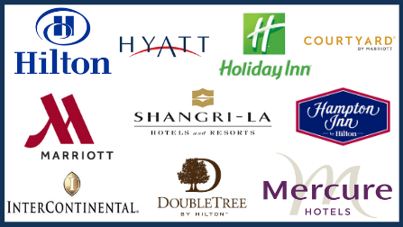
Hotel chains
A Hotel Chain is a company that owns or operates several hotels. A hotel chain is an enterprise that manages a number of hotels located in different areas.

Slide 2
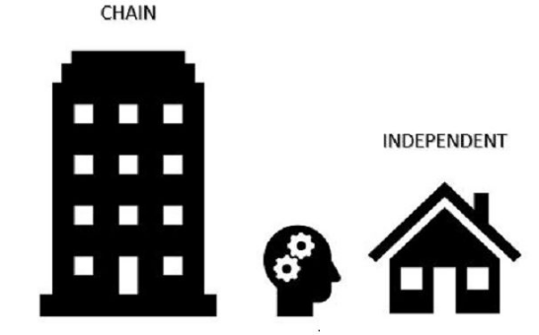
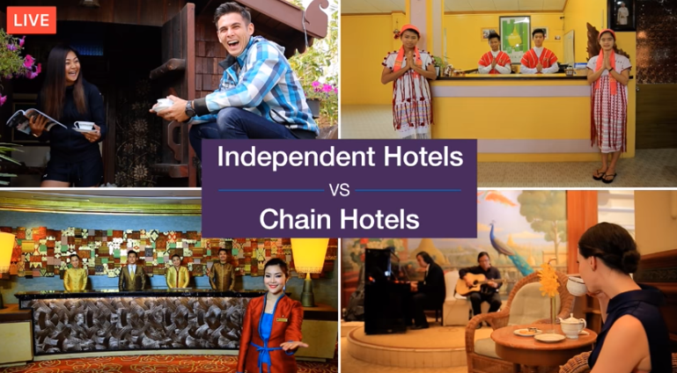
The difference between hotel chains and hotel groups is that the latter have multiple subsidiary brands, allowing the hotel to greatly differ their services, products and prices offered with hotels that differ in characteristics.
A hotel that is part of a hotel chain is known as a chain hotel.

Slide 3

Benefits of chain hotels
- A chain hotel lets you know what to expect before you even check in;
Chain hotels have multiple locations;
Chain hotels can offer hotels nationally and internationally;
Chain hotel offers miles or reward points that can offer benefits such as a free night, free meals, and other amenities;
The staff is great.

Slide 4
The biggest hotel chains in the world
In old times, hotels were just a place that's not your home but you can spend the night at. But with time, the concept of hotels has evolved drastically and it's more like a part of lifestyle now.
While most hotels in the world are localised, with usually just a single location, some hotels are part of a brand of hotel chains with franchised locations all over the world.
These hotel chains usually come with a standardised degree of service, comfort, and other properties to their guests.
They offer hotels in several pricing classes: be it luxury, upscale (sometimes also known as "premium"), midscale, economy or special boutique hotels.

Slide 5
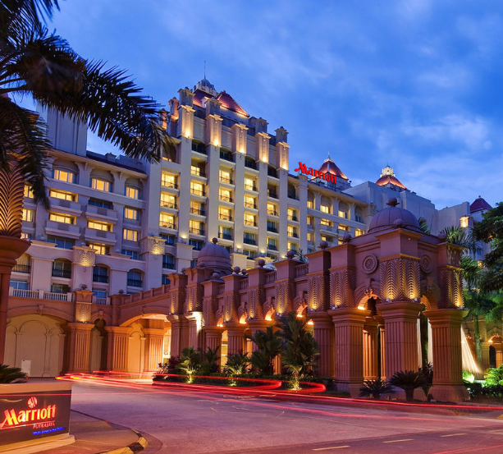
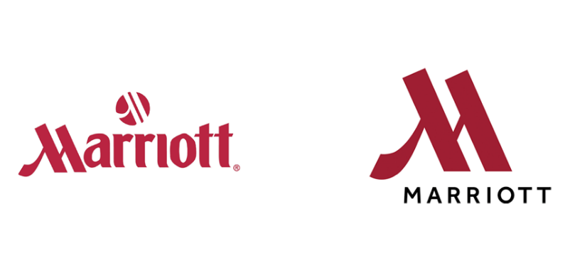
Marriott International
Marriott International is the largest hotel chain, leading by a number of rooms (over 1400000). Its founder — John Willard Marriott. The first hotel was opened in 1957, and already in 1969, the company went international.
Today Marriott has more than 7,000 properties in 131 countries and 30 hotel brands.

Slide 6
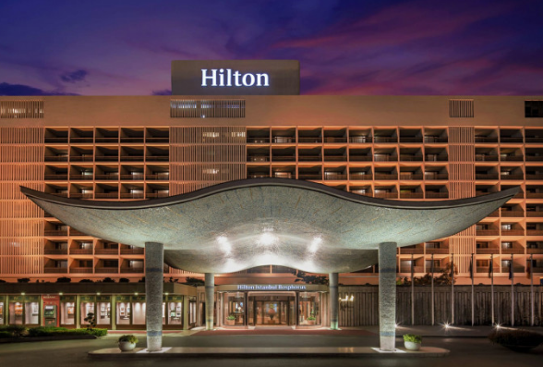
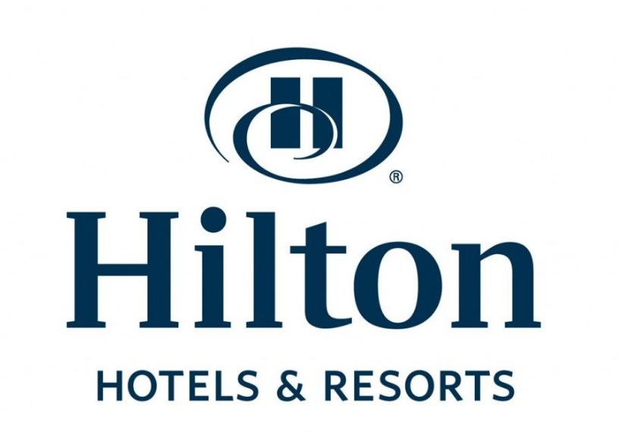
Hilton
It is one of the most important and fastest-growing hotel companies in the world that began its road to success in 1919 when a businessman named Conrad Hilton opened the first hotel in Texas. It currently has more than a million room units.
It owns 6,400 properties in 119 countries and 18 hotel brands.

Slide 7

Accor
Accor started its journey in 1960 being a product of Accor SA. They have 4800 hotels in 100 countries.

Slide 8
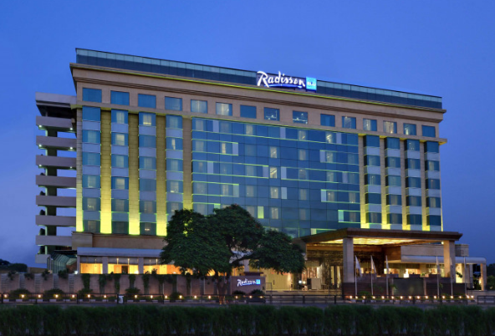
Radisson Hotel Group
Owned by Jin Jiang International Holdings Company Ltd, Radisson started its journey in 1962. They have 1100 hotels in 115 countries.

