Slide 1
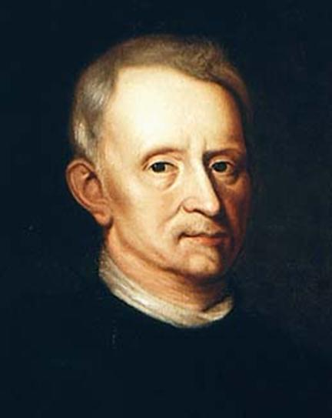
Robert Hooke
English scientist Robert Hooke was one of the greatest minds of the seventeenth century. He has worked on a variety of hypotheses and appliances, improved the structure of the microscope and the first to set a particular cellular tissue

Slide 2
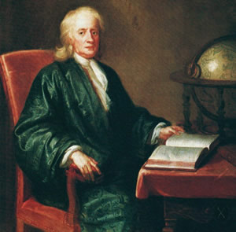
Future physicist, botanist, inventor, and astronomer, was born on July 18, 1635 in the town of Freshwater, which is located on the Isle of Wight. His father was the rector of the church of All Saints. Close long feared for the health of your baby, because he was very weak and tscheduschnym, but Robert survived. In 1648, after the death of his father, Robert Hooke moved to London and became a pupil of the artist by the name of Peter Lely. Already a well-known scientist, he disapproved recalled his childhood, but the skill illustrations that accompanied the physicist their works, lets say that the time in a studio was not lost in vain. At fourteen years old boy became a pupil of Westminster School Bashbi from which graduated in 1653-m. As any scientist Robert Hooke learned Latin, which was the main language of scientific communication at the time. In addition, he owned the Hebrew and Greek, he knew how to play the organ and instantly learn complex book

Slide 3
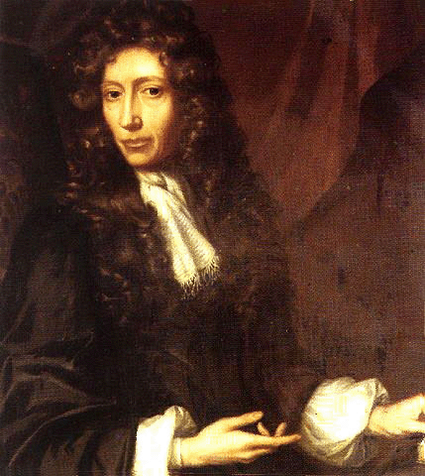
Start of scientific activity
After high school, Robert Hooke moved to Oxford to become a student at Christ Church College. In addition, he was a chorister in the church, as well as an assistant and close associate of Boyle. In those same years, was an acquaintance with members of the "Invisible College" of Oxford, the creators of the scientific and organizational society that played a significant role in the life of Hooke. During this period, a physicist invented the air pump, created a treatise on the motion of the fluid in the capillaries. In addition, Robert Hooke, the opening of which will create a spring mechanism for pocket watches, had a small dispute with Huygens, who also worked with such devices. In 1662 the scientist was awarded the degree of Master of Arts, University of Oxford, the Royal Society, at that time only to form, appointed him curator of experiments. In 1663-m Robert Hooke created a charter for this academic community, was admitted to the number of its members, and in 1677, he became its secretary.

Slide 4
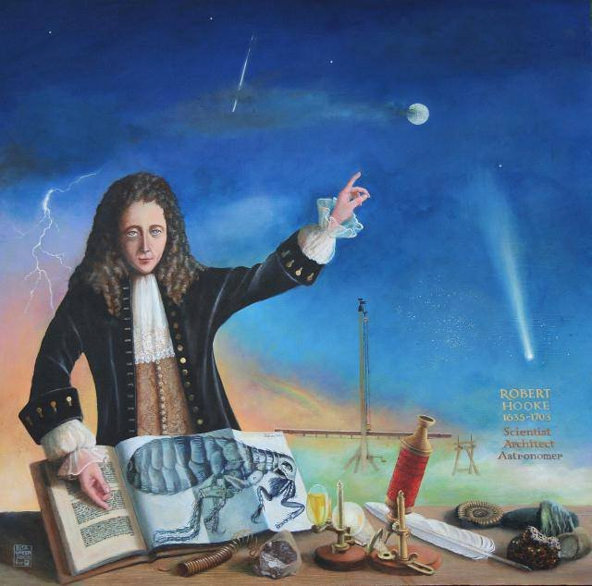
London professor
Even a brief biography of Robert Hooke can not do without mention of the fact that in 1664, when the plague was raging in England, physicist left London. Shortly before he was appointed professor Greshemovskogo college and lived in an apartment in his building. In addition, Hooke did not stop the activities of the curator of experiments of the Royal Society. It was a difficult position for which was not supposed to reward. For not too secured scientist preparing new experiments was associated with significant costs. Nevertheless, this work helped his personal research and established the authority of the distinguished physicist honorary consultant. In addition, the breadth of interests Robert impressed the other members of the community. Information about Robert Hooke in the "History of the Royal Society" talks about his work as a curator and describes its amazing experiments with vacuum artillery gunpowder, thermal expansion of the glass, as well as work on the creation of the microscope, iris and various meteorological instruments.

Slide 5
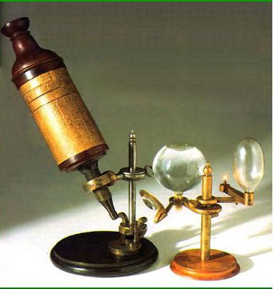
Creating a "Micrographia"
In 1665 saw the release of the most important work of the scientist. A treatise entitled "Micrographics" details the methods of using the microscope for a variety of scientific research. It describes the various experiments with sixty parts of plants, insects and animals. Opening of the cellular structure of organisms did exactly Robert Hooke. Biology was not his main scientific interest, so that the result is all the more surprising findings. In addition, the material on fossils makes Hooke's also the founder of paleontology. Excellent quality illustrations and engravings made "micrographics" invaluable book. Despite the fact that the scientist is almost forgotten for the moment, his breakthrough in the study of cells is of great.

Slide 6
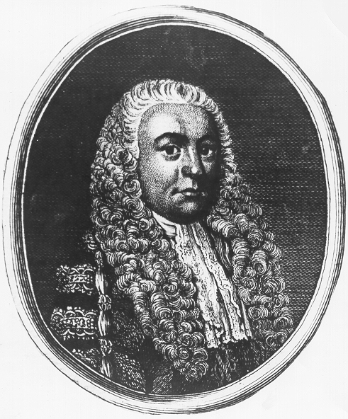
further activity
Robert Hooke, whose biography has enriched the publication "Micrographia" did not stop there. He developed the theory of light, gravity, and the structure of matter, invented computer for complex arithmetic operations and perfected a device that allows to study the Earth's magnetic field. In some of his views of scientists was too harsh. For example, in 1674 he had a dispute with Hevelius associated with the peculiarities of the use of microscopes. In the second half of the 1670's were written papers on the theory of elasticity, which have become a breeding ground for famous Hooke's law. It is stated that the increase in length relative to the original caller proportional elongation force inversely proportional to the size of the section associated with the object and the material from which the one is made.

Slide 7
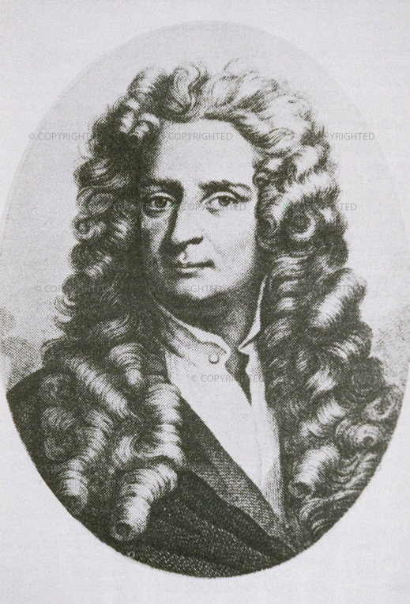
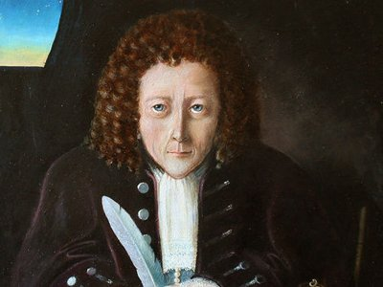
Interesting facts about the scientist
Doctors and relatives Hooke feared that he would die in infancy. Some claimed that he would not live up to twenty years. However, physicist lived 68 years, which by the standards of the seventeenth century can be called a very long time. The name "cell", which he offered for elementary units of a living organism, due to the fact that Hooke such particles resembled monks' cells. One of the experiments associated with the breath, nearly ended in tears for pundit. He placed himself in a special sealed unit from which air is pumped out, and as a result lost some hearing. In addition to the monument, built in collaboration with Wren, Hooke project created such buildings as the Observatory at Greenwich and St. Paul's Cathedral. To see these works of the great physicist can now.

